Slide 1
NEUROGENIC BLADDER Neurogenic lower urinary tract dysfunction (NLUTD)

Slide 2
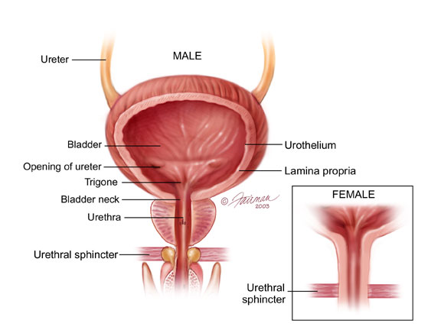

Slide 3
NORMAL VESICAL FUNCTION
The Bladder Unit
The functional features of the bladder include:
1. a normal capacity of 400–500 ml.
2. a sensation of fullness.
3. the ability to accommodate various volumes without a change in intra-luminal pressure.
4. the ability to initiate and sustain a contraction until the bladder is completely empty.
5. voluntary initiation or inhibition of voiding despite the involuntary nature of the organ.

Slide 4
NORMAL VESICAL FUNCTION
The Sphincteric Unit:
There are 2 sphincteric elements:
(1) an internal involuntary smooth-muscle sphincter at the bladder neck.
(2) an external voluntary striated-muscle sphincter from the prostate to the membranous urethra in males and at the mid urethra in females.

Slide 5
NORMAL VESICAL FUNCTION
INNERVATION & NEUROPHYSIOLOGY:
Parasympathetic S2-S4 (hypogastric nerves): supply both the bladder and smooth-muscle sphincter. .… acetylcholine.
Sympathetic T10–L2 (pelvic nerves): innervate the smooth muscles of the bladder base, internal sphincter, and proximal urethra….. Noradrenaline.
Somatic motor innervations originate in S2–S3 and travels via the pudendal nerve to the striated urethral sphincter.
There are both somatic and visceral afferents from the bladder and urethra.

Slide 6
Normal Micturition - Physiology
Normal micturition cycle requires that the urinary bladder and the urethral sphincter work together as a coordinated unit to store and empty urine.
2 phases
Filling (Storage ) :
Bladder is a low-pressure reservoir.
Urinary sphincter : closed with high resistance to urinary flow.
Emptying :
Bladder contracts to expel urine.
Urinary sphincter : opens to allow urinary flow.

Slide 9
Neurogenic lower urinary tract dysfunction (NLUTD)
A lower urinary tract dysfunction secondary to confirmed pathology of the nervous supply.

Slide 10
RISK FACTORS
Brain tumours
Dementia
Mental retardation
Cerebral palsy
Parkinson disease
Cerebrovascular pathology (CVA)
Multiple sclerosis
Spinal cord lesions
Disc disease
Spinal stenosis and spine surgery
Peripheral neuropathy: DM, Alcohol abuse, B12 deff.
Human immunodeficiency virus HIV
Iatrogenic: Abdominoperineal resection, hysterectomy or pelvic irradiation for cervical cancer

Slide 11
Spastic Neuropathic Bladder
The patient may have frequency, nocturia, urgency or urinary incontinence.
Involuntary urination is often frequent, spontaneous, scant.

Slide 12
Flaccid (Atonic) Bladder
The principal urinary symptom is retention with overflow incontinence.

Slide 13
URODYNAMIC STUDIES
An important part of the evaluation of patients with voiding dysfunctions. It can provide useful clinical information about the function of the urinary bladder, the sphincteric mechanism, and the voiding pattern itself.

Slide 14
URODYNAMIC STUDIES
Uroflowmetry: the study of the flow of urine from the urethra. The normal peak flow rate for males is 20–25 ml/s and for females 20–30 ml/s.
Cystometry: the urodynamic evaluation of the reservoir function of the bladder.
Urethral Pressure Recordings: both during filling and during voiding.
Electromyography: to monitor the activity of the striated urethral muscles without obstructing the urethral lumen.

Slide 15
TREATMENT
Spastic Neuropathic Bladder:
#Medical therapy: anticholinergic drugs.
#Botulinum-A Toxin
#Timed voiding.
#A permanent indwelling catheter.
#A condom catheter.
#Performance of a sphincterotomy in males.
#Conversion of the spastic bladder to a flaccid bladder through sacral rhizotomy.
#Neurostimulation of the sacral nerve roots to accomplish bladder evacuation.
#Urinary diversion.

Slide 16
TREATMENT
Flaccid Neuropathic Bladder:
Bladder evacuation can be accomplished by straining, using the abdominal and diaphragmatic muscles to raise intra-abdominal pressures.
Bladder training and timed voiding.
CISC (clean intermittent self catheterization)
Medications: parasympathomimetics.

Slide 17
Complications
Recurrent infection
Hydronephrosis
Stones formation
Deterioration of renal function
Renal Amyloidosis
Sexual Dysfunction

Slide 18
Autonomic Dysreflexia
seen in patients with cord lesions above the sympathetic outflow from the cord. As a rule, it occurs in rather spastic lesions above T1.
Symptoms: elevations in blood pressure, sweating, bradycardia, headache, and piloerection.
Symptoms are brought on by over-distention of the bladder.
Immediate catheterization is indicated and usually brings about prompt lowering of blood pressure.

