Slide 1
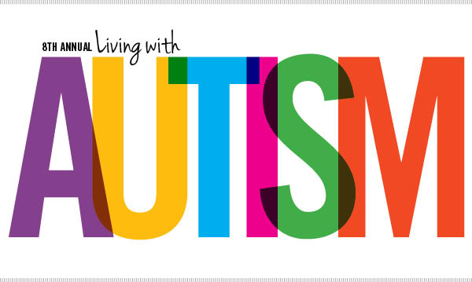

Slide 2
outline
*Objective
*Definition
*Signs and symptoms
*Causes
*Screening and diagnosis
*Nurses role in dealing with autism kids
*Summary
*Conclusion
*references

Slide 3
Objective
At the end of this presentation ,student will be able to :
Define ASD and autistic disorser
Know the signs and symptoms
Identify community health nurses role in dealing with autism kids .

Slide 4
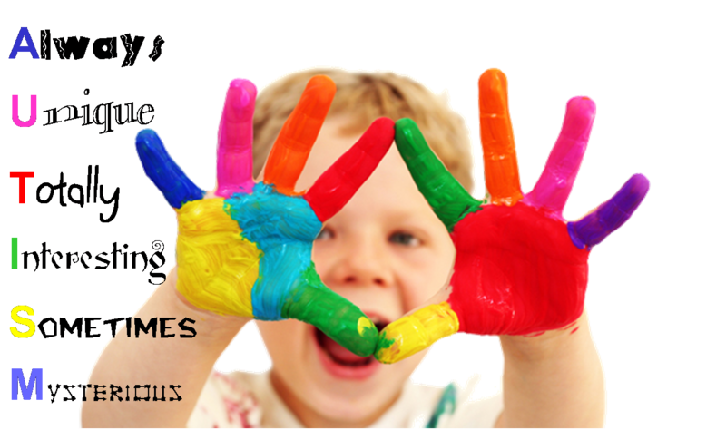

Slide 5
Autism Spectrum Disorders
A group of disorders that are characterized by
impairment in several areas of development, including
social interaction skills and interpersonal communication.
Tend to occur in young children and may diagnosed as early as 18 month of age .

Slide 6
Autism vs. ASD
Autism is just one syndrome that now falls under the heading of autism spectrum disorders. Previous disorders that are now classified under the umbrella diagnosis of ASD or a social communication disorder include:

Slide 7
Included in this category are:-
autistic disorder
Asperger syndrome .
Childhood disintegrative disorder.
Pervasive development disorder, not otherwise specified (PDD-NOS )

Slide 8
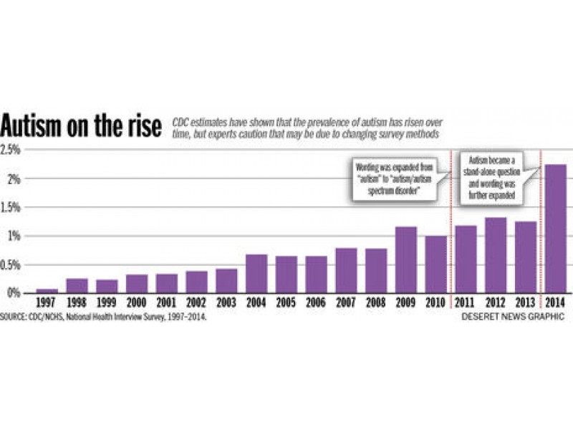

Slide 9
إحصائيات في الأردن
يؤكد اختصاصي علاج مرض التوحد في الجامعة الأردنية الدكتور رائد الشيخ ذيب أنه لا يوجد احصائيات دقيقة حول عدد المصابين بهذا المرض في المملكة، مقدرا العدد بين 7500 و8 الاف مصاب، "معظمهم في بيوت ذويهم لا يتلقون الخدمات المناسبة للعلاج، بالإضافة إلى أن بعضهم يتلقى العلاج في مراكز الإعاقة العقلية، والتي لا تلبي احتياجاتهم، ولا تنمي قدراتهم".

Slide 10
Sign & symptom
Deficit in social interaction.
Deficit verbal & non verbal communication.
Repetitive behavior or interests.
Unusual response to sensory stimulation .
Delay development .

Slide 12
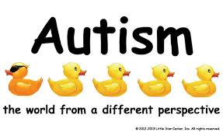
Autistic disorder
This is what most people think of when they hear the word "autism." It refers to problems with social interactions, communication, and imaginative play in children younger than 3 years.

Slide 13
Autism may be caused by:
1]Genetic ..
2]perinatal influences..
3]physiological implication ..
4]neurological implication..

Slide 14
Screening and diagnosis
The Diagnosing takes two steps:
Developmental Screening
Comprehensive Diagnostic Evaluation

Slide 15
Developmental Screening :
During developmental screening the doctor might ask the parent some questions or talk and play with the child during an exam to see how she learns, speaks, behaves, and moves. A delay in any of these areas could be a sign of a problem.
during regular well-child doctor visits at:
9 months
18 months
24 or 30 months
18 months
24 months

Slide 16
Comprehensive Diagnostic Evaluation:
This thorough review may include looking at the child’s behavior and development and interviewing the parents. It may also include a hearing and vision screening, genetic testing, neurological testing, and other medical testing.

Slide 17
Initial assessment
a medical history of the mother’s pregnancy
review of developmental milestones
eating and sleeping habits
coordination
sensory challenges
any family history of developmental disorders
any family history of genetic and metabolic disorders
routine lab tests

Slide 18
Nursing diagnosis:
1.Impaired social interaction.
2.Impaired in verbal in communication.
3.Ineffective relation ship.
4.Ineffective role performance.
5.RISK FOR DELAYED DEVELOPMENT.

Slide 19
Nursing role in caring with autistic patents :
Understand Autism Spectrum Disorder .
Encourage Family Involvement .
Determine the Best Method of Communication .
Challenged by Change .
Use Consistent Caregivers .
Create a Safe Environment .
Identify Emotional Disturbances and Establish a Reward System .
Support the Family and Encourage Them to Stay .

Slide 20
Summary

Slide 21
Conclusion
The family and nurse should supported the patient with autism and motivate him to promote the social interactions and communication with others , and the community should provide a special care centers for them .

Slide 22
Referance
-Lord C, Risi S, DiLavore PS, Shulman C, Thurm A, Pickles A. Autism from 2 to 9 years of age. Arch Gen Psychiatry. 2006 Jun;63(6):694-701.
-http://www.medscape.com .
- https://www.cdc.gov

