Slide 1
LECTURE 3, DISEASES OF THE
JAW
Fatima Obeidat, MD

Slide 2
I.Cysts of the Jaw

Slide 3
EPITHELIAL CYSTS
Epithelium-lined cysts of the mandible and maxilla are common disease.
A majority of these cysts are derived from remnants of odontogenic epithelium.
Clinico-radiologic and pathologic correlation is essential to reach a specific diagnosis

Slide 4
Two types:
Odontogenic cysts: Arise from odontogenic epithelium and located in the jaw
Non odontogenic cysts :
- Arise from epithelium inclusions in soft tissues or bony portions of the region along embryonal tissue lines .

Slide 5
1.ODONTOGENIC CYSTS
i. Dentigerous cysts.
ii. Eruption cysts
iii. Gingival cysts.
vi. Radicular cysts
v. keratocysts

Slide 6
i. The dentigerous cyst
- Originates around the crown of an un-erupted tooth and is thought to be the result of a degeneration of the dental follicle (primordial tissue that makes the enamel surface of teeth

Slide 7
Clinically
Affects young adults
Manifests with pain ad swelling
Dysplasia and carcinomas can arise in these cysts.
Surgical excision is the treatment of choice
Recurrence is unusual

Slide 8
On radiographic evaluation:
- Are unilocular lesions most often are associated with impacted third molar (wisdom) teeth.

Slide 9
Histopathology
Thin fibrous wall lined by keratinized stratified squamous epithelium.
Secondary changes: Inflammation, ulceration, hyperplasia, calcifications and clusters of histiocytes

Slide 10
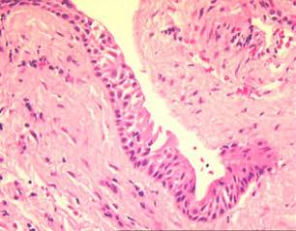
Dentigerous cyst

Slide 11
ii. ERUPTION CYST
A subtype of dentigerous cyst
Arise above erupting primary teeth or rarely above permanent teeth
Patients present with gingival swelling .
- Pathologic examination shows hemorrhagic cyst wall lined by thin non-keratinizing stratified squamous epithelium

Slide 12
iii. GINGIVAL CYSTS
Affect newborn and infants
Are minute cystic structures
- Seen in most neonates and gradually disappear within weeks.

Slide 13
iv. RADICULAR OR PERIAPICAL CYSTS
- Are the most common jaw cyst
Result from inflammation
Are more common in the third and fourth decades
If are seen after tooth extraction are called residual cysts

Slide 14
Histopathology
Are lined by stratified squamous epithelium
Ulceration is common
Calcification can occur along with many cholesterol clefts.

Slide 15
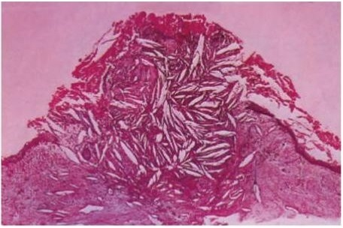
histopathology

Slide 16
v. KERATOCYSTS
- Can occur at any age but are most frequent in persons between 10 and 40 years of age,
Have a male predominance,
Account for 10% of the jaw cysts.

Slide 17
Are solitary in 90% of cases
Are multiple in 10% of cases- Associated with Gorlin’s syndrome
Differentiation of the odontogenic keratocysts from other odontogenic cysts is important because these are locally aggressive and have a high recurrence rate.

Slide 18
Clinically
Patients present with swelling
Most common sites: Typically are located within the posterior mandible--third molar region of the mandible
Recurrence rates of up to 60% are associated with inadequate resection

Slide 19
On radiographic evaluation,
- Odontogenic keratocysts are seen as well-defined unilocular or multilocular radiolucencies.

Slide 20
On histologic examination
- The cyst lining consists of a thin layer of parakeratinized or orthokeratinized stratified squamous epithelium with a prominent basal cell layer and a corrugated luminal epithelial surface

Slide 21
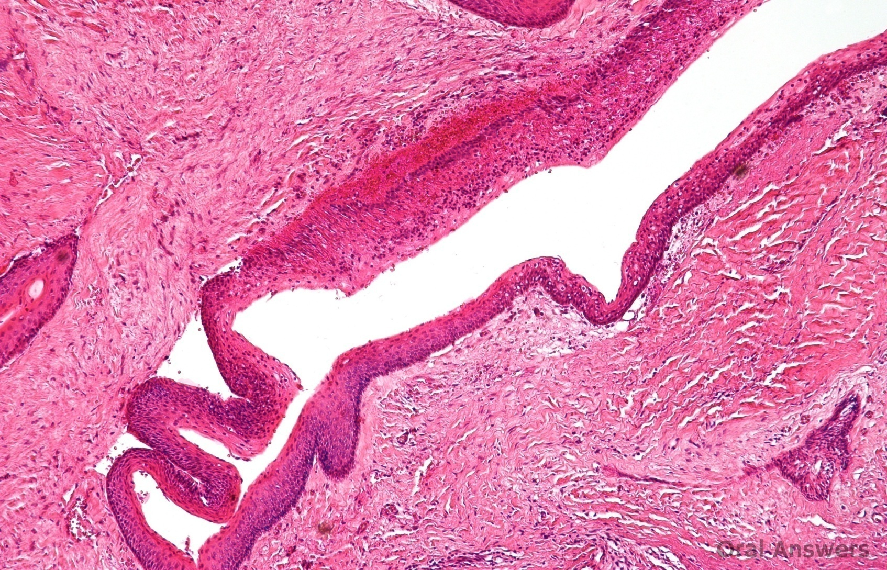
keratocyst

Slide 22
2.NONODONTOGENIC CYSTS
i. Nasoalveolar cysts
ii.Nasopalatine cysts
iii.Dermoid cysts
iv.Palatal cysts

Slide 23
Nasopalatine cyst is the most common non- odontogenic cyst
Is lined by squamous or respiratory epithelium.

Slide 24
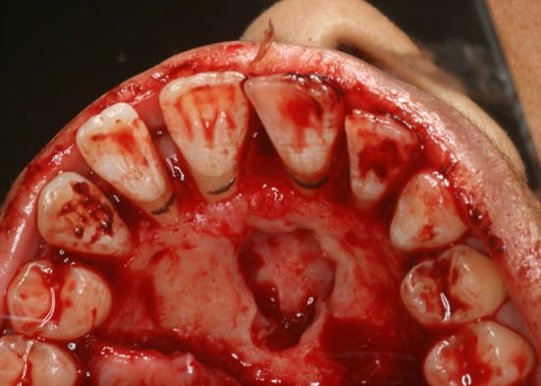
Nasopalatine cyst

Slide 25
II.ODONTOGENIC TUMOURS
- Are tumors of the jaw which differentiate towards tooth structures.
Are classified into
1.Benign
2.Borderline
3. Malignant tumors

Slide 26
1.BENIGN ODONTOGENIC TUMOURS
Squamous odontogenic tumor
Adenomatoid odontogenic tumor
others

Slide 27
2.BORDERLINE TUMOUR
AMELOBLASTOMA
Is the most common epithelial odontogenic tumor
Affect people in the third to fifth decades of life
80% arise in the mandible.
- Radiography : lytic expansile lesion.

Slide 28
Clinically
Characterized by an abnormal growth in
the jaw, often at the site of the third
molar.
It may be aggressive and may spread to the nose, eye socket and skull.
It is important for ameloblastoma to be diagnosed and treated early in order to stop growth of the tumors and possible progression to cancer.

Slide 29
Histopathology
Several histological patterns
The most common patterns are the follicular and plexiform
- .Follicular type: - Shows nests of loose network of cells resembling stellate reticulum and surrounded by an outer palisaded layer of tall columnar epithelium

Slide 30
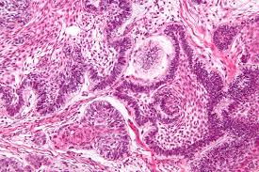

Slide 31
3. MALIGNANT TUMOURS
- Ameloblastic carcinoma is a tumor that has histological features similar to ameloblastoma but also shows malignant features such a as nuclear atypia and increased mitotic rate and necrosis

