Slide 1
Diffuse alveolar hemorrhagic syndromes

Slide 2
1. Goodpasture Syndrome
- Is uncommon condition characterized by a proliferative, rapidly progressive, glomerulonephritis and) hemorrhagic interstitial pneumonitis.
- Both the renal and the pulmonary lesions are caused by antibodies targeted against the noncollagenous domain of the α3 chain of collagen IV which can be detected in the serum of more than 90% of patients

Slide 3
The characteristic linear pattern of immunoglobulin deposition (usually IgG, that is the hallmark diagnostic finding in renal biopsy specimens may be seen along the alveolar septa by immunoflurescence studies. - Plasmapheresis which removes the offending agent and immunosuppressive therapy that inhibits antibody formation have markedly improved the prognosis
- With severe renal disease, renal transplantation is eventually required

Slide 4
2.Idiopathic Pulmonary Hemosiderosis
- Is a rare disease of uncertain etiology that has pulmonary manifestations and histologic features similar to those of Goodpasture syndrome but
a. No associated renal disease
b. No circulating anti-basement membrane antibody.
.

Slide 5
Most cases occur in children, although the disease is reported in adults as well, who have a better prognosis
- With steroid and immunosuppressive therapy, survival has markedly improved from the historical 2.5 years;
- thus, an immune-mediated etiology is postulated

Slide 6
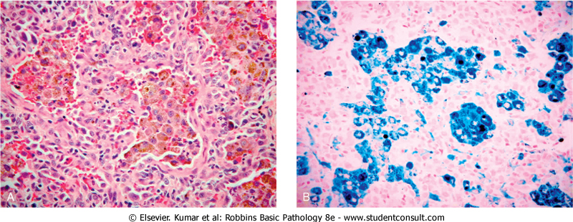
Diffuse alveolar hemorrhage syndrome –perl’sstain

Slide 7
- Tuberculosis is a communicable chronic disease
Epidemiology
- It flourishes under conditions of poverty, crowding, in old people and disease states such as
a. Diabetes mellitus,
b. Hodgkin lymphoma,
c. Silicosis
d. Immunosuppression..

Slide 8
NOTE:
- In areas of the world where HIV infection is prevalent, it has become the single most important risk factor for the development of tuberculosis

Slide 9
Etiology
1- M. tuberculosis hominis is responsible for most cases of tuberculosis
- The reservoir of infection typically is found in persons with active pulmonary disease
- Most infections are acquired by direct person to person transmission of airborne droplets of organisms from an active case to a susceptible host

Slide 10
2. Mycobacterium bovis
- Causes intestinal tuberculosis
- Is contracted by drinking milk contaminated with the microorganism
- Infection is now rare in developed nations, but it is still seen in countries with tuberculous dairy cows and sales of unpasteurized milk.

Slide 11
- In years past, intestinal tuberculosis contracted by the drinking of contaminated milk was a common primary focus of tuberculosis.
- In developed countries today, intestinal tuberculosis is more often a complication of advanced pulmonary secondary tuberculosis, resulting from swallowing of coughed up infective material.

Slide 12
- The organisms are trapped in mucosal lymphoid aggregates of the small and large bowel, which then undergo inflammatory enlargement with ulceration of the overlying mucosa, particularly in the ileum

Slide 13
PATHOGENESIS
The pathogenesis in the previously unexposed immunocompetent person is centered on the development of a targeted cell mediated immunity that confers resistance to the organism and results in development of tissue hypersensitivity to tubercular antigens.
- The sequence of events from inhalation of the infectious inoculum

Slide 14
I. In the first 3 weeks:
- Once the mycobacteria gains entry into the macrophage endosomes , the organisms are able to inhibit normal microbicidal responses by preventing the fusion of the lysosomes with the phagocytic vacuole and this allows unchecked mycobacterial proliferation
- It is characterized by bacillary proliferation within the alveolar macrophages with resulting bacteremia

Slide 15
- Despite the bacteremia, most persons at this stage are symptomatic or have a mild flu-like illness.
- The genetic makeup of the patient may influence the course of the disease
- People with polymorphisms of the NRAMP1 (natural resistance associated macrophage protein 1) gene, the disease may progress from this point without development of an effective immune response

Slide 16
- NRAMP1 is a transmembrane ion transport protein found in endosomes and believed to contribute to microbial killing
II. 3 weeks after exposure
- Development of cell-mediated immunity
a. Processed mycobacterial antigens reach the draining lymph nodes and are presented to CD4 T cells by macrophages which secret IL-12, which generates

Slide 17
TH1 subtype of CD4+ T cells that secret Gamma- IFN which activates macrophages
b. Activated macrophages release a variety of mediators and upregulate expression of genes with important downstream effects, including

Slide 18
(1) TNF, which is responsible for recruitment of monocytes, which in turn undergo activation and differentiation into the "epithelioid histiocytes
(2) Expression of the inducible nitric oxide synthase (iNOS) gene, which results in elevated nitric oxide levels with antibacterial activity;
(3) Generation of reactive oxygen species, which can have antibacterial activity

Slide 19
Note:
- It is important that infection be differentiated from disease
- Infection implies seeding of a focus with organisms, which may or may not cause clinically significant tissue damage (i.e., disease).
- Infection with M. tuberculosis typically leads to the development of delayed hypersensitivity, which can be detected by the tuberculin (Mantoux) test

Slide 20
- About 2 to 4 weeks after the infection has begun, intracutaneous injection of 0.1 mL of PPD induces a visible and palpable induration (at least 5 mm in diameter) that peaks in 48 to 72 hours.
- A positive tuberculin skin test result
a. Signifies cell-mediated hypersensitivity to tubercular antigens

Slide 21
b. It does not differentiate between infection and disease
- False-negative reactions (or skin test anergy)
a. Certain viral infections,
b. Sarcoidosis
c. Immunosuppression
False-positive reactions
- May result from infection by atypical mycobacteria

Slide 22
- About 80% of the population in certain Asian and African countries is tuberculin positive.
- About 3% to 4% of previously unexposed persons acquire active tuberculosis during the first year after "tuberculin conversion," and no more than 15% do so thereafter.
- Thus, only a small fraction of those who contract an infection develop active disease

Slide 23
Primary Tuberculosis
- Is the form of disease that develops
in previously unexposed and unsensitized patient.
- The inhaled bacilli implant in the alveoli of the of the lower part of the upper lobe or the upper part of the lower lobe,usually close to the pleura.
- 2-3 weeks after exposure , a 1-to 1.5- cm lesion develops ( Ghon focus ) composed of granulomas

Slide 24
- Tubercle bacilli, travel in lymph drainage to the regional nodes, forming granuloma in the lymph nodes.
- The combination of Ghon focus and nodal involvement is called Ghon complex
- In approximately 95% of cases, development of cell-mediated immunity controls the infection

Slide 25
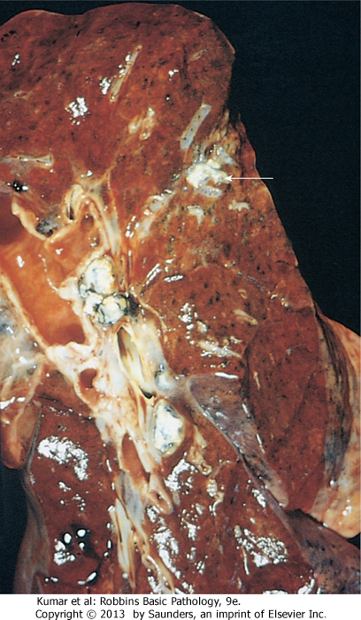
Primary Tuberculosis

Slide 26
- The Ghon complex undergoes progressive fibrosis, followed by radiologically detectable calcification (Ranke complex)

Slide 27
The major consequences of primary tuberculosis are that
(1) It induces hypersensitivity and increased resistance;
(2) The foci of scarring may harbor viable bacilli for years, perhaps for life, and thus be the nidus for reactivation at a later time when host defenses are compromised.

Slide 28
(3) uncommonly, it may lead to progressive primary tuberculosis and this complication occurs in patients who are immunocompromised or in malnourished children or in elderly persons
- The incidence of progressive primary tuberculosis is particularly high in HIV-positive patients with an advanced degree of immunosuppression (i.e., CD4+ counts below 200 cells/μL).

Slide 29
- Immunosuppression results in an inability to mount a CD4+ T cell-mediated immunologic reaction that would contain the primary focus
- Because hypersensitivity and resistance are most often concomitant factors, the lack of a tissue hypersensitivity reaction results in the absence of the characteristic caseating granulomas (nonreactive tuberculosis)

Slide 30
- Persons with primary tuberculosis are infected but do not have active disease and therefore cannot transmit organisms to others.
- When their immune defenses are lowered, the infection may reactivate to produce communicable and potentially life-threatening disease

Slide 31
Secondary Tuberculosis
- Is the pattern of disease that arises in a previously sensitized host.
a. It may follow shortly after primary tuberculosis,
b. More commonly arises from reactivation of dormant primary TB decades after initial infection, particularly when host resistance is weakened.

Slide 32
c. It also may result from exogenous reinfection because of waning of the protection afforded by the primary disease
- Only a few patients with primary disease subsequently (5%) develop secondary tuberculosis.
- Secondary tuberculosis is classically localized to the apices of upper lobes related to high oxygen tension in the apices.

Slide 33
- Because of the preexistence of hypersensitivity, the bacilli excite marked tissue response to wall off the focus .
- As a result of this localization, the regional lymph nodes are less prominently involved early in the disease than they are in primary tuberculosis
- Cavitation occurs in the secondary form, leading to erosion into and dissemination along airways.

Slide 34
- Such changes become an important source of infectivity, because the patient now produces sputum containing bacilli.

Slide 35
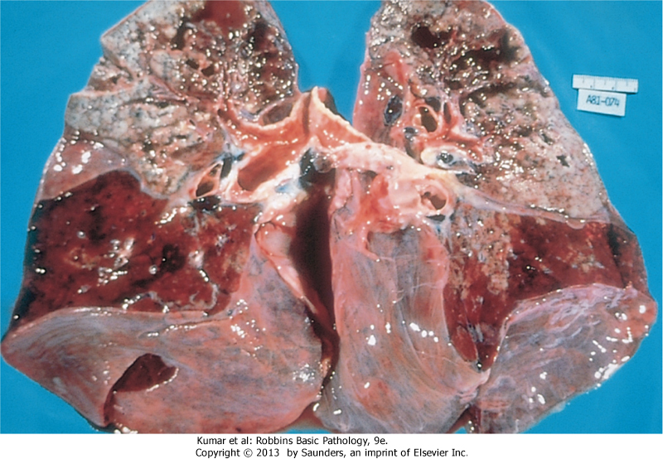
Secondary tuberculosis

Slide 36
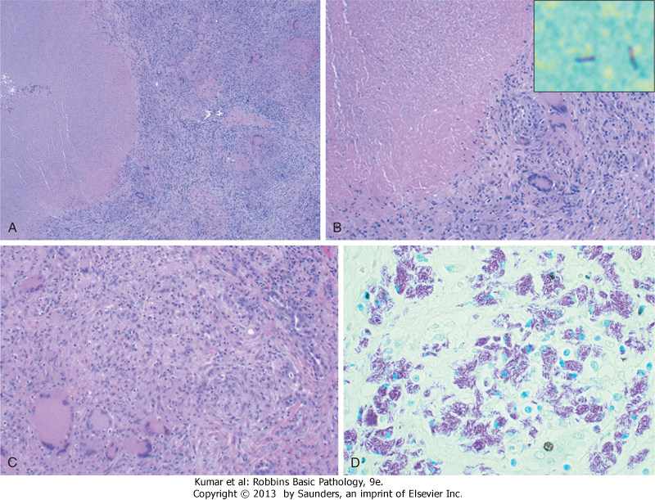
Tuberculosis

Slide 37
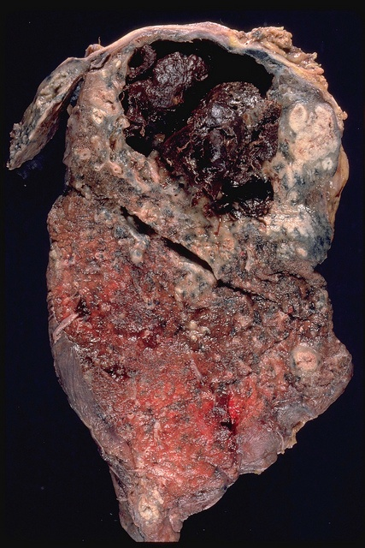
CAVITATION

Slide 38
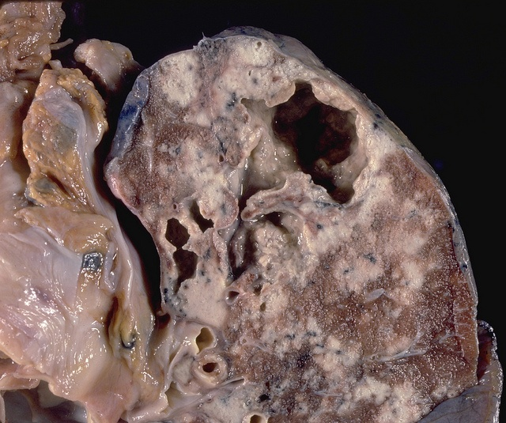
CAVITATION AND CASEATION

Slide 39
- Secondary tuberculosis should always be an important consideration in HIV-positive patients who present with pulmonary disease
- Although an increased risk of tuberculosis exists at all stages of HIV disease, the manifestations differ depending on the degree of immunosuppression

Slide 40
1. Patients with CD4+ counts greater than 300 cells/mm present with "usual" secondary tuberculosis
2. Patients with CD4+ counts below 200 cells/mm present with a clinical picture that resembles progressive primary tuberculosis (lower and middle lobe consolidation, and, no granulomas, or cavitations (non-reactive disease).

