Slide 1
Hemodynamic disorders

Slide 2
Edema
60% of lean body weight is water. Two thirds inside the cells and one third outside the cell
Edema is Increased fluid in the interstitial tissue space.
Edema is the result of the movement of fluid from the vasculature into the interstitial spaces

Slide 3
Edema
Disorders that disturb cardiovascular, renal, or hepatic function are often marked by the accumulation of fluid in tissues (edema) or body cavities (effusions).
Edema fluids and effusions may be inflammatory or noninflammatory

Slide 4
Edema وذمه: Accumulation of interstitial fluid in tissues and also collect in cavities
1. The pleural cavity ( pleural effusion),
2. The pericardial cavity (pericardial effusion),
3. Peritoneal cavity (ascites).

Slide 5
Edema وذمه
Edema may be caused by:
■ Increased hydrostatic pressure (e.g., heart failure)
■ Decreased colloid osmotic pressure caused by reduced plasma albumin, either due to decreased synthesis (e.g., liver disease, protein malnutrition) or to increased loss (e.g., nephrotic syndrome)
■ Increased vascular permeability (e.g., inflammation),
which is usually localized but may occur throughout the body in severe systemic inflammatory states such as sepsis
■ Lymphatic obstruction (e.g., infection or neoplasia)
■ Sodium and water retention (e.g., renal failure)
■ Inflammation, acute and chronic

Slide 6
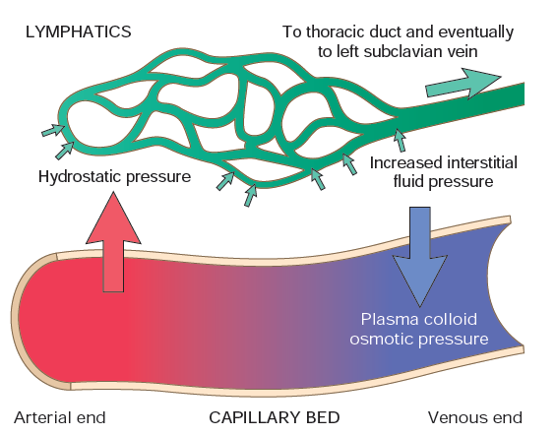

Slide 7
Hyperemia and Congestion
Increase in blood volume in a tissue
Hyperemia and congestion both stem from increased blood volumes within tissues, but have different underlying mechanisms and consequences

Slide 8
Hyperemia and Congestion
Hyperemiaتوقد الدم
is an active process in which arteriolar dilation (e.g., at sites of inflammation or in skeletal muscle during exercise) leads to increased blood flow. Affected tissues turn red (erythema) because of increased delivery of oxygenated blood.

Slide 9
Congestion احتقان
Results from impaired outflow of venous blood and can occur
a. Systemically, as in cardiac failure
b. Locally due to an isolated venous obstruction such as vein thrombus
- The tissues have an abnormal blue-red color due to accumulation of de-oxygenated hemoglobin

Slide 10
Hemostasis
Hemostasis is a precisely regulated process involving platelets, clotting factors, and endothelium that occurs at the site of vascular injury and culminates in the formation of a blood clot, which serves to prevent or limit the extent of bleeding.
The main roles are of the platelets, coagulation factors, and endothelium in hemostasis

Slide 11
Thrombosis
Thrombus development usually is related to one or more components of the Virchow triad:
■ Endothelial injury (e.g., by toxinsسموم , hypertension, inflammation, or metabolic products)
■ Abnormal blood flow—stasis ركود الدم or turbulence (e.g., due to aneurysmsتوسع الوعاء الدموي , atherosclerotic plaque تصلب الشرايين )
■ Hypercoagulability, either primary or secondary
A. Genetic factors
1. Factor V mutation
2. Inherited deficiencies of anticoagulants such as, protein C, or protein S
Acquired hypercoagulability from
1. Oral contraceptive use and Pregnancy
2. Some cancers

Slide 12
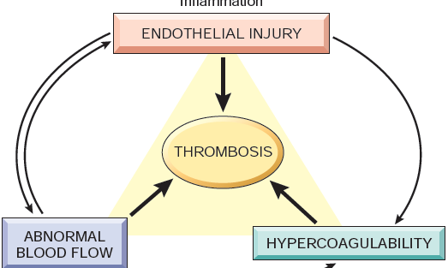

Slide 13
Thrombosis
Thrombi can develop anywhere in the cardiovascular system and vary in size and shape depending on the involved site and the underlying cause
Arterial or cardiac thrombi usually begin at sites of turbulence or endothelial injury, whereas venous thrombi characteristically occur at sites of stasis
Thrombi are focally attached to the underlying vascular surface
Thrombi occurring in heart chambers or in the aortic lumen are designated mural thrombi

Slide 14
Fate مصيرof the Thrombus
Propagation تتمدد. Thrombi accumulate additional platelets and fibrin
Embolization.تنتقل Thrombi dislodge and travel to other sites in the vasculature
Dissolution ذوبان . the rapid shrinkage and total disappearance of thrombi
Note: older thrombi, are more resistant to dissolution, and become fibrosed

Slide 15
Clinical Correlation of thrombi
1- Venous thrombi by obstructing the veins can cause swelling but are most worrisome because they can embolize to the lungs and cause death.
- Conversely, arterial thrombi mainly obstruct vessels (in coronary and cerebral arteries ) to cause acute ischemia (myocardial and cerebral infarction)

Slide 16
Deep venous thromboses ("DVTs") -Occur in the larger leg veins at or above the knee (popliteal, femoral, veins)
Are serious because they can embolize and cause acute lung ischemia (called pulmonary embolism “PE”)

Slide 17
EMBOLISM
EMBOLISM - Is an intravascular solid, liquid, or gas that is carried by the blood to site distant from point of origin and cause obstruction
Thromboembolism The majority of emboli derive from a fragmented thrombi- thromboembolism, and result in vascular occlusion

Slide 18
Pulmonary Embolism
Pulmonary emboli originate from deep venous thromboses and are the most common form of thromboembolic disease
In more than 95% of cases, PEs originate from leg DVTs
the patient who has had one PE is at high risk for more
Consequences may include right-sided heart failure, pulmonary hemorrhage, pulmonary infarction, or sudden death.

Slide 19
Systemic Thromboembolism
Most systemic emboli (80%) arise from intracardiac mural thrombi( (تجلطات من القلب
Most come to rest in the lower extremities (75%) or the brain (10%),and other tissues
whether an embolus causes tissue infarction depends on the site of embolization and the presence or absence of collateral circulation

