Slide 1
Inflammation-4
Fatima Obeidat,MD

Slide 2
Platelet activating factor
From membrane phospholipids by phospholipase A2.
Source: Neutrophils, monocytes, basophils, platelet, endothelial cells and other cells.
Actions:
Platelet stimulation
Potent broncho-constrictor.
Potent vasodilator.
Increase vascular permeability.
Stimulates synthesis of other mediators.

Slide 3
Cytokines (TNF, IL-1, IL-6, chemokines)
Polypeptides.
TNF and IL 1
Source: activated macrophages++mast cells, endothelial cells.
Actions :
Endothelial activation, expression of adhesion molecules.
Increase production of other cytokines and AA metabolites.
Systematic effects: Fever, Lethargy, cachexia, neutrophilia, Decreased blood pressure (also IL-6 plays a role)
TNF increase thrombogeninicity of endothelium.

Slide 4
Chemokines
Small proteins.
Actions:
Chemo attraction.
Control normal organization of lymph nodes.
Activate leukocytes...increase affinity of integrins…

Slide 5
Neuropeptides
Substance P.
Produced from nerve fibers.
Actions:
Transmit pain signals.
Regulate vessel tone.
Modulate vascular permeability.

Slide 6
Nitric oxide
Short lived.
Soluble free radical gas.
Synthesized de novo from arginine by nitric oxide synthase (NOS):
Type 1 NOS, neuronal.. No role in inflammation.
Type 2 NOS,.. inducible, in macrophages and endothelial cells and others
Type 3 NOS in endothelial cells.

Slide 7
Nitric oxide
ACTIONS:
Microbicidal
Vasodilator
Antagonist for platelet aggregation.
Reduced leukocyte recruitment

Slide 8
Systemic effects of inflammation acute phase reaction
Mediated by TNF, IL-1, IL-6.
IL-6 stimulate hepatic synthesis of plasma proteins.
Several clinical and pathologic features:
Fever
Elevated plasma levels of acute phase proteins.
Leukocytosis.
Sepsis.
Others.

Slide 9
Fever
Elevated body temperature,
External pyrogens( bacterial LPS) stimulate synthesis of internal pyrogens(IL 1 and TNF)
Pyrogens stimulate prostaglandin synthesis in hypothalamus (PGE2)
PG stimulate production of neurotransmitters which increase temperature.
NSAIDs reduce fever by blocking prostaglandin synthesis.

Slide 10
Elevated plasma levels of acute-phase proteins.
Synthesized in the liver, IL-6 mediated.
1- C-reactive protein (CRP)
May act as opsonin
Used to assess response to TX
Marker for increased risk of MI or stroke in patients with atherosclerosis
2- Fibrinogen,
binds to erythrocytes >>>sediment more rapidly than individual erythrocytes…rouleaux,,,,,,,basis for measuring ESR
Elevated ESR is a simple test for the systemic inflammatory response,
3- Serum amyloid A (SAA)
May act as opsonin

Slide 11
Rouleaux formation by RBCs

Slide 12
Leukocytosis
Common feature of inflammatory reactions, especially infections.
Leukocyte count usually reach 15,000 to 20,000 cells/mL.
Leukomoid reaction,,,,,40,000 to 100,000 cells/mL.
Mediated first by TNF and IL-1, then by CSF on bone marrow.

Slide 13
Most bacterial infections cause neutrophilia
Viral infections (infectious mononucleosis, mumps), cause lymphocytosis.
Bronchial asthma, hay fever and parasite infections cause, eosinophilia
Paradoxically , Typhoid fever and certain viruses are associated with leukopenia.

Slide 14
Other systemic signs
Increased heart rate.
High blood pressure.
Decreased sweating.
Rigors (shivering)
Chills (perception of cold)
Malaise
Anorexia.
Sepsis and septic shock (DIC, metabolic acidosis and hypotension)

Slide 15
Morphologic Appearance of Acute Inflammation
Serous inflammation
Abundant protein-poor fluid with low cellular content
e.g. skin blisters in burns or viral infections and fluid in body cavities (effusions)
Fibrinous inflammation:
Accumulation of thick exudate rich in fibrin.
may resolve by fibrinolysis or organize into thick fibrous tissue.
e.g. acute pericarditis

Slide 16
Suppurative (purulent):
Pus: Creamy yellow or blood stained fluid consisting of neutrophils, microorganisms & tissue debris
Staphylococcal infections.
Abscess: Focal localized collection of pus
Empyema: Collection of pus within a hollow organ
Ulcers:
Defect of the surface lining of an organ or tissue
Mostly GI tract or skin

Slide 17
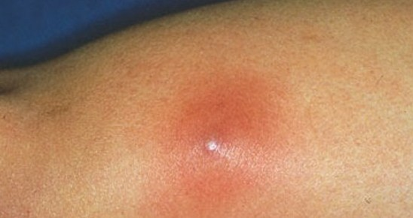
Subcutaneous Abscess

Slide 18
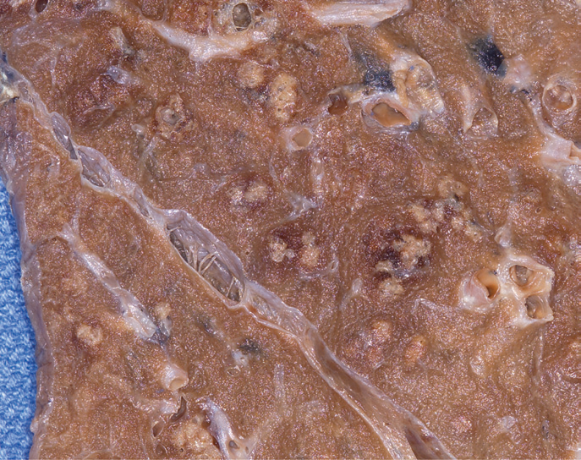
Lung Abscess

Slide 19
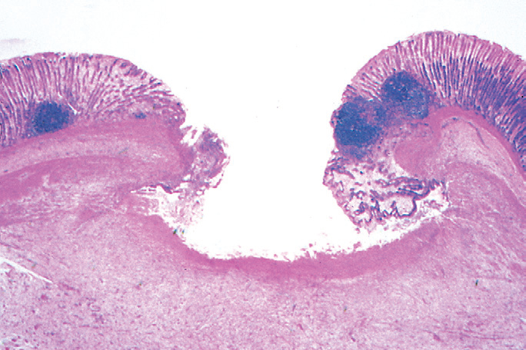
Gastric ulcer

Slide 20
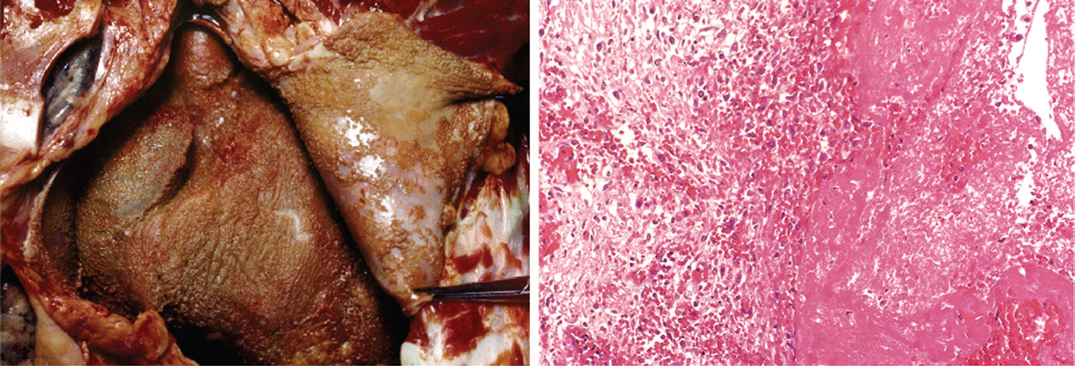
Fibrinous Pericarditis

Slide 21
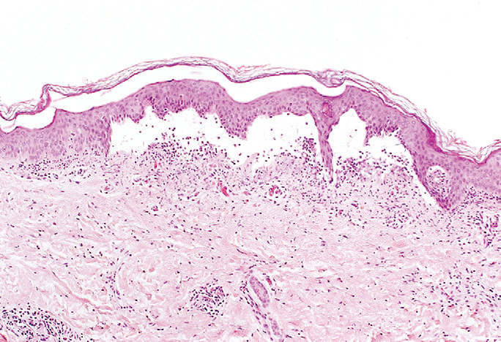
Serous inflammation skin blister

Slide 22
Outcomes of Acute Inflammation
Complete resolution (back to normal)
Clearance of injurious stimuli
Removal of the exudate, fibrin & debris
Reversal of the changes in the microvasculature
Replacement of lost cells (regeneration)
Healing
organization by fibrosis through formation of Granulation tissue. Why?
Substantial tissue destruction or
Tissue cannot regenerate or
Extensive fibrinous exudates
Abscess formation
Progression to chronic inflammation

Slide 23
