Slide 2
Diseases of the Respiratory system
Fatima Obeidat, MD
Assistant Professor
Consultant: Histopathologist /Neuropathologist

Slide 3
I. ATELECTASIS (COLLAPSE)

Slide 4
- Is loss of lung volume caused by inadequate expansion of air spaces.
- It results in shunting of inadequately oxygenated blood from pulmonary arteries into veins, thus giving rise to hypoxia.

Slide 5
- On the basis of the underlying mechanism , atelectasis is classified into three forms:
1. Resorption atelectasis
2. Compression atelectasis
3. Contraction atelectasis

Slide 6
1. Resorption atelectasis. :
- Occurs when an a total obstruction of bronchus prevents air from reaching distal airways.
- The air already present gradually becomes absorbed, and alveolar collapse follows.

Slide 7
1. The most common cause of resorption collapse is total obstruction of a bronchus by mucus or mucopurulent plug
a. Postoperatively
b. Complicate bronchial asthma, bronchiectasis, chronic bronchitis,

Slide 8
2. Obstruction by:
a. Tumor.
b. Foreign body aspiration, particularly in children.

Slide 9
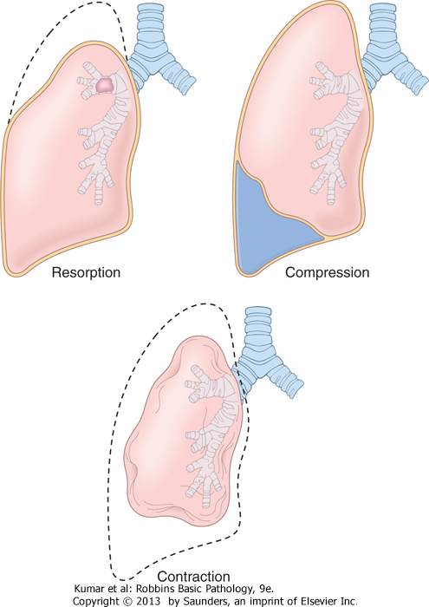
Types of atelectasis

Slide 10
2. Compression atelectasis.
- Sometimes called passive or relaxation atelectasis)
- Is usually associated with accumulation of fluid, blood, or air within the pleural cavity, which mechanically collapses the adjacent lung.

Slide 11
- Causes:
a. Pleural effusion, caused most commonly by congestive heart failure (CHF).
b. Leakage of air into the pleural cavity (pneumothorax)
c. Hemothorax

Slide 12
Types of atelectasis

Slide 13
C.- Contraction atelectasis.
- Called cicatrization atelectasis
- Occurs when either local or generalized fibrotic changes in the lung or pleura or prevents expansion of air spaces

Slide 14
Note
- Atelectasis (except when caused by contraction) is potentially reversible and should be treated promptly to prevent hypoxemia and superimposed infection of the collapsed lung.

Slide 15
OBSTRUCTIVE PULMONARY DISEASES

Slide 16
The major diffuse obstructive disorders are
1. Emphysema,
2. Chronic bronchitis,
3. Bronchiectasis,
4. Asthma.

Slide 17
Emphysema
- Abnormal permanent enlargement of the air spaces distal to the terminal bronchioles accompanied by destruction of their walls without fibrosis with destruction of the alveolar septae and no fibrosis

Slide 18
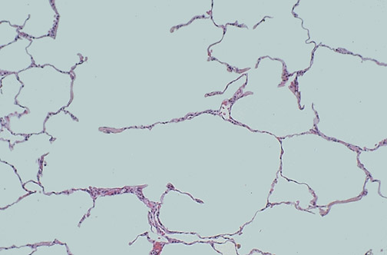
Emphysema

Slide 19
Types of emphysema
- There are four major types of emphysema:
(1) Centriacinar,
(2) Panacinar
(3) Distal acinar,
(4) Irregular.

Slide 20
1. Centriacinar (Centrilobular) Emphysema
- The central or proximal parts of the acini, formed by respiratory bronchioles, are affected, while distal alveoli are spared

Slide 21
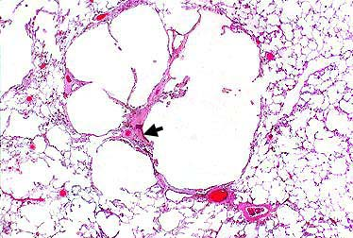
Centriacinar emphysema

Slide 22
- The lesions are more common and severe in the upper lobes.
- This type of emphysema is most commonly caused by cigarrete smoking

Slide 23
2. Panacinar (Panlobular) Emphysema
- The acini are uniformly enlarged, from the level of the respiratory bronchiole to the terminal blind alveoli
- Tends to occur more commonly in the lower lung zones
- It occurs in α₁-antitrypsin deficiency.

Slide 24
3. Distal Acinar (Paraseptal) Emphysema
- It involves the distal part of the acinus.
- The proximal portion of the acinus is normal

Slide 25
- The characteristic finding is the presence of multiple, contiguous, enlarged air spaces ranging in diameter from less than 0.5 mm to more than

Slide 26
2.0 cm, sometimes forming cystic structures that, with progressive enlargement, are referred to as bullae
- It is seen most often in cases of spontaneous pneumothorax in young adults.

Slide 27
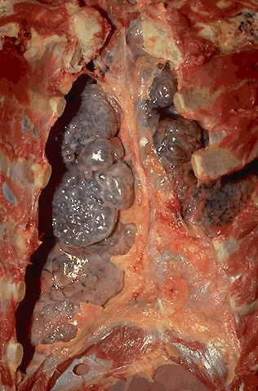
Emphysema

Slide 28
Clinical Features
-In emphysema with no "bronchitic" component is one in which the patient is
- Dysppnea is the first symptom
-Barrel-chested with prolonged expiration,
- Sitting forward in a hunched-over position, attempting to squeeze the air out of the lungs with each expiratory effort.

Slide 29
- Dyspnea and hyperventilation are prominent, so that until very late in the disease, gas exchange is adequate and blood gas values are relatively normal.
- Because of prominent dyspnea and adequate oxygenation of hemoglobin, these patients sometimes are called "pink puffers."

Slide 30
2. Chronic Bronchitis
- Is common among cigarette smokers and urban dwellers
- The diagnosis of chronic bronchitis is made on clinical grounds:
- It is defined by the presence of a persistent productive cough for at least 3 consecutive months in at least 2 consecutive years.

Slide 31
Note
-In early stages of the disease, the productive cough raises mucoid sputum, but airflow is not obstructed.

Slide 32
- A subset of bronchitic patients, especially heavy smokers, develop chronic outflow obstruction, usually with associated emphysema

Slide 33
- These environmental irritants
a. Induce hypertrophy of mucous glands in the trachea and main bronchi,
b. Marked increase in mucin-secreting goblet cells in the surface epithelium of smaller bronchi and bronchioles.

Slide 34
Note
- The defining feature of chronic bronchitis (mucus hypersecretion) is primarily a reflection of large bronchial involvement
- The morphologic basis of airflow obstruction in chronic bronchitis is more peripheral and results from:

Slide 35
(1) Small airway disease –(chronic bronchiolitis) is induced by:
a. Goblet cell metaplasia with mucous plugging of the bronchiolar lumen,
b. Inflammation,
c. Bronchiolar wall fibrosis,
(2) Coexistent emphysema

Slide 36
.
Note
- Small airway disease ( chronic bronchiolitis) is an important component of early and relatively mild airflow obstruction,
- Significant airflow obstruction is almost always caused by emphysema - chronic bronchitis with

Slide 37
Clinical Features
- In patients with chronic bronchitis, a prominent cough and the production of sputum may persist indefinitely without ventilatory dysfunction
- Some patients develop significant COPD with outflow obstruction.

Slide 38
- This clinical syndrome is accompanied by hypercapnia, hypoxemia, and (in severe cases) cyanosis (hence the term "blue bloaters").
- With progression, chronic bronchitis is complicated by pulmonary hypertension and cardiac failure .
- Recurrent infections and respiratory failure are constant threats.

Slide 39
3.Asthma

Slide 40
3. Asthma
- Asthma is a chronic inflammatory disorder of the airways that causes recurrent episodes of wheezing, breathlessness, chest tightness, and cough, particularly at night and/or early in the morning.

Slide 41
1. Atopic Asthma
- This is the most common type of asthma,
- Usually beginning in childhood,

Slide 42
- A positive family history of atopy and/or asthma is common,
- Asthmatic attacks are often preceded by allergic rhinitis, urticaria, or eczema.
- The disease is triggered by environmental antigens, such as dusts, pollen, and foods

Slide 43
2. Non-Atopic Asthma
- No evidence of allergen sensitization,
- A positive family history of asthma is less common.

Slide 44
d. Respiratory infections due to viruses (e.g., rhinovirus, parainfluenza virus) and inhaled air pollutants (e.g., sulfur dioxide, ) are common triggers.
- It is thought that virus-induced inflammation of the respiratory mucosa lowers the threshold of the subepithelial vagal receptors to irritants.

Slide 45
Note:
-Although the connections are not well understood, the ultimate humoral and cellular mediators of airway obstruction (e.g., eosinophils) are common to both atopic and nonatopic variants of asthma, so they are treated in a similar way.

Slide 46
3. Drug-Induced Asthma
- Several pharmacologic agents provoke asthma--aspirin being the most striking example
- Patients with aspirin sensitivity present with recurrent rhinitis and nasal polyps, urticaria, and bronchospasm.

Slide 47
- The precise mechanism remains unknown, but it is presumed that aspirin inhibits the cyclooxygenase pathway of arachidonic acid metabolism without affecting the lipoxygenase route, thereby shifting the balance of production toward leukotrienes that cause bronchial spasm.

