Slide 1
Reproductive Health class#2
Safe motherhood

Slide 2
Women’s Health
Key facts

Slide 3
Worldwide, women live an average four years longer than men.
In 2011, women's life expectancy at birth was more than 80 years in 46 countries, but only 58 years in the WHO African Region.
Girls are far more likely than boys to suffer sexual abuse.
Road traffic injuries are the leading cause of death among adolescent girls in high- and upper-middle-income countries.
Almost all (99%) of the approximate 287 000 maternal deaths every year occur in developing countries.
Globally, cardiovascular disease, often thought to be a "male" problem, is the number one killer of women.
Breast cancer is the leading cancer killer among women aged 20–59 years worldwide.
http://www.who.int/mediacentre/factsheets/fs334/en/

Slide 4
Globally, 287 000 pregnancy-related deaths occur every year, 99% of which are in developing countries.
Maternal deaths are the second biggest killer of women of reproductive age.
There is a broad range of direct and indirect efforts to reduce deaths and disabilities resulting from pregnancy and childbirth.
Notes:
Every minute of every day, a woman dies somewhere as a result of pregnancy or childbirth. This means 786 women die every day, and for each woman who dies, 50-100 suffer from long-term illnesses or disabilities
Maternal mortality is the main factor that substantially lowers the life expectancy of women. Twenty-five per cent of maternal deaths occur during pregnancy; 50% within 24 hours of childbirth; 20% within seven days of delivery; and 5% from two to six weeks after childbirth.
The term safe motherhood covers a broad range of direct and indirect efforts to reduce deaths and disabilities resulting from pregnancy and childbirth. Direct efforts include those to ensure that every woman has access to a full range of high-quality, affordable sexual and reproductive health services, especially maternal care and treatment of obstetric emergencies.
Indirect efforts include addressing social and other conditions that may affect women’s health.

Slide 5
In 1987 the World Bank, in collaboration with WHO and UNFPA, launch of the Safe Motherhood Initiative (SMI).
Safe motherhood means ensuring that all women receive the care they need to be safe and healthy throughout pregnancy and childbirth
SMI sets its aim to reduce maternal mortality and morbidity by one half by the year 2000
Inter-Agency Group (IAG) for Safe Motherhood established Pillars of Safe Motherhood
Notes:
In 1987 the World Bank, in collaboration with WHO and UNFPA, sponsored the Safe Motherhood Conference in Nairobi. The launch of the Safe Motherhood Initiative (SMI) was seen as a major milestone in the race to reduce the burden of maternal mortality throughout the world, particularly in developing countries
It issued a call to action to reduce maternal mortality and morbidity by one half by the year 2000.
The initiative recognized the need for national governments, funding agencies, and non-governmental organizations (NGOs) to make maternal health an urgent health priority and to ensure that necessary political and financial support was dedicated to this effort.
It also gave birth to the Inter-Agency Group (IAG) for Safe Motherhood. All events that make pregnancy unsafe, irrespective of the gestation or outcome, are important part of safe motherhood. Subsequent work on Safe Motherhood by the Inter-Agency Group and others have outlined clear strategies and specified interventions for the reduction of maternal morbidity and mortality, often referred to as the Pillars of Safe Motherhood. The Safe Motherhood Initiative outlined strategies and specific interventions, referred to as the Pillars of Safe Motherhood, for the reduction of maternal morbidity and mortality.

Slide 6
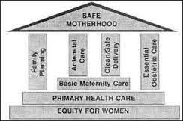
Pillars of Safe Motherhood
Caption

Slide 7
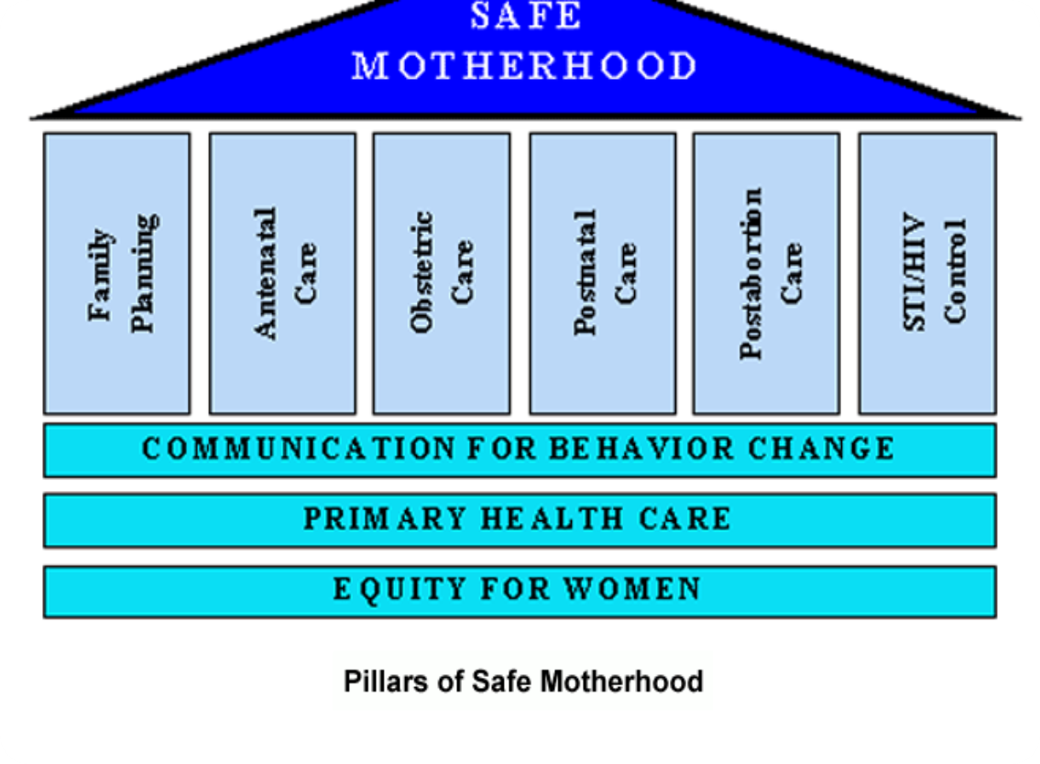
Pillars of Safe Motherhood
Caption

Slide 8
Safe motherhood initiatives, are they cost-effective?
Subtitle

Slide 9
Unwanted or unplanned pregnancies cause emotional and economic hardship not only to women but also to their families.
Children whose mothers die or are disabled in childbearing have drastically diminished prospects of leading a productive life.
The burden on women associated with frequent pregnancies, poor maternal health, pregnancy complications, and caring for sick children contributes to their poverty
“Safe motherhood is an important social and economic investment. It is a matter of social justice and human rights.”
Notes:
Over a decade of research and experience in addressing maternal health has made it clear that safe motherhood initiatives are cost-effective, ensuring high social and economic returns at low cost. Interventions to improve maternal health are also feasible, even in poor settings.
The potential benefits are substantial:
· · Unwanted or unplanned pregnancies can interfere with women’s social and economic activities and cause emotional and economic hardship not only to women but also to their families.
· Children whose mothers die or are disabled in childbearing have drastically diminished prospects of leading a productive life.
Studies in developing countries indicate that the risk of death for children under five years doubles or triples if their mother dies. Other studies estimate that children whose mothers have died are 3-10 times more likely to die within two years than those whose parents are both alive. Motherless children are likely to get less healthcare and education as they grow up. Girls, in particular, suffer because they are forced to drop out of school to look after younger siblings.
· The burden on women associated with frequent pregnancies, poor maternal health, pregnancy complications, and caring for sick children drains their productive energy, jeopardizes their income-earning capacity, and contributes to their poverty
Investments in safe motherhood not only improve women’s health and the health of her family, but also increase the labor supply, productive capacity and economic well-being of communities, ultimately having a positive impact on the economy. Investment in safe motherhood reduces household poverty, saves families and governments the costs of treatment and other services, and strengthens the health system. An investment in safe motherhood is an investment in the emotional, social, and economic well-being of millions of women, children, families and communities.
Throughout the world women face poverty, discrimination, and gender inequalities. These factors contribute to poor reproductive health and unsafe motherhood even before a pregnancy occurs, and they make it worse once pregnancy and childbearing have begun.
High levels of maternal mortality are a symptom of neglect of women’s most fundamental human rights. Such neglect affects the poor, the disadvantaged and the powerless most acutely. Protecting and promoting women’s rights, empowering women to make informed choices, and reducing social and economic inequalities are all key to safe motherhood.

Slide 10
What are the determinants of maternal mortality and morbidity?
Medical factors
Socioeconomic and cultural factors that consider “women are a socially disadvantaged group”
Keep in mind that maternal mortality is not merely a “health disadvantage”—it is also a “social disadvantage” (WHO1986).
Caption
Notes:
pregnancy, 110 experience a pregnancy-related complication, 40 have an unsafe abortion, and one woman dies from a pregnancy-related cause.
These include women’s poor health before pregnancy; inadequate, inaccessible or unaffordable health care; and poor hygiene and care during childbirth, or Childbirth can be particularly dangerous when the births are too soon, too close together, or too many. Women may also receive substandard or slow care at health facilities since they cannot support adequate staff,. Women can die because they do not realize they have a medical problem, because they
postpone decisions to seek care, or because it takes them too long to reach appropriate care,
affecting their chances of surviving an obstetric emergency.
cultural realities also contribute, including illiteracy, poverty, women’s low status, women’s unequal access or limited access to resources , and their lack of decision-making power about child birth in families and societies, poor women are less likely to have formal education than wealthy women, and are less likely to be in good health and to seek or receive medical care.
Social and cultural practices, which themselves are responsible for the poor health conditions of most women, are among the important causes of maternal mortality. Women are left vulnerable by early marriage and pregnancy (when the reproductive organs are not yet properly developed), high fertility rates
leading to recurrent pregnancies; and unwanted pregnancies, when the fetus is aborted, most often at home. Globally, only one out of six pregnant women between the ages of 17 and 35 receives prenatal care, and more than half of all pregnant women are anaemic
(WHO 2001).

Slide 11
Strategies for Prevention of Maternal Mortality pillars of safe motherhood
1. Antenatal Care: Effective antenatal care is essential to detect preexisting conditions, prevent complications where possible, and ensure that complications of pregnancy are detected early and treated appropriately.
2. Clean and Safe Delivery: All birth attendants must have the knowledge, skills, and equipment to perform a clean and safe delivery and provide postpartum care to mother and baby pregnancies.

Slide 12
3. Essential Obstetric Care: Pregnancy is a period of potential risk, and any pregnant woman can develop complications. Therefore, interventions are needed at a community level and also within health services to ensure that essential care for high-risk pregnancies and complications is made available to all women who need it.
4. Family Planning: Individuals and couples must have the information and services to plan the timing, number, and spacing of pregnancies, and to prevent unwanted
Notes:
Essential Obstetric Care: Pregnancy is a period of potential risk, and any pregnant woman can develop complications. Accurately predicting which women will develop complications is not possible. Making motherhood safer requires the establishment of a chain of care linking women, families, and communities with the health system. Therefore, interventions are needed at a community level and also within health services.

Slide 13
Making motherhood safe requires action on:
Reducing the numbers of high-risk and unwanted pregnancies
Requirement: All women have access to contraception to avoid unintended pregnancies
Reducing the numbers of obstetric complications
All pregnant women have access to skilled care at the time of birth
Reducing the case fatality rate in women with complications
All women with complications have timely access to quality emergency obstetric care
Notes:
Achieving safe motherhood and reducing maternal mortality requires action on three fronts and requires a three-pronged strategy:

Slide 14
Effective Strategies to Achieve Safe Motherhood
Focused Antenatal Care
Minimizing Delays
Skilled Attendant at Birth
Pregnancy Spacing

Slide 15
Antenatal care helps women maintain normal pregnancies through focused assistance and individualized care.
The WHO model of antenatal care recommends 4-5 focused antenatal care visits for women not having problems or complications.
Antenatal care aims to:
–Detect and treat existing conditions or complications
–Prevent complications and disease
–Prepare for the birth and be ready for complications
–Include health promotion education
Notes:
The World Health Organization has proposed a model of antenatal care that is aimed as providing quality care to women in an efficient, cost-effective way. Called focused, or goal-directed, antenatal care, this model proposes 4 to 5 focused antenatal visits (fewer than previously recommended) for women not having problems or complications at the outset. The specific elements of care are designed to prevent, detect early and/or manage conditions that impact pregnancy outcome for the mother and newborn. The care package recommends routine blood pressure measurement, testing of urine for bacteriuria and proteinuria, blood tests for anemia, and screening and treatment for existing conditions that may impact pregnancy outcome such as tuberculosis, HIV, malaria, sexually transmitted infections, hookworm and nutritional deficiencies. Routine weight and height measurement at each visit is considered optional. This model does not emphasize a risk approach, as this has often failed to accurately predict which women will have complications during pregnancy, labor and delivery

Slide 16
Minimizing Delays
Delays leading to maternal death are often multi-factorial.
Three Delays Model
Delay in decision to seek care can be influenced by:
Failure to recognize complications
Societal acceptance of pregnancy risk/maternal death
Low status of women
Socio-cultural barriers to seeking care
Notes:
An estimated 15% of women have life-threatening complications during pregnancy, so It is difficult to predict which women will have complications and to prevent all complications.
Estimated average interval from onset of obstetric complication to death, without medical intervention:
For example for Antepartum hemorrhage is 12 hours
Postpartum hemorrhage 2 hours
Ruptured uterus 1 day , Eclampsia 2 days, Obstructed labor 3 days, Infection 6 days
The Three Delays Model, proposed by Deborah Maine, identifies potential points at which delays can occur in managing obstetric complications. It points the way for development of strategies and programs to address these delays at local and regional levels. The model suggests that women who die in childbirth experience at least one of the following three delays:
The First Delay is in deciding to seek care for an obstetric complication. This may occur for several reasons, including late recognition that there is a problem, fear of the hospital or of the costs that will be incurred, or the lack of an available and appropriate decision maker to seek care.
▪The Second Delay (in reaching the health care facility) occurs after the decision to seek care has been made. The delay in actually reaching the care facility is usually caused by difficulty in transport. Many communities, towns or villages have very limited transportation options and poor roads. Some communities have developed innovative ways to address this problem, including prepayment schemes, community transportation funds and a strengthening of links between community practitioners and the health system.
▪The Third Delay is a delay in receiving treatment once at a health facility. Women may wait for hours at a health facility because of poor staffing, prepayment policies, or difficulties in obtaining blood supplies, equipment or an operating room. Once a woman has actually reached a facility that can provide emergency obstetric care, many economic and sociocultural barriers have already been overcome. Focusing on improving services in existing health facilities is a major component in promoting access to emergency obstetric care

Slide 17
Delay in reaching care can be influenced by:
Poor referral organization and lack of transport
Delay in obtaining care at a facility can be influenced by:
Inadequate facilities, supplies, personnel
Poor training/ lack of motivation of personnel
Lack of finances

Slide 18
Skilled Attendant at Birth
The presence of a skilled attendant at delivery is a leading predictor of a safe delivery.
Notes:
A skilled attendant is an accredited health professional – such as a midwife, doctor, or a nurse – who has been educated and trained to proficiency in the skills needed to manage normal (uncomplicated) pregnancies, childbirth, and the immediate postnatal period, and in the identification, management, and referral of complications in women and newborns.”
A traditional birth attendant is traditional to the culture of the society, independent of the health system, non-formally trained and functions as a community-based provider of care during pregnancy, childbirth and the postnatal period. Traditional birth attendants, trained or not, are
not considered skilled birth attendants.

Slide 19
Pregnancy Spacing
Timing of pregnancy and intervals between pregnancies are strongly related to personal preference and social custom.
Age, family desires, family supports, economic and social circumstances, and access to health care may all play a role in birth spacing.
The recommended birth spacing is:
At least 2 years after a live birth
At least 6 month after a miscarriage or induced abortion
Intervals <6 months pose an increased risk of maternal mortality, intervals >5years increase the risk of pre-eclampsia in the mother, preterm birth, low birth weight and small for gestational age growth problems in the infant.
Notes:
The length of time between a woman’s pregnancies can have significant impact on health outcomes for both the woman and her baby
The consensus arrived at through this detailed technical review process proposed the recommended birth spacing presented in this module, that is:
•At least 2 years after a live birth
•At least 6 month after a miscarriage or induced abortion
•Furthermore, the weight of the evidence seems to suggest that intervals less than 6 months pose an increased risk of maternal mortality, and intervals greater than five years increase the risk of pre-eclampsia in the mother, preterm birth, low birth weight and small for gestational age growth problems in the infant.

Slide 20
References
www.safemotherhood.org
http://web.worldbank.org/WBSITE/EXTERNAL/TOPICS/EXTHEALTHNUTRITIONANDPOPULATION/EXTPRH/0,,contentMDK:20200213~menuPK:548457~pagePK:148956~piPK:216618~theSitePK:376855,00.html
Women and Health Learning Package: Safe Motherhood: www.theNetworktufh.org

