Slide 1
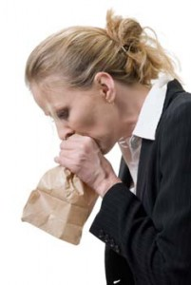
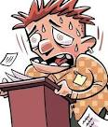
Anxiety Disorders
DSM 5

Slide 2
Anxiety Disorders
Separation anxiety disorder
Selective Mutism
Specific phobias
Social anxiety disorder (social phobia)
Panic disorder
Agoraphobia
Generalized anxiety disorder

Slide 3
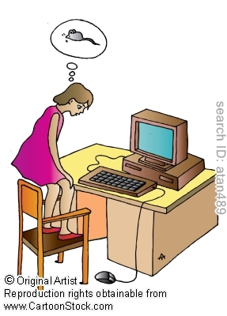
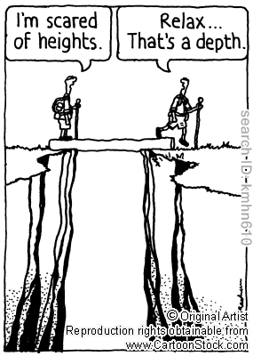

Slide 4
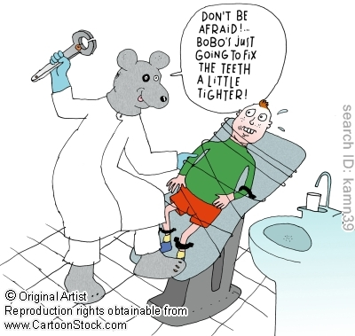

Slide 5
Specific Phobias diagnostic criteria
A. Marked fear or anxiety about a specific object or situation
Animals: cats, spiders
Natural Environmental: heights, storms
Blood- injection- injury: needles, invasive medical procedures
Situational: airplanes, elevators
B. The phobic object or situation almost always provokes immediate fear or anxiety

Slide 6
Specific Phobias diagnostic criteria
C. The phobic object or situation is actively avoided or endured (يتحمله)with intense fear or anxiety
D. The fear or anxiety is out of proportion to the actual danger posed by the specific object or situation and to the socio-cultural context
E. the fear anxiety or avoidance is persistent, typically lasting for 6 months

Slide 7
Specific Phobias diagnostic criteria
F. the fear, anxiety or avoidance causes clinically significant distress or impairment in social, occupational, or other important areas of functioning
G. exclude any other mental disorders
Such as fear, anxiety and avoidance of situations associated with panic-like symptoms
Agoraphobia
Object or situation related to obsessions (OCD)
Reminder of traumatic event (PTSD)
Social situation (social phobia)

Slide 9
Social anxiety disorder (social phobia) diagnostic criteria
A. Marked fear or anxiety about one or more social situations in which the person exposed to possible scrutiny (التدقيق والتفحص)by others.
Social interaction: meeting new people
Being observed: eating or drinking
Performing in front of others: giving speech
B. the person feels that he/she will act in a way or show anxiety symptoms that will be negatively evaluated (that will be humiliating or embarrassing; will lead to rejection or offend others)
Notes:
Criteria A. children, the anxiety occur in peer settings and not just during interaction with adults
The individual is concerned that he or she will be judged as anxious,
weak, crazy, stupid, boring, intimidating, dirty, or unlikable. The individual fears that
he or she will act or appear in a certain way or show anxiety symptoms, such as blushing,
trembling, sweating, stumbling over one's words, or staring, that will be negatively evaluated
by others (Criterion B).

Slide 10
Social anxiety disorder (social phobia)
C. The social situations almost always provoke anxiety or fear
D. The social situations are avoided or endured with intense anxiety or fear
E. The fear or anxiety is out of proportion to the actual threat posed by the social situation and to the socio-cultural context
F. The fear anxiety or avoidance is persistent, typically lasting for 6 months
Notes:
criteria C. in children the fear Or anxiety may be expressed by crying, tantrums, freezing, clinging, shrinking, or failing to speak in social situations

Slide 11
Social anxiety disorder (social phobia)
G. The fear or anxiety or avoidance causes clinically significant distress or impairment in social, occupational or other important areas of functioning
Exclude any physical medical illness (burn), medication, substance use or any other psychiatric illness

Slide 13
Panic Disorder diagnostic criteria
A. recurrent unexpected panic attacks. A panic is an abrupt surge of intense fear or discomfort that reaches a peak within minutes

Slide 14
A discrete period of intense fear or discomfort in which at least 4 of the following symptoms develop abruptly and reached a peak within few minutes
Panic Anxiety Disorder
Palpitation, pounding heart, accelerated heart beats
Sweating
Trembling or shaking
Sensations of shortness of breath
Chills or heat sensations
Fear of dying
Feeling dizzy, unsteady, lightheaded, or faint
Feeling of choking
Chest pain
Nausea or abdominal distress
Numbness
Derealization
Fear of losing control

Slide 15
Panic Anxiety Disorder
B. At least one of the attacks has been followed by one month (or more) of one or both of the following:
Persistent concern about having additional panic attack or their consequences (losing control or having a heart attack)
A significant maladaptive change in behavior related to the attacks (avoiding unfamiliar situations, or exercise…)

Slide 16
Panic Anxiety Disorder
C. The disturbance is not caused by physiological effects of substances, medications, or medical condition
D. The disturbance is not explained by another mental disorder

Slide 18
Agoraphobia diagnostic criteria
A. Marked fear or anxiety about 2 or more of the following
1. Using public transportation: buses, trains
2. Being in open spaces: parking lots, bridges
3. Being in enclosed places: shops, cinemas
4. Standing in line or being in a crowed
5. Being outside of the home alone

Slide 19
Agoraphobia
B. The person fears or avoids these situations because of thoughts that escape might be difficult or help might not be available in the event of developing panic-like symptoms or other incapacitating or embarrassing symptoms (fear of incontinence)
C. The agoraphobia situation almost always provoke fear or anxiety

Slide 20
Agoraphobia
D. The agoraphobia situations are actively avoided, require the presence of a companion, or endured with intense fear or anxiety
E. The fear or anxiety is out of proportion to the actual threat posed by the social situation and to the socio-cultural context
F. The fear or anxiety or avoidance is persistent typically for 6 months or more

Slide 21
Agoraphobia
G. The fear or anxiety or avoidance causes clinically significant distress or impairment in social, occupational or other important areas of functioning
H. if another medical condition (eg.;. Parkinson’s disease, inflammatory bowel disease) is present the fear, anxiety or avoidance is clearly excessive
Exclude any other mental disorder

Slide 22
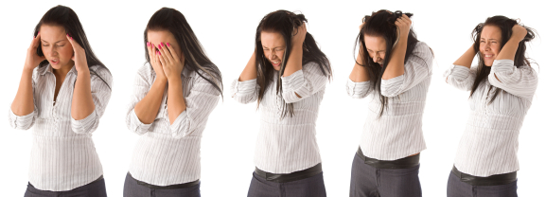
Generalized Anxiety Disorder

Slide 23
Generalized Anxiety Disorder diagnostic criteria
A. Excessive anxiety and worry (apprehensive expectation), occurring more days than not for at least 6 months, about a number of events or activities (such as work or school performance)
B. The person finds it difficult to control the worry

Slide 24
Generalized Anxiety Disorder
C. The anxiety and worry are associated with 3 or more of the following 6 symptoms (with at least some symptoms having been present for more days than not for the last 6 months)
1. Restlessness or feeling keyed up or on edge
2. Being easily fatigued
3. difficulty concentrating or mind going blank
4. irritability
5. Muscle tension
6. Sleep disturbance (difficulty falling or staying asleep or restless unsatisfying sleep)

Slide 25
Generalized Anxiety Disorder
D. The anxiety, worry or physical symptoms cause significant distress or impairement in social, occupational or other important areas of functioning
E. The disturbance is not attributed to the physiological effects of substances, medications or medical condition
F. The disturbance is not explained by other mental disorders

