Slide 1
Nursing Care of Client with Bipolar Disorder
Lina Wardam. RN. PNS

Slide 2
Nursing Intervention: Risk for Injury
Assign one nurse to stay with the client to limit number of people interacting with the client, for this will decrease distractibility and agitation, offers support & provide sense of safety & security for the client
Provide structured schedule of activities that includes rest periods (one – to – one activities provide sense of security)

Slide 3
Nursing Intervention: Risk for Injury
Decrease number of environmental stimuli that might provoke anxiety, agitation and distractibility by:
Assign private room ( prevent taking patient to crowded areas, and if the patient has to be in a crowded place, do not stay for a long time ).
Do not include patient in group activities until ready (gradual inclusion)

Slide 4
Nursing Intervention: Risk for Injury
Keep low level of noise at the unit
Provide a wide space for patient to move around.
Low lightening.
Simple decoration with no bright colours.
Limited number of furniture that is fixed.
Prevent patient from eloping (running away) from the hospital.

Slide 5
Nursing Intervention: Risk for Injury
Provide safe environment By:
Remove hazardous materials from the environment (even smoking)
Observe patient every 15 minutes to prevent any injury
Be calm and talk to the patient in a firm, kind, low-pitched voice and in a matter of fact way to help decrease anxiety. (loud demanding tone provokes hostile and aggressive behavior).

Slide 6
Nursing Intervention: Risk for Injury
Redirect excessive energy by providing a physical activities such as: exercise, gathering the linen, helping in cleaning the unit (but make sure not to exploit the client), this will release tension and give a focus that is productive. (planned activities should not be competitive for it may precipitate an aggressive behavior, and should put to use large muscle movement that does not need concentration and not fine muscle use that needs concentration).

Slide 7
Nursing Intervention: Risk for Injury
Plan for periods of rest in between activities to prevent exhaustion and to give a sense of security to the patient.
Administer medication, as ordered. Haldol, Largactil, and observe for side effects.

Slide 9
Nursing Diagnosis: Impaired Social Interaction
Impaired social interaction
Related to: Egocentric and narcissistic behaviour, delusion of grandeur, low self esteem
Evidenced by: Inability to develop satisfying relationships and manipulation of others for own desires (pretends to be helpless, pits (يحرض) staff against each other, insincere complimenting of a staff member to his face, followed by negative comments about him for others, makes on going demands for nurse’s time continues to act out- demand, yell.. even when told his behaviour is unacceptable), inability to delay gratification.

Slide 10
Nursing Interventions: Impaired Social Interaction
Develop a therapeutic nurse-client relationship
Assess the client’s behavior, attitudes, problems, and needs.
Obtain the client’s perception of his or her problems and what the client expects to gain from the relationship or hospitalization.
Make your expectations for the relationship clear to the client
Be honest in all interactions with the client. Avoid glossing over any unpleasant topics or circumstances (complements the staff while criticizing another)

Slide 11
Nursing Interventions: Impaired Social Interaction
Let the client know that you will work with him or her for a specified period of time and that the relationship will end when the client is no longer in treatment.
Be consistent with the client at all times.
Show the client that you accept him or her as a person
Avoid becoming the only one the client can talk to about his or her feelings and problems

Slide 12
Nursing Interventions: Impaired Social Interaction
Teach the client social skills. Describe and demonstrate specific skills, such as eye contact, attentive listening, nodding, and so forth, and not interrupting others. Discuss the types of topics that are appropriate for social conversation, such as the weather, news, local events, and so forth.
Assist the client in identifying more effective methods of dealing with stress.

Slide 13
Nursing Interventions: Impaired Social Interaction
Recognize the purpose or rewards that the patient gets from manipulative behaviour, does it reduce insecurity by increasing feeling of power of control. understand motivation behind the manipulative behaviour.

Slide 14
Nursing Interventions: Impaired Social Interaction
Set limits on manipulative behaviour
Establish realistic, enforceable consequences for breaking and keeping rules.
Explain to the patient what you expect from him and what are the consequences of violating the limits.
Make sure that limits are consistently affirmed by all staff member by recording the instruction & information you give to the patient in the nursing care plan so that patient will not be able to change distort or ignore the communication.

Slide 15
Nursing Interventions: Impaired Social Interaction
Evaluate the effects of limits
Assign one nurse to give information and help patient.
Keep family informed of what you are doing and teach them how to handle this behaviour if it occurs..
Confront the patient with his manipulative behaviour then ignore manipulative behaviour when possible.
provide positive reinforcement for non-manipulative behaviours.

Slide 16
Nursing Interventions: Impaired Social Interaction
Do not argue , bargain, or try to reason with the patient. State what the limits are and what is expected. Be sure to follow through with consequences if limits are violated.
Help client to explore own feelings, and recognize consequences of own behaviours and refrain from attributing them to others. Take responsibility for own behaviour before adaptive change can occur.

Slide 17
Nursing Interventions: Impaired Social Interaction
Teach patient to set limits on self.
Give feedback on the effect of manipulative behaviour on others.
Set with the patient on regular times that is not related to his demands.
Discuss alternative behaviours in dealing with certain situations and help patient rehearse the alternatives

Slide 18
Nursing Interventions: Impaired Social Interaction
Do not allow the client to bargain to obtain special favors, to avoid responsibilities, or to gain privileges
When limiting the client’s behaviors, offer acceptable alternatives
Do whatever you say you will do, and conversely, do not make promises you cannot keep

Slide 19
Nursing Interventions: Impaired Social Interaction
Establish a regular schedule for meeting with the client (such as 1 hour each day or 10 minutes every hour) and discuss:
Assist the client in identifying personal behaviors or problem areas in his or her life situation that interfere with relationships or interactions with others.
Help patient identify positive aspects about self, recognize accomplishments, and feel good about them. As self esteem increases need for manipulation decreases

Slide 20
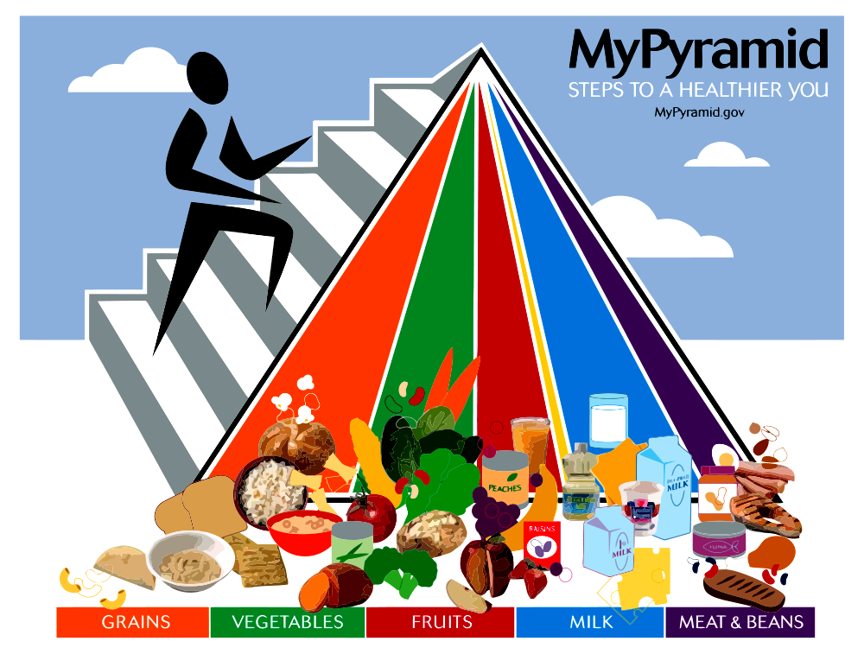

Slide 21
Nursing Diagnosis: Imbalanced Nutrition
Imbalanced Nutrition/ less than body weight
Related to: Refusal or inability to sit still long enough to eat, lack of interest in food, excessive physical agitation
Evidenced by: Refusal or inability to sit still long enough to eat, lack of interest in food, excessive physical agitation, loss of weight, pale conjunctiva and mucous membrane, Poor muscle tone, amenorrhea, poor skin turgor, anemia, electrolyte imbalance

Slide 22
Nursing Interventions: Imbalanced Nutrition
Monitor intake, out put, vital signs and weight daily. To ensure adequate fluid and caloric intake, minimize dehydration and cardiac collapse.
Provide high protein, high calorie foods and drinks that can be taken while the patient is moving around).
Provide with juice and snacks on regular basis.
Provide the patient with his favorite food if possible..
Provide with vitamins as order by psychiatrist

Slide 23
Nursing Interventions: Imbalanced Nutrition
Stay with the patient until the snack or meal is finished, and offer support and encouragement for it may decrease agitation during food intake.
Explain the importance of food and teach patient and family about amount and type of food that is important to
Monitor daily laboratory values & Assess lithium carbonate level, electrolytes

Slide 24
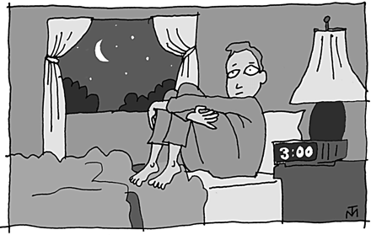

Slide 25
Nursing Diagnosis: Sleep Pattern Disturbance
Sleep pattern disturbance
Related to: Excessive hyperactivity and agitation
Evidenced by: Difficulty falling asleep and sleeping only short periods, pacing in the hall during sleep hours, Numerous periods of wakefulness during the night

Slide 26
Nursing Interventions: Sleep Disturbance
Provide a quiet environment, with low level of stimulation.
Monitor sleep pattern and provide a structured schedule of activities that includes established times for naps or rest
Observe for signs of fatigue such as increased restlessness, fine tremors, slurred speech and puffy dark circles under eyes to prevent from collapsing exhaustion.
Prohibit caffeine intake in drinks such as tea, coffee colas.
Administer sedatives as ordered

