Slide 1
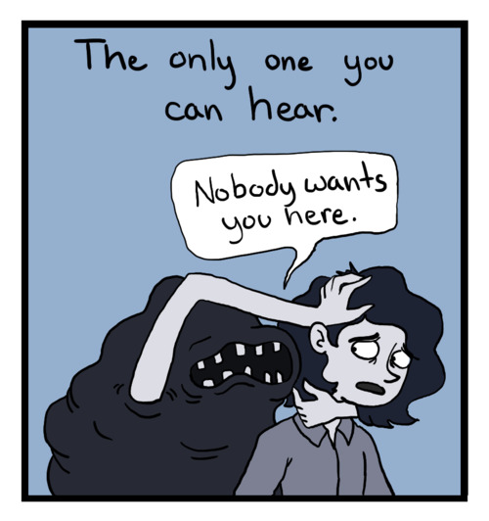
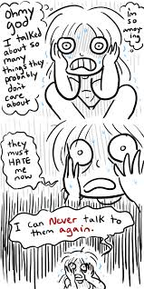
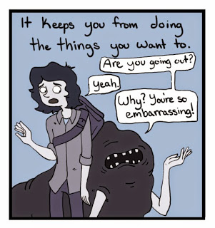
Depressive Disorders
DSM 5

Slide 2
Depressive disorders
At the end of this lecture the student will be able to:
Identify the psychiatric diagnostic criteria for the different depressive disorders according to the DSM 5 criteria
Differentiate between the different depressive disorders according to the DSM 5 criteria

Slide 3
Depressive disorders
Disruptive mood dysregulation disorder
Major depressive disorder
Persistent depressive disorder (dysthymia)
Premenstrual dysphoric disorder
Substance/ medication – induced depressive disorder
Depressive disorder due to another medical condition
Other specified depressive disorder
Recurrent brief depression
Short duration depressive episode
Depressive episode with insufficient symptoms

Slide 4
Depressive Disorders
What does depression mean?
Characterized by:
Presence of changes in the mood (sad, empty or irritable)
Accompanied by somatic and cognitive changes
These signs & symptoms significantly affects the person’s ability to function

Slide 5
Depressive disorders
The most prevalent psychiatric disorder
It affect 20-30% of the population
Does problems in our region increase the incidence of depression?
Affect men more than women
Varies in the severity of symptoms

Slide 6
Diagnostic Criteria of Major Depression
A. 5 or more of the following present in a 2 week period and represent a change from previous functioning
At least one of the symptoms is either
Depressed mood (e.g.; feels sad, empty, hopeless) or observed by others (e.g.; appears tearful).
Loss of interest or pleasure in all activities the person used to enjoy
Decrease or increase in weight (5%) in the last month (Loss of appetite or over eating)
Insomnia or hypersomnia
Fatigue and loss of energy (preoccupied with bodily symptoms)
Agitation or psychomotor retardation

Slide 7
Diagnostic Criteria of Major Depression
Feelings of hopelessness, helplessness, worthlessness associated with feelings of
Unrealistic, negative evaluation of one’s worth
Guilty preoccupation over minor past things or events
Misinterpret neutral or trivial every day events as evidence of personal defects
Exaggerated sense of responsibility towards general events
Negative thinking , Overreaction to criticism
Decreased ability to think or concentrate, Poor memory, Indecisiveness
Suicidal ideations

Slide 8
Diagnostic Criteria of Major Depression
Criteria B The symptoms cause impairment in social and occupational and daily functioning
Criteria C Exclude any physiological of substance or medical conditions
Criteria D Exclude any other psychotic or schizophrenia spectrum disorders
Criteria E Exclude any prior Mania or hypomania episode

Slide 9
Specifiers (Types) of Depression
Chronic (after 2 years)
Melancholic
Anhedonia, lack of reactivity to usual pleasurable stimuli, psychomotor retardation, anorexia or weight loss, guilt, depression worse in the AM
Atypical
Mood reactivity (mood brightens in response to positive events), weight gain, hypersomnia, increased appetite and weight gain, leaden paralysis (feelings of heaviness in the arms or legs)
Seasonal Affective Disorder
Episodes begin in fall or winter and remit in the spring
Pattern has occurred for 2 yrs

Slide 10
Specifiers (Types) of Depression
Psychotic features
Indicate the presence of delusions (guilt, being punished for sins), somatic (horrible disease or body rotting), poverty (going bankrupt,), or hallucinations (usually auditory, voices berating for sins or shortcomings).
Peripartum onset
Occurs 4 weeks after child birth. Can present with or without psychotic features. Severe ruminations or delusional thoughts about infant signifying increased risk of harm to the infant.

Slide 12
Persistent Depressive Disorders (Dysthymia)
A. Depressed mood indicated by either the subjective reporting of the client or observation by others, and for at least two years
B. Presence, while depressed, of 2 or more of the following
Poor appetite or overeating.
Insomnia or hypersomnia.
Law energy or fatigue.
Low self esteem.
Poor concentration or difficulty making decisions.
Feeling of hopelessness and despair

Slide 13
C. During the 2 year period the person never has been without the symptoms A or B for more than 2 months
D. Criteria for a major depressive disorder may be continuously present during the 2 years
E. There has never been a manic, hypomanic episodes, or cyclothymic disorders during the 2 years
F. Exclude any other psychiatric disorder

Slide 14
G. Exclude any physiological responses to substance use or medical conditions
H. The symptoms cause significant distress or impairment in social, occupational, or other important areas of functioning
Early onset before 21
Late onset after 21

Slide 16
Premenstrual Dysphoric Disorder
A. In the majority of menstrual cycles, at least five symptoms must be present during the final week before the onset of the menses and starts to improve within few days after the onset of menses, and become minimal or absent in the week postmenses

Slide 17
Premenstrual Dysphoric Disorder
B. At least one or more of the symptoms must be present:
Marked affective lability (mood swings; feeling suddenly sad or tearful, or increased sensitivity to rejection or criticism)
Marked anxiety, tension, feeling of being “keyed up” , on the edge.
Marked irritability, anger or increased interpersonal conflict.
Marked depressed mood, feelings of hopelessness and self –deprecating thoughts

Slide 18
Premenstrual Dysphoric Disorder
C. one or more of the following symptoms must additionally be present to reach a total of 5 symptoms when combined with symptoms from Criteria B:
Decreased interest in usual activities
Subjective sense of difficulty ion concentrating
Lethargy, easily fatigued, lack of energy
Marked change in appetite; overeating or food craving
Insomnia or hypersomnia
Subjective sense of being out of control
Physical symptoms: breast swelling, headache, joints pain, weight gain.

Slide 19
Premenstrual Dysphoric Disorder
D. Interference with work or social activities or relationships (avoidance of social activities, decrease in the efficiency and productivity at work)
E. Not exacerbation of depressive disorder, dysthymia, panic disorder or personality disorder
F. Criteria A must be confirmed by rating during at least 2 consecutive symptomatic cycles.
G. The symptoms are not attributed to the physiological effects of a substance (drug abuse or medication) or another medical condition (hypothyroidism)

Slide 20
