Slide 1
Causes of Depression

Slide 2
Causes of depressive disorders
Depressive disorders results from a combination or interaction of genes, environment, individual life history, development, and neuro-biologic makeup.
Definitive causes have not yet been discovered.

Slide 3
Genetic causes
Family studies found increased risk for depression in clients with first-degree relatives (parents, siblings, children) who have had depression (Kelsoe, 2005).
Twin studies show that the concordance rate of depression in monozygotic (identical) twins is 45% to 60%, whereas the concordance rate in dizygotic (non-identical) twins is 12% (Kelsoe, 2005).
The difference in concordance rates supports that genetic factors contribute in some way to the development of depression in certain clients
Adoption studies: children of parents with depression are at an increased risk of developing a mood disorder even when adopted & raised by healthy parents

Slide 4
Biogenic Amines
It has been hypothesized that depressive illness may be related to a deficiency of the neurotransmitters norepinepherine, serotonin, and dopamine at functionally important receptor sites in the brain.

Slide 5
BIOGENIC AMINES
The monoamines that have been implicated in depression are norepinephrine (NE), dopamine (DA), and serotonin (5-HT).
Disturbances in mood may result when absolute concentrations of NE, 5-HT, or both are deficient.
Altered numbers, affinities, or both of 5-HT and NE receptors and uptake sites may affect metabolism.

Slide 6
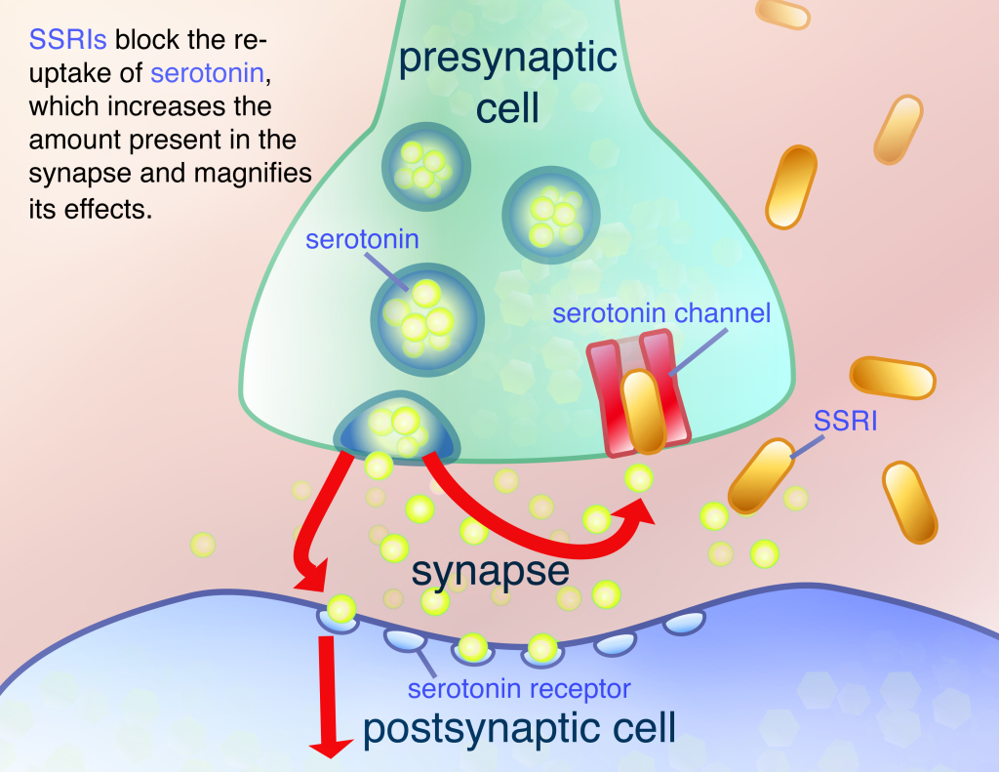

Slide 7
Functions of brain parts implicated in depression
Hippocampus: memory impairment, feelings of worthlessness, hopelessness & guilt
Amygdala: Anhedonia, anxiety, reduced motivation
Hypothalamus: increased or decreased sleep & appetite, decreased energy & libido
Other Limbic structures: emotional alteration
Frontal Cortex: depressed mood, problems concentration
Cerebellum: Psychomotor retardation / agitation

Slide 8
