Slide 1
Substance Abuse

Slide 3
What is Substance Abuse
“Is a chronic, relapsing brain disease that is characterized by compulsive drug seeking and use, despite harmful consequences”.
It is considered a brain disease because drugs change the brain—they change its structure and how it works.
These brain changes can be long-lasting, and can lead to the harmful behaviors seen in people who abuse drugs

Slide 4
What are the type of Substance Misuse/Abuse/Addiction

Slide 5
Commonly Misused Over-The-Counter (OTC) Drug
Aspirin
Nonsteroidal Anti-Inflammatory Drugs
Ibuprofen
Nasal sprays
Laxatives
Diet pills
Eye drops
Sleep aids
Cough syrup

Slide 6
DSM-5 Substance Abuse Disorders
Alcohol
Amphetamines
Cannabis (marijuana)
Cocaine
Hallucinogens
Inhalants
Nicotine
Opioids
Phencyclidine
Sedative-hypnotics
Anxiolytics
Caffeine

Slide 8
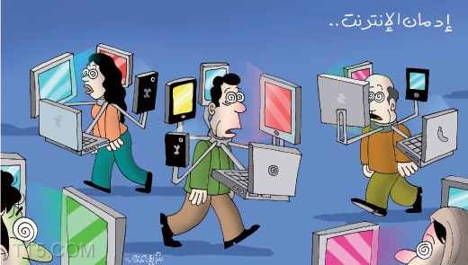
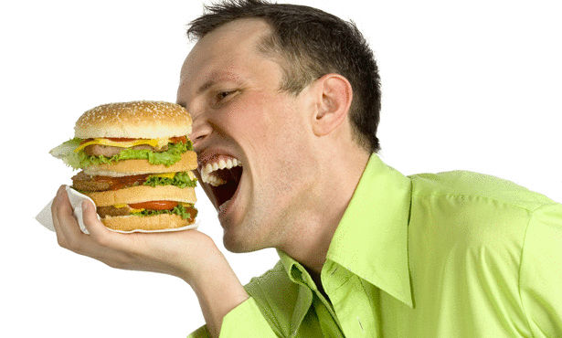
Other Addictions
Gambling
Computers
(technology)
Food (hamburgers –combination of salt sugar and fat)

Slide 9
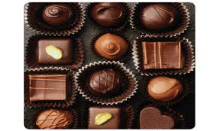
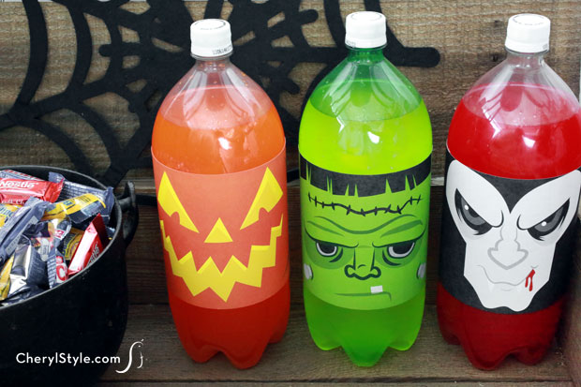
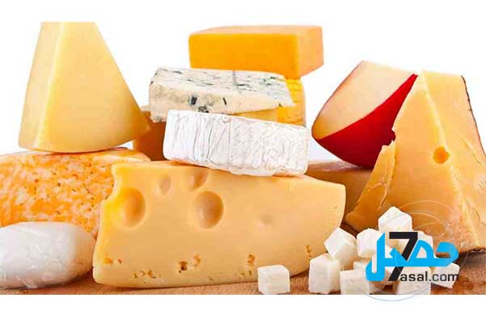
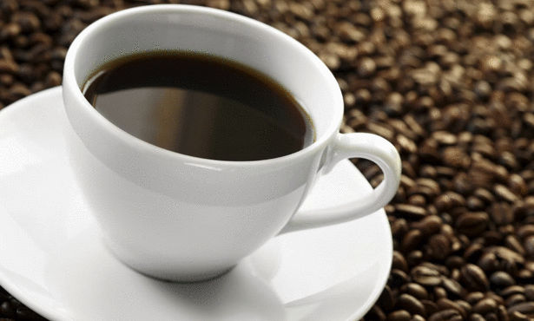
Chocolate
Sugar
Cheese
Coffee
Shopping

Slide 10
Myths About Drugs, Addiction, and Recovery
Deni Carise, Ph.D. Chief Clinical Officer, Phoenix House - See more at: http://www.phoenixhouse.org/news-and-views/our-perspectives/ten-popular-myths-drugs-addiction-recovery/#sthash.n3EoxnWM.dpuf

Slide 11
Myth #1
If it’s a prescription, it must be safe; you can’t get addicted to something your doctor prescribes.
Although many medications are perfectly safe if taken in the prescribed dosage for a short period of time, prolonged use can be dangerous—and, yes, addictive. Some prescription drugs are especially hazardous if the user exceeds the prescribed dosage or takes a combination of drugs.

Slide 12
Myth #2
“Natural” drugs are safer than synthetic ones.
Marijuana and other “natural” highs still alter brain chemistry and produce dangerous side effects.
They aren’t harmless just because they grow in the ground.

Slide 13
Myth #3
If you have a high alcohol tolerance, you don’t have a drinking problem.
If you feel nothing after several drinks, you DO have a problem. A casual drinker wouldn’t be able to finish a couple of six-packs—and if they did, they’d feel very sick. If you’re drinking this much and feeling fine, you need help.

Slide 14
Myth #4
If you have a stable job and family life, you’re not addicted.
You may still have a job or career, a loving spouse and kids, and still have a drug or alcohol problem. Just ask any physician in recovery—many of them practiced for years without anyone recognizing their drug addiction. Holding down a job doesn’t mean you’re not addicted—it could mean that you have a tolerant spouse or boss, or you are in a career that puts up with excessive drug or alcohol use.

Slide 15
Myth #5
Drug addiction is a choice.
Drug use is a choice, and prolonged use changes your body and brain chemistry. When that happens, the user no longer appears to have a choice—this is when use and misuse become addiction.

Slide 16
Myth #6
Detox is all you need. You aren’t addicted after you finish detox.
Detox is difficult and it’s just the beginning. The new “ultra rapid detox” programs can be dangerous and even deadly. Finally, detox is the first step towards recovery, but addiction is a chronic illness—like diabetes, asthma or hypertension, it needs to be managed throughout the lifespan. There is no cure

Slide 17
Myth #7
If someone in recovery uses drugs or alcohol again, they’ll be right back where they were when they first quit.
This can be a self-fulfilling prophecy. If you believe that one drink will throw you back to “square one,” then it will. However, it is entirely possible to relapse, realize your mistake, and get right back in recovery

Slide 18
Myth #8
You need to be religious in order to get sober.
Sobriety doesn’t require you to believe in God or subscribe to any organized religion. It helps, however, if you believe in humanity, family, community, and the good aspects of yourself—beliefs that are greater and stronger than your own daily life with drugs

Slide 19
Myth #9
Addicts are bad people.
Addicts aren’t “bad” people trying to get “good,” they’re sick people trying to get well. They don’t belong to a particular race or exist only in certain parts of the country. They are lawyers, farmers, soldiers, mothers and grandfathers who struggle with drug dependence on a daily basis. They are proof that addiction doesn’t discriminate—but, thankfully, neither does recovery.

Slide 20
Myth #10
It can’t hurt to try a drug just once.
Some health effects of substance abuse take time to develop. But others can appear the very first time of use. Fatal overdoses can occur to people who have never before used a substance. Even if the drug itself doesn’t harm you, it can affect your decision-making process and your common sense. You might do something you regret while under the influence.

Slide 21
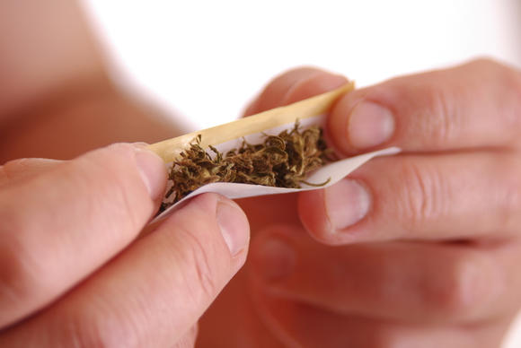
Myth #11
Marijuana is a safe drug, especially if you only use it occasionally.
Studies show real dangers linked to its use. When you start smoking at a young age, marijuana damages your cognitive and social development, and you stand about a 1 in 6 chance of becoming addicted. Plus, you risk many of the same problems as cigarette smokers, including bronchitis, asthma and emphysema.

Slide 22
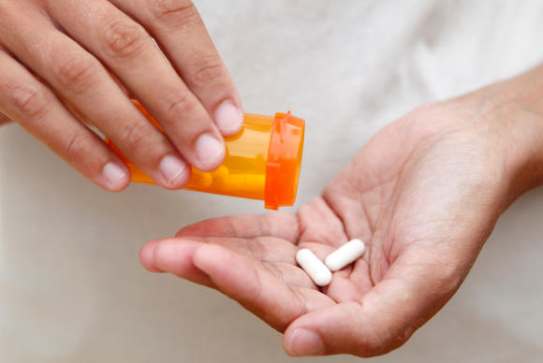
Myth #12
Stimulants can help you focus at school or work.
In reality, the initial rush of exhilaration and energy these drugs sometimes provide quickly turns into paranoia, hostility, panic, and the desire to harm yourself or others.

Slide 23
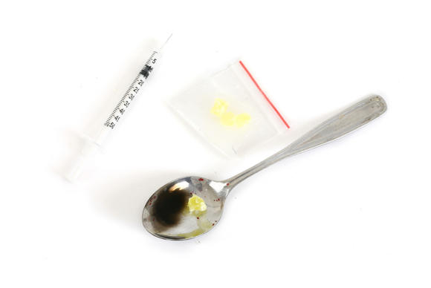
Myth #13
Only street drugs can harm your health or cause addiction.
More people die from overdosing on prescription painkillers than from cocaine and heroin combined.
Many prescription or over-the-counter drugs can be, and are, used in ways other than improving health. You can get hooked on cough syrup, anti-anxiety medications, stimulants, and others—and doing so poses serious risks to your health.

Slide 24
Myth #14
Substance abuse is a choice—or a character flaw.
A person makes the choice to use an addictive substance for the first time, or on occasion.
But over time, drugs change the brain in ways that transform substance use from a habit into a disease. Symptoms include changes in mood and memory, altered motor skills, and a shift in motivation so that the thing that matters most is getting the next fix.

Slide 25
Myth #15
Substance abusers don’t require treatment; they just need to try harder to quit.
Just as dependence isn’t a choice, quitting isn’t either.
Sheer willpower usually isn’t enough to get someone to quit using. The process involves more than just detoxification from the substance involved. After withdrawal, treatment can include counseling, group therapy, and medications.
Recovery is a process that can take time and several attempts to return to health and substance-free living.

Slide 26
Why do people take drugs?
To feel good
To feel better
To do better
Curiosity and "because others are doing it.“

Slide 27
What factors increase risk of addiction?

Slide 28
Risk and Protective Factors for Drug Abuse and Addiction
Addiction
Risk Factors | Protective Factors
Aggressive behavior in childhood | Good self-control
Lack of parental supervision | Parental monitoring and support
Poor social skills | Positive relationships
Drug experimentation | Academic Competence
Availability of drugs at school | School anti-drug policies
Community poverty | Neighborhood pride

