Slide 1
Generation of Biochemical Energy
Dr. Mamoun Ahram
Biochemistry for Nursing
Summer 2015

Slide 2
Part (1): Notes on energy

Slide 3
How do we get energy?
We generate energy from the oxidation of biomolecules made mainly of carbon, hydrogen, and oxygen.
The end products are carbon dioxide, water, and energy:

Slide 4
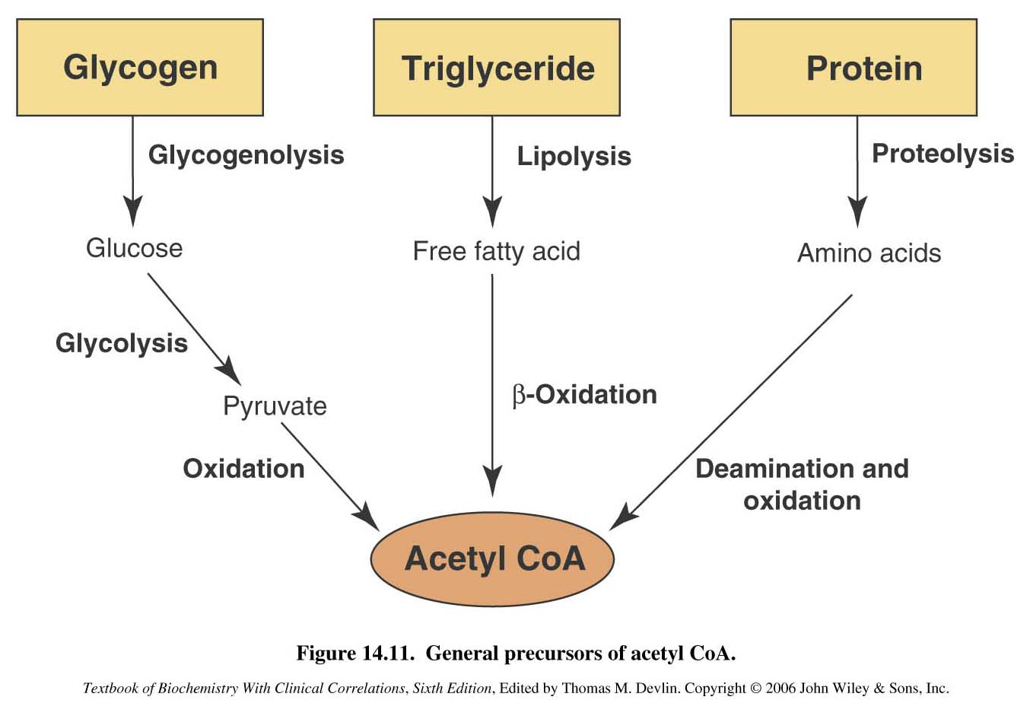
Acetyl Coenzyme A (acetyl CoA)
The principal food molecules lipids, proteins, and carbohydrates are broken down by separate pathways into a common end-product called acetyl coenzyme A.

Slide 5
Energy-producing pathways
Acetyl CoA enters the central, final pathways to yield usable energy.

Slide 6
Energy and Life

Slide 7
Energy: from start to end
Energy can be converted from one form to another but can be neither created nor destroyed.
Chemical energy is stored in chemical bonds

Slide 8
Conditions related to energy
Energy must be released from food gradually.
Energy must be stored in accessible forms (fast and easy).
Release of energy from storage must be controlled so that it is available exactly when and where it is needed.
Just enough energy must be released as heat to maintain constant body temperature.
Energy in a form other than heat must be available to drive chemical reactions that are not favorable.

Slide 9
Energy and Biochemical Reactions

Slide 10
Types of energy
There are two forms of energy
potential - capacity to do work (stored)
kinetic - energy of motion
Potential energy is more important in the study of biological or chemical systems.

Slide 11
Free energy (G)
All molecules have potential energy within them.
Molecules have their own potential energy stored in the bonds connecting atoms in molecules.
This is known as free energy or G
IN biochemistry. free energy indicates the energy of a chemical that is available for useful work

Slide 12
ΔG
In any given reaction (reactants → products), the difference between the free energy values between reactants and products (free-energy change ΔG) is defined by
ΔG = G_{products} – G_{reactants}

Slide 13
What does it mean? ΔG = G_{products} – G_{reactants}
If ΔG is negative (G_{products} is less than G_{reactants}), energy is not needed to drive the reaction but released, making the reaction spontaneous (the reaction is called exergonic).
If ΔG is positive (G_{products} is more than G_{reactants} ), energy is needed, making the reaction not spontaneous (the reaction is called endergonic).
If ΔG is zero, both forward and reverse reactions occur at equal rates; the reaction is at equilibrium.

Slide 14
Favorable vs. unfavorable reactions
d
d
The larger the positive free-energy change, the greater the amount of energy that must be added to convert the reactants to products.

Slide 15
How do enzymes accelerate reactions?
Enzymes accelerate how quickly this equilibrium is reached.
Enzymes lower the activation energy.

Slide 16
ΔG values and signs
The free-energy change switches sign for the reverse of a reaction, but the value does not change.
Energy is stored in the products of an overall endergonic reaction pathway. This stored energy is released as needed in an overall exergonic reaction pathway that regenerates the original reactants.

Slide 17
Cells and Their Structure

Slide 18
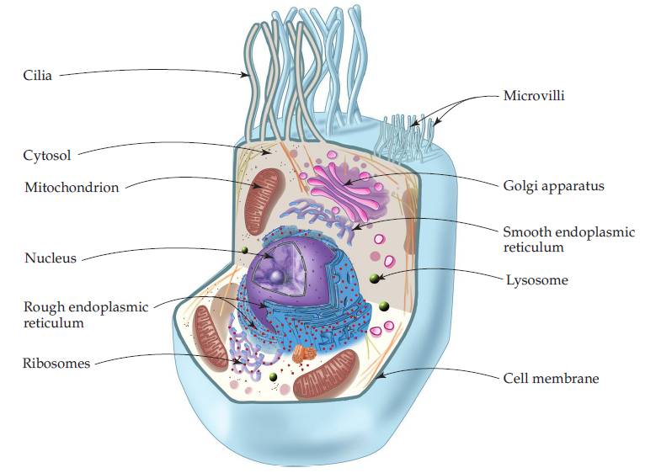
Organelles inside cells
Eukaryotic cells are made of organelles (small, functional units that perform specialized tasks)
The organelles are surrounded by the fluid part of the cytoplasm, the cytosol, which contains electrolytes, nutrients, and many enzymes, all in aqueous solution.

Slide 19
The mitochondria
The mitochondria (one is mitochondrion) responsible for energy production.
It produces 90% of ATP.
The number of mitochondria is greatest in eye, brain, heart, and muscle cells, where the need for energy is greatest.

Slide 20
Structure of mitochondrion
A mitochondrion is composed of a smooth outer membrane and a folded inner membrane
The space enclosed by the inner membrane is the mitochondrial matrix.

Slide 21
Metabolic pathways
Catabolism
Anabolism
Metabolic reaction pathways that break down food molecules and release biochemical energy.
Metabolic reactions that build larger biological molecules from smaller pieces.

Slide 22
How do metabolic pathways look like?
Metabolism: All chemical reactions that occur in an organism.
Such pathways may be:
linear (that is, the product of one reaction serves as the starting material for the next);
cyclic (a series of reactions regenerates one of the first reactants)
spiral (the same set of enzymes progressively builds up or breaks down a molecule)

Slide 23
Catabolic pathways

Slide 24
Strategies of Metabolism

Slide 25
Structure of adenosine triphosphate

Slide 26
Hydrolysis of ATP
Removal of one of the phosphate groups groups from ATP by hydrolysis gives adenosine diphosphate (ADP).
Note that the ATP → ADP reaction is exergonic (it releases chemical energy that is stored in the bonds)

Slide 27
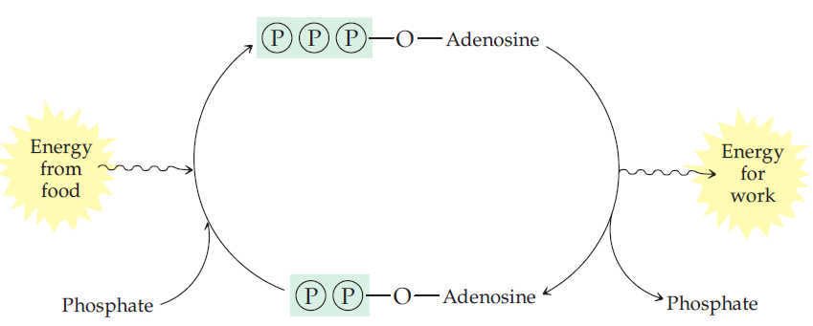
Strategy 1: ATP and Energy Transfer
Biochemical energy is gathered from exergonic reactions that produce ATP.
The ATP goes to where energy is needed inside the cell, and ATP hydrolysis releases the energy for whatever energy-requiring work.

Slide 28
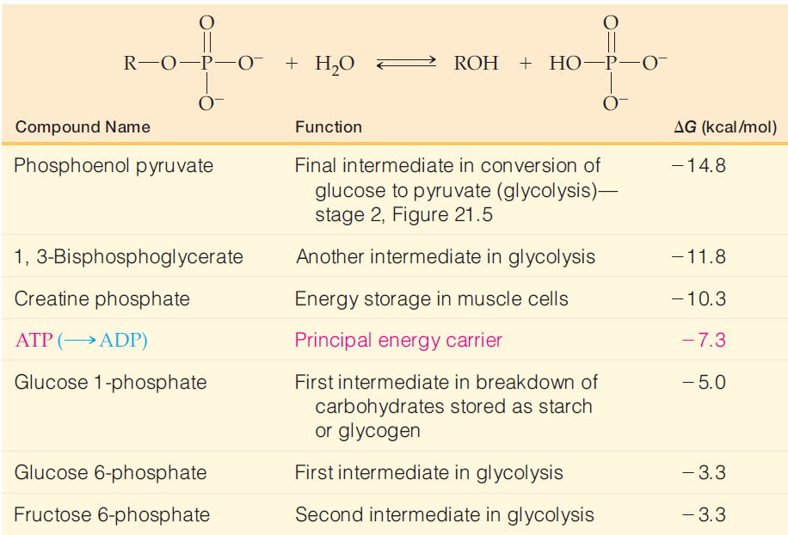
Why is ATP a favorable energy carrier?
One: its synthesis and hydrolysis is slow and enzymatically catalyzed (under regulation)
Two: it has intermediate value of the free energy of hydrolysis relative to other high-energy compounds

Slide 29
Strategy 2: coupling reactions
Energy stored in one chemical compound is transferred to other compounds. How?
Couple an energetically unfavorable reaction to with an energetically favorable reaction so that the overall energy change for the two reactions is favorable.
Note: the phosphoryl group is transferred directly from ATP to glucose without the intermediate formation of HPO₃⁻

Slide 30
Synthesis of ATP from ADP
Coupled reactions are written like this:

Slide 31
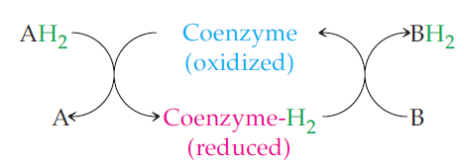
Strategy 3: use of oxidized and reduced coenzymes
Many metabolic reactions are therefore oxidation reduction reactions, which means that a steady supply of oxidizing and reducing agents must be available.
To deal with this requirement, a few coenzymes cycle continuously between their oxidized and reduced forms

Slide 32
Examples of coenzymes

Slide 33
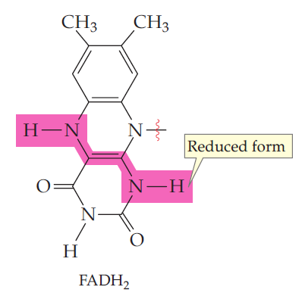
Oxidation-reduction of NAD⁺ and FAD
Phosphate of NADP⁺

Slide 34
Last notes on coenzymes
The reduced coenzymes, NADH and FADH₂ pick up electrons (in their bonds to hydrogen). These electrons are passed along in subsequent reactions, they are referred to as electron carriers.
In their reduced forms, they also carry energy along from reaction to reaction.
Ultimately, this energy is passed on to the bonds in ATP.

Slide 35
Part (1): Citric acid cycle

Slide 36
Acetyl-CoA is a central molecule of metabolism

Slide 37
Acetyl-CoA has energy in its bonds
The bond between the acetyl group and the Coenzyme A group carries energy.
Hydrolysis of he acetyl groups in acetyl-SCoA molecules is an energy-releasing reaction.

Slide 38
Citric acid cycle
Also known as Krebs cycle or tricarboxylic acid cycle
It describes the oxidation of the 2 carbons of acetyl-CoA to give and transfer of energy to reduced coenzymes.
It is a cycle because the product of the final step, oxaloacetate is the reactant in the first step.

Slide 39
Summary of the cycle
The 2 carbon atoms of the acetyl group add to the 4 carbon atoms of oxaloacetate in Step 1
2 carbon atoms are set free as carbon dioxide in Steps 3 and 4.
Coenzymes are produced in four stages (3, 4, 6, and 8)
One energy carrier (GTP) is produced in stage 5
Oxaloacetate is regenerated in stage 8.

Slide 40
Where does it happen?
The cycle takes place in mitochondria, where seven of the enzymes are dissolved in the matrix and one (for Step 6) is embedded in the inner mitochondrial membrane.

Slide 41
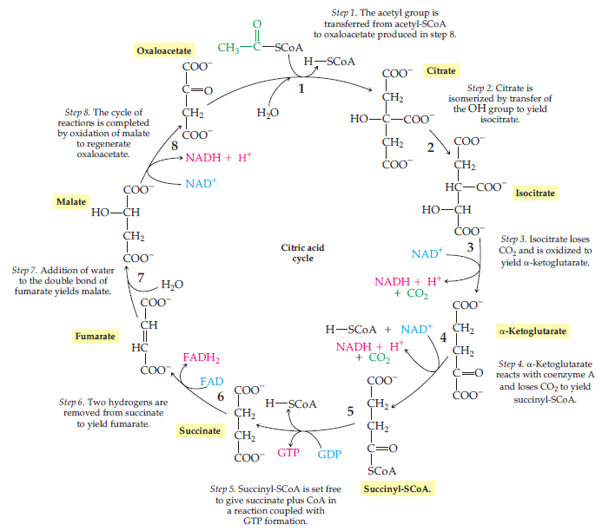

Slide 42
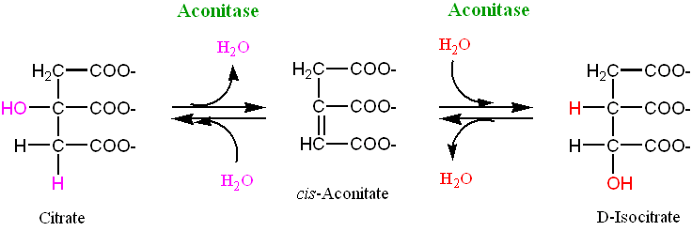
Steps 1 and 2
Acetyl groups enter the cycle at Step 1 by addition to 4-carbon oxaloacetate to give citrate, a 6-carbon intermediate.
Citrate is a tertiary alcohol and cannot be oxidized; it is converted in Step 2 to its isomer, isocitrate, a secondary alcohol that can be oxidized to a ketone in Step 3.

Slide 43
Steps 3 and 4
Both steps are redox reactions with production of NADH+ and CO₂.
Step 3: The group of isocitrate is simultaneously oxidized to a keto group.
Step 4: succinyl group is added to coenzyme A.

Slide 44
Step 5
The exergonic conversion of succinyl-SCoA to succinate is coupled with phosphorylation of (GDP) to give (GTP).
GTP is an energy carrier like ATP.
GTP can be converted to ATP
Step 5 is the only step in the cycle that generates an energy-rich triphosphate.

Slide 45
STEP 6
Succinate is oxidized to give fumarate.
The enzyme for this reaction, succinate dehydrogenase, is part of the inner mitochondrial membrane.
The reaction requires the coenzyme FAD, which is covalently bound to its enzyme.

Slide 46
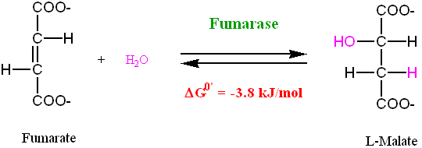
Steps 7 and 8
Regeneration of oxaloacetate.
Fumarate is converted to malate, which is a secondary alcohol, that is oxidized to produce oxaloacetate.

Slide 47
Overall reaction
Acetyl-CoA + 2H₂O + 3NAD⁺ + FAD + GDP + P_{i}
2 CO₂ + 3 NADH + FADH₂ + CoASH + GTP + 2H ⁺
Production of four reduced coenzyme molecules (3 NADH + FADH₂)
Conversion of an acetyl group to two molecules of CO₂
Production of one energy-rich molecule (GTP, converted immediately to ATP)

Slide 48
Regulation of citric acid cycle
Isocitrate dehydrogenase is activated allosterically by high rate of ADP and allosterically inhibited by high rate of NADH.
α-Ketoglutarate dehydrogenase is inhibited by high levels of ATP and its products (succinyl-CoA and NADH)

Slide 49
Part(3): The Electron-Transport Chain

Slide 50
Electron-transport chain

Slide 51
At the conclusion of the citric acid cycle, the reduced coenzymes formed in the cycle are ready to donate their energy to making additional ATP.
How is it done?

Slide 52
Electron-transport chain respiratory chain reaction
Electrons move from one electron carrier to the next.
Each carrier becomes reduced when it gains an electron and then oxidized when it loses the electron.
Each reaction is favorable; that is, it is exergonic, and energy is stored.
This sequence of reactions is known as the electron-transport chain
It is coupled to another process known as respiratory chain reaction that utilizes the stored energy to generate ATP.

Slide 53
The reactions are sequential and exergonic

Slide 54
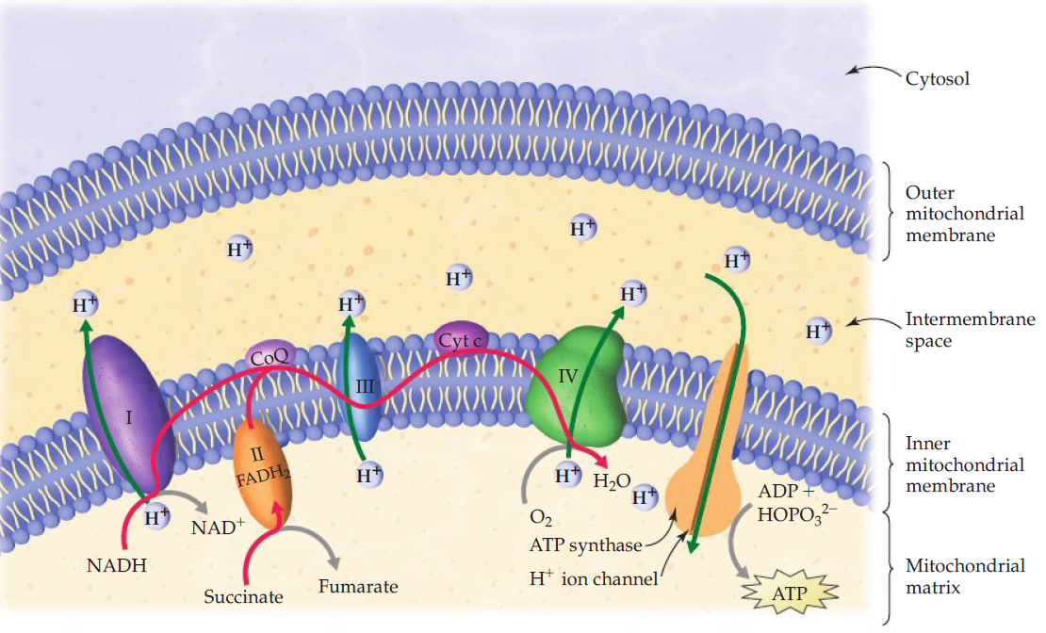
Where does it take place?
The enzymes and coenzymes of the chain and ATP synthesis are embedded in the inner membrane of the mitochondrion.

Slide 55
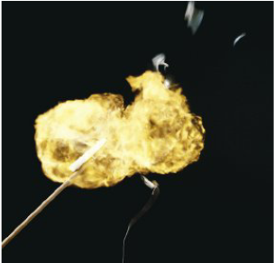
Final reaction
In the last step of the chain, the electrons combine with the oxygen and with hydrogen ions from their surroundings to produce water:
The reaction is explosive in nature, but it is not in biological system. Why?

Slide 56
How is energy made?
As electrons are transferred, the released energy is used to move hydrogen ions out of the mitochondrial matrix and into the intermembrane space.
The result is a higher concentration in the intermembrane space.
This energy is recaptured for use in ATP synthesis by moving hydrogen ions back into the matrix.

Slide 57
Electron transport
Electron transport proceeds in
four enzyme complexes located within the inner membrane of mitochondria and
two electron carriers that move from one complex to another.
The four fixed complexes are very large and assembled on polypeptides and electron acceptors.

Slide 58
The electron acceptors
Various cytochromes
proteins that contain heme groups in which the iron cycles between and Fe⁺² and Fe⁺³
Proteins with iron sulfur groups
The iron also cycles between Fe⁺² and Fe⁺³
Coenzyme Q (CoQ) – also known as ubiquinone
It has a ring structure with the two ketone groups known as quinone

Slide 59
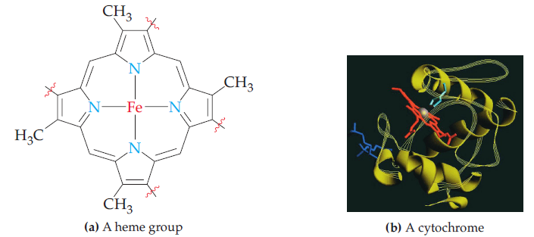
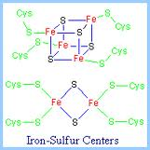

Slide 60
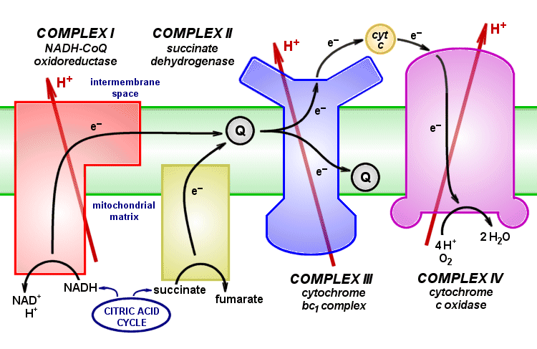
The steps of electron transport
Electrons from NADH enter the chain at enzyme complex I.
Electrons from FADH₂ enter the chain at enzyme complex II.
The enzyme for Step 6 of the citric acid cycle is part of complex II, so when FADH₂ is produced, it does not leave complex II and enter the chain immediately.
Electrons are passed from weaker to increasingly stronger oxidizing agents, with energy released at each transfer.
Electrons are carried between the complexes by two electron carriers: coenzyme Q and cytochrome c.

Slide 61
Gradient of hydrogen ions
Hydrogen ions are transported across the inner membrane from the matrix to the intermembrane space at complexes I, III, and IV.
The concentration difference creates a potential energy difference across the two sides of the inner membrane (like the energy difference between water at the top and bottom of the waterfall).

Slide 62
Oxidative phosphorylation
The reactions of the electron-transport chain are tightly coupled to oxidative phosphorylation
The conversion of ADP to ATP by a reaction that is both an oxidation and a phosphorylation.
How is this done?

Slide 63
ATP synthase
Hydrogen ions can return to the matrix only by passing through a channel that is part of the ATP synthase enzyme complex.
When they are transported back, they release the potential energy they gained as they were moved against the concentration gradient at the enzyme.

Slide 64
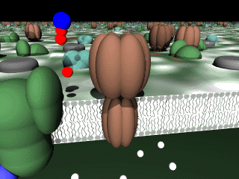
Synthesis of ATP
The energy they release drives the phosphorylation of ADP by reaction with hydrogen phosphate ion:
As hydrogen ions flow through the complex, ATP is produced and released back into the matrix.
The reaction is facilitated by changes in the shape of the enzyme complex that are induced by the flow of hydrogen ions.

Slide 65
How much ATP energy is produced?
The electrons from NADH molecules enter the electron-transport chain at complex I, while those from FADH₂ enter at complex II.
These different entry points into the electron-transport chain result in different yields of ATP molecules.
Each NADH molecule → 2.5 molecules of ATP.
Make it 3 to simplify.
Each molecule of FADH₂ → 1.5 molecules of ATP.
Make it 2 to simplify.

Slide 66
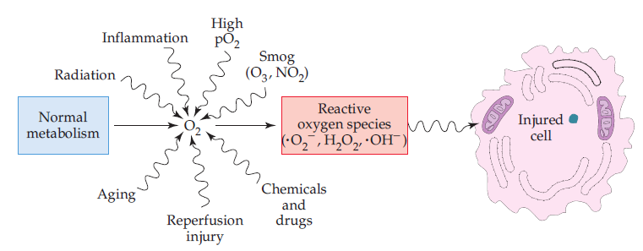
Harmful Oxygen By-Products
In addition to water, the product of electron transport chain may be highly reactive species.
free radicals (hydroxyl (HO•) and superoxide (•O₂⁻)) and hydrogen peroxide (H₂O₂)
How are they produced?

Slide 67
Causes of reactive species
The reactivity of the superoxide free radical is beneficial in destroying infectious microorganisms.
They can break covalent bonds in enzymes and other proteins, DNA, and the lipids in cell membranes.
Among the possible outcomes of such destruction are cancer, liver damage, rheumatoid arthritis, heart disease, and immune system damage.

Slide 68
How are they removed?
Our protection against them is provided by:
Superoxide dismutase
Catalase
The antioxidant vitamins E, C, and A (or β-carotene)
Vitamin C is water-soluble, it is a free-radical scavenger in the blood.

Slide 69
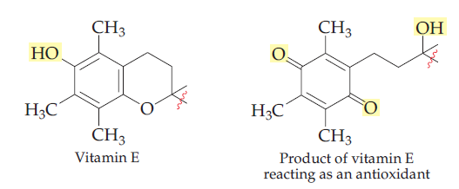
Vitamin E
Vitamin E protects cell membranes from potential damage
When a cell membrane lipid (RH) is converted to an oxygen-containing free radical (ROO.), vitamin E gives up electrons and hydrogen atoms to convert the lipid free radical to ROOH, a peroxide that is then enzymatically converted to ROH.

