Slide 1
Metabolism of carbohydrates
Dr. Mamoun Ahram
Biochemistry for Nursing
Summer 2015

Slide 2
What is digestion?
It is the breakdown of food into small molecules.
Digestion includes the physical grinding, softening, and mixing of food, as well as the enzyme-catalyzed hydrolysis of carbohydrates, proteins, and fats.
Digestion begins in the mouth, continues in the stomach, and concludes in the small intestine.

Slide 3
Fate of small molecules
The small molecule products of digestion are absorbed from the intestinal tract into the bloodstream.
In the bloodstream, the small molecules are:
transported into target cells where many are converted to carbon dioxide for the purpose of releasing energy
are excreted, and
some are used as building blocks to synthesize new biomolecules.

Slide 4
Interstitial villi
The absorption happens through the villi

Slide 5
Lacteal (lymphatic vessel)

Slide 6
The digestion of carbohydrates
Mouth: α-Amylase in saliva catalyzes hydrolysis of the α-glycosidic bonds in the carbohydrates (glycogen and amylose and amylopectin of starch)
Small intestines: Pancreatic α-amylase converts polysaccharides to disaccharides, which are hydrolyzed by other enzymes to monosaccharides
Monosaccharides are then transported across the intestinal wall into the bloodstream.

Slide 7
Glucose Metabolism: An Overview

Slide 8
Importance of glucose-6-phosphate
When glucose enters a cell from the bloodstream, it is immediately converted to glucose 6-phosphate.
Glucose is trapped within the cell because phosphorylated molecules cannot cross the cell membrane.
The formation of glucose-6-phosphate is highly exergonic and not reversible, thereby committing the initial substrate to subsequent reactions.

Slide 9
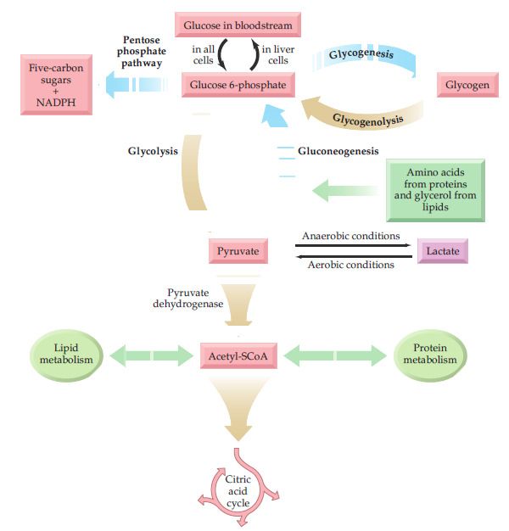

Slide 10
Metabolic pathways of glucose

Slide 11
Glycolysis

Slide 12
Where is it located in relation to other metabolic pathways?
Glycolysis is a series of 10 enzyme-catalyzed reactions that breaks down each glucose molecule into two pyruvate molecules, and in the process yields two ATPs and two NADHs.

Slide 13
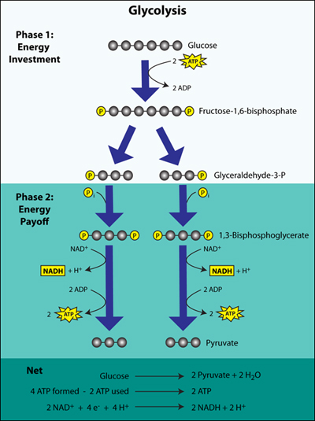

Slide 14
Where does it occur?

Slide 15
Glycolysis: the Energy investment steps

Slide 16
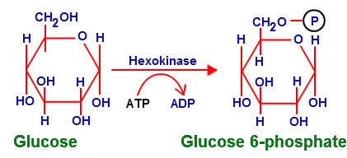
Step 1: phosphorylation
Glucose is phosphorylated bty hexokinase, which requires an energy investment from ATP.
A highly exergonic and irreversible step.
Glucose 6-phosphate is an allosteric inhibitor for hexokinase.

Slide 17
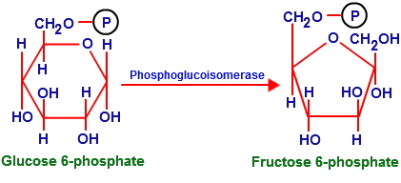
Step 2: isomerization
The enzyme (glucose 6-phosphate isomerase) acts by converting glucose 6-phosphate (an aldohexose) to fructose 6-phosphate (a ketohexose).

Slide 18
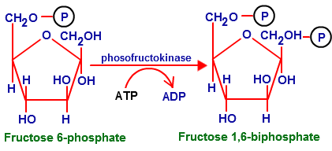
Step 3: phosphorylation
A second energy investment as fructose 6-phosphate is converted to fructose 1,6-bisphosphate by reaction with ATP in another exergonic reaction.

Slide 19
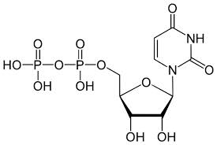
Bis- versus di
(Bis- means two that is, fructose with two phosphate groups. The bis prefix is used to distinguish between a molecule containing two phosphate groups in different locations and a diphosphate a compound that contains a single diphosphate
Bisphosphate
Diphosphate

Slide 20
Regulation
When the cell is short of energy, ADP and AMP (adenosine monophosphate) concentrations build up and activate phosphofructokinase.
When energy is in good supply, ATP and citrate build up and allosterically inhibit the enzyme.

Slide 21
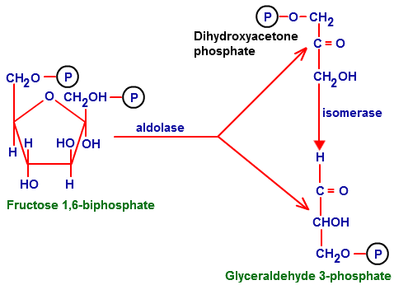
Steps 4 and 5: Cleavage and Isomerization
Aldolase catalyzes the breakage of the bond between carbons 3 and 4 in fructose 1,6-bisphosphate
A (C=O) group is formed.
The two 3-carbon sugar phosphates are isomers that are interconvertible by triose phosphate isomerase.
Only glyceraldehyde 3-phosphate can continue on the glycolysis pathway

Slide 22
Glycolysis: the Energy Generation steps

Slide 23
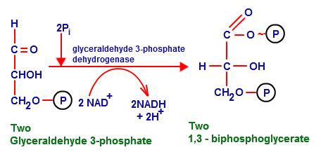
Step 6
The oxidation of glyceraldehyde 3-phosphate to 1,3-bisphosphoglycerate by glyceraldehyde 3-phosphate dehydrogenase.
The enzyme cofactor is the NAD⁺.
Some of the energy from the exergonic oxidation is captured in NADH, and some is directed to forming the phosphate.

Slide 24
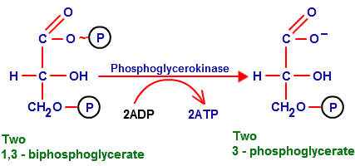
Step 7
The enzyme phosphoglycerate kinase catalyzes the first ATP of glycolysis by transferring a phosphate group from 1,3-bisphosphoglycerate to ADP

Slide 25
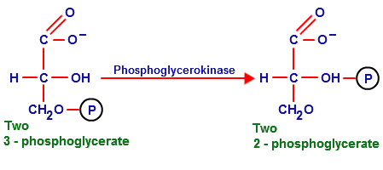
Step 8
Isomerization of 3-phosphoglycerate to 2-phosphoglycerate is catalyzed by phosphoglycerate mutase.
Phosphoglyceate mutase

Slide 26
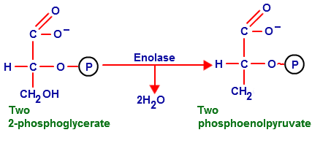
Step 9
Dehydration of 2-phosphoglycerate by enolase generate phosphoenolpyruvate,
This is the second energy-providing phosphate of glycolysis.

Slide 27
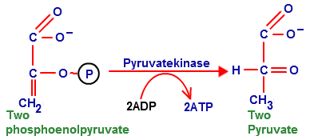
Step 10
a highly exergonic, irreversible transfer of a phosphate group to ADP catalyzed by pyruvate kinase.
The production of ATP by transfer of a phosphate group to ADP from another molecule is called substrate level phosphorylation.

Slide 28
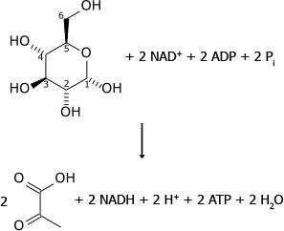
Net result of glycolysis
Conversion of glucose to two pyruvates
Production of two ATPs
Production of two molecules of reduced coenzyme NADH from NAD+

Slide 29
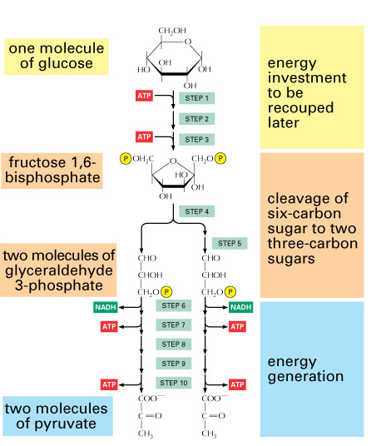

Slide 30
Entry of other sugars

Slide 31
Entry of other sugars
Lactose
A defect in this pathway causes galactosemia
Hexokinase
Hexokinase
Sucrose
Hexokinase
In muscles
In liver

Slide 32
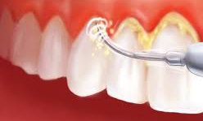
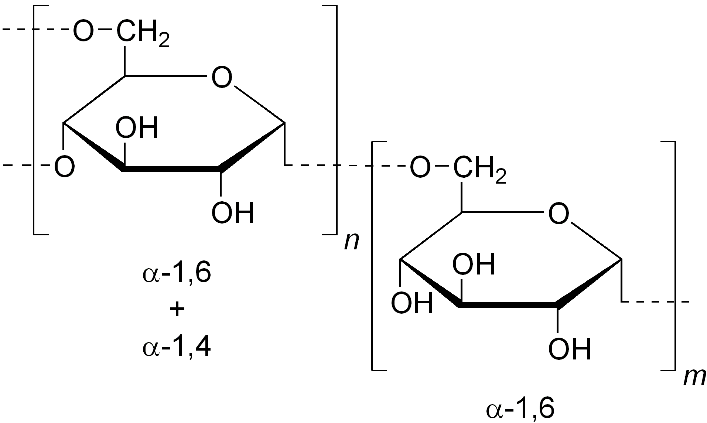
Dental plaque
Dental plaque is bacterial aggregations on the teeth that cannot be removed by the strong water spray.
The bacterial mass (known as biofilm), their sticky matrix, and the glycoprotein film together comprise dental plaque.
Bacteria secrete a sticky matrix of an insoluble polysaccharide known as dextran, which allows the bacteria to stick firmly to the teeth
Dextran is a branched polymer of the glucose that is produced by hydrolysis of sucrose from food.

Slide 33
Causes of tooth cavities and decay
A sucrose-high diet favors the growth of bacteria that has an enzyme (a glucosyltransferase), which transfers glucose units from sucrose to the dextran polymer.
The bacteria in plaque metabolizes fructose from the sucrose to lactate, and this acid causes a drop in pH that dissolves the minerals in the teeth.
Cleaning teeth favors the growth of other bacteria that can also cause tooth decay.
The third factor the composition of saliva, the shape of the teeth, and exposure to fluoride.

Slide 34
Fates of pyruvate
When O₂ level is low
When O₂ level is high

Slide 35
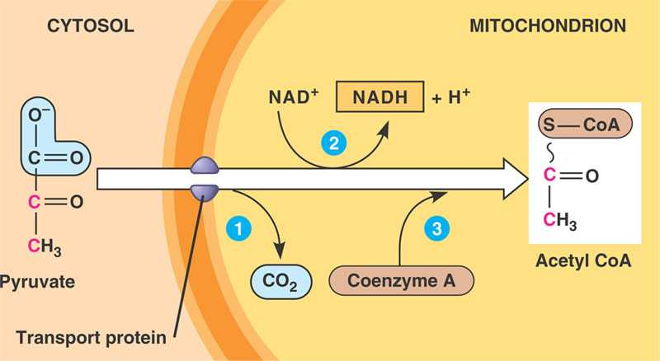
Aerobic Oxidation of Pyruvate to Acetyl-CoA
Pyruvate diffuses across the outer mitochondrial membrane from the cytosol.
Then, it is carried by a transporter protein across the inner mitochondrial membrane into the mitochondrial matrix.
Pyruvate dehydrogenase complex converts pyruvate into acetyl CoA
Pyruvate dehydrogenase complex

Slide 36
Complete oxidation of glucose
(a) glycolysis
(b) conversion of pyruvate to acetyl-SCoA
(c) conversion of two acetyl groups to four molecules of CO₂ in the citric acid cycle
(d) the passage of reduced coenzymes from each of these pathways through electron transport and
the production of ATP by oxidative phosphorylation.

Slide 37
Number of ATP molecules produced
Theoretical:
1 NADH = 3 ATP molecules
1 FADH2 = 2 ATP molecules
Then,
ATP molecules = 4 + (10 x 3) + (2 x 2)
= 4 + 30 + 4
= 38 per one glucose molecule

Slide 38
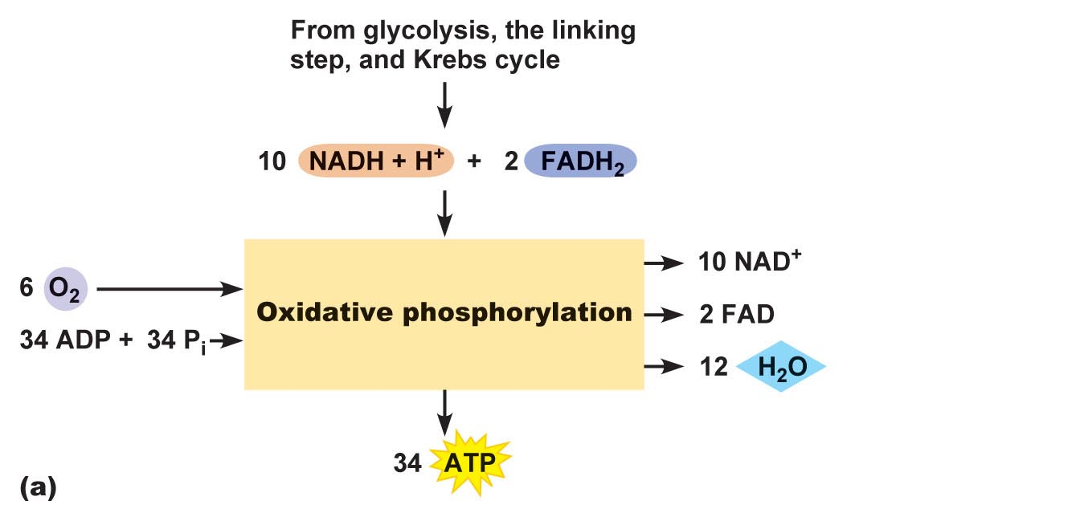
When does happen when O₂ is in short supply?
If electron transport slows down because of insufficient oxygen, NADH concentration increases, decreasing the supply of NAD⁺, and glycolysis cannot continue.
Glycolysis must continue because it is the only source of ATP
NADH must therefore be reoxidized.

Slide 39
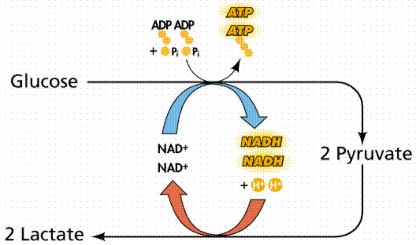
Anaerobic Reduction to Lactate
When lactate is reduced to pyruvate, NADH serves as the reducing agent and is reoxidized to NAD⁺, which is then available in the cytosol for glycolysis to continue.

Slide 40
Tissue and cells that perform anaerobic metabolism of glucose
Red blood cells have no mitochondria and therefore always form lactate as the end product of glycolysis.
Tissues where oxygen is in short supply like the cornea of the eye, where there is little blood circulation, and muscles during intense activity.

Slide 41
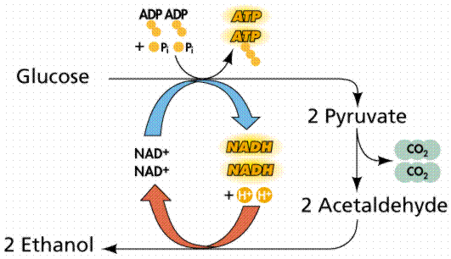
Alcoholic fermentation
When pyruvate undergoes fermentation by yeast, it is converted into ethanol plus carbon dioxide.

Slide 42
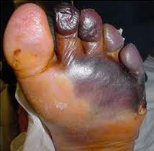
Gas gangrene
Gas gangrene is a condition that causes the death of living tissue and can cause the death of the infected person.
The bacteria invade the body through a wound and produce organic acids and CO2.
CO2 maintains an anaerobic environment and causes necrosis (tissue death).
The presence of the organic acids and toxins secreted by the bacteria leads to the spread of gangrene.
Treatment usually involves surgical removal of necrotic tissue and sometimes hyperbaric (at a pressure above atmospheric pressure) oxygen treatment.

Slide 43
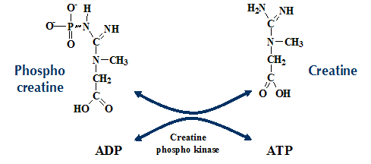
Metabolism during marathon races
The first source of energy is ATP, but it is consumed within seconds.
Additional ATP is then provided by the reaction of ADP with creatine phosphate, which is consumed within seconds.
Anaerobic metabolism of glucose to lactate starts.
Aerobic pathway is activated and ATP generated by oxidative phosphorylation.

Slide 44
Glycogen Metabolism: Glycogenesis and Glycogenolysis

Slide 45
Where is glycogen in our body?
All cells contain glycogen, but most is stored in liver cells (about 90 g in a 70 kg man) and muscle cells (about 350 g in a 70 kg man).
Glycogen synthesis, known as glycogenesis, occurs when glucose concentrations are high.

Slide 46
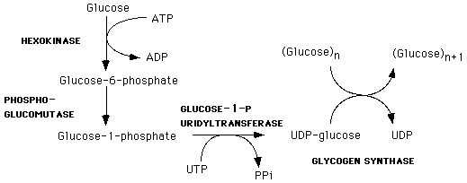
Glycogenesis
Glucose 6-phosphate is isomerized to glucose 1-phosphate by phosphoglucomutase.
UDP-glucose uridyltransferse attaches uridine diphosphate (UDP) to glucose residue forming Glucose-UDP.
Glucose-UDP is transferred to a glycogen chain in an exergonic reaction catalyzed by glycogen synthase.

Slide 47
Glycogenolysis
Glycogenolysis occurs in two steps:
One: formation of glucose 1-phosphate by glycogen phosphorylase on a terminal glucose residue in glycogen.
Two: glucose 1-phosphate is converted to glucose 6-phosphate by phosphoglucomutase.

Slide 48
Liver versus muscle
In muscle cells, glycogenolysis occurs when there is an immediate need for energy. The glucose 6-phosphate produced from glycogen goes directly into glycolysis.
In the liver, glycogenolysis occurs when blood glucose is low and gluconeogenesis is activated to release glucose after dephosphorylation of glucose-6-phosphate by a phosphatase.

Slide 49
Gluconeogenesis: Glucose from Noncarbohydrates

Slide 50
Gluconeogenesis
Gluconeogenesis, which occurs mainly in the liver, is the pathway for making glucose from noncarbohydrate molecules.
This pathway becomes critical during fasting and the early stages of starvation.
Failure of gluconeogenesis is usually fatal.

Slide 51
Synthesis and breakdown are not accomplished
by exactly reverse pathways.

Slide 52
Sources
Lactate
Lactate dehydrogenase
Amino acids
Transaminase reactions
Glycerol
From dihydroxyacetone phosphate

Slide 53
Reactions
Remember: for metabolic pathways to be favorable, they must be exergonic.
There are three exergonic reactions in glycolysis:
Glucose to glucose-6-phosphate
Fructose-6-phosphate to fructose-1,6-bisphosphate
Phospoenolpyruvate to pyruvate
Their reverse reactions will be very endergonic and, thus, cannot happen in cells

Slide 54
How do they become reversible?

Slide 55
Pyruvate → phosphoenolpyruvate
Pyruvate is transported from the cytosol into the mitochondria or is produced there from amino acids
pyruvate is converted to Oxaloacetate by pyruvate carboxylase
Oxaloacetate is reduced to malate and transported out of the mitochondrion into the cytosol where malate is immediately reconverted to oxaloacetate
Phosphoenolpyruvate carboxykinase adds a phosphate group and converts oxaloacetate to phosphoenolpyruvate

Slide 56
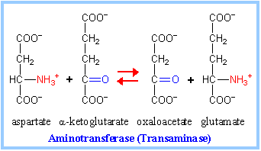
Pyruvate → phosphoenolpyruvate

Slide 57
Fructose-1,6-bisphosphate → Glucose
Fructose 1,6-bisphosphatase removes a phosphate group by hydrolysis in an energetically favorable reaction.
Glucose 6-phosphatase hydrolyzes glucose 6-phosphate producing glucose and inorganic phosphate.
Glucose is the transported out of liver to other organs.

Slide 58
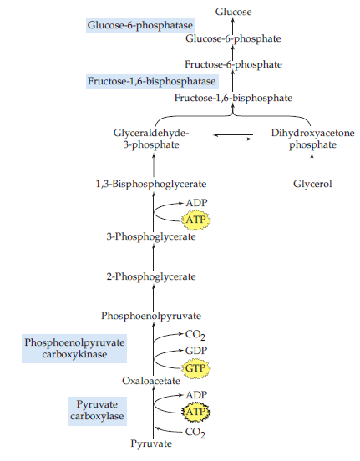
Glycerol from triacylglycerol catabolism is converted to dihydroxyacetone phosphate and enters the gluconeogenesis pathway.
The carbon atoms from certain amino acids (the glucogenic amino acids) enter gluconeogenesis as either pyruvate or oxaloacetate.

Slide 59
Cori cycle
Lactate produced in muscles under anaerobic conditions during exercise is sent to the liver, where it is converted back to glucose.
The glucose can then return via the bloodstream to the muscles, to be stored as glycogen or used for energy production

Slide 60
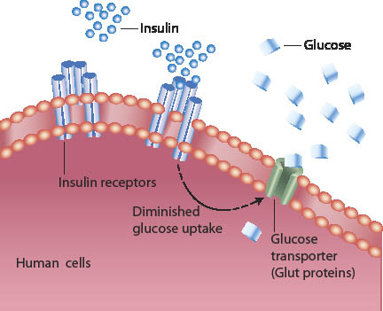
Hormonal regulation
Insulin is a hormone secreted by the pancreas in response to elevated blood glucose levels. In target tissues throughout the body, it accelerates uptake and utilization of glucose.
Glucagon is a hormone that is released when blood glucose concentration drops. It stimulates the breakdown of glycogen in the liver and release of glucose.

Slide 61
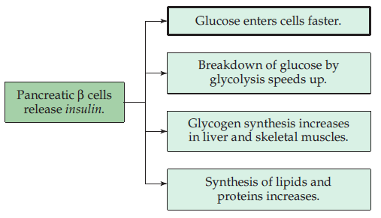
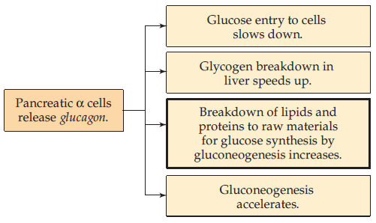
Hormonal regulation

Slide 62
Hormonal regulation
Insulin
Glucagon
Released when blood glucose concentration rises.
It decreases blood glucose concentrations by:
accelerating the uptake of glucose by cells where it is used for energy production
stimulating synthesis of glycogen, proteins, and lipids.
Released when blood glucose concentration drops.
It stimulates the breakdown of
glycogen in the liver and release of glucose.
Proteins and lipids so that amino acids from proteins and glycerol from lipids can be converted to glucose in the liver by the gluconeogenesis pathways.
Epinephrine (the fight-or-flight hormone) also accelerates the breakdown of glycogen to glucose in muscle tissue to generate immediate energy.

Slide 63
Metabolism in Fasting and Starvation

Slide 64
Metabolism in Fasting and Starvation
A gradual decline in blood glucose concentration accompanied by an increased release of glucose from glycogen, both are used up in 15 20 hours of normal activity.

Slide 65
Production of ketone bodies
When fasting, glucose and glycogen reserves are consumed, metabolism turns first to breakdown of proteins and gluconeogenesis is activated in the liver
Lipid catabolism is then activated producing acetyl-SCoA.
The citric acid cycle cannot degrade acetyl-SCoA as rapidly as it is produced. Therefore, it builds up inside cells and begins to be removed as a group of compounds known as ketone bodies.

Slide 66
Utilization of ketone bodies as a source of energy
The brain and other tissues can use ketone bodies as a source of acetyl-CoA to enter Krebs cycle.

Slide 67
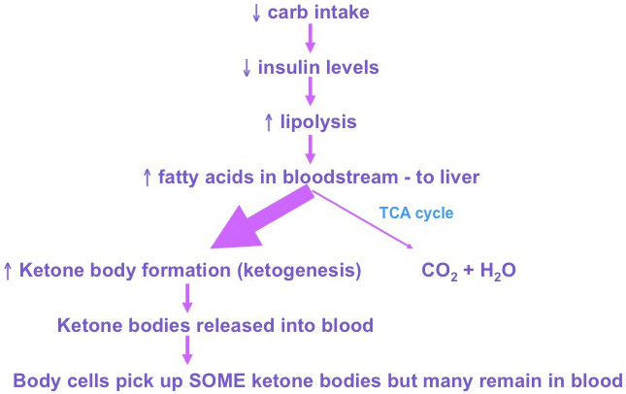

Slide 68
Blood glucose

Slide 69
Abnormal levels of glucose Normal blood glucose concentration = 65-110 mg/dL
Hypoglycemia
Hyperglycemia
Weakness, sweating, and rapid heartbeat.
low glucose in brain cells causes mental confusion, convulsions, coma, and death.
At a blood level of 30 mg/dL, consciousness is impaired.
Prolonged hypoglycemia can cause permanent dementia.
increased urine flow as the normal osmolarity balance of fluids within the kidney is disturbed.
Prolonged hyperglycemia can cause low blood pressure, coma, and death.

Slide 70
Medical emergencies: Ketoacidosis and hypoglycemia
Ketoacidosis
Hypoglycemia (insulin shock)
Ketoacidosis results from the buildup of acidic ketones in the late stages of uncontrolled diabetes.
It can lead to coma and diminished brain function
It can be reversed by timely insulin administration.
It may be due to an overdose of insulin or failure to eat.
If untreated, diabetic hypoglycemia can cause nerve damage or death.

Slide 71
How can you tell if is ketoacidosis or Hypoglycemia?
One indication of ketoacidosis is the aroma of acetone on the breath.
Another is rapid respiration driven by the need to diminish acid concentration by eliminating carbon dioxide:
An overdose of insulin does not cause rapid respiration.

Slide 72
Diabetes
Type I
Type II
Juvenile-onset diabetes
Autoimmune disease causing destruction insulin-producing pancreatic cells
Excessive thirst, frequent urination, abnormally high glucose concentrations in urine (glucosuria), and blood, and weight loss
Starvation-like metabolism
Treatment: insulin injection
Adult diabetes
Cells become resistant to insulin
Treatment: increase insulin or insulin receptor, diet modification and exercise

Slide 73
Diabetic cataract leading to blindness
Increased glucose levels within the eye increase the quantity of glucose converted to sorbitol.
Sorbitol cannot be transported out of the cell rising its concentration and increasing the osmolarity of fluid in the eye, resulting in increased pressure and cataracts.
Elevated sorbitol is also associated with blood vessel lesions and gangrene in the legs, conditions that can accompany long-term diabetes.

