Slide 1
Hydraulic Circuits

Slide 2
Introduction
A hydraulic circuit is a group of components including one or more pump, actuators, valves, piping, and ancillary equipment. It is used for power transmission and control.
Hydraulic Valve
Hydraulic Cylinder
F x v
V x I
Electric Motor
Hydraulic Pump
T x ω
Hydraulic Motor
T x ω
P x Q

Slide 3
Hydraulic Circuits
Single Acting Hydraulic Cylinder Control Circuit
Double Acting Hydraulic Cylinder Control Circuit
Regenerative Cylinder Circuit
Pump Unloading Circuit
Double Pump Circuit
Counterbalance Valve Circuits
Cylinder Sequencing Circuits
Locked Cylinders using Pilot Check Valves
Cylinder Synchronization Circuits
Fail Safe Circuits

Slide 4
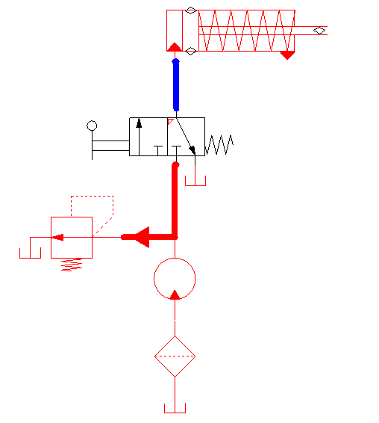
Single Acting Hydraulic Cylinder Control Circuit

Slide 5
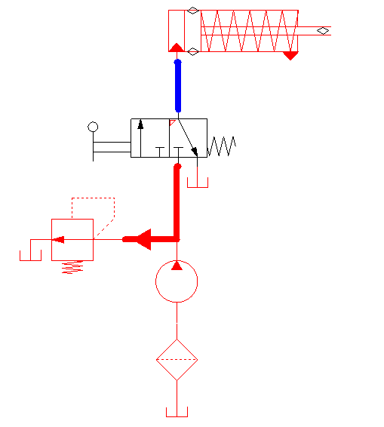
Single Acting Hydraulic Cylinder Control Circuit

Slide 6
Single Acting Hydraulic Cylinder Control Circuit

Slide 7
Single Acting Hydraulic Cylinder Control Circuit

Slide 8
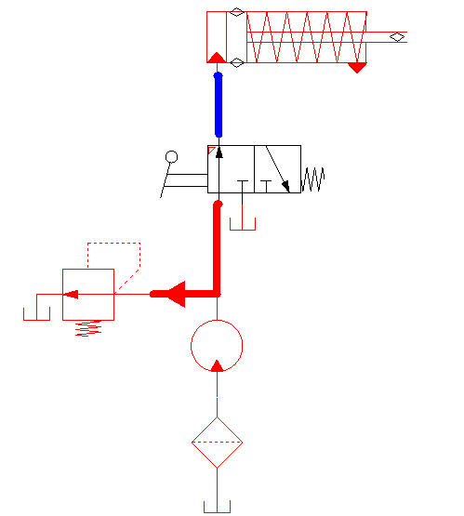
Single Acting Hydraulic Cylinder Control Circuit

Slide 9
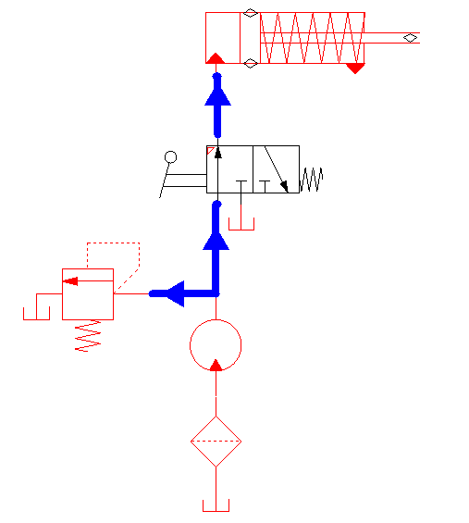
Single Acting Hydraulic Cylinder Control Circuit

Slide 10
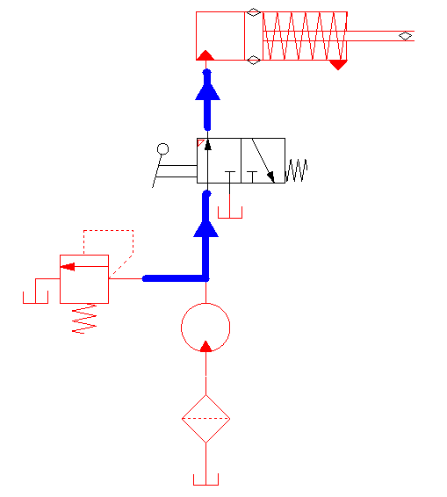
Single Acting Hydraulic Cylinder Control Circuit

Slide 11
Single Acting Hydraulic Cylinder Control Circuit

Slide 12
Single Acting Hydraulic Cylinder Control Circuit

Slide 13
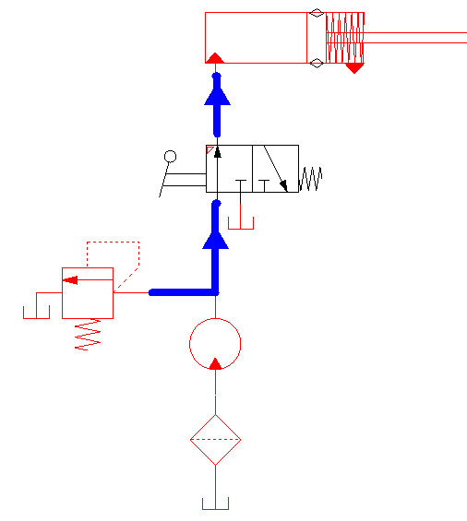
Single Acting Hydraulic Cylinder Control Circuit

Slide 14
Single Acting Hydraulic Cylinder Control Circuit

Slide 15
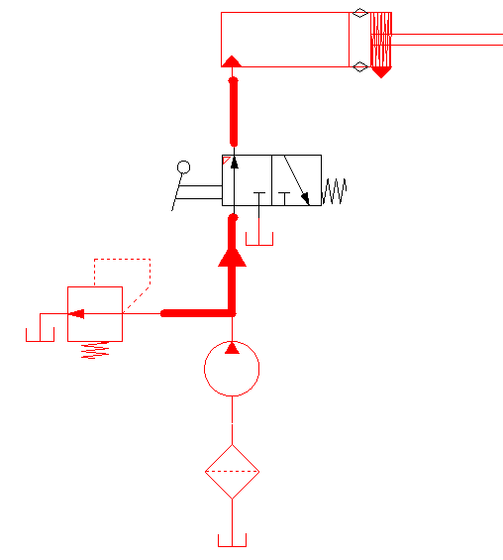
Single Acting Hydraulic Cylinder Control Circuit

Slide 16
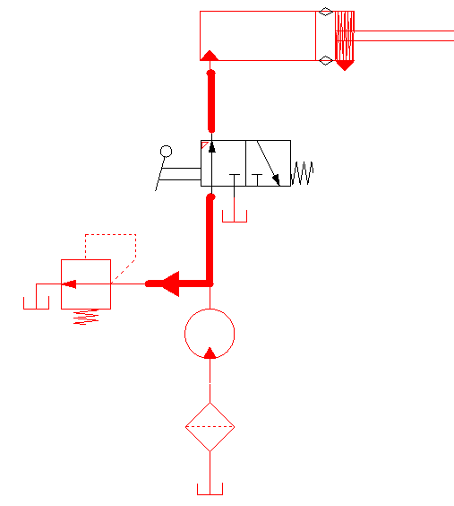
Single Acting Hydraulic Cylinder Control Circuit

Slide 17
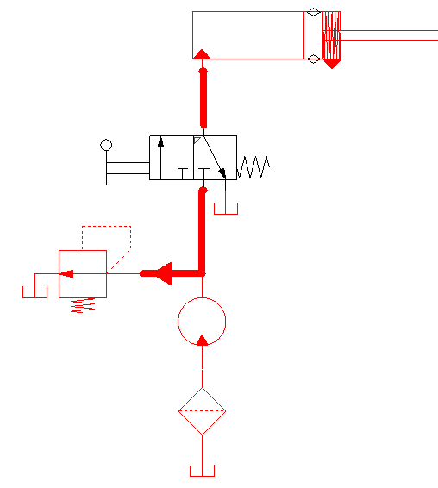
Single Acting Hydraulic Cylinder Control Circuit

Slide 18
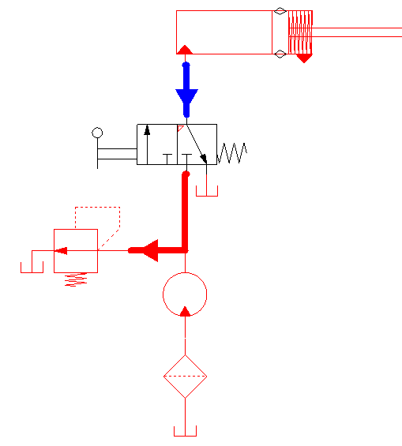
Single Acting Hydraulic Cylinder Control Circuit

Slide 19
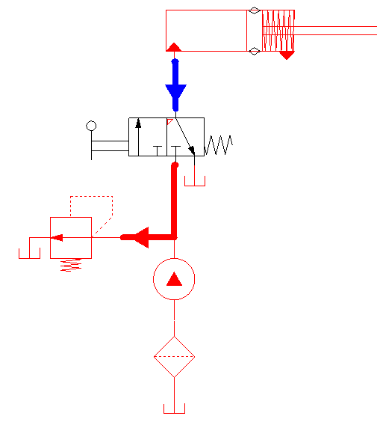
Single Acting Hydraulic Cylinder Control Circuit

Slide 20
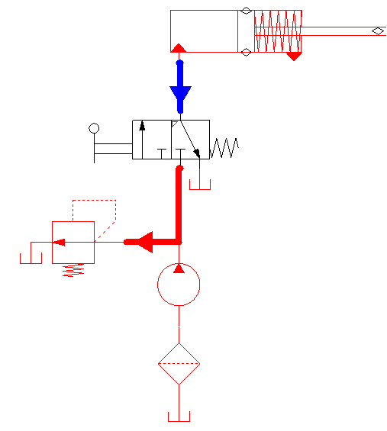
Single Acting Hydraulic Cylinder Control Circuit

Slide 21
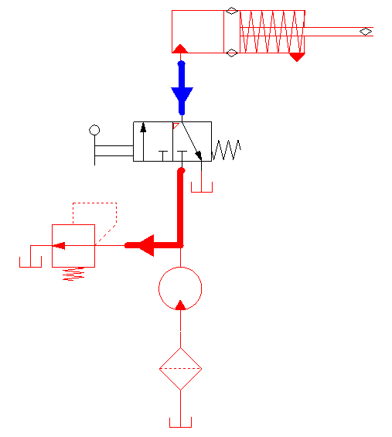
Single Acting Hydraulic Cylinder Control Circuit

Slide 22
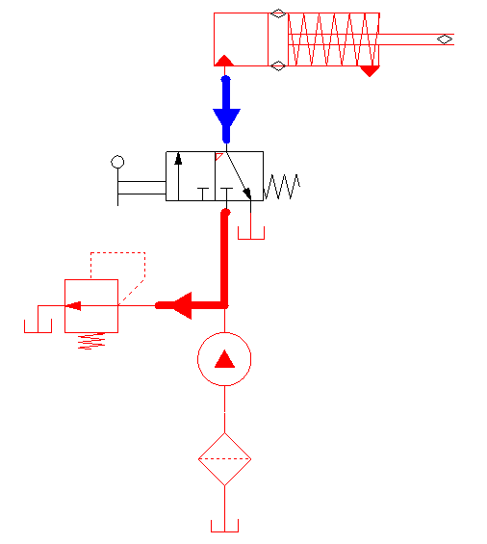
Single Acting Hydraulic Cylinder Control Circuit

Slide 23
Single Acting Hydraulic Cylinder Control Circuit

Slide 24
Single Acting Hydraulic Cylinder Control Circuit Analysis Objectives
Given:
Load carrying capacity
Extension speed
Retraction speed
What are the objective of design analysis?

Slide 25
Single Acting Hydraulic Cylinder Control Circuit Analysis Objectives
Pump
Flow rate
Pressure Head
Type
Pressure Relief Valve
Cracking pressure
Full Open pressure
Size
Spring
Stiffness
Initial Compression

Slide 26
Single Acting Hydraulic Cylinder Control Circuit Design Optimization
What are the objective of design optimization?

Slide 27
Single Acting Cylinder Control Circuit Design Optimization
Improve efficiency (operating cost)
Reduce size and weight
Increase safety
Reduce cost
Simplify operation
Improve functionality
Allow to stop during stroke
Allow servo control
Increase retraction speed
…..
Extend working life
Reduce noise
Improve reliability
Reduce pollution and environmental effects
…

Slide 28
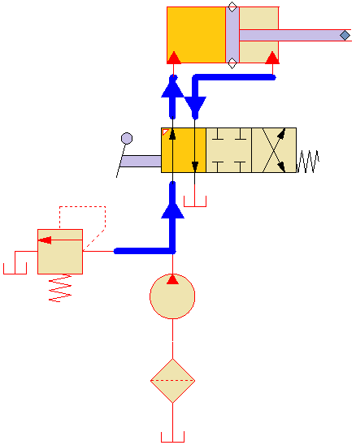
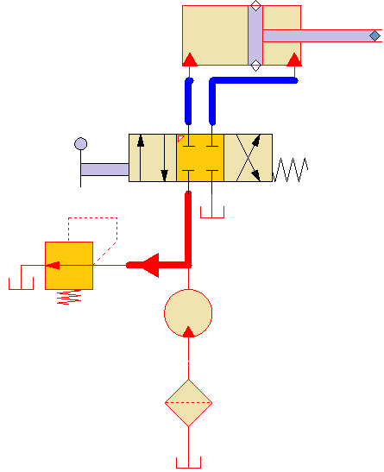
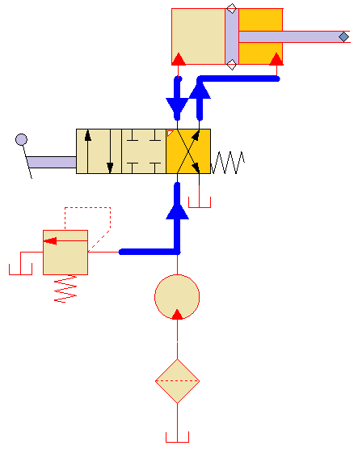
Double Acting Cylinder Control Circuit
Extend
Hold
Retract

Slide 29
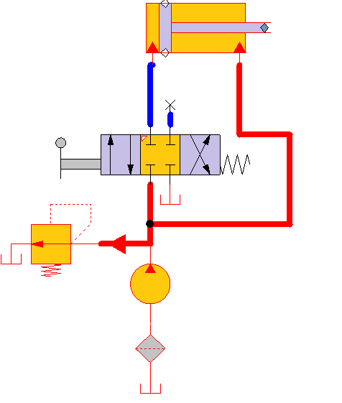
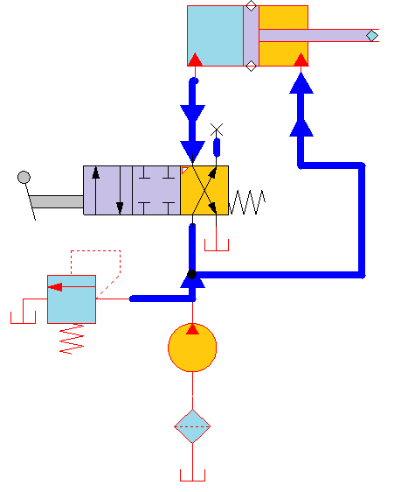
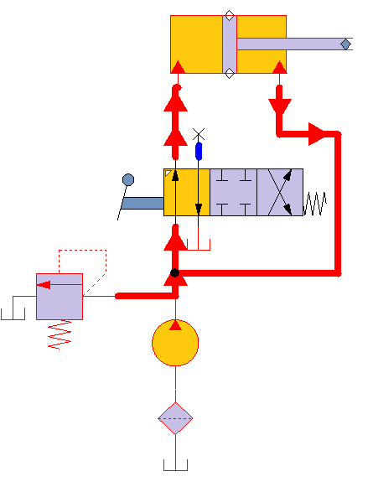
Double Acting Cylinder Control Circuit
Extend
Hold
Retract

Slide 30
Automatic Cylinder Reciprocating System
Two sequence valves sense a stroke completion by corresponding buildup of pressure. Each check valve and corresponding pilot line prevents shifting of the directional control valve until the particular stroke of the cylinder has been completed.
The check valves are needed to allow pilot oil to leave either end of the DCV while pilot pressure is applied to the opposite end. This permits the spool of the valve to move as required.

Slide 31
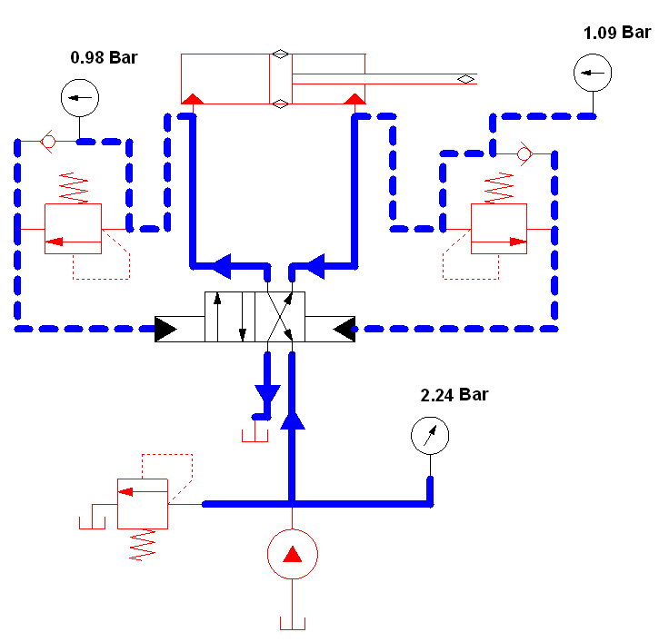
Automatic cylinder Reciprocating System

Slide 32
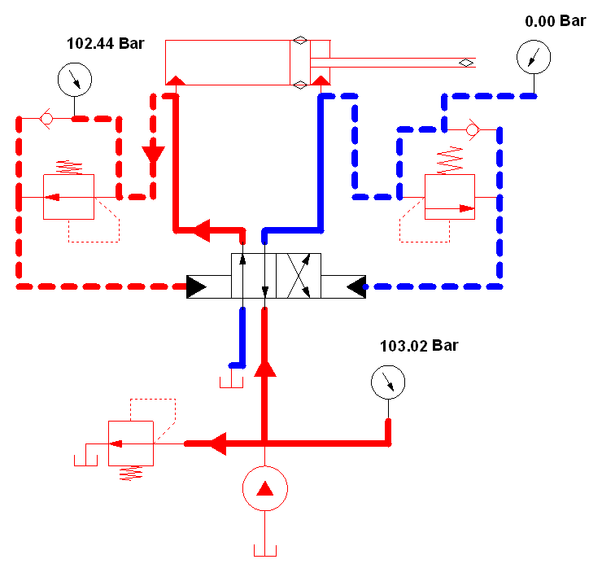

Slide 33
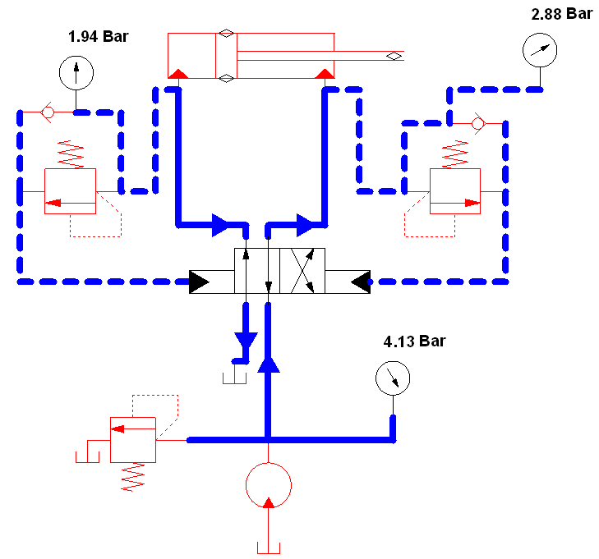

Slide 34
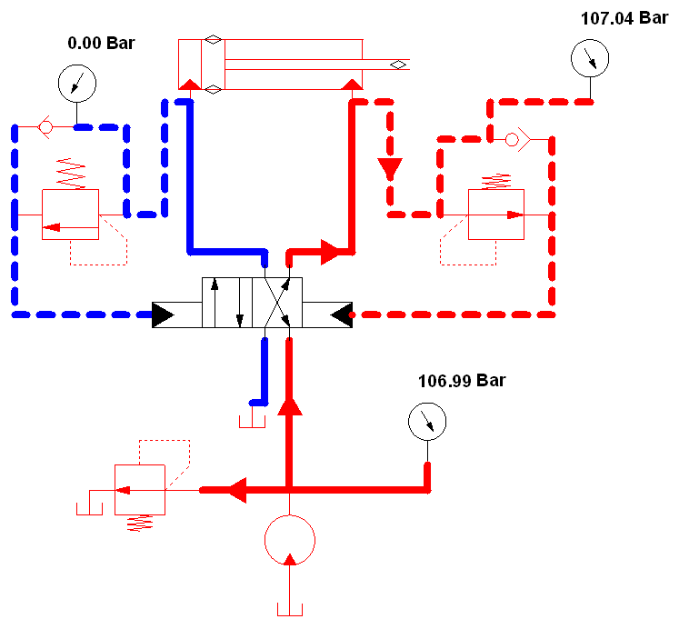

Slide 35
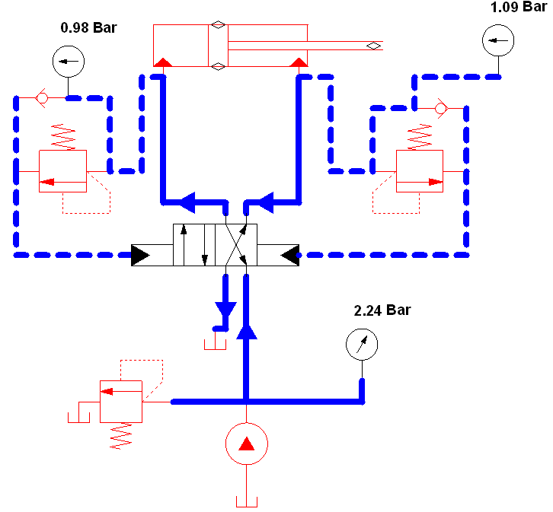

Slide 36
Flow and pressure analysis in the automatic reciprocating cylinder
During the extension stroke, the speed of the piston is determined by the flow rate out of the pump, and the area of the blank-end of the piston.
Assuming constant piston speed, and resistive load on the piston, (load resisting the extension), the pressure on the rod end of the piston (gauge pressure) is equal to the pressure loss in the return line connecting the outlet port to the tank.
For a straight circular pipe, the pipe flow coefficient, K _{pipe} is:
f is the friction factor for the pipe. For fully turbulent flow, f is a function of the pipe’s relative roughness. In the transition region, f is a function of the relative roughness and Re. It is determined from the Moody diagram.

Slide 37
Flow and pressure analysis in the automatic reciprocating cylinder
The pressure on the blank end is determined by the pressure on the rod side and the load

Slide 38
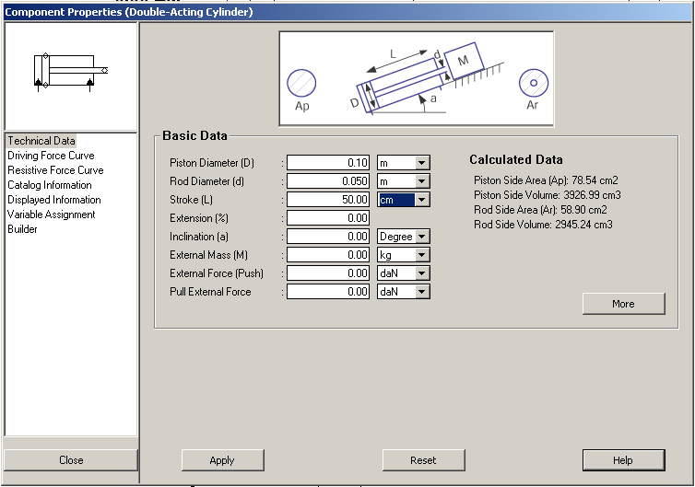

Slide 39
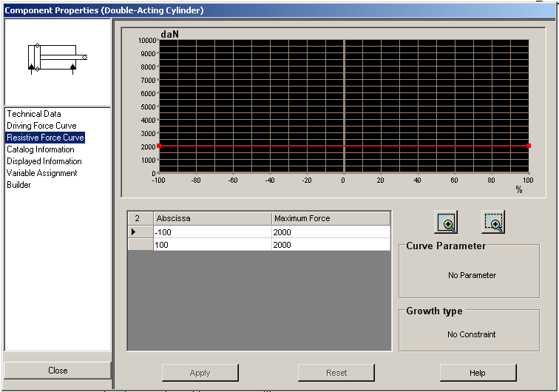

Slide 40
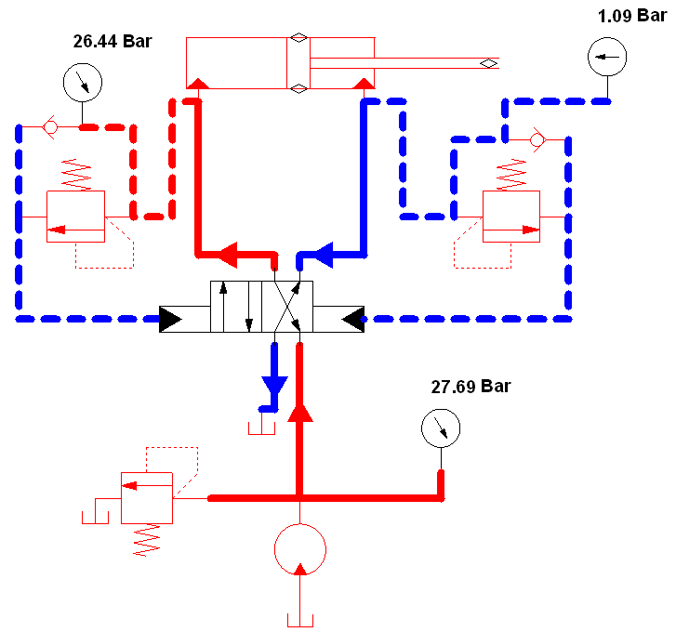

Slide 41
Double Pump Hydraulic System

Slide 42
Double Pump Hydraulic System
A high-pressure, low-flow pump works in conjunction with a low-pressure, high-flow pump. A typical application is a sheet metal punch where high force and pressure requirements occur during a short motion portion of the hydraulic cylinder when the punching operation occurs.
During the punching operation, the cylinder travel is small, and thus the flow-rate requirements are low. The circuit eliminates the necessity of having a very expensive high pressure, high flow pump

Slide 43
Double Pump Hydraulic System
Before the punching operation begins, the rapid extension of the piston is provided by both pumps operating at low pressure outlet (pressure is determined by the load). The flow of the high-flow pump goes through the check valve to the hydraulic cylinder.
Near the end of the cylinder stroke the punching operation begins and the increased pressure opens the unloading valve to unload the high-flow pump. The check valve protects this pump from the high pressure generated by the high-pressure pump.

Slide 44
Analysis of a Double Pump Circuit
The gauge pressure on the rod end of the piston is equal to the pressure loss in the return line connecting the outlet port to the tank.
During the rapid extension, the flow rate is high and the rod-end pressure will be significant. The blank-end pressure, p_{b,ext} is given by:
The pressure calculated above may be used to determine the settings of the unloading valve, p_{s,uv} . For example, we could set it to be equal to 1.5 times p_{b,ext}
During the punching operation, the flow rate is small, and the rod-end pressure is negligible. The blank-end pressure is determined by the punching load:
The pressure calculated above may be used to determine the settings of the pressure relief valve, p_{s,rv} . For example, we could set it to be equal to 1.5 times p_{b,punxh}

Slide 45
Fail-Safe Circuits

Slide 46
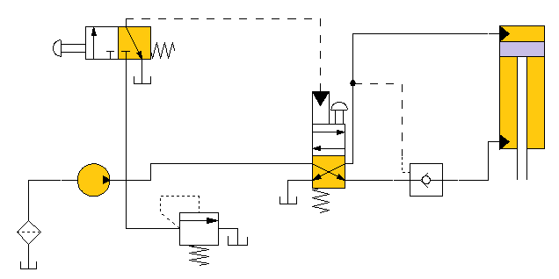
Protection from Inadvertent Cylinder Extension
The circuit utilizes a pilot operated check valve to prevent the cylinder from falling in the event of hydraulic line rupture or pump failure. The valve also provides protection in case someone inadvertently operates the manual override on the pilot actuated directional control valve when the pump is not operating.

Slide 47
Protection from Inadvertent Cylinder Extension
This design also allows the upper directional control valve to be placed at a distant location from the machine. The lines connected to the valve are basically for sensing. Flow and pressure (high power lines) go though the bottom DCV, which acts in a manner similar to relay.

Slide 48
Protection from Inadvertent Cylinder Extension
This design also allows the upper directional control valve to be placed at a distant location from the machine. The lines connected to the valve are basically for sensing. Flow and pressure (high power lines) go though the bottom DCV, which acts in a manner similar to relay.

Slide 49
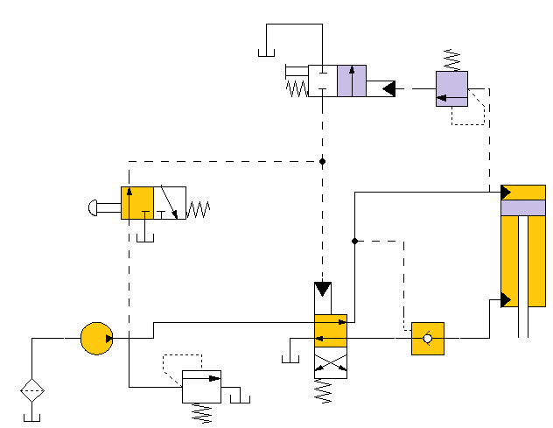
Fail Safe with Overload Protection
Directional Control Valve 1 is controlled by the pushbutton, three-way DCV2. If the cylinder experiences excessive resistance during its extension stroke, the sequence valve pilot actuates the overload DCV 3.
This drains the pilot line of DCV1, causing it to return to its spring-offset mode. If an operator then tries to push DCV 2, nothing happens unless DCV3 is manually shifted to its blocked port configuration. Thus the system components are protected from excessive load during the extension stroke.
Sequence Valve
DCV 3
DCV 2
DCV 1

Slide 50
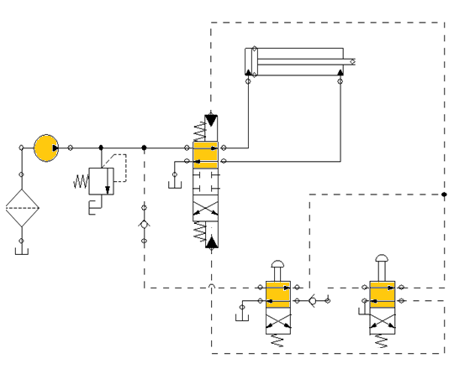
Two-Handed Safety System
For the circuit to extend, the operator must depress both manually actuated valves via the push button.
When the two buttons are depressed, the main DCV is pilot-actuated to extend the cylinder. When one of the pushbuttons is released, the cylinder retracts.

Slide 51
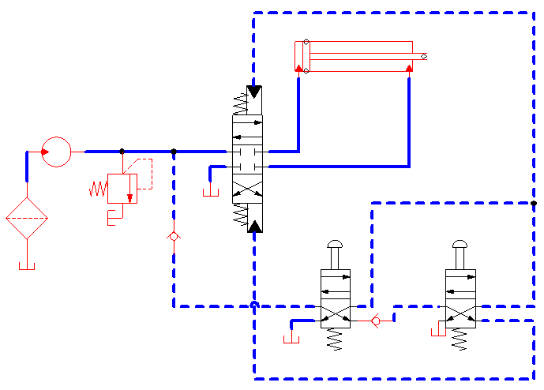
Two-Handed Safety System

Slide 52
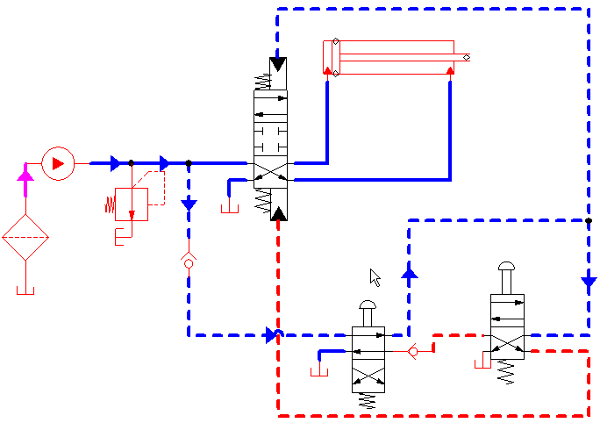
Two-Handed Safety System

Slide 53
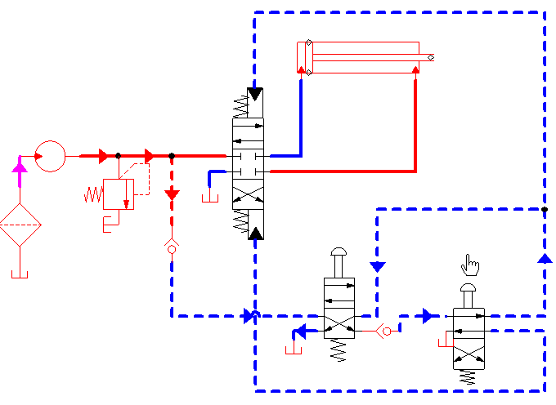
Two-Handed Safety System

Slide 54
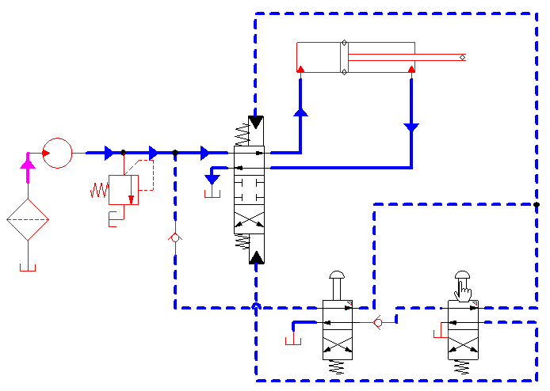
Two-Handed Safety System

Slide 55
Two-Handed Safety System

Slide 56
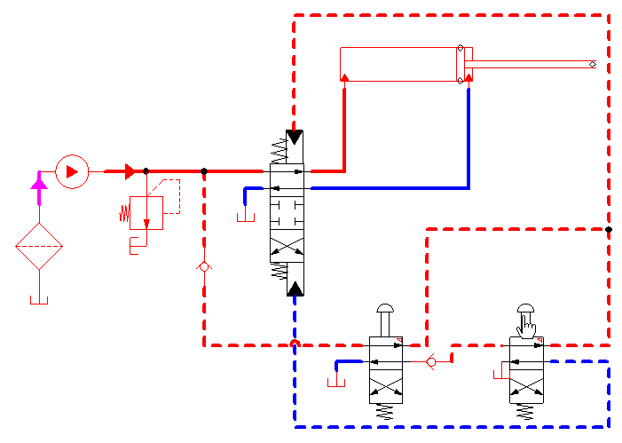
Two-Handed Safety System

Slide 57
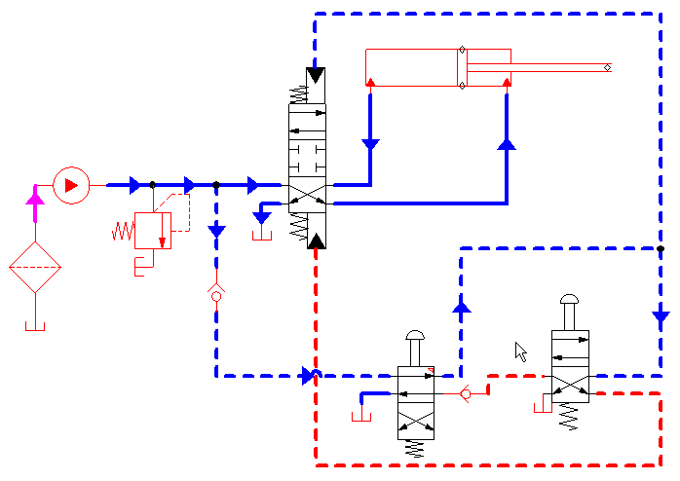
Two-Handed Safety System

