Slide 1
Physical Properties of Hydraulic and Pneumatic Fluids
Mohammad I. Kilani
Mechatronics Engineering Department
University of Jordan

Slide 2
HW 1 Output speed of a Hydraulic Jack
The hydraulic jack has an input area of 10 mm² and an output area of 40 mm², and is used to move the output piston against a constant 2kN load with different output speed values. The input cylinder is connected to the output cylinder with a 4 mm² pipe of length L. The density of the hydraulic fluid used in the jack is 900 kg/m³ and its viscosity is 0.3 kg.m/s².
Plot the force F needed on the input piston as a function of the steady output piston speed. Generate three different curves on the same plot corresponding to (i) L = 5 m, (ii) L = 10 m and (iii) L = 20 m. Identify all the critical inflection points on the plot.
For F = 1 kN and L = 20 m, derive an expression for the transient output speed, v, as a function of time, t, and find the time needed for the piston to reach 95% of the steady speed. Plot v(t) using appropriate scale.
F
2 kN
L

Slide 3
HW 1 Output speed of a Hydraulic Jack
Under steady operating conditions, the weight of the 2kN load is balanced by the force of the oil pressure
For laminar flow in the connecting pips, Re = 2300
The hydraulic jack has an input area of 10 mm² and an output area of 40 mm², and is used to move the output piston against a constant 2kN load with different output speed values. The input cylinder is connected to the output cylinder with a 4 mm² pipe of length L. The density of the hydraulic fluid used in the jack is 900 kg/m³ and its viscosity is 1.1 x 10⁻⁷ kg.m/s².
Plot the force F needed on the input piston as a function of the steady output piston speed. Generate three different curves on the same plot corresponding to (i) L = 5 m, (ii) L = 10 m and (iii) L = 20 m. Identify all the critical inflection points on the plot.
F
2 kN
L

Slide 4
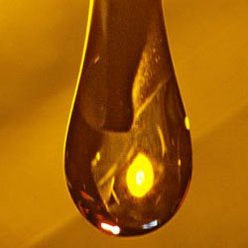
Introduction
The single most important material in a fluid power system is the working fluid itself. In pneumatic applications, air is the common working fluid. In hydraulic applications different types of hydraulic fluids are available.
Hydraulic fluid characteristics have a crucial effect on equipment performance and life. It is important to use clean, high-quality fluid in order to achieve efficient hydraulic system operation.
Most modern hydraulic fluids are complex compounds that have been carefully prepared to meet their demanding tasks. In addition to having a base fluid, hydraulic fluids contain special additives to provide desired characteristics.

Slide 5
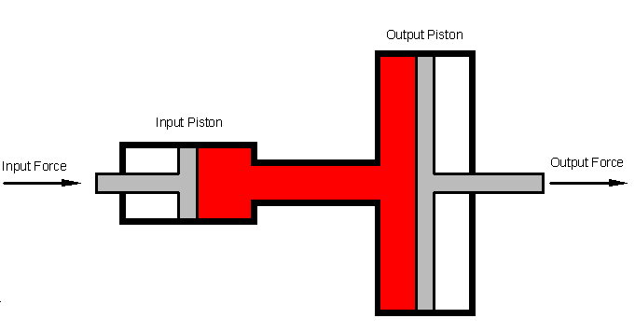
Function of Hydraulic Fluids
A hydraulic fluid has four primary functions:
Transmit power
Lubricate moving parts
Seal clearances
Dissipate heat

Slide 6
Required Properties of Hydraulic Fluids
To accomplish its primary functions, a hydraulic fluid should have the following properties
Good lubricity
Chemical and environmental stability
Fire resistant
Foam resistant
Low density
High degree of incompressibility
Compatibility with system material
Suitable viscosity
Good heat transfer capability
Nontoxicity
Low volatility
Inexpensive
Readily available

Slide 7
Required Properties of Hydraulic Fluids
No single hydraulic fluid possesses all the desirable characteristics. The system designer must select the fluid that comes closest to being ideal overall for a particular application.

Slide 8
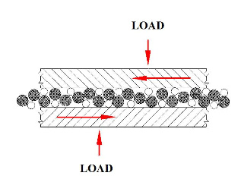
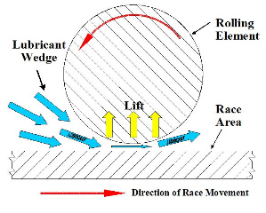
Required Properties of Hydraulic Fluids: Good Lubricity
A lubricant is a substance that reduces friction by creating a slippery film between two surfaces in relative motion. Lubricants permit one surface to move easily over the other surface with low frictional force.
When a lubricant is present between two rolling and/or sliding surfaces, a pressurized film can be generated by the movement of the surfaces . The viscosity and non-compressibility properties of this film separates the surfaces resulting in no metal to metal contact.

Slide 9
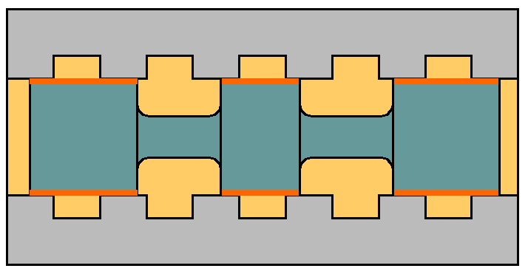
Required Properties of Hydraulic Fluids: Good Lubricity
Hydraulic fluids must have good lubricity to prevent wear to the closely fitted working parts. Direct metal-to-metal contact is avoided by the film strength of fluids having adequate viscosity and incompressibility.
Wear is the actual physical removal of surface material due to rubbing action resulting from the frictional forces between mating parts. Parts that are affected by wear include pump internals, valve spools, pistons, cylinders, rings and rod bearings.

Slide 10
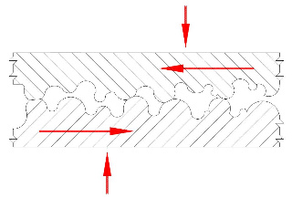
Required Properties of Hydraulic Fluids: Good Lubricity
The condition in which surfaces are completely separated by a continuous film of lubricating fluid is commonly referred to as hydrodynamic or full fluid film lubrication.
Under full film lubrication, the lubricant immediately adjacent to each surface travels at the same speed and direction of each surface. Fluid speed gradually changes across the film as it changes from the speed of the upper plate to the that of the lower plate.
Full film lubrication may fail due to low lubricant viscosity, or high oil compressibility. An increase in speed or viscosity increases oil film thickness. An increase in load decreases oil film thickness.
Moving plate
v
Stationary plate

Slide 11
Required Properties of Hydraulic Fluids: Chemical Stability
A substance is said to be chemically stable if it is not particularly reactive with its environment during normal use, and retains its useful properties on the timescale of its expected usefulness.
Hydraulic fluids are exposed to air, moisture, metals and other surfaces. Hydraulic fluid may oxidize, decompose, polymerize, burn or explode under the conditions of anticipated use or normal environmental conditions.
Oxidation, which is caused by a chemical reaction with oxygen from the air with the oil particles, can seriously reduce the service life of the hydraulic fluid. Most oxidation products are soluble in oil and are acidic in nature, which can cause corrosion to parts throughout the system.

Slide 12
Required Properties of Hydraulic Fluids: Fire Resistance
Most hydraulic fluids will burn under certain conditions. Flammability is defined as the ease of ignition and ability to propagate a flame. Determination of a fluid’s flammability depends on the following:
Flash point: The temperature at which the oil surface gives off sufficient vapors to ignite when a flame is passed over the surface.
Fire point: The temperature at which the oil will release sufficient vapor to support combustion continuously for five seconds when a flame is passed over the surface.
Autogenous ignition temperature: The temperature at which ignition occurs spontaneously.
Hydraulic fluids should not initiate or support fire. A fire resistant fluid is one that can be ignited, but will not support combustion when the ignition source is removed.

Slide 13
Required Properties of Hydraulic Fluids: Foam Resistance
Air can become dissolved or entrained in hydraulic fluids forming air bubbles. For example, the air at the liquid-air surface of the reservoir can be dissolved with oil. Similarly, a small leak in the suction line can cause the entrainment of large quantities of air from the atmosphere.
Air bubbles will greatly reduce the bulk modulus of the hydraulic fluid and affect its viscosity. If air bubbles rise to the surface too slowly, they will be drawn to the pump intake causing pump damage due to cavitation.
The amount of dissolved air can be greatly reduced by proper design of the reservoir, since this is where the vast majority of air is picked up. Foam-resistant fluids have chemical additives which break out entrained air to separate quickly the air from the oil while it is in the reservoir.

Slide 14
Required Properties of Hydraulic Fluids: Low Density
Hydraulic fluid density influences the overall weight of the system and the amount of frictional losses in turbulent flow, which in turn reflects on the cost of pumping. High density also increases the possibility of cavitation.

Slide 15
Required Properties of Hydraulic Fluids: Incompressibility
The highly favorable stiffness and power-to-weight ratio of hydraulic systems make them the frequent choice of most high-power applications. This stiffness of a hydraulic system is directly related to the incompressibility of the oil.
Bulk modulus is a measure of this incompressibility. The higher the bulk modulus, the less compressible, or stiffer the fluids. A compressible fluid has a low bulk modulus and causes sluggish operation. It can not be used in applications where accurate positioning or rigid holding is required.

Slide 16
Required Properties of Hydraulic Fluids: Incompressibility
Mathematically, the bulk modulus is defines by the following equation.
The bulk modulus of an oil changes with pressure and temperature. But within the operating ranges in most fluid power systems. This factor can be neglected. A typical value for β for hydraulic oils is 1.72 x 10⁶ kPa (250,000 psi). Note that the atmospheric pressure is 14.7 psi.
Where
β = bulk modulus (kPa)
ΔP = change in pressure (kPa)
ΔV = change in volume (m³)
V = original volume (m³)

Slide 17
Required Properties of Hydraulic Fluids: Viscosity
Viscosity is probably the single most important property of a hydraulic fluid. It is a measure of the sluggishness with which fluid moves.
When the viscosity is low, the fluid flows easily and is thin in appearance. A fluid that flows with difficulty has a high viscosity and is thick in appearance.
The viscosity of a given hydraulic fluid must be selected carefully. Too high viscosity results in high resistance to flow, sluggish operation, increased power consumption, increased pressure drop through valves and lines and high temperature rise.

Slide 18
Required Properties of Hydraulic Fluids: Viscosity
On the other hand, too low viscosity results in increased leakage losses past seals, excessive wear due to the breakdown of the oil film between mating moving parts. These mating parts.
For example, a typical sliding valve spool moves back and forth inside its body on a thin film of oil. If this passage is under pressure, the fluid film seals it from adjacent passage. If this film breaks, sealing will fail and metal parts will start to rub against each other.

Slide 19
Required Properties of Hydraulic Fluids: Viscosity
The concept of viscosity can be understood by examining two parallel plates separated by an oil film of thickness y.
The lower plate is stationary, whereas the upper plate moves with a velocity v as it is being pushed by a force F.
Moving plate
F
v
y
Stationary plate

Slide 20
Required Properties of Hydraulic Fluids: Viscosity
Because of viscosity, the oil adheres to both surfaces. Thus the velocity of the layer of fluid in contact with the lower plate is zero, and the velocity of the layer in contact with the top plate is v.
The consequence is a linearly varying velocity profile, whose slope is v/y.
Moving plate
F
v
y
Stationary plate

Slide 21
Required Properties of Hydraulic Fluids: Viscosity
The absolute viscosity of the oil is represented mathematically by
Where
τ = shear stress in the fluid (N/m², Pa)
v = velocity of the moving plate (m/s)
y = oil film thickness (m)
μ = the absolute viscosity of the oil (N.s/m²)
F = Force applied to the moving plate (N)
A = area of the moving plate surface in contact with oil (m²)

Slide 22
Required Properties of Hydraulic Fluids: Viscosity
Calculations in hydraulic systems often involve the use of kinematic viscosity rather than absolute viscosity. Kinematic viscosity, ν, is defined as the absolute viscosity divided by the mass density.
The SI units of ν is m²/s. Another common method of measurement is the stoke, which is 1 cm²/s.
F
M
oving
plate
v
Stationary
plate

Slide 23
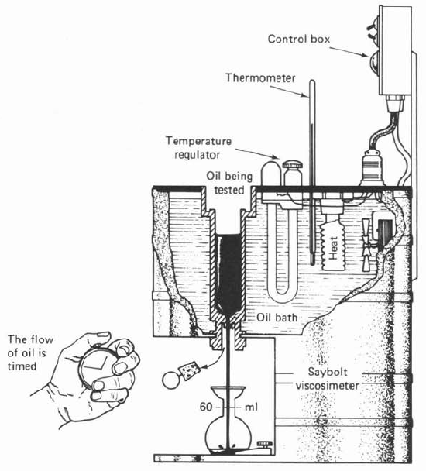
Required Properties of Hydraulic Fluids: Viscosity
The viscosity of a fluid can be measured by a Saybolt viscometer, which measures viscosity of a liquid sample based on the time it takes to flow form a test chamber to a container through a standard orifice.
Basically, this device consists of an inner chamber containing the sample of oil to be tested. An outer compartment which completely surrounds the inner chamber contains a quantity of oil whose temperature is controlled by a heater and an electrical thermostat.
When the oil sample is at the desired temperature, the time it takes to fill a 60- cm³ container through the metering orifice is recorded. The time (t) measured in seconds is the viscosity of the oil in official units called Saybolt Universal Seconds (SUS).

Slide 24
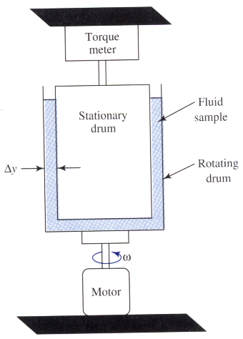
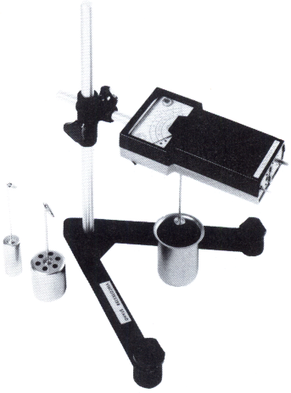
Required Properties of Hydraulic Fluids: Viscosity
In rotary drum method, an outer drum is caused to rotate at a constant angular velocity, while the inner drum is held constant.
Because of fluid viscosity, a drag force exists on the surface of the surface of the inner drum, causing a torque to be developed, which can be measured using a sensitive torquemeter.
The magnitude of the measured torque is a measure of the shear stress acting on the surface of the stationary drum. Thus the viscosity can be calculated from the relation

Slide 25
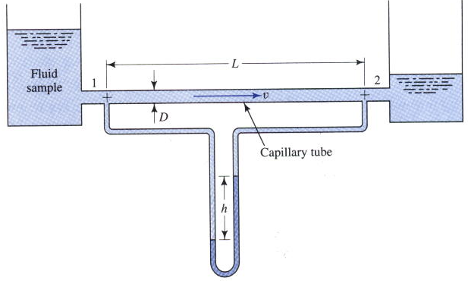
Required Properties of Hydraulic Fluids: Viscosity
A capillary tube viscometer consists o two reservoirs connected by a long, small diameter tube called a capillary tube.
As fluid flows through the tube with constant velocity, some energy is lost from the system, causing a pressure drop that can be measured by a manometer.
The magnitude of the pressure drop is related to the fluid viscosity by the following equation

Slide 26
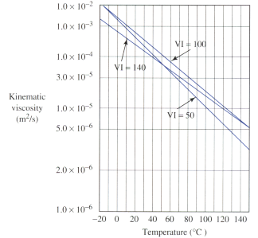
Required Properties of Hydraulic Fluids: Viscosity
Oil becomes thicker as the temperature decreases and thins when heated. Hence the viscosity of a given oil must be expressed at a specified temperature.
For most hydraulic applications, the viscosity normally equals about 150 SUS at 30 degree centigrade. As a rule of thumb, the viscosity should never fall below 50 SUS, or rise above 4000 SUS regardless of the temperature.
Viscosity index (VI) is a measure of an oil’s viscosity change with respect to temperature change. An oil with low VI exhibits a large change in viscosity with temperature change. A high-VI oil is one that has a relatively stable viscosity, which does not change appreciably with temperature change

Slide 27
Required Properties of Hydraulic Fluids: Viscosity

Slide 28
Changing Hydraulic Fluids
No single hydraulic fluid possesses all the desirable characteristics. The system designer must select the fluid that comes closest to being ideal overall for a particular application.
Hydraulic fluids must be changed periodically, with a frequency that depends on operating conditions. Laboratory analysis is the best method for determining when a fluid should be changed.
Generally speaking, a fluid should be changed when its viscosity and acidity increase due to fluid breakdown and contamination.
Preferably, the fluid should be changed while the system is at its operating temperature. In this way, most of the impurities are in suspension and will be drained off.

Slide 29
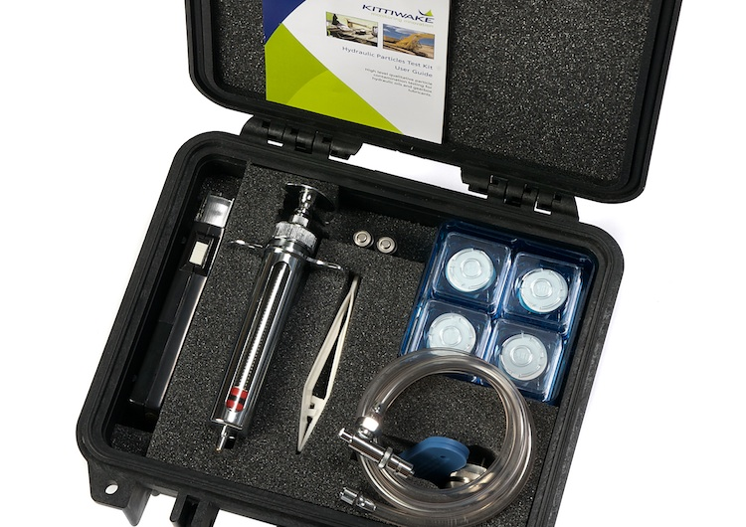
Changing Hydraulic Fluids
Much hydraulic fluid have been discarded due to the possibility that contamination existed – it costs more to test the fluid than to replace it. This situation has changed as the need to conserve hydraulic fluids has developed.
Fluid test kits that provide a quick and easy method to test hydraulic system contamination were developed. These kits may be used on the spot to determine whether fluid quality permits continued use. Three key quality indicators can be evaluated: viscosity, water content and foreign particle contamination level.

Slide 30
Properties of Pneumatic Fluids – (Air)
In pneumatic applications, air is the only gas commonly used. It has the following advantages:
It is inexpensive and readily available.
It is fire resistant.
It is not messy.
It can be exhausted back to the atmosphere.
Air, however, has the following disadvantages:
Due to its compressibility, it tends to be sluggish and can not be used in applications where accurate positioning or rigid holding is required.
It can be corrosive as it contains oxygen and water.
A lubricant must be added to lubricate valves and actuators.
Pressures of greater than 250 psi are typically not used due to the explosion dangers involved if components such as air tanks should rupture. This is because air, due to its compressibility, can store a large amount of energy as it is compressed, in a manner similar to a mechanical spring.

Slide 31
HW #1
3-15 M, 3-17M, 3-24 M, 3-27 M, 3-42 M, 3-43 M, 3-49 M, 3-51 M, 3-62 M, 3-63 M, 3-65 M.
Example 4-10
4-14 M, 4-15 M, 4-28 M, 4-32 M, 4-38 M.

