Slide 1
Physical Properties of Hydraulic and Pneumatic Fluids
Mohammad I. Kilani
Mechatronics Engineering Department
University of Jordan

Slide 2
Midterm Exam Thursday, 22-11-2012 12:00 – 12:50

Slide 3
Introduction
The transfer of power and energy is a key consideration in hydraulic systems. As seen in Chapter 1, a hydraulic power transmission system may be considered as a back-to-back converter.
A pump converts mechanical energy from a prime mover such as an electric motor or internal combustion engine into hydraulic energy by increasing the pressure of the fluid. The fluid flows to an actuator via a hydraulic circuit that consists of pipeline containing valves other control components. The actuator converts hydraulic energy back to mechanical energy to drive an external load.
Hydraulic Cylinder
F x v
V x I
Electric Motor
Hydraulic Pump
P x Q
T x ω
Hydraulic Motor
T x ω

Slide 4
Example Hydraulic System: Hydraulic Jack
F
2 kN
L

Slide 5
Example Hydraulic System: Hydraulic Jack
F
2 kN
L

Slide 6
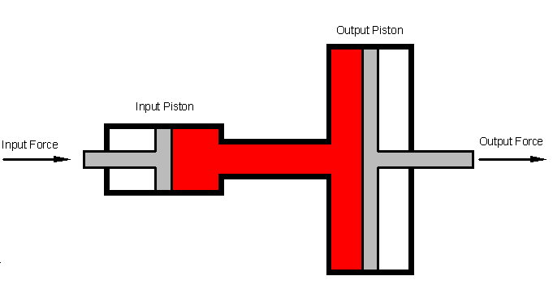
Example Hydraulic System: Hydraulic Jack

Slide 7
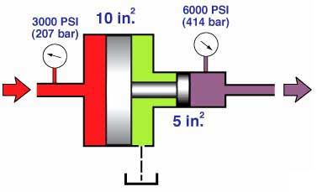
Example Hydraulic System: Pressure Intensifier (Booster)

Slide 8
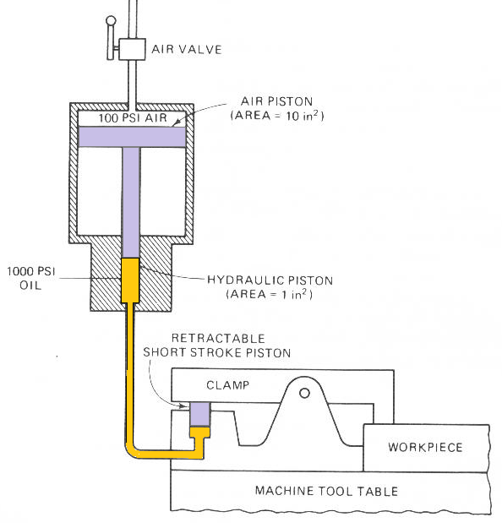
Example Hydraulic System: Pressure Intensifier (Booster)

Slide 9
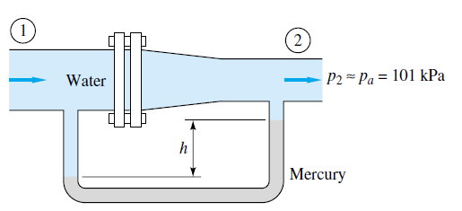
Continuity Equation (Conservation of Mass)
F
2 kN
L

Slide 10
Bernoulli Equation (Conservation of Mechanical Energy)
F
2 kN
L

Slide 11
Example: Flow in a reducing section

Slide 12
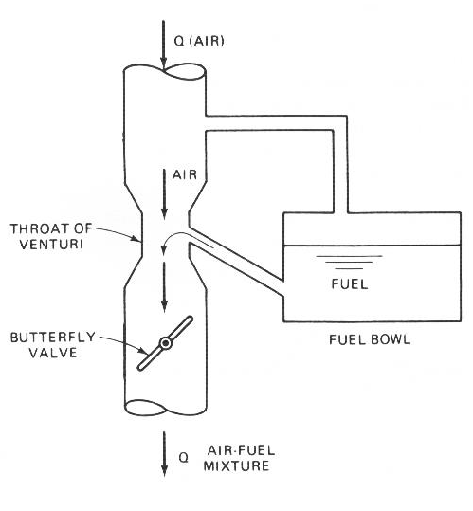
Example: Automobile Gas Tank

Slide 13
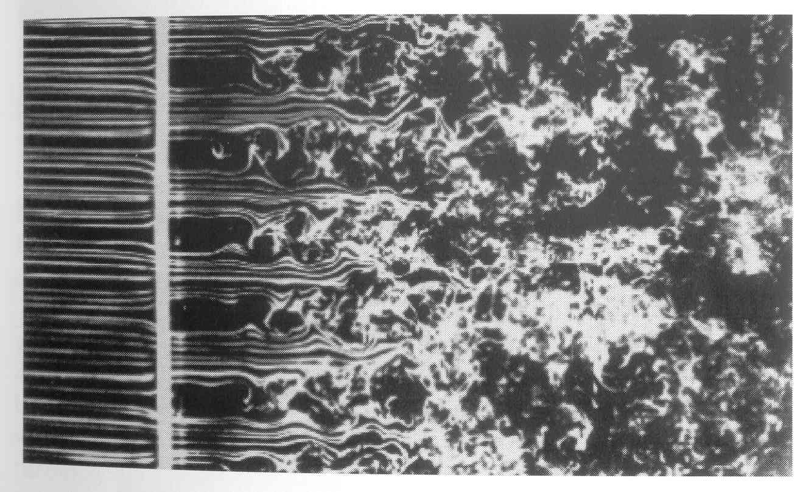
Frictional Losses in Pipelines

Slide 14
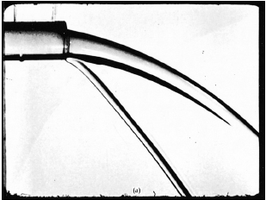
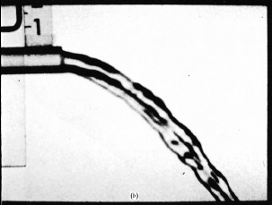
Frictional Losses in Pipelines

Slide 15
Frictional Losses in Pipelines: Laminar Flow

Slide 16
Frictional Losses in Pipelines: Fully Turbulent Flow

Slide 17
Frictional Losses in Pipelines: Transition Region Flow

Slide 18
Frictional Losses in Pipelines: The Friction Factor

Slide 19
Frictional Losses in Pipelines: The Friction Factor

Slide 20
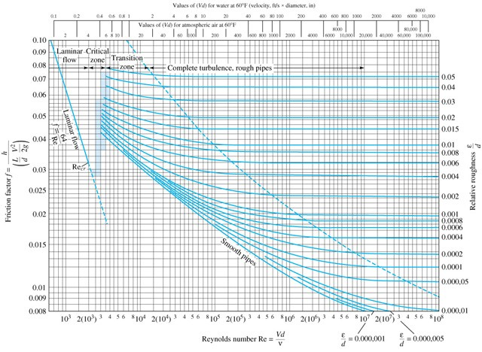
Frictional Losses in Pipelines: Transition Region Flow

