Slide 1
Gauss Elimination
It combines equations to eliminate unknowns.
For a small number of equations ,methods such as the graphical method,cramer’s rule, and the elimination of the unknown used.
The graphical method:
Plot the two equations with one axis corresponding to the other to .We get two straight lines.
intercept

Slide 2
Ex.:
Solve graphically the two equations:
Sol.:
Let be the abscissa
Slope= and intercept is 9
ordinate
Abscissa
intercept

Slide 3
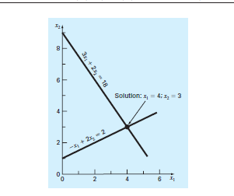
The intersection of the two lines is the solution.

Slide 4
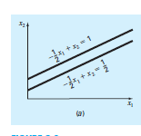
Potential Problems in solving a system of linear equations.
Parallel lines
No intersection No solution Singular.

Slide 5
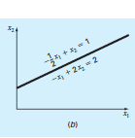
Coincident lines infinite numbers of solutions Singular

Slide 6
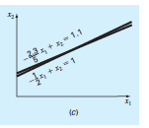
Slopes are too close Point of intersection is difficult to detect
ill-Conditional system.

Slide 7
Condition number=
As CN increase sensitivity increase.
If CN >>1 ill conditional & if CN <<1 ill conditional.
Determinants and Cramer’s rule
‘
~
~
~
Coefficient Matrix

Slide 8
Determinant,
The determinant is not a matrix, it is a single number.

Slide 9
Ex.:
Find the determinant of the following equations:
Sol.:
D=0 for singular system.
D is close to zero for an ill-conditional systems.

