Slide 1
Chapter 14
Sec 14.1.2
The Normal Distribution

Slide 2
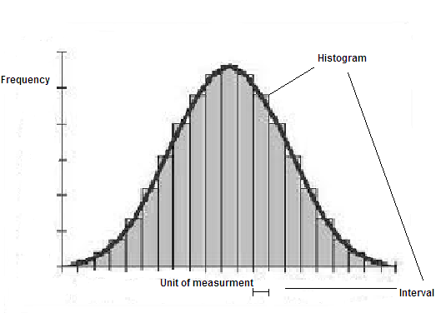
The Normal Distribution
It represents the shape with which the data is around the mean.

Slide 3
The main purpose of statistics is to estimate the properties of a population based on a limited sample drawn from that population.

Slide 4
Estimation of confidence intervals
: Sample Mean (Estimated Mean)
Sy: Sample Standard Deviation (Estimated S.D)
µ : Population Mean (True Mean )
σ: Population Standard Deviation (True S.D)

Slide 5
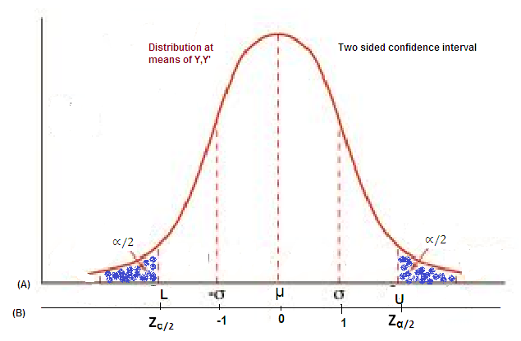

Slide 6
Units of the random variable Y
Normalaized scale of the random variable where the mean is at the origin
***σ corresponds to a unit value
P{L≤µ≤U}=1-α,
Where α is significance level
σ²: True variane

Slide 7
Standard Normal Estimate
Corresponds to scale (B) above
OR
: Sample Mean
µ: True Mean
σ : Standard Deviation
n: Number of points
With a propapility(P) of α,
Where
Is Standard Normal Random Variable

Slide 8
With p of 1-α
t-distribution (STUDENT DISTRIBUTION)
Is standard random variable for t-zdistribution for probability of α/2.
t gives more conservative confidence than normal.

Slide 9
