Slide 1
Chapter 14
Linear Regression

Slide 2
Example :
Linear Regression
Fit a straight line to x and y values :
x_{i} | 1 | 2 | 3 | 4 | 5 | 6 | 7
y_{i} | 0.5 | 2.5 | 2.0 | 4.0 | 3.5 | 6.0 | 5.5

Slide 3
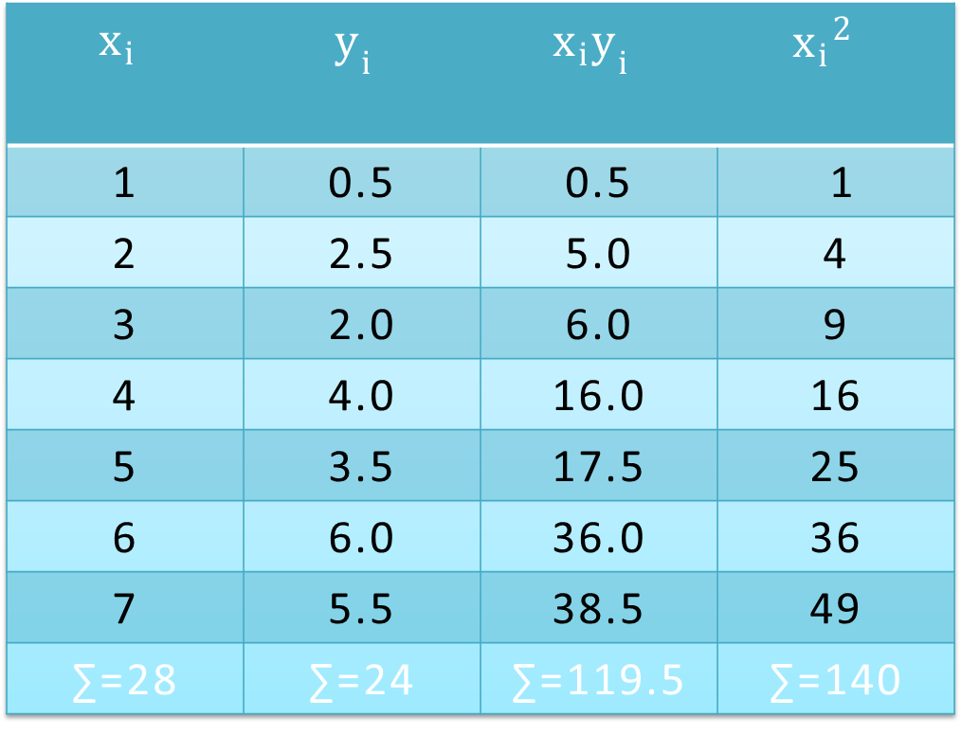
Solution:
$$x_{i}$$ | $$y_{i}$$ | $$x_{i}y_{i}$$ | $${x_{i}}^{2 }$$
1 | 0.5 | 0.5 | 1
2 | 2.5 | 5.0 | 4
3 | 2.0 | 6.0 | 9
4 | 4.0 | 16.0 | 16
5 | 3.5 | 17.5 | 25
6 | 6.0 | 36.0 | 36
7 | 5.5 | 38.5 | 49
∑=28 | ∑=24 | ∑=119.5 | ∑=140

Slide 4
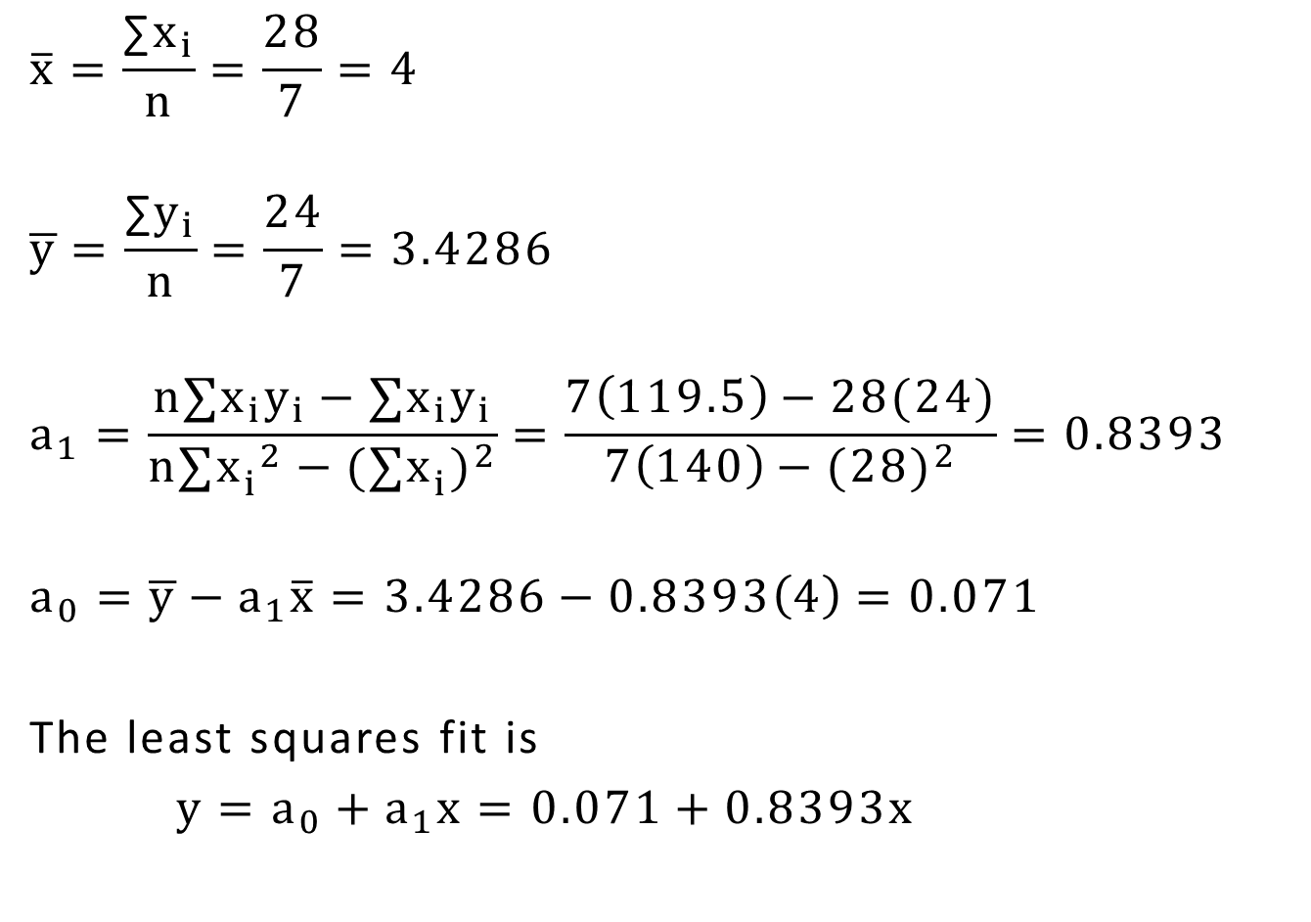
$$\overline{x}=\frac{\text{∑}x_{i}}{n}=\frac{28}{7}=4$$
$$\overline{y}=\frac{\text{∑}y_{i}}{n}=\frac{24}{7}=3.4286$$
$$a_{1}=\frac{n∑x_{i}y_{i}−∑x_{i}y_{i}}{n∑{x_{i}^{}}^{2}−{(∑x_{i}^{})}^{2}}=\frac{7\left(119.5\right)−28(24)}{7\left(140\right)−{(28)}^{2}}=0.8393$$
$$a_{0}=\overline{y}−a_{1}\overline{x}=3.4286−0.8393\left(4\right)=0.071$$
The least squares fit is
$y=a_{0}+a_{1}x=0.071+0.8393x$

Slide 5
Error Of Linear Regression
Recall that
$$S_{t}=∑{(y_{i}−\overline{y}\text{)}}^{2}=S_{r}=∑{(y_{i}−a_{0}−a_{1}x_{i})}^{2}$$
$S_{t}$ total sum of the squares of the residuals between data points and the mean (before regression)
$S_{r}$ sum of the squares of the residuals between data points and regression line (after regression)

Slide 6
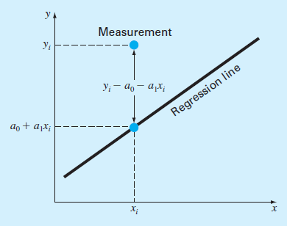
The straight line corresponds to the mean
Residual represents vertical
distance between the data
point and the straight line

Slide 7
Standard deviation for the regression line is :
$S_{y/x}=\sqrt{\frac{S_{r}}{n−2}}≡$ Standard error for the estimate
because $a_{0}$ and $a_{1}$ were derived from the data and used to compute $S_{r}$
predicted value corresponding to x
More spread of data → more error
$S_{y/x}$ is used to measure the goodness of fit, and to compare it to other regressions.

Slide 8
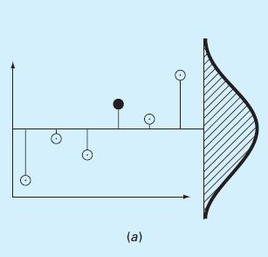
The spread of data around the mean
(more error)

Slide 9
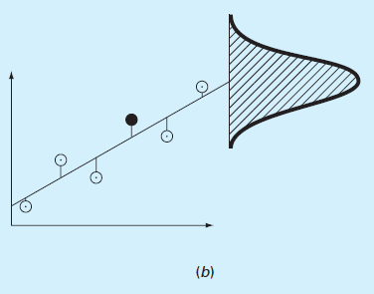
(b) The spread of data around the beast-fit line
(less error)

Slide 10
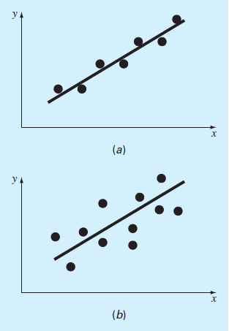
(a) Small residual error
(b) Large residual error

Slide 11
Coefficient of determination $r^{2}$
error reduction
(from mean to a straight line)
$$r^{2}=\frac{S_{t}−S_{r}}{S_{t}}$$
normalized
r : is the correlation coefficient
If $S_{r}=0$ → perfect fit → $r^{2}=0$ → no improvement in the fit

Slide 12
For computer implementation :
$$r=\frac{n∑x_{i}y_{i}−(∑x_{i})(∑y_{i})}{\sqrt{n∑{x_{i}}^{2}−{(∑x_{i})}^{2}\sqrt{n∑{y_{i}}^{2}−{(∑y)}^{2}}}}$$
$r=1$ → perfect fit
$r=0$→ fit provides no improvement

