Slide 1
The University of Jordan
Mechatronics Engineering Department
Dr. Osama M. Al-Habahbeh
2012

Slide 2
Chapter 5: Bracketing methods

Slide 3
Bracketing methods: Two initial guesses for the root are required.
5.1 Graphical techniques
They aren’t precise; they provide rough estimates of roots (Starting guesses for numerical methods).
If and have opposite signs this means odd number of roots. (See figure 5.1 plot b and d)
If and have same sign this means no roots or even number of roots (See figure 5.1 plot a and c)
Exceptions: tangential and discontinuous functions (see figure 5.2).

Slide 4
Figure 5.1

Slide 5
Figure 5.2

Slide 6
5.2 Bisection Method
If is real and continuous on and (opposite signs) then there is at least one real root between and .
Search interval, then subinterval (half of previous interval). Function value at midpoint is evaluated = sign change subinterval, repeat evaluation.
5.3 Algorithm
1- Choose and such that .
2- Estimate root by

Slide 7
3- If then root is at lower subinterval ,
set and go to step 2.
If then root is at upper subinterval,
set and go step 2.
4- If then root ,end the computation.
5.4 Termination criteria and error estimates
Where, is the relative error
is root from previous iteration
is root of present iteration

Slide 8
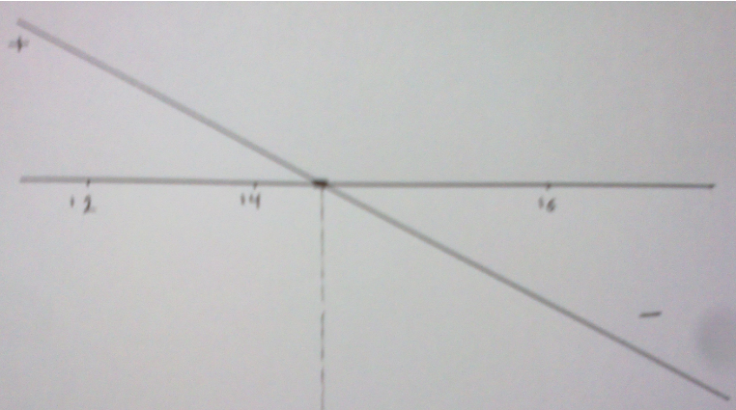
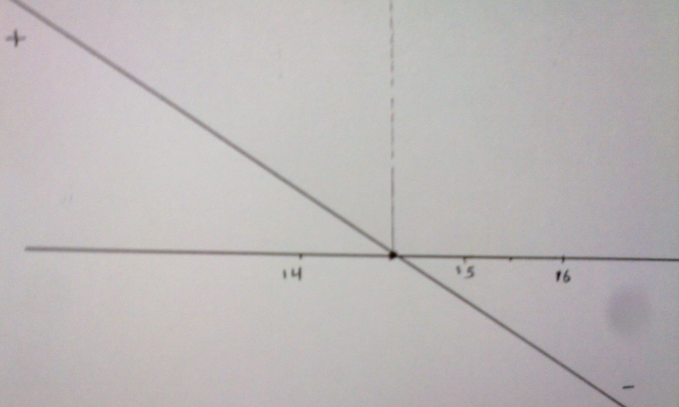
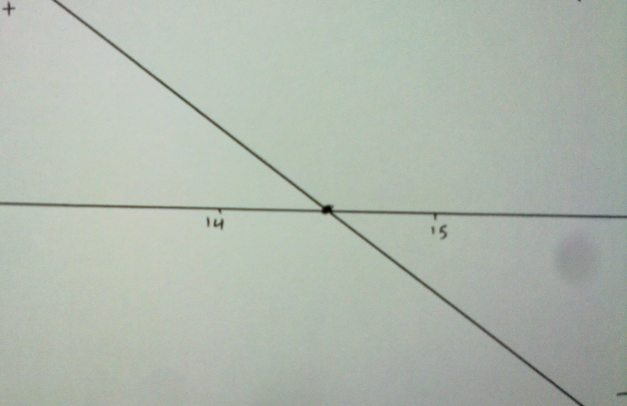
Figure 5.3

Slide 9
when then terminate the computation, is stopping criterion.
Each iteration halves the error
where, is error at iteration(n) and n is the number of iterations
, iteration(0) is zero iteration.
If is the desired error then the required number of iterations (n) is :

