Slide 1
Nonlinear regression
In many cases nonlinear models are needed to fit to data ,for example; F(x) = a_{o} (1 - e^{-a1x} ) + e
The nonlinear regression is similar to the linear regression ,however; it proceeds in an iterative fashion ,it is called gauss-newton method.
The procedure starts by setting the general equation.
y_{i} = f (x_{i} ; a_{o} , a_{1,}….,a_{m}) + e_{i}
Error
Measured value function independent variable

Slide 2
.
Abbreviated form : y_{i} = f(x_{i} ) + e_{i}
The regression curve (nonlinear model) can be expanded in ataylor series , for example;
____ ___ __ ____.
Prediction initial guess a0j +1 - a0j a1j+1 -a1j
Therefore : y_{i} = f(x_{i} ) + e_{i}
Put f(xi)j+1 instead of f(xi)

Slide 3
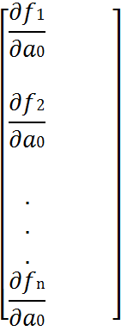
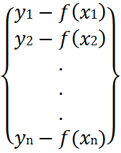
.
In matrix form :
Partial derivative {D} = ,[Zj] =
at (j) matrix vector
measurement function value n is number of data
(prediction) points

Slide 4
{ A} = change in parameters values
After linearizing the equation using taylor series , linear least-squares to get the normal equation.
Sence
solve to get them iterate as in :
and
Repeat until convergence as :
stop crite

Slide 5
Example :Gauss-newton method
Fit ) to the data;
Initial guesses a0 =1.0 ; a1 =1.0 ; sr =0.02+8
Solu. Normal equation :
2.25 | 1.75 | 1.25 | 0.75 | 0.25 | x
0.79 | 0.74 | 0.68 | 0.57 | 0.28 | y

Slide 6


 

