Slide 1
{∆A} =
{∆A} =
Remember that
a_{0,j+1} = a_{0,j} + ∆ a₀
And a_{1,j+1} = a_{1,j} + ∆ a₀

Slide 2
=
+
Shortcomings of Gauss-Newton method:
Partial derivatives may be hard to evaluate
It may converge slowly

Slide 3
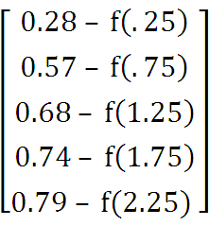
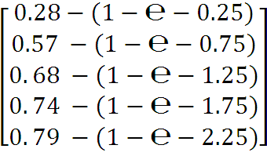
{D} =
=

Slide 4
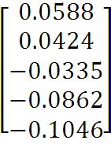
=
[Z₀]^{T}_{2x5}{D}_{5x1} =
Find {∆A} by solving the normal equation :
[[Z_{j}]^{T}_{2x5}[Z_{j}]_{5x2} ] {∆A} = [Z_{j}]^{T}_{2x5}{D}_{5x1}
One parabola (2nd order polynomial) connects three points.
1st order polynomial (Straight line) connecting two points.

Slide 5
2nd order polynomial (quadratic or parabolic) connecting 3 points.
Third- order polynomial (cubic) connecting 4 points.
Newton’s Divided-Difference interpolating polynomials
Linear Interpolation
It is to connect 2 data points with a straight line by similar triangles:

Slide 6
3- It may oscillate widely
4- It may not converge at all
CH-18 Interpolation
Interpolation is the estimation of intermediate values
between precise data points.
Polynomial interpolation
The general formula for an nth-order polynomial is f(x) =a₀+a_{1x} +a_{2x}² + ….. +a_{nx}^{n}
There is one nth-order polynomial that fits n+1 point.
Example: Straight line (1st order polynomial) connects two points.

Slide 7
Error E_{t} = 48.3 %
x. = 1 , x₁ =4
f₁(2)= 0 +
(2-1) = 0.462
Error E_{t} = 33.3 %

Slide 8
(x-x.)
f₁(x)=f(x₀)+
linear – interpolation Formula
The term
is the slope of the line

Slide 9
connecting the points and is a finite –divided difference approximation of the 1st derivative. The smaller interval (x₁-x₀), the better the approximation.
Ex: Estimate ln2 by linear interpolation Given ln1=0,ln=6=1.792,ln4=1.386, True value of
ln2=0.693
Solu:f₁(x)=f(x₀)+
(x-x.)
x. = 1 , x₁ =6
f₁(2)= 0 +
(2-1) = 0.358

