Slide 1
CHAPTER 21
numerical integration formulas

Slide 2
21.1 Newton – cotes integration formula
They are the most common numerical integration schemes. They are based on the strategy of replacing a complicated function or tabulated data with approximating function that is easy to integrate
I=
Where
n order of polynomial
Closed forms of the Newton –cotes formulas know data points at the limits of integration.
Open forms of the Newton –cotes formulas integration limits that extend beyond the range of the data.

Slide 3
21.2 Trapezoidal Rule
It’s the first of the Newton –cotes closed integration formulas. It involves a first order polynomial;
I=
Area under the straight line estimates the integral of F(X) between a and b
I=
I=

Slide 4
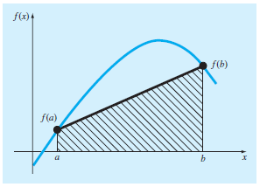

Slide 5
21.2.1 Error of the Trapezoidal Rule
An estimate for the local truncation error a single application of the trapezoidal rule is
If f(ξ) is linear then f”(ξ)=0 then Et=0
Example :integrate f(x) numerically
a=0 b=0.8

Slide 6
Solution:
The value is 1.641
Et=1.641-0.1728=1.468
% relative error
Εt=89.5%
Using

Slide 7
21-2-2 the multiple application trapezoidal rule
to improve the accuracy of the trapezoidal rule integration interval can be divided into a number of segments ,then the method is applied each segment .the areas of the segments are added to yield the integral of the entire interval.
The error (Ea) is expressed as:
If n is doubled

