Slide 1
Chapter 21 section 5 1 ⁄ 3 Rule The Multiple-Application Simpsons
the rule can be improved by dividing the integration interval into a number of segments :
n h=(b-a) ⁄
h : width
n : number of segments

Slide 3
Simpsons 3 ⁄ 8 Rule
Using a third order interpolation polynomial for integration yields :

Slide 4
From the definition of Et ,Et for 3 ⁄ 8 rule is less than Et for 1 ⁄ 3 rule , therefor 3 ⁄ 8 rule is more accurate for 3 ⁄ 8 rule is more accurate . For 3 ⁄ 8 rule , no problem if n is odd.
1 ⁄ 3 rule and 3 ⁄ 8 rule could be used together in one problem .

Slide 5
Integration with unequal segments :
it is used with unequal spaced data points . The trapezoidal rule is applied to each segment , then the results are summed .

Slide 6
Also , simpsons rule could be included in the evaluation of uneven data to get more accurate results ,i.e : equal adjacent segments could be integrated by simpsons and unequal segments by trapezoidal.

Slide 7
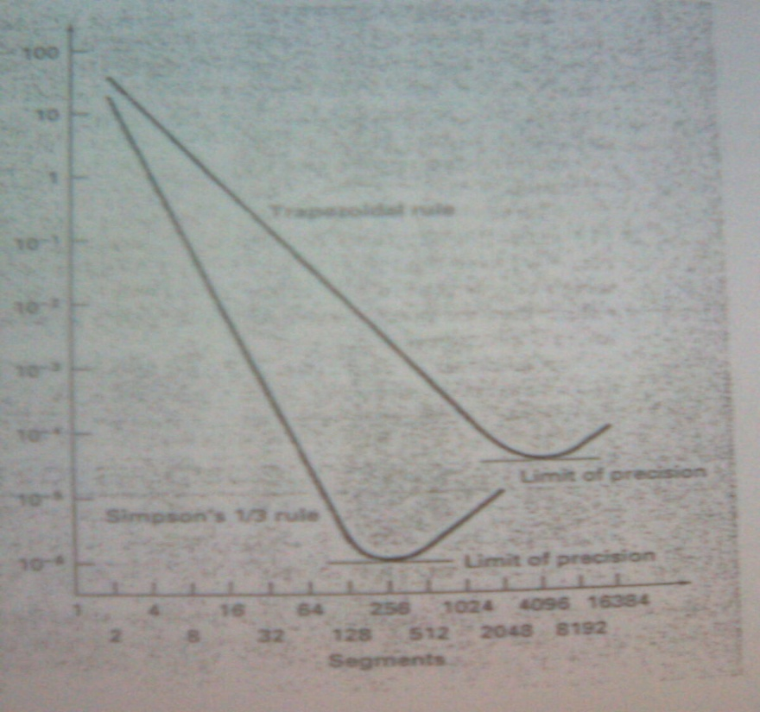
Chapter 22 integration of equation s
when the function is given ,some techniques are used to generate function values to develop sc for numerical integration .
Figure (22.1)

Slide 8
The multiple application trapezoidal rule and
simpsons rule are sometimes inadeqate .
22.2 : Romberg Integration
Designed to attain efficient numerical integrals of
function.
22.2.1 : Richardsons Extrapolation
It is the use of two estimates of an integral to compute athird , more accurate approximation .
I=I(h) +E(h)……………………………………………(1)
I : exact value of the integral
I(h) : estimate associated with amultiple-application
Trapezoidal rule with h (step size) = (b-a) ⁄ h .
E(h) : the trunceation error

Slide 9
Example: the integral of f(x) is evaluated from a=0 to b= 0.8 as:
Ƹtr % | Integral | h | Segments
89.5 | 0.1728 | 0.8 | 1
34.9 | 1.0688 | 0.4 | 2
9.5 | 1.4848 | 0.2 | 4
Compute improved estimates of the integral .

Slide 10
Solution :
for h2 = h1 ⁄ 2
I ≈ I(h2) + (1⁄3)[I(h2)-I(h1)]
I ≈ (4⁄3) I(h2) - (1⁄3)I(h1)
I ≈ (4⁄3) (1.0688) - (1⁄3)(0.1728) =1.367
Ƹt=16.6 %) Et=1.641 – 1.367 =0.273 (
Between 2 and 4 segments can be combined to give
I ≈ (4⁄3) (1.4848) - (1⁄3)(1.0688) =1.623
Ƹt = 1%) Et=1.641 – 1.623 =0.0171 (

