Slide 1
Chapter 21 integration of equations

Slide 2
When the original trapezoidal estimates are based on successive halving of the step size, for o($h^{6}$) accuracy
$I^{}$=16/15 $I_{m}$– 1/15 $I_{l}$
Where >>$I_{l}$: max. accurate estimate ,, $I_{l}$: less accurate estimate . Two o($h^{6}$) result can be combined to give I as :
I= 64/63 $I_{m}$– 1/63$I_{l}$>>>>o($h^{8}$)
*The Romberg Integration Algorithm
For computer implementation
- $I_{j,k−1}$($I_{j+1,k−1}$)($4^{\text{k}\text{−}\text{1}}$)
$I_{j,k}$ = , k-1 :level of integration
- 1($4^{\text{k}\text{−}\text{1}}$)
*($I_{j+1,k−1}$): more accurate integral.
* $I_{j,k−1}$ : less accurate integral .

Slide 3
100% │ Stopping criterion : $εa$= │$\frac{I1(k)−I2(k−1)}{I1\left(k\right)}$
$εa$:Estimate of % relative error
If $εa$<$εs$ ….. Terminate .
Romberg integration combines multiple segments trapezoidal rules.
The function must be known .

Slide 4
*two nonlinear equations with two unknowns (p 15+16)
*gauss-seidal (p 29)
Romberg *Linear curve fitting (p 44+46)
Ralston *Polynomial curve fitting (p 54)
Euler *Nonlinear curve fitting (p 57)
Heun *Interpolation (p 61)
1st derivative *trapezoidal rule (p 72)
*Simpson’s 1/3 (p 74) 2nd derivative
RK-4 *Simpson's 3/8 (p 76)

Slide 5
LV decomposition :
For a system of linear algebraic equations :
[A]{X} = {B}
A: coefficients , B: Constants , X: Unknowns
[A]{X} - {B}=0
[u]{X} – {D}=0
$\left\{\begin{aligned}d1 \\ d2 \\ d3\end{aligned}\right\}$= $\left\{\begin{aligned}x1 \\ x2 \\ x3\end{aligned}\right\}$Rearranged….>>>$\left[\begin{matrix}u_{11} & u_{12} & u_{13} \\ 0 & u_{22} & u_{23} \\ 0 & 0 & u_{33}\end{matrix}\right]$

Slide 6
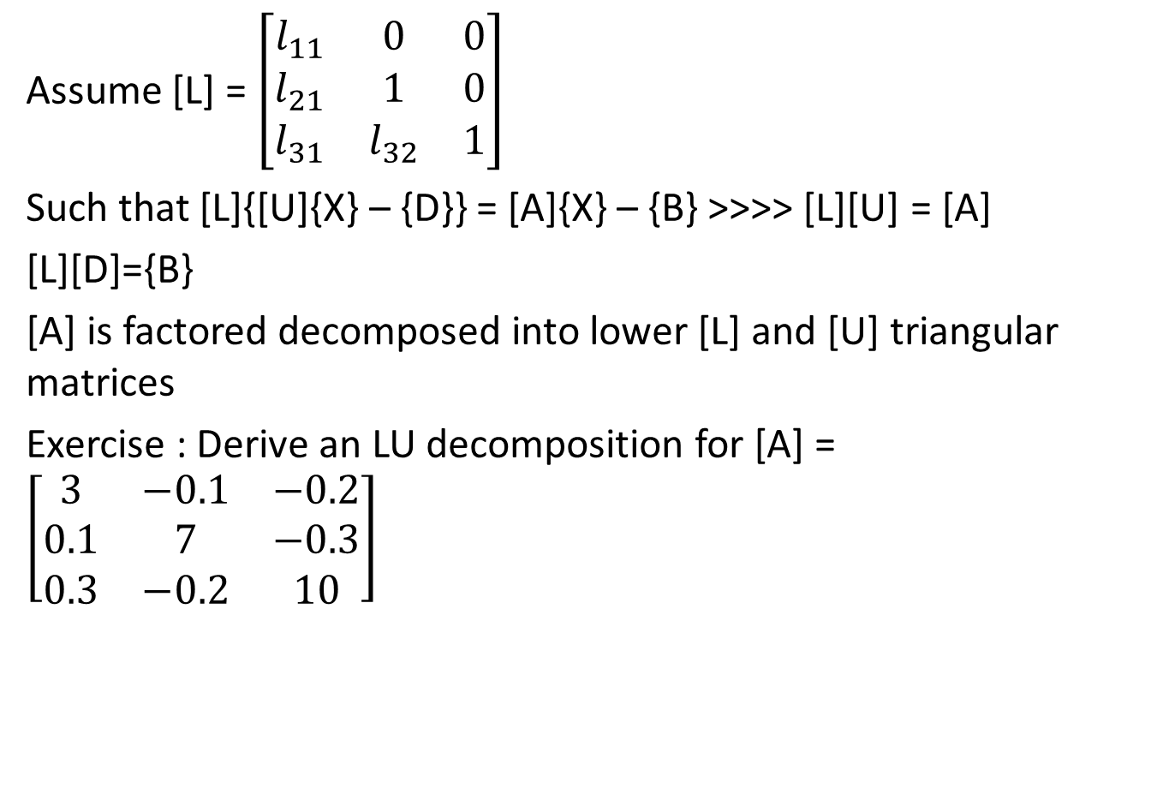
Assume [L] = $\left[\begin{matrix}l_{11} & 0 & 0 \\ l_{21} & 1 & 0 \\ l_{31} & l_{32} & 1\end{matrix}\right]$
Such that [L]{[U]{X} – {D}} = [A]{X} – {B} >>>> [L][U] = [A]
[L][D]={B}
[A] is factored decomposed into lower [L] and [U] triangular matrices
Exercise : Derive an LU decomposition for [A] = $\left[\begin{matrix}3 & −0.1 & −0.2 \\ 0.1 & 7 & −0.3 \\ 0.3 & −0.2 & 10\end{matrix}\right]$

Slide 7

Solution :
Using factored elimination :
[U]=$\left[\begin{matrix}3 & −0.1 & −0.2 \\ 0 & 7.0033 & −0.2933 \\ 0 & 0 & 10.012\end{matrix}\right]$and [L]=$\left[\begin{matrix}1 & 0 & 0 \\ 0.0333 & 1 & 0 \\ 0.1 & −0.0271 & 1\end{matrix}\right]$
Then [A] = [L][U]

Slide 8
Chapter 23
Numerical Differentiation
High Accuracy Differentiation Formulas

Slide 9
They can be generated by including more terms from Taylor series expansion . As derived from Taylor series :
$${f(xi)}^{′}= \frac{f\left(x_{i+1}\right)−f(xi)}{h}+o(h)$$
h : step size , o(h) : error term
$${f(xi)}^{′′}= \frac{f\left(x_{i+2}\right)−2f\left(x_{i+1}\right)+f(x_{i})}{h^{2}}+o(h)$$
F’(xi) can be expressed as ${f(xi)}^{′}= \frac{−f\left(x_{i+2}\right)+4f\left(x_{i+1}\right)−3f(x_{i})}{{2h}^{}}+o(h^{2})$
And all of these are forward finite divided difference formulas
*There are similar expression for higher derivatives listed in the book .

Slide 10
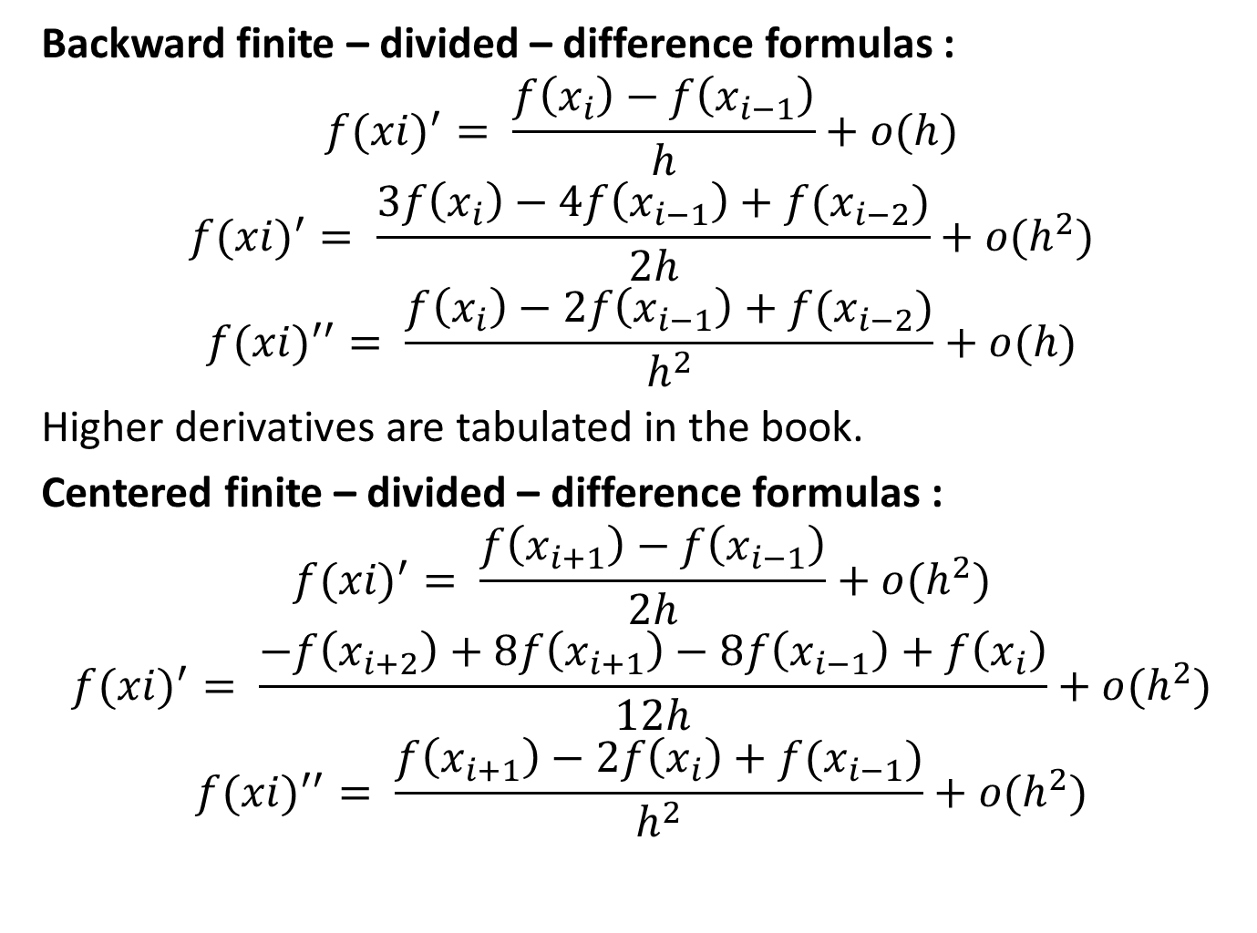
Backward finite – divided – difference formulas :
$${f(xi)}^{′}= \frac{f\left(x_{i}\right)−f\left(x_{i−1}\right)}{h}+o(h)$$
$${f(xi)}^{′}= \frac{3f\left(x_{i}\right)−4f\left(x_{i−1}\right)+f(x_{i−2})}{2h}+o(h^{2})$$
$${f(xi)}^{′′}= \frac{f\left(x_{i}\right)−2f\left(x_{i−1}\right)+f(x_{i−2})}{h^{2}}+o(h)$$
Higher derivatives are tabulated in the book.
Centered finite – divided – difference formulas :
$${f(xi)}^{′}= \frac{f\left(x_{i+1}\right)−f\left(x_{i−1}\right)}{2h}+o(h^{2})$$
$${f(xi)}^{′}= \frac{−f\left(x_{i+2}\right)+8f\left(x_{i+1}\right)−8f\left(x_{i−1}\right)+f\left(x_{i}\right)}{12h}+o(h^{2})$$
$${f(xi)}^{′′}= \frac{f\left(x_{i+1}\right)−2f\left(x_{i}\right)+f(x_{i−1})}{h^{2}}+o(h^{2})$$

Slide 11
Exercise : estimate the derivative of f(x) at x= 0.5 using h= 0.5 .
The true value is -0.9125
F(x) = -0.1$x^{4}$ - 0.15$x^{3}$ - 0.5$x^{2}$ - 0.25$x^{}$ +1.2
Solution :
1.2=$x_{i−1}$= 0 f$\left(x_{i−1}\right)$
0.425= $x_{i}$= 0.5 $f\left(x_{i}\right)$
$x_{i+1}$= 1 $f\left(x_{i+1}\right)$=0.2
$${f(xi)}^{′}= \frac{f\left(x_{i+1}\right)−f\left(x_{i}\right)}{h}+o(h)$$
${f(0.5)}^{′}= \frac{0.2−0.925}{0.5}=−1.45$$ε_{t}$= 58.9

