Slide 1
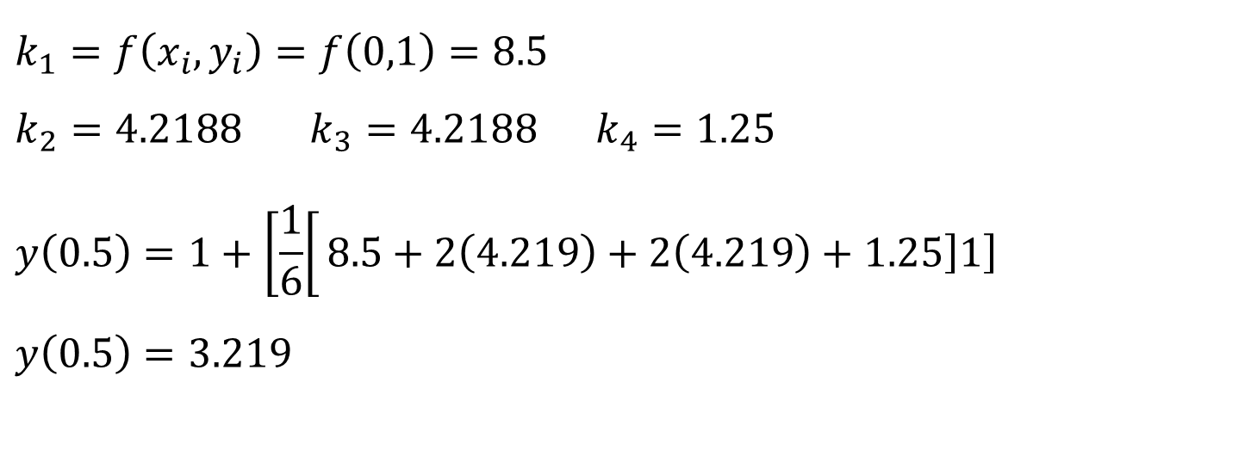
$$k_{1}=f\left(x_{i},y_{i}\right)=f\left(0,1\right)=8.5$$
$k_{2}=4.2188$ $k_{3}=4.2188$ $k_{4}=1.25$
$$y\left(0.5\right)=1+\left[\frac{1}{6}\right[8.5+2\left(4.219\right)+2\left(4.219\right)+1.25\left]1\right]$$
$$y\left(0.5\right)=3.219$$

Slide 2
CHAPTER -26
Ordinary Differential Equations /Stiffness and Multistep Methods
Explicit Euler Method (Forward):
$$y_{i+1}=y_{i}+h\frac{dy_{i}}{dt}$$
Implicit Euler Method (Backward):
$$y_{i+1}=y_{i}+h\frac{dy_{i+1}}{dt}$$

Slide 3
Chapter -27
Boundary-Value and Eigenvalue Problems
Finite Difference Methods
$$\frac{dy}{dx}=\frac{y_{i+1}−y_{i−1}}{2h}$$
$$\frac{d{}_{}^{2}y}{dx^{2}}=\frac{y_{i+1}−{2y}_{i}+y_{i−1}}{h^{2}}$$
Solve:
$\frac{d{}_{}^{2}y}{dx^{2}}+\acute{h }\left(a−y\right)=0$Use four interior odes
When y(0)=40 ,y(1)=200
$\acute{h}=0.01$ ,a=20

Slide 4

$\ddot{y}+0.01\left(20−y\right)=0$
$\ddot{y}−0.01y+0.2=0$
$$\frac{d{}_{}^{2}y}{dx^{2}}=\frac{y_{i+1}−{2y}_{i}+y_{i−1}}{h^{2}}$$
$h=\frac{10−0}{5}$=2
$$\frac{y_{i+1}−{2y}_{i}+y_{i−1}}{h^{2}}−0.01y_{i}+0.2=0$$
$$y_{i+1}−2y_{i}+y_{i−1}−0.04y_{i}+0.8=0$$
$$y_{i+1}=2y_{i}−y_{i−1}+0.04y_{i}−0.8→Algabraic Equation$$

Slide 5

$$\frac{10−0}{5}=2=∆x$$
$$y_{i+1}=2y_{i}−y_{i−1}+0.04y_{i}−0.8$$
$$y_{i+1}=2.04y_{i}−y_{i−1}−0.8$$
When i=1$→ y_{2}=2.04y_{1}−y_{0}−0.8 ⋯(1)$
When i=2$→y_{3}=2.04y_{2}−y_{1}−0.8 ⋯(2)$
When i=3 $→y_{4}=2.04y_{3}−y_{2}−0.8 ⋯(3)$
When i=4 $→y_{5}=2.04y_{4}−y_{3}−0.8 ⋯\left(4\right)$
From equation (1) substitute $y_{0}$
$$y_{2}=2.04y_{1}−y_{0}−0.8$$
$$y_{2}=2.04y_{1}−40−0.8 →{ y}_{2}+−2.04y_{1}=−40.8$$

Slide 6
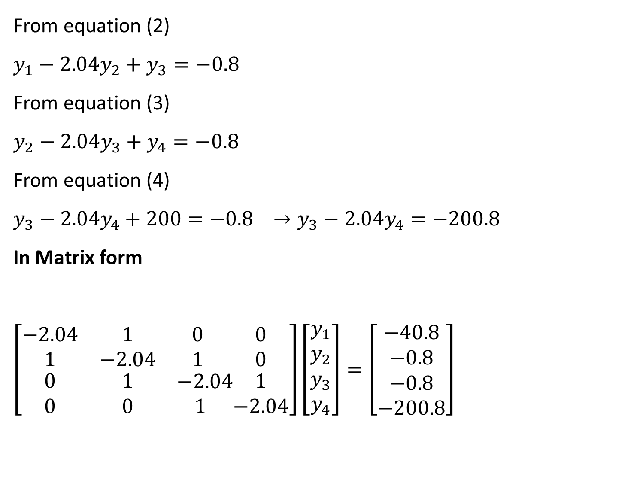
From equation (2)
$$y_{1}−2.04y_{2}+y_{3}=−0.8$$
From equation (3)
$$y_{2}−2.04y_{3}+y_{4}=−0.8$$
From equation (4)
$$y_{3}−2.04y_{4}+200=−0.8 →y_{3}−2.04y_{4}=−200.8$$
In Matrix form
$$\left[\begin{matrix}−2.04 & 1 & 0 \\ 1 & −2.04 & 1 \\ \begin{aligned}0 \\ 0\end{aligned} & \begin{aligned}1 \\ 0\end{aligned} & \begin{aligned}−2.04 \\ 1 \end{aligned}\end{matrix}\begin{matrix}0 \\ 0 \\ \begin{aligned}1 \\ −2.04\end{aligned}\end{matrix}\right]\left[\begin{aligned}y_{1} \\ y_{2} \\ y_{3} \\ y_{4}\end{aligned}\right]=\left[\begin{aligned}−40.8 \\ −0.8 \\ −0.8 \\ −200.8\end{aligned}\right]$$

Slide 7
$$\left[\begin{matrix}2.04 & −1 & 0 \\ −1 & 2.04 & −1 \\ \begin{aligned}0 \\ 0\end{aligned} & \begin{aligned}−1 \\ 0\end{aligned} & \begin{aligned}2.04 \\ −1 \end{aligned}\end{matrix}\begin{matrix}0 \\ 0 \\ \begin{aligned}−1 \\ 2.04\end{aligned}\end{matrix}\right]\left[\begin{aligned}y_{1} \\ y_{2} \\ y_{3} \\ y_{4}\end{aligned}\right]=\left[\begin{aligned}40.8 \\ 0.8 \\ 0.8 \\ 200.8\end{aligned}\right]$$

