Slide 1
Polynomial Methods
Example (27.6):
Use the polynomial method to find the eigenvalues of the BVP:
ODE with Boundary Conditions:
y(0)=0 & y’(3)=0
Use 1,2,3,&4 interior nodes.

Slide 2
Solution :
Substituting in equations :

Slide 3
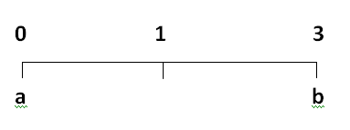
1. One interior node:
n=2
P= ±0.9428

Slide 4
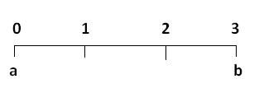
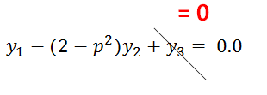
2. Two interior nodes :
n=3
0 →2
1→3

Slide 5
In matrix form :
P= ±1, ±1.73205 New

Slide 6
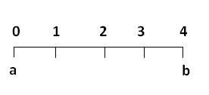
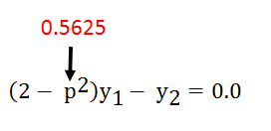
3. Three interior points :
n=4
0 →2
( done previously )
1 →3
2 →3

Slide 7
In matrix form :

Slide 8
P1 = ±1.0205 ,P2= ±2.4637 New

Slide 9
4. Four interior points :
n=5
With 4 applications of the equation , we get the equal in matrix from as :
Taking the determinant equal to zero

Slide 10
P1 = ±1.0301
P2= ±1.9593
P3 = ±2.6967
P4= ±3.1702 New

Slide 11
CH -9
Gauss Elimination
Section 9.6 :Nonlinear System of Equations
To solve n simultaneous nonlinear equations:

Slide 12
A multidimensional version of Netwon –Raphson method can be used . A Taylor series expansion is written for each equation :
For example , K th equation :
Present value
Next value

Slide 13
A similar equation ( expansion) is written for each nonlinear equation .
All values are set to zeros ( to find the roots ).
Unknown

