Slide 1
Automation
The University of Jordan
Mechatronics Engineering Department
Chapter 2
Manufacturing Operations
Dr. Osama Al-Habahbah
2015

Slide 2
Manufacturing operation
Manufacturing can be defined as the application of physical and chemical processes to alter a given starting material to make products.
It also include joining parts to make assembled products. It is a technological as well as an economic process . A "value" is added to the starting material by means of Machinery, tools, power and labor.
Examples :
Iron ore is converted into steel → value is added.
Sand is converted to→ Glass.
Petroleum is converted to→ Plastic.

Slide 3
2.1 Manufacturing Industries and Products
Classification of industries
Primary
Secondary
Tertiary
Cultivates and exploits natural resources such as agriculture and mining.
Constitutes the service sector of the economy ,such as banking, education, health ,etc…
Converts the outputs of the primary industries into products (Manufacturing) such as Aerospace ,Apparel, etc…

Slide 4
Our focus will be on the secondary industries or manufacturing companies.
They are two types:
Process industries : Such as chemicals, Pharmaceuticals , Petroleum, beverages, electric power…
Discrete product industries : Such as automobiles ,aircraft, appliances, computers, machinery and their component parts.

Slide 5
2.1 Manufacturing Industries and Products
The above classification is according to the International Standard Industrial Classification (ISIC) used by the UN.
The process and Discrete industries are further divided into two methods:

Slide 6
2.1 Manufacturing Industries and Products
The process and Discrete industries are further divided into two methods:
1- Continues production: No interruptions in the output flow, such as gas material or powder.
2- Batch production: Input and output are in finite quantities. They can be different from each other.

Slide 7
2.1 Manufacturing Industries and Products
Final products can be divided into:
1- Consumer goods:
Purchased directly by consumers, e.g. cars, PC’s and TV’s.
2- Capital goods:
Purchased by others companies to produce goods and supply services. e.g. commercial aircraft, railroad equipment.
Some companies produce components for the companies that make the final product.

Slide 8
2.2 Manufacturing Operations:
The factory activities to convert raw materials into products are:
1- Processing and assembly operations.
2- Material handling.
3- Inspection and test.
4- Coordination and control.

Slide 9
2.2 Manufacturing Operations:
2.2.1 Processing and Assembly Operations
Manufacturing processes are two types:
1- Processing operations:
Transformer a work material from one state to another more advanced state (closer to the final product). It adds value by changing the work material.
2- Assembly operation:
Joins two or more components to create a new entity, which is called an assembly.

Slide 10
2.2 Manufacturing Operations:
Categories of Processing operations:
1- Shaping operations (of parts).
2- Property-enhancing operations.
3- Surface processing operations.
1- Part shaping operations apply mechanical force and/or heat/energy to change the geometry of the work material. They are divided into four categories:
A- Solidification processes: such as casting for metals, molding for plastics → (liquid to solid)

Slide 11
2.2 Manufacturing Operations:
1- Part shaping operations
B- Particulate processing: The starting material is a powder, it is pressed in a die cavity under high pressure so as to take the shape of the cavity. Then it is sintered; (heated to a temperature below the melting point) so that particles bond together. It is called “powder metallurgy” for metals it can be used to form ceramics too.
C- Deformation processes: used on ductile metals. Stresses higher than yield strength are applied, maybe combined with heating to increase ductility. Examples include: forging, extrusion, rolling, sheet metal drawing, forming and bending.

Slide 12
2.2 Manufacturing Operations:
1- Part shaping operations
D- Material removal processes: Performed on solid metals. Include “machining” such as turning, drilling, milling and grinding, as well as lasers electron beams, chemical erosion, water jet, plasma, etc……
2- Property-enhancing operations:
Designed to improve mechanical or physical properties of the work material. They include; heat treatments, used for strengthening or toughening of metals and glasses.

Slide 13
2.2 Manufacturing Operations:
1- Part shaping operations
3- Surface processing operations:
Include cleaning, surface treatments, and coating and thin film deposition.
* Cleaning can be chemical or mechanical.
* Surface treatments include sand blasting and ion implantation.
* Coating includes electroplating, anodizing, painting, oxidation.
Assembly Operations:
Two or more parts are joined. Either permanently by welding, brazing, soldering and adhesive bonding or mechanically by threaded fasteners (screw, bolts, nuts).

Slide 14
Other factory operations:
* Material handling and storage:
It takes more time than material processing. The ratio is 95-5! The 5% includes loading, cutting and unloading.
* Inspection and Testing:
Product meets design standards?
Product meets functional specifications?
* Coordination and Control
Includes control at the process level and at the plant level.
Labor, maintenance,….

Slide 15
2.3 Production Facilities:
Annual produced are classified as:
1- Low-production (1-100 units)
2- Medium-production (100-10,000 units)
3- High-production (100,000-millions of units)
Product variety: Types that are produced.
Relationship between product variety and production quantity:

Slide 16
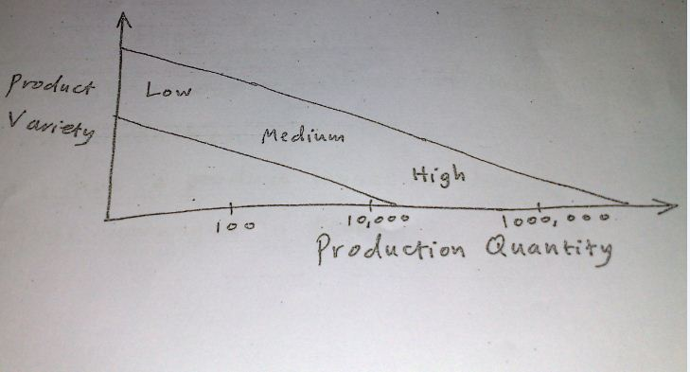
Product variety

Slide 17
Product variety
Hard product variety Products differ substantially.
Soft product variety Products differ slightly.

Slide 18
2.3.1 Low Production
Quantity: 1 to 100 units annually.
Production facility is called “job shop”.
Products are complex /Large.
Equipment is general purpose.
Labor is highly skilled.
Plant has a fixed-position layout Workers and equipment are brought to the product.

Slide 19
2.3.2 Medium Production
Quantity: 100 to 10,000 units annually.
Batch production with change-over between batches (Variety)
Equipment in process layout (each step done separately).
2.3.3 High Production
Quantity: 10,000 - millions of units per year Mass Production
Plant has a product layout flow line work-stations arranged in sequence.

Slide 20
2.3.3 High Production, cont..
Work moved by powered conveyor, e.g. Assembly line.
Product complexity can be measured by the number of its components or the number of processing operations required to fabricate it.
For example, an automobile typically has 20,000 components, while a commercial airplane may have 1 million components!

Slide 21
2.4.3 Limitations and Capabilities of a Manufacturing Plant
Focused factories can be parts producers or assembly plants.
Manufacturing capability of the plant depends on:
1. Technological Processing Capability:
It is the available set of manufacturing processes and the
expertise of the company.
2. Physical Product Limitations:
Size and weight ranges.
3. Production Capacity:
Quantity that can be produced in a given time period.

Slide 22
2.5 Lean Production
It means operating the factory with the minimum possible resources, and yet maximizing the work accomplished and maintaining high quality.
Some programs associated with lean production include :
Just-in-time delivery of parts minimizes work-in-process.
2. Worker involvement more flexible skills and duties,
more utilization.

Slide 23
2.5 Lean Production
3. Continuous improvement by worker teams to solve
problems.
4. Reduced setup times change-over time between batches.
5. Stopping the process when something is wrong less
defective parts.
6. Error Prevention taking precautions.
7. Total productive maintenance Preventive maintenance.
Overhead costs are the factory expenses not including direct labor and materials.

