Slide 1
Chapter 5 Industrial Control Systems
The University of Jordan
Mechatronics Engineering Department
Dr. Osama M. Al-Habahbah
2015

Slide 2
Industrial control systems
Industrial control is the automation regulation of manufacturing operations and their associated equipment, as well as integration of manufacturing operations into the larger production system.

Slide 3
5.1 Process Industries vs. Discrete Manufacturing Industries
Typical Manufacturing operations in the process industries and Discreet industries :
Process industries :
▪ Chemical reactions
▪ Commination
▪ Deposition
▪ Distillation
▪ Mixing
▪ Separation

Slide 4
5.1 Process Industries vs. Discrete Manufacturing Industries
Manufacturing Industries
Discrete industries
▪ Casting
▪ Forging
▪ Extrusion
▪ Machining
▪ Assembly
▪ Plastic Molding
▪ Sheet Metal Stamping

Slide 5
5.1.1 Levels of Automation in the Two Industries
Process Industries | Discrete Industries
Level 5: Corporate level: Management information system, Strategic planning, high –level management of enterprise | Management information System, Strategic planning high –level management of enterprise
Level 4: Plant level: Scheduling Tracking materials Equipment monitoring | Scheduling Tracking work-in-process, Routing parts through machines, Machine utilization
Level 3: Supervisory Manufacturing cell Control level : Control and coordination of several Interconnected manufacturing operations that make up the total process | System level: Control and coordination of groups of machines and supporting equipment working in coordination, including material handling equipment

Slide 6
5.1.1 Levels of Automation in the two Industries
Process Industries | Discrete Industries
Level 2 : Regulatory Control level: Control of Manufacturing operations | Machine level: Production machines of work stations for discrete part and product manufacture
Level 1: Device level: Sensors and actuators comprising the basic control loops for manufacturing | Sensors and actuators to accomplish control of machine actions

Slide 7
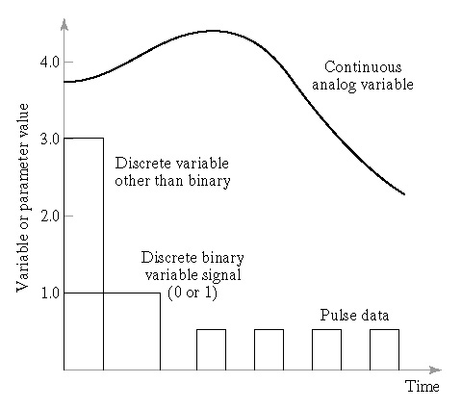
5.1.2 Variable and Parameters in the Two Industries
Fig:5.1

Slide 8
5.1.2. Variable and Parameters in the two Industries
Manufacturing operations
▪ Variables - Outputs of the process
▪ Parameters - Inputs to the process
▪ Continuous analog variable such as:
Force, temperature, flow-rate, pressure, velocity
▪ Discrete variable: other than binary such as daily piece count
▪ Discrete binary variable (0 or 1):
Signal such as Open/Close, On/Off
▪ Pulse data: A train of pulses that can be counted

Slide 9
5.2 Continuous vs. Discrete Control
Process industries:
→ Control of continuous variable and parameters
▪ Continues control: variables and parameters are continuous
and analog.
Discrete manufacturing industries:
→ Control of discrete variable and parameters
▪ Discrete control : variable and parameters are discrete, mostly binary

Slide 10
5.2 Continuous vs. Discrete control
Comparison Factor | Continuous Control in Process Industries | Discrete Control in Discrete Manufacturing Industries
Typical measures of product output | Weight measures liquid volume measures Solid volume measures | Number of parts Number of products
Typical quality measures | Consistency Concentration Absence of contaminants conformance to specification | Dimensions Surface finish Appearance Absence of defects Product reliability
Typical variables and parameters | Temperature Volume flow rate Pressure | Position Velocity Acceleration Force

Slide 11
5.2 Continuous vs. Discrete control
Comparison Factor | Continuous Control in Process Industries | Discrete Control in Discrete Manufacturing Industries
Typical sensors | Flow meters Thermocouples Pressure sensors | Limit switches Photoelectric sensors Strain gages Piezoelectric sensors
Typical actuators | Valves Heaters Pumps | Switches Motors pistons
Typical process time constants (lag coefficient) Ʈ* | Seconds Minutes hours | Less than a second
Ʈ* :time required for a quantity to change from 0 to 63.2% of steady state value or to change from steady-state to (36.8%) of it .
* Most industries deal with a mix of continuous and discrete variables and parameters

Slide 12
5.2 .1 Continuous Control System
• The objective is to maintain the value of an output variable at
a desired level similar to a feed back control system.
• Example :
▪ Chemical reactions → temperature, pressure, flow rates
▪ Work part position relative to cutting tool → X,Y,Z values are
continuous
• Continuous control categories :
Regulatory control :
The objective is to maintain process performance at a certain level. Compensation action is taken only after a disturbance has affected the process output

Slide 13
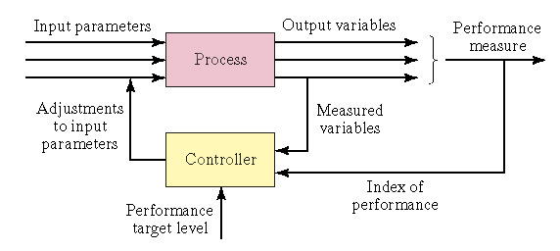
5.2 .1 Continuous Control System
• Continuous control categories :
Regulatory control :

Slide 14
Feed-forward Control :
Disturbance
Input parameters
Output variables
Process
Adjustment to input parameters
Measured variables
Feed forward
Control element
Controller
Index of performance
Performance target level

Slide 15
Feed-forward Control :
The strategy is to anticipate the effect of disturbances and compensate for them before they can affect the process.

Slide 16
Steady-State Optimization :
Input parameters
Output variables
Performance measure
Process
Adjustments to input parameters
Well-defined index of performance (IP)
Controller
Algorithm to determine
optimum input parameter values
adjustments
Mathematical model of process and IP

Slide 17
Steady-State Optimization :
Index of performance IP :
1- Well defined
2- Algorithm to determine optimum input parameter value .
3- Mathematical model of process and IP.
IP could be product cost , production rate ,…
Used when mathematical relations exist such as differential equation

Slide 18
Adaptive Control
It responds to the change of the environment with time, such as raw materials.
Output variables
Performance measure
Input parameters
Process
Adjustment to input parameters
Modification
Measured variables
Decision
Adaptive Controller
Identification
Index of performance

Slide 19
Adaptive Control
Identification : Continuous update of index of performance .
Decision : Based on algorithm + IP .
Modification : Actuators.
Examples : Adaptive control machining, jet aircraft, flight controls .

Slide 20
On-Line Search strategies :
Continuous Control System
In case the relationship between input parameter and the index of performance is unknown .Trial and error and other techniques are used to find which input parameter affect IP, so as to optimize it .

Slide 21
5.2.2 Discrete control systems :
Changes are executed either due to a change of the state of the system or because of elapsed time .
Event-driven changes:
Responds to some event that has changes the state of the system ,such as presence of a part ,low-level of plastic molding compound, counting parts on a conveyer belt.

Slide 22
5.2.2 Discrete control systems :
Time-driven change :
Executed either at a specific time , or after a certain time lapes , such as “Shop Clock” to start and end work , length of heat treatment ,..
A washing machine has both event-driven and time-driven changes that control it.
Types of discrete control :
1- Combinational logic control :controls the event –driven changes.
2-Sequential control : manages time-driven changes .

Slide 23
5.3 Computer Process Control
5.3.1 Control Requirements :
A “real – time controller “ is a controller that is able to respond to the process within a short enough time that performance is not degraded .

Slide 24
Requirements for a real-time controller :
1- Process – initiated interrupts : (event – driven change )
The computer may interrupt execution of current program to service a higher priority need of the process , often triggered by abnormal condition .
2- Timer – initiated actions : ( time – driven change )
The controller must be capable of executing certain actions at specified points in time. These actions could be : scanning sensor values …….

Slide 25
Requirements for a real – time controller :
Switch on/off . Displaying data , recomposing parameter
Other requirements for a real – time control computer are : Computer commands to process , low – priority system and program – initiated events , and Operator – initiated events .

Slide 26
5.3.2. Capabilities of Computer Control :
* Polling ( Data Sampling ) : ( Scanning )
Periodic sampling of data that indicates the status of the process .
Issues related to polling :
1
1. Polling frequency : = -------------------------------------------------
Time interval between data collection
2. Polling order : Sequence of different data point
3. Polling format : The manner in which the sampling procedure is designed .

Slide 27
5.3.2 Capabilities of Computer Control :
The alternatives include :
(a) Entering all new sensors data every polling cycle
(b) Updating the control system only with data that have changed .
(c) Using high-level scanning : Collecting only certain key data.
Using Low-level scanning : Collecting more complete data .
Using conditional scanning : Collecting more complete data if necessary .

Slide 28
* Interlocks
5.3.2 Capabilities of Computer Control :
Safeguard mechanism for coordinating the activities of devices sequence of activities.
Input interlock : ( a signal from a sensor / machine to the controller ) proceed work cycle , interrupt the work cycle for some reason . Ex.: washing machine door.
Output interlock : a signal from the controller to an external device to control its activities .

Slide 29
Interrupt System
5.3.2 Capabilities of Computer Control :
Permits the execution of the current program to be suspended to execute another program in response to a higher priority event.
Ex.: pushing keyboard key.

Slide 30
5.3.2 Capabilities of Computer Control :
Priority levels in an Interrupt System :
Priority Level ( ranking ) Computer Function / Control Function
1- ( lowest priority ) Most operator inputs
2- System & program interrupts
3- Timer interrupts
4- Commands to process
5- Process interrupts
6- (highest priority ) Emergency stop ( operator input )

Slide 31
Interrupt System
5.3.2 Capabilities of Computer Control :
Internal interrupts: generated by the computer itself.
External interrupts: process- initiated and operator inputs.
A higher priority function can interrupt a lower priority function.
A function at a given priority level cannot interrupt a function at the same priority level.

Slide 32
Interrupt System
5.3.2 Capabilities of Computer Control :
Single-level interrupt system has only two modes of operation; normal mode and interrupt mode.
If higher priority signal arrives after a lower priority signal, it has to wait .
Multilevel interrupt system has a normal operating mode plus more than one interrupt level (with relative properties).
If higher priority interrupt signal arrives after a lower priority interrupt, it will override it and its task serviced first.

Slide 33
Exception Handling (Error detection & recovery ):
5.3.2 Capabilities of Computer Control :
An exception is an event that is outside the desired operation of the process.
e.g. Production quality problem, variables outside normal range, shortage of raw materials, hazard conditions, controller malfunction…..

Slide 34
5.3.3 Forms of Computer Process Control

Slide 35
Computer process monitoring
Control remains in the hands of humans.
Categories of data collected by the computer:
Process data: input parameters, output variables, …..
Equipment data: status of the equipment in the work cell, machine utilization, schedule, tool changes, diagnosis,…..
Product data: maybe required by regulations for the firm own use.
data may be entered manually or automatically

Slide 36
Direct digital control (DDC)
No longer used today! It was a transitional phase in computer process control.
It was an improvement on the analog control loop.

Slide 37
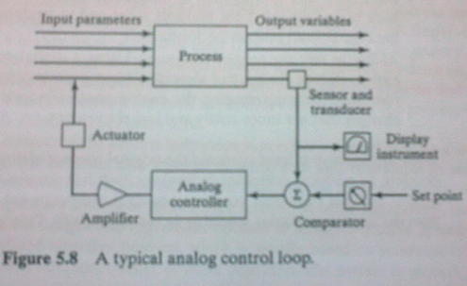
A Typical Analog Control Loop
Sensor and Transducer
Display Instrument
Analog Controller
Comparator

Slide 38
Direct digital control (DDC)
Input parameters
Output Variables
Process
Actuators
Sensors
Multiplexer
Multiplexer
DAC
ADC
DDC Computer
Operator Console

Slide 39
Improvement to the DDC system include
More control options than traditional analog, such as on/off or nonlinear functions.
Integration and optimization of multiple loops. Such as feedback measurements integration.
Ability to edit the control programs, more flexibility to reprogram, no need for hardware changes as in analog control.

Slide 40
Numerical control and robotics
Numerical control (NC): a microcomputer directs a machine tool through a sequence of steps defined b y a program of instructions.
Industrial robotics: the joints of the robot arm are controlled to move the end of the arm through a sequence of positions during the work cycle.

Slide 41
PLC) Programmable logic controller)
Introduced in 1970 as an improvement on the electromechanical relay controllers used to implement discrete control.
A PLC is a microprocessor-based controller that uses stored instructions to implement logic, sequencing, timing, counting, etc…for controlling machines and processes . It’s used for both continuous and discrete control

Slide 42
Supervisory control, e.g. SCADA (Supervisory Control And Data Acquisition)
It corresponds to cell or system level control (higher level than NC and PLC)
It is superimposed on those process-level control systems (NC and PLC).
Has economic objectives.
Could be regulatory control, feed forward control, or optimal control.

Slide 43
Supervisory control
Input Parameters
Output Variables
Economic Objective
Process
Actuators and Input Parameters
Feedback from output variables
Direct Process Controller
Supervisory Control
Human Interface

Slide 44
Distributed Control Systems (DCS)
Multiple microcomputers are connected together to share and distributed the process control work load.
component and features:
Multiple process control stations.
A central control room for supervisory control.
Local operator stations (for redundancy).
Communications network (data highway) for process and operator stations interaction.

Slide 45
Distributed Control System
Local Operator Station
Central Control Room
Local Operator Station
Communication
Network
Process Station
Process Station
Process Station
Process Station
Signals
Process
Raw
Product
Materials

Slide 46
Benefits and advantages of DCSs :
Can be enhanced in the future (after installation ).
Parallel multitasking is possible with multiple computers.
It has built-in redundancy.
Control cabling is reduced compared with central control.
Networking facilitates plant management.
Example : Multiple PLC’s through a factory, connected by network.

Slide 47
PCs in Process Control
Categories of PC implementations in process control:
Operator Interface: The PCs interfaced to one or more PLCs or other devices that directly control the process.
Advantages :
The PC is user-friendly.
It can be used for other functions.
The failure of the PC does not disrupt the PLCs functions.
Can be easily upgraded.

Slide 48
PCs in Process Control
2. Direct Control: The PC is interfaced directly to the process and controls its operations in real-time.
Problems :
If the PC fails, the process fails.
PC is not designed for process control.
PC is designed to be used in an office environment.

Slide 49
PCs in Process Control
However, There is a trend for PC deployment for direct control due to several factors :
Wide-spread familiarity with PCs.
Availability of high performance PCs.
“Open architecture philosophy” in control systems design, which means procuring hardware and software from a diverse pool of vendors; not getting the whole system from the same supplier.

Slide 50
PCs in Process Control
Availability of PC operating systems that facilitates real-time control, multitasking and networking.
Industrial-grade PCs can be used to cope with the harsh factory environment.
Data integration is easier using one PC than using a PC and a PLC.

Slide 51
Enterprise-Wide Integration of Factory Data:
It entails less management levels and more empowerment of front line workers.
Enterprise Resource Planning (ERP) is a software that achieves company-wide integration of all business functions, including factory data.
A key features of ERP is the use of a single central database that is accessible from anywhere in the company.

Slide 52
Capability resulting from integrating process data:
Managers have direct access to factory operations.
Production planners have access to most current data on production to help in scheduling future orders.
Sales personnel can provide realistic delivery dates.
Customers can track the status of their orders.
Quality performance is more predictable.
Production cost accounting can be updated.
Production personnel have access to product design.

