Slide 1
University of Jordan School of Engineering Mechatronics Engineering Department Design of Integrated Systems Dr. Osama M. Al-Habahbeh Spring Semester 2016/2017

Slide 2
System Integration
Introduction :
System Engineering :
Examples of complex engineering systems:
include jet airplanes, aircraft carriers, submarines, space shuttles, information systems, cars, mobile phones, etc.…

Slide 3
System Integration
A system is defined as a set of elements that work together to produce results not obtainable by individual elements.
The elements could include people, hardware, software, facilities, policies and documents.
The results include system level characteristics and performance and they depend on how the elements are interconnected.
A system can be devided into subsystems, and a subsystem can be devided into components or parts.

Slide 4
System Integration
System engineering is an interdisciplinary field that integrates all the efforts to develop and verify a set of system, people, product, and process solutions that satisfy customer needs.
The system engineering process starts with the user requirement analysis, then system requirement analysis, then system design.

Slide 5
System Integration
The components development, then system integration validation, and verification.
The system engineering process has dynamic nature, that is : iterative and incremental not sequential.
A requirement can be mentioned in a contracted, a standard. A specification, or a regulation.
A requirement should be necessary, verification and attainable.
System architecture identify performance requirements, while physical architecture depicts the products subsystems and components.
System integration means bringing the subsystems and components together so that they work as a whole.

Slide 6
System Integration
System Engineering (SE) is a moving from documents based to model based.
The system life cycle starts with the concept, then development, then production, then operation and support.

Slide 7
System Integration
Each of these stages can be modeled, and the resulting models can be integrated.
Part 2:
Product Lifecycle :
Product lifecycle is triggered by a market need or a main idea.
It starts with product planning, and ends with disposal.

Slide 8
Market need
Goals of company
Product Planning
Design/development
Production/Assembly/Test
Product Lifecycle
management
Requirements
Marketing/Sales
Use/Consumption/Maintenance
Recycling
Disposal/Environment

Slide 9
Structure of system:
S:SystemBoundary
I/P 1
O/P 1
$$S_{1}$$
$$S_{32}$$
I/P 2
O/P 2
$$S_{2}$$
$$S_{31}$$
$$S_{34}$$
$$S_{4}$$
$$S_{33}$$
$$S_{3}$$
I/P 3
$$S_{5}$$

Slide 10
Structure of system
$S_{1}$,$S_{2}$,$S_{4}$ and $S_{5}$ are subsystems of S.
$S_{31}$,$S_{32}$,$S_{33}$ and $S_{34}$ are subsystems of $S_{3}$.
I/P 1, I/P 2, and I/P 3 are inputs.
O/P 1 and O/P 2 are outputs.
Transfer function can be used to express the static and dynamic behavior of the elements (Subsystems) of the system model.

Slide 11
System Life Phases
Planning
Preliminary
Study
System
Development
System
Production
System
Installation
System
Operation
System
Replacement
Problem
Analysis
Problem
formulation
System
Synthesis
System
Analysis
Evaluation
Decision
The System approach is iterative goes in cycles

Slide 12
System Design Steps
Product Design Specification (PDS) is based on market need.
Requirements Planning
Abstract
Costing
Synthesis
Market
Need
Specifications
(PDS)
Concept
Design
Detailed Design
Embodiment Design
-Optimization
-Simulation
Iterations
Competition
Analysis
Testing
Prototyping

Slide 13
Top-Down System Design:
Sub-functions
Decomposing
Function Structures
A set of parts
or subsystems
Requirements/Objectives
Integrated
System
Integrating
The Subsystems
Building the
subsystems

Slide 14
Interface Identification
Good interface design between subsystems is essential for correct functionality of the whole systems , Compatibility of subsystems and components.
Example of interface include electrical signals damage and dust protection (case), air cooling, user display, user control, mounting supports, power input, etc.…
Some interface are external and others are internal (with the system), such as joining subsystems.

Slide 15
System Integrity
Means the system is organized to meet quality and consistency standards, with an acceptable useful life.
Example:
If one of the components has much lower reliability than other components, the total reliability of the system will be lower than the minimum reliability !

Slide 16
Commonality
It means using some common parts in different components for the purpose of decreasing the number of required spare parts, and by doing so, decreasing cost.

Slide 17
Design Requirements/Specifications Could Include:
- Design for reliability, availability, or maintainability.
- Design for minimum cost, recycling.
- Design for high production and case of assembly.
- Design for compatibility with existing systems.
- Design for case of use, Ergonomics.
- Design for safety, standards, quality.
- Design for Aesthetics ( appearance).
- Design for easy future enhancement.
- Design for robustness, weight, or energy requirement.

Slide 18
CAD – Computer Aided Design
It enhances the Creativity and flexibility of the design process .
Easier retrieval of design data .
Easier analysis and optimization .
It enables more effective modeling and simulation of system .
It reduce the cost of experimental testing .
It needs special experience and training .
In general it reduces the time required for design and development .

Slide 19
Methods of Design Analysis
Literature search of existing technologies .
Study of Natural Systems. that is the connection between biology and technology (bionics and biomechanics), examples include honey combs, ships, etc .
Study of existing technical systems of competing companies .
Use of an analogous or experimental system .
Brainstorming , where a group of people bring their thoughts up in a session .
Systematic study of physical processes , when represented by equation
Modeling and Simulation

Slide 20
Component selection
Component selection is part of Detail design phase the selection process depends on the Component Design Specification (CDS). CDS includes all essential elements to provide the required quality.

Slide 21
Component selection these element include :
Performance
Input/output (I/O):
Local constraint/interfaces
Imposed by surrounding environment , such as harmonization with adjacent component
Environment
Temperature
Loads
Transients
Stresses
Effect of interfaces
Humidity
Corrosion
Shock
Vibration
Pressure
Testing of the component
Shelf life storage
Where to store spaces and for how long
Quality and reliability
Materials
Alternatives
Other considerations
Component design
Selection area
maintenance
Reliability
Weight considerations
Usually lighter weight costs more
manufacturing
Manufacturing facility
Consumable : used only one time
Expendable : used until unusable that throw away
Repairable :remove and repair
Manufacture in-house or by out
Ergonomics
How to handle the component within the system ?
safety
Any facilities or procedure required for safety
Aesthetics
Shape or form, is it important for this component ?
Components and accessibility
standards
Cost
For materials
Dimensions
Consideration of design alternative to minimize the cost

Slide 22
Other consideration of component design/selection are :
Defining a component within a system places constraints on other component of the system .
The cheapest component my not always be the most economic in a total sense .
Generally, less component variety results in shorter lead times minimum cost.
Look for a simpler way.
How do other industries do it ?
Can it be abolished / reduced ?
Can any functions be taken over by other components ?
Can functions be split giving simpler parts ?
Can Parts or functions be amalgamated ?
Can it be made of standard parts ?
would it help to make it standard

Slide 23
Some Types of Components
Dynamic Load supports
Electronic controls and displays
Data processing software
Propulsive machinery

Slide 24
Repetitive and modular element
Example include memory chips in computers and masonry blocks in building .
They result in economic benefits such as economy of scale and reducing spare parts inventory
Examples of interfaces between components include:
Physical interface : dimensions, shapes sizes
Electrical interface : Current capacity, Maximum voltage
Expected life time (ON/off operation)
Thermal interface criteria such as maximum safe temperature
Data format ,and communication protocol .
it is desirable to reduce the number of interfaces where possible , while keeping them simple.

Slide 25
Repetitive and modular element
Some system components and developed by system builder, while others are developed by subcontractors or procured off the shelf .
The proper system integration requires correct initial design. By doing so, delays and losses in later stages can be avoided .
When components are connected, they form a chain which can be a closed or open Loop .
Recording is an important part of the system integration process .
Component selection is pant of the system synthesis process.
New innovations can be achieved by using new layouts existing pants, or existing layouts with a mix of new and existing parts .

Slide 26
Repetitive and modular element
A components I/O can be classified as below
.
Energy
.
Material
.
Signals
Energy
.
Material
.
Signals
.
The overall function of the system can be divided into sub functions The links between sub functions must be compatible .
Sub functions can be represented by blocks, then different block can be logically linked to represent the system
Each sub functions is performed by a single components

Slide 27
Engineering system Definition
Engineering Emergency shutdown system , ESP(spill, leak) warning signals
Emergency e pressurization system (EDS), trip
Pressure safety valve (PSV), VBV
Circuit breaker : protect from short circuit/overload
HSE : Health, Safety, and Environment
Reverse Engineering (RE): Analyze system in detail (ex . Machine software) by taking it a part to determine its design . It is done for maintenance , economic upgrade, Military, imitation, patent infringement, etc.
Engineering design methodology : method of design , system design steps.

Slide 28
Engineering system Definition
Design Model : Describes detail the structure of the system, and how it will be implemented.
Design process : Refer to design methodology .
Design Feasibility : Possibility with acceptable cost.
Boundary Conditions : Interface specification/component selection .
Modular Design : Dividing the system into module, each module performs some function, Usually modules follow a standard use of standard modules in system construction reduces cost and risk Ex computer memery, car parts.
Design Hierarchy(ranked group) : Specification of the hierarchical structure of the design ,which identifies the form of the relationships between the overall goal, sub goal and alternatives. example is a transportation system

Slide 29
Design Hierarchy of a transportation system
Good life
convenience
safety
Aesthetics
Travel times
Probability of delay
Out of pocket cost
Decrease fatalities
Decrease injuries
Decrease property damage
User
Nonuser
Overall Goal
Subgoals
Specific attributes

Slide 30
Design Hierarchy of a transportation system
It helps the designer/analyst to compare attributes properly.
He can deal with the lower level first, then go up to the upper level.

Slide 31
System verification:
Ensuring that design output meet company requirements (done by testing).

Slide 32
System validation:
Ensuring that design meets user requirements ( done after installation ).

Slide 33
System commissioning:
Comes after system installation.
It involves testing and inspection to ensure that the system meets the requirements.
It refers to running the system for the first time at the customer’s site.

Slide 34
Axiomatic Design (AD):
AD was developed in the 90’s.
It divides the design process into four domains: customer, functions, physical and process.
The need of customer is defined in the customer domain, then started as a required.
Functionality of the product in the functional domain.
Design parameters that satisfy the functional requirements are defined in the physical domain.
In the process domain, the production variables of the product are defined.
Mapping is using to link these four domains.

Slide 35
Complexity Theory
Complexity Theory is describes the interdependencies among the components of a system. And the variations in each component.
The relationships maybe nonlinear variable. So the subfunctions may also be variable.
The majority of the world systems are this type.
This is defferent from conventional systems that we studied so far.

Slide 36
Taxonomy
It means classification, hierarchy, parent-child relationship.

Slide 37
Adaptive Design vs. Static Design
It is self-modifies in different environments.
Examples:
Robots
self-healing materials
self-repairing parement.

Slide 38
Sensitivity Analysis
It is the study of input variables to determine which ones are most effective on the output

Slide 39
Operational Reliability Analysis Program (ORAP)
ORAP is a reliability reporting system.
It involves reliability, availability and maintainability (RAM).
It focuses on gas turbines industry, power and energy industries.
It collects analyze and reports plant data.

Slide 40
Simulation models
They are grouped into four groups:
1- Iconic Models: Physical replicas of the real system on a reduced scale; such as wind tunnels are used to test aircraft models.
2- Analog models: The real system is modeled through a completely different physical media; such that when an electro-hydraulic system is used to simulate earthquakes.
3- Analytical models: Used when the characteristics of the system components can be mathematically defined.
4- Numerical models: Used when commercial simulation packages are available. It could also be done using general purpose codes if the analytical model is available.

Slide 41
Critical Path Method (CPM)
CPM Used for project management, especially large-scale projects.
It aims to define the critical sequence of operations on which the completion of a project depends.
The object is to determine which particular steps in a process are most likely to create delays, to determine in effect what is the shortest path through the network (activities and tasks).

Slide 42
Gantt chart
It is a time scaled version of the CPM.
It is common in construction and packaging industries.
…….. | Week 2 | Week 1
 |  | ----------- | Task 1
 | ----------- |  | Task 2
 |  |  | ….

Slide 43
Alternative classification of hazard
1. Safe:
Human error, deficiency, inadequacy of design or equipment malfunction will NOT result in personal injured or equipment damage.
2. Marginal:
Human error or equipment malfunction will degrade system performance or damage equipment, but counteraction can be undertaken such serious injury NOT occur.
3. Critical:
Human error or equipment malfunction will cause injury, serious damage, or will result in a hazard requiring immediate action for personnel or system survival.
4. Catastrophic:
human error or equipment malfunction will severely degrade system performance and cause system loss or cause death or serious injuries.

Slide 44
Hazard classification
Personnel Injury | Equipment damage | hazard | Class
None | None | Safe | I
None | Minor | Marginal | II
Minor | Substantial | Critical | III
Major injury or Death | System loss | Catastrophic | IV

Slide 45
Evolution of Hazard control
Unregulated
Regulated
No systems approach
Regulated
System Approach
Time

Slide 46
Program Evaluation and Review Technique (PERT)
It is a time sequence representation of system safety tasks, shown as a network. Not all events in a PERT chart are of equal importance.
The chain of events with time intervals containing zero slack time is called a critical path.
Slack time equals the difference between the scheduled duration and the actual duration of an event.

Slide 47
Hazard priority levels (Assigned to hazard elimination)
Low priority
Depends on jugmental factors
Severity
LOW
LOW
HIGH
LOW
Probability of occurrence
LOW
HIGH
HIGH
HIGH
Depends on jugmental factors
High priority

Slide 48
Methods for Representing systems
1. Series – Parallel structure (Block Diagrams):
A
Input
A
B
Output
Input
Output
B

Slide 49
Methods for Representing systems
2. Source – Sink structure:
b
b
a
a
c
c
Examples: Combustible gas, Compartment, Electricity
To prevent hazard, simultaneous flow of (b) and (c) is not permitted.

Slide 50
Methods for Representing systems
3. Decision Structure
IV
Sequential, discrete activities that occur during the life time of the system.
Optimal choice should select decisions (a) and (c) at levels II and III.
III
a
c
d
b
e
f
h
i
j
k
l
m
n
o
g
p
q
r
II
I

Slide 51
Methods for Representing systems
4. Hierarchical Structure:
I
II a
II b
II c
III ba
III bb
It can represent an organization of personnel and resources.
It is used to assure that each function needed for achievement of a specified safety level is assigned to a specific individual or organizational entity.

Slide 52
5- Time Sequence Structure
An information reporting technique.
$$t_{1}$$
$$t_{2}$$
$$t_{3}$$
$$t_{4}$$
a
b
c
C
C
Start
Stop
$$t_{5}$$
d
$$t_{6}$$
C
Time Sequence of a PERT Network
e
$$t_{7}$$
$$t_{8}$$
h
C
f
C
C
g
$$t_{9}$$
C
$$t_{10}$$

Slide 53
Time Sequence Structure
It can be used as an aid in assuring hazard control through use of a system safety program, which involves establishing a safe system, designing the system to minimize hazards, installing safety devices, installing warning devices, to establishing proper emergency procedures.

Slide 54
6- Logic Structure
Used to describe how system events are interrelated
And controlled.
IN: Describes the event.
REF: Reference against which the input (IN) is compared.
YES & NO : Two alternative outputs.
NO
IN
Logic
Process
REF
YES

Slide 55
7- Information Flow Structure
Information flow directional between system
Topographical Structure: Structure safety mapping
ӏӏ
$$d_{1}$$
ӏ
$$d_{2}$$
ӏӏӏ
s

Slide 56
8- Open - Loop - Closed - Loop Structure
A
A
B
B
Open Loop
Closed Loop

Slide 57
9- Signal Flow Structure
Information flows among the elements of a system a, b, and c are events.
(b) is a function of (a) and (c).
(c) is a function of (b).
It focuses on the dependencies that exist among the elements of a system.
activities
a
b
c

Slide 58
Physical Characterises
They are the most fundamental characteristics used to describe a system. They include Mechanical, chemical, electrical, optical, acoustical and hydraulic qualities of a system component as well as their interrelationships.

Slide 59
Types of Mathematical Models
Deterministic Model : No randomness, exact relationships.
Static Model: Does not consider time.
Dynamics Model: Includes time as a variable.
Stochastic Model : Includes operating characteristics that are described by a probability function. It can be static or dynamic.

Slide 60
Flow-Chart Symbiology
Any processing operation, except a decision.
A decision.
An input or output operation.

Slide 61
Flow-Chart Symbiology
The beginning or ending point of the process.
A connection between two or move points.
Direction of flow.

Slide 62
References
1- de NEUFVILLE, R., and STAFFORD.J.H., Systems Analysis for Engineers and Managers, McGraw-Hill, 1971.
2-Yang K, and Zhang H., A comparison of TRIZ and Axiomatic Design, Dept. of Ind, and Mufctrng Eng., Wayne State U.,2000.
3- http://www.calresco.org/lucas/quantify.htm
4- Meredith, D.D., Wong K.W., Woodhead R.W., Wortman R.H., Design and Planning of Engineering System, Printice-Hall,NJ,1973.
5- Malasky S.W., System Safety , Planning/Engineering/ Management, Spartan Books, Hayden Book Company, NJ, 1974.

Slide 63
Chapter 1. Reliability and Availability
The collection of techniques connected with Reliability, Availability, Maintainability, and Safety integrity are referred to as RAMS.
Reliability:
The probability that an item will perform a required function, under stated conditions, for a stated period of time.
Availability:
The proportion of time that an item is capable of operating to specification within a large time interval.

Slide 64
Reliability and Availability
Maintainability:
The probability that a failed item will be restored to operational effectiveness within a given period of time when the repair action is performed in accordance with prescribed procedures.
Safety Integrity:
The probability of system preforming specific safety functions in a stated period of time.
Failure :
Termination of the ability of an item to perform its specified function.

Slide 65
Reliability and Availability
Hazard :
A scenario whereby there is a potential for human, property, or environmental damage.

Slide 66
Reliability and Availability Technology
Reliability and Risk prediction
Duplicating, Derating, Component Selection, Design Qualification, Equipment Diversity
Change Control, Quality Assurance, Production Testing, Training, Method Study Process Instructional
Failure Feedback, Replacement Strategy, Preventive Maintenance, User Interaction
Design
requirements
Design
reliability
Manufacture
Achieved
Reliability
Field

Slide 67
Achieving Reliability and Safety-Integrity
Complexity: fewer component higher reliability
Redundancy: Provision of more than one means of achieving a function active or standby
Excess Strength : Safety factor
Example: Cycles or hours before replacement

Slide 68
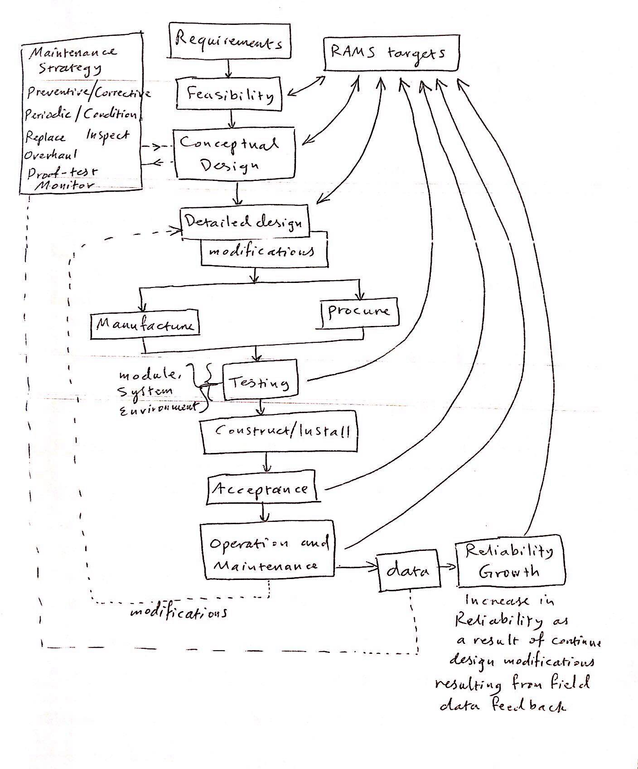

Slide 69
Chapter 2. Terms and Jargon.
2.1 failure mode.
2.2 Failure rate and mean time between failure.
2.3 Interrelationships Of Terms.
2.4 The Bathtub Distribution.
2.5 Down Time & Repair Time.
2.6 Availability, Unavailability, & Probability Of Failure on Demand.
2.7 Failure.

Slide 70
2.1 failure mode
Failure mode: the outward appearance of a specific failure affect (e.g. open circuit, leak to atmosphere)
Example: control valve failure rate (the number of failures of an item per unit time) per million hours.
fail shut 7
fail open 3
Leak to atmosphere 2
Limit switch fails to operate 1
--------------------------------------------------------------
Total 15
quality: conformance to specification

Slide 71
2.2 Failure rate and mean time between failure
failure rate λ
number of items (batch) : N
time of failure: t
number of failed items: k
cumulative time: T
For non-replacement case: T= $t_{1}+t_{2}+…+t_{k}+\left(N−k\right)t , such t_{1}:accutance of the 1st failure$
For replacement of failure when it occurs: T=Nt.

Slide 72
2.2 Failure rate and mean time between failure
observed failure rate (λ) = $\frac{k}{T}$= Estimated of λ
[λ] = $\sec^{−1}$.
The Observed Mean Time Between Failure (MTBF):
MTBF($Ɵ$)
$\hat{Ɵ }(observed)$= $\frac{T}{K}=\frac{1}{k/T}=\frac{1}{\text{λ}}$

Slide 73
2.2 Failure rate and mean time between failure
The observed Mean Time To Fail (MTTF) :
MTTF is used for items not repaired.
MTBF is used for repaired items.
MTTF = $\frac{T}{k} ==$ $Ɵ$ (MTBF).

Slide 74
2.3 Interrelationships Of Terms
The probability of failure in the interval between t and t+ td is :
f(t)dt : Failure probability density function (PDF)
If we assume $\text{λ}$ is constant, then reliability R(t) = $e^{−\text{λ}t}.$
MTBF $Ɵ$ = $\int_{0}^{∞}{R\left(t\right)dt}$ , general case.
$Ɵ$= $\frac{1}{\text{λ}}$ , if $\text{λ}$ is constant

Slide 75
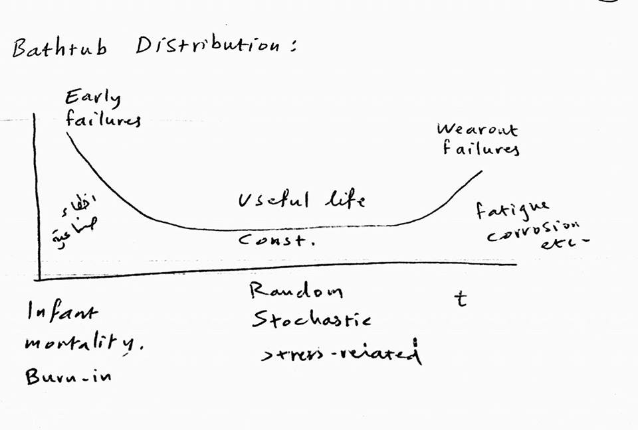
2.4 The Bathtub Distribution

Slide 76
2.5 Down Time & Repair Time.
Down Time (outage): period when equipment is failed.
MDT: Mean Down Time.
MTTR: Mean Time To Repair.
MDT & MTTR overlap but not identical.
Diagnosis: Fault finding.

Slide 77
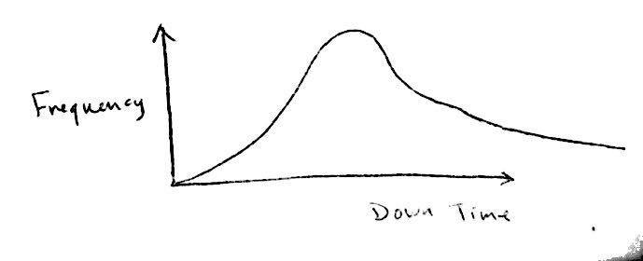
2.5 Down Time & Repair Time
LRA: Least Replaceable Assembly , is usually replaced when faulty.
MDT & MTTR includes the stages of : Realization, Access, Diagnosis, Spares, Replace, Check, Align.
Repair Rate (M) = $\frac{1}{MTTR}.$

Slide 78
2.6 Availability, Unavailability, & Probability Of Failure on Demand
Availability is the amount of available time.
Availability (A)= $\frac{Up Time}{Total Time}$ =$\frac{Up Time}{Up Time+Down Time}=\frac{MTBF}{MTBF+MDT}$ > Steady-state availability.
Unavailability ($\overline{A}$) = Probability of failure on demand.

Slide 79
2.6 Availability, Unavailability, & Probability Of Failure on Demand
$\overline{ A}$=1-A= $1−\frac{MTBF}{MTBF+MDT}$= $\frac{MTBF−MDT−MTBF}{MTBF+MDT}=\frac{MDT}{MTBF+MDT}$ ,
Since MTBF($Ɵ$) = $\frac{1}{\text{λ}}$ $\text{λ}$= $\frac{1}{Ɵ}=\frac{1}{MTBF} ,$ then $\overline{ A}$ =$\frac{\text{λ} MDT}{1+\text{λ} MDT}$ ≈ $\text{λ}$ MDT
If MDT = $\frac{T}{ 2} , then \overline{ A}$ = $\text{λ}$ $\frac{T}{ 2}$

Slide 80
2.7 Failure
Failure is the actual event.
Hazard: potential injury or fatality.
Risk : probability (rate) of event x scale of consequence.
These terms are important in contracts

Slide 81
Example.
if $\text{λ}$= ${10}^{−6} /hr$ , find:
MTBF in years.
Reliability for one year (R(1yr)).
If MDT is 10 hrs, find $\overline{ A}$
If MTTR is 1 hr, failures are dormant and inspection interval is 6 month, find $\overline{ A}$.

Slide 82
Example.
solution.
MTBF ($Ɵ$) =$\frac{1}{\text{λ}}=\frac{1}{{10}^{−6}} hr={10}^{6}=114 years.$
R(t)= $e^{−\text{λ}t}$= $e^{−{10}^{−6} \frac{365∗24 hr}{hr}}=0.9913=99.13\%.$
$\overline{ A}$= $\text{λ}$ MDT=${10}^{−6}∗10={10}^{−5}.$
Assume MTTR=MDT
$\overline{ A}$=Probability of failure on demand.
$\overline{ A}$=$1\frac{hr}{6 month ∗30 days ∗24 hr}=2.3∗{10}^{−4}.$

Slide 83
Chapter 3.
A cost-effective approach to quality, reliability, and safety.
3.1 Reliability and cost.
types of costs: acquisition, ownership, operation, administrative.
as reliability increases, life-cycle and costs decrease , less maintenance and spares

Slide 84
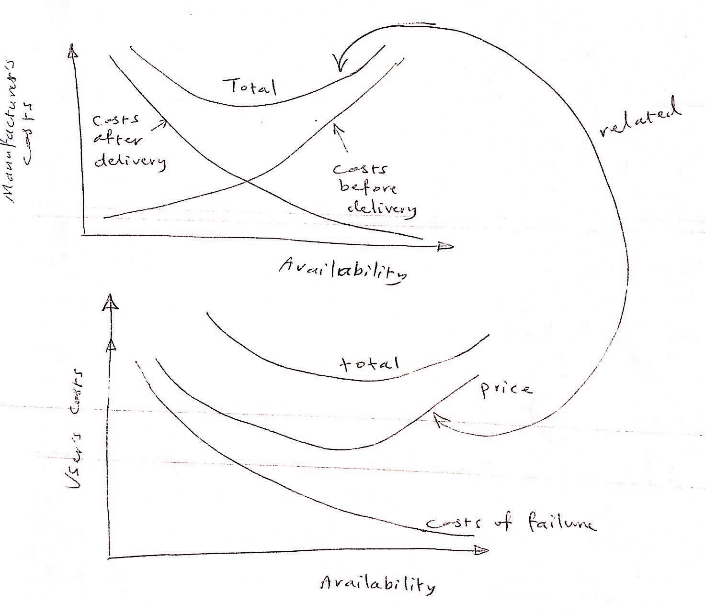

Slide 85
3.2: Costs And Safety
ALARP:As Law as reasonably practicable
The higher the safety requirements, the higher the associated costs.
It is either required to eliminate hazard (which is most costly) or to take it as ALARP (less costs).

Slide 86
3.3: The Cost Of Quality
1- Cost of preventing failures
2- Cost of Appraised (measurements)
3- Cost of failures, scrap, new work

Slide 87
Chapter 4. Realistic failure rates and prediction confidence
4.1: Data Accuracy
Failure rate data are published by many industries, usually in Handbooks, such as:
US MIC Handbook (Electronics) and others, These data may include preventive maintenance data, or affected by reliability growth, and other sources of errors.

Slide 88
4.2: Sources Of Data
Company Specific
Industry Specific
Generic specific
Some of data provided in the book appendix

Slide 89
4.3: Data Ranges
Presented in three ways:
1- Single Value
2- Two Values (range)
3- Three Values (data dominated in middle column)

Slide 90
4.3: Data Ranges
Arithmetic Mean of “n” values of “$λ_{i}$” is:
$$\sum_{i}^{n}{\frac{λ_{i}}{n}}$$
Geometric Mean of “n” values “$λ_{i}$” is:
$${\text{(}\prod_{i}^{n}{λ_{i}}\text{) }}^{i/n}$$

Slide 91
Example:
For $λ_{1}=0.1∗{10}^{−6}{hr}^{−1}$and $λ_{2}=1∗{10}^{−6}{hr}^{−1}$
Arith. Mean $=\sum_{1}^{2}{\frac{λ_{i}}{n}}=\frac{λ_{1}}{2}+\frac{λ_{2}}{2}=\frac{0.1+1}{2}=0.55$
Geo. Mean $={(λ_{1}∗λ_{2})}^{0.5}={(0.1)}^{0.5}=0.32$
Note that: $\frac{0.55}{0.1}=5.5$and $\frac{1}{0.55}=1.8$, for Arith. Mean
And $\frac{0.32}{0.1}=3.2$ and $\frac{1}{0.32}=3.1$, for Geo. Mean
Because Geo. Mean describes the range better. It is preferable in $λ$ computations (from a range).

Slide 92
4.4: Confidence Limits Of Prediction
Prediction Confidence $= \frac{Predicted λ}{Field λ}$
Categories Of Prediction:
1- Company data for similar systems.
2- Industry data such as offshore gas compression.
3- Generic data (combination of sources).
4- Physics-based modelling.

Slide 93
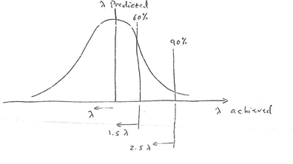
For company specific data:
Example:
One can be 90% confident that the actual $λ<2.5λ_{predicted}$

Slide 94
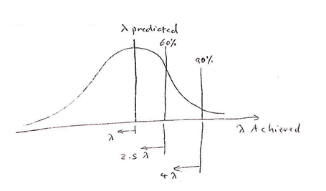
For industry specific data:
Example:
One can be 90% confident that the actual $λ<4λ_{predicted}$
In order of preference, company data is best, while industry data is better than generic data.
We don’t know $λ_{actual}$beforehand, but we know $λ_{predicted}$or estimated.
The actual $λ$ would be known after actual failure occur.

Slide 95
Chapter 5. Interpreting data and demonstrating reliability.
5.1: There are four potential situations when it comes to the study of failure cases:
 | $$λ constant$$ | $$λ variable$$
Few failures (Small “K”) | CH-5 | CH-6
Many failures (High “K”) | CH-4:$λ=\frac{k}{T}$ | CH-6

Slide 96
5.2: Inference and confidence levels
To find $Θ^{∧}$ (estimated MTBF), one point of $λ,T, and k$ is enough.
To find true $Θ,$use:
MTBF =$\int_{0}^{∞}{\frac{N_{s}(t)}{N}}dt,$ where $N_{s}$ is Number surviving = $N−k$,
So; as to cover the whole batch: $Θ=\int_{0}^{∞}{R\left(t\right)dt}$
That means all devices must fail in order to find the true $Θ,$that’s why we need to estimate it.
This process is called statistical inference. It is the use of PDF to describe the data with associated confidence limits.

Slide 97
5.2: The Chi-Square Test ($X^{2})$
$\frac{2T}{Θ}\sim X^{2}$ , obtained from tables
$Θ=\frac{2T}{x^{2}} ∝ λ= \frac{X^{2}}{2T}$
$n=2k=degrees of freedom.$

Slide 98
Example:
$N=100 devices, Test:1000 hr \left(=t\right), k=3 failures$
Find $Θ$ of the batch at 90% (confidence)
Solution:
$T=N.t \left(failed devices are replaced immediately\right)$
$=100∗1000 hr=100,000 hr$
$n=2k=2∗3=6 DOF$
At 90% conf. $⟶ α=\left(1−0.9\right)=0.1$
From Appendix 2, for $n=6 andα=0.1, so; X^{2}=10.6$
$Θ_{90\%}=\frac{2T}{X^{2}}=\frac{2∗100,000 hr}{10.6}=18,868 hr$

Slide 99
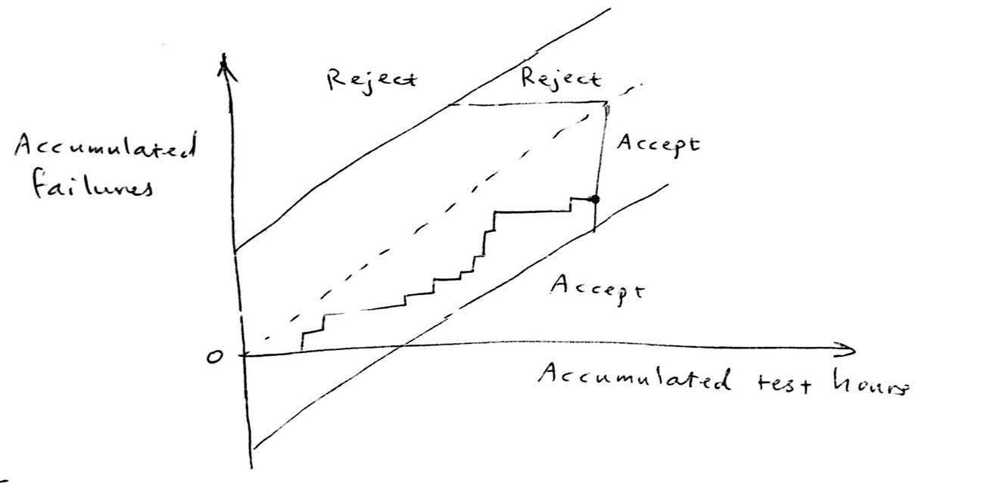
5.7 Sequential testing ( for verification )

Slide 100
Equation for constructing Accept/reject lines are :
Where β : consumer’s risk and α : producer’s risk ( not confidence ).
( α and β < 25% )

Slide 101
Definition :
Producer’s risk (α) : Probability of an acceptable batch being rejected owing to an unfavorable sample .
Consumer’s risk (β ) : Probability of an unacceptable batch being accepted owing to a favorable sample .

Slide 102
Chapter 6. Variable failure rates and probability plotting
It was shown previously that :
Since λ(t) can be complicated. Weibull distribution is used and defined as :
: location parameter .ɣ : scale parameter , ɳ : shape parameter , β
When using only parameters:

Slide 103
Wei bull distribution can be linearized by taking the logarithms of the two sides of
the equation twice .
: This result is
( Y = m x + c )

Slide 104
6.2 Using the Wei bull Method : 6.2.1 Curve fitting to interpret failure data ( Probability Modeling )
is constant or not . Assume we are not sure if λ
Assume that failure data can be described by ( 2 parameters model )
Normally, curve fitting is done using software modeling considerations :
If ( β = 1) , failures are random and λ is constant
If ( β >1) , λ is increasing
If ( β <1) , λ is decreasing
In some cases, the 2 parameters model is inadequate and
:The 3 parameters model is used

Slide 105
Manual plotting is done using Wei bull graph paper .
The software method uses numerical curve fitting algorithms such as Least squares . At least , 6 points are required to construct a Wei bull plot .
Example :
The Reliability of a system is
Where t in hours .
Probability of failure < 5%
Find how many hours before the system needs maintenance ?
Also find β and ɳ ? ( shape parameter and scale parameter )
R(t)=1 – ( 5% ) = 95%
So, ( take ln of equation )
then t = 153 hrs
β = 1.5 , ɳ = 1110 h

Slide 106
Chapter 7. Basic Reliability prediction theory
Some benefits of reliability prediction include comparison between design proposals , ensuring that the system meet’s the requirements , estimating life-
cycle and indicating most critical components .
7.2 Probability Theory
7.2.1 Multiplication Rule :
Probability of shaded area
So , A & B happen
simultaneous event

Slide 107
7.2.2 The Addition Rule :
A or B happens or both
P ( a or b ) =
because the common area is included twice

Slide 108
7.2.3 The Binomial Theorem
If P is the probability of a random event and q = 1 – P
Then, the probability of the event in n trials is :

Slide 109
7.2.4 The Bayes Theorem
joint probability of A & B
probability of B ( marginal )
probability of A given B
( conditional )

Slide 110
7.3 Reliability of Series system
Failure of any component causes the whole system to fail .
in general
components # of components
For constant λ ,
For several components N ,

Slide 111
7.4 Redundancy Rules ( Parallel systems ) 7.4.2 Full active Redundancy ( without repair )
System reliability
Redundancy
Active
Full
Conditional
Standby
Identical
units
Different
units
Partial

Slide 112
For N components ,
MTBF =
( )
In this case , even though λ is constant for all components , it is variable for the
system , therefore ( )

Slide 113
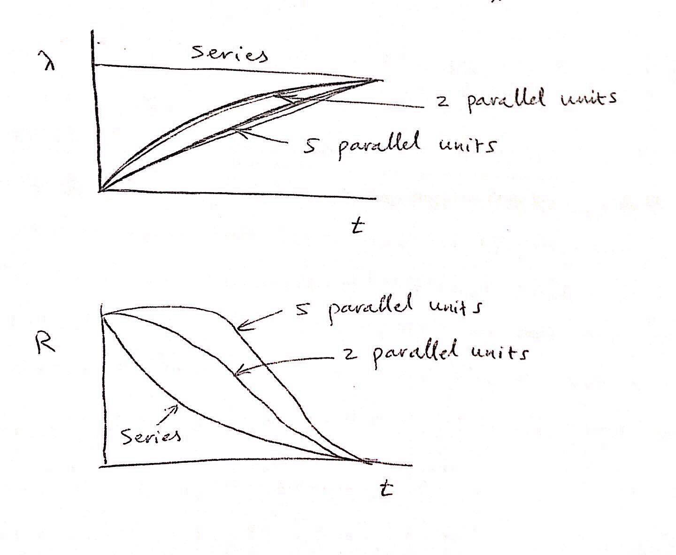

Slide 114
7.4.3 Partial Active redundancy ( without repair )
If Q is unreliability R + Q = 1
probability of failure in a given time
Binomial dist
Probability of one failure

Slide 115
Each of The three units has identical reliability
Full redundancy one unit required to function ( 2 units allowed to fail )
1 unit allowed to fail )) Partial redundancy two units required to function
For partial redundancy ,

Slide 116
General law :
If r items may fail out of n ( the first ( r+1 ) terms only )

Slide 117
7.4.5 Standby Redundancy
In active redundancy , every unit is operating standby redundancy involves additional units which are activated only when the operating unit fails .
So it is operated for less time than the active one .
Active
1
If 1 is detective ,
2 is switched on
2
standby

Slide 118
Assumptions:
Failure sensing and switching from the defective to the standby is assumed failure free.
$λ_{(standby unit)}$ = $λ_{(main unit)}$
standby unit does not fail in the idle state
Poisson distribution is used to express R :
$R_{s}$ = R(t) =$e^{−λt}$ (1+ $λt$ +$\frac{λ^{2} t^{2}}{2!}$ ... $\frac{λ^{\left(n−1\right)} t^{(n−1)}}{(n−1)!}$
For 2 units : $R_{s}$ = $e^{−λt}$ (1+$λt)$.
# units

Slide 119
Redundancy Improvement
System
MTBF
Number of Unit
Generally , more units means more MTBF ,however ,too many units is not recommended because the increase in MTBF is not worth it .

Slide 120
7.5.2 further comparisons of redundancy
4 units with active redundancy
(ί)
(ίί)
Protects against
short circuit
Protects against short and open circuit

Slide 121
R
(ii)
`
ίί in harder to implement
Single Unit
(i)
t
MTBF (θ) = area under the R curve
$$θ_{(single unit)} > θ_{i}$$
ί is good only when short –circuit failure mode is more likely

Slide 122
Comparison between standby & active
7 .5 .3 Cast of redundancy include capital cost ,weight ,spares ,space ,maintenance ,power consumption .

Slide 123
Example :
Express MTBF of the system shown :
λ
λ
λ

Slide 124
Solution:
$for series system R_{AB }= R_{A}∗ R_{B }$
$for parallel system \left(active redundancy \right) R_{s} = R_{A}+ R_{B}− R_{A}R_{B}$
R(t) = R [2R - $R^{2}$ ]
= $e^{−λt} \left[2 e^{−λt}− e^{−2λt} \right]= 2e^{−2λt}− e^{−3λt}$
MTBF = $\int_{0}^{∞}{R\left(t\right)dt= \int_{0}^{∞}{(2}} e^{−2λt}− e^{−3λt} ) dt$
= $\frac{−2 e^{−2λt}}{+2 λ}+\frac{− e^{−3λt}}{+3 λ} =\left( 0+0\right)+ \left(\frac{+1}{λ}+ \frac{1}{3λ}\right)=\frac{3−1}{3λ}=\frac{2}{3λ}$
R = $e^{−λt}$
∞

Slide 125
Chapter 8. Method of Modeling
8 .1 Block diagrams and repairable systems
8 .1 .1 reliability block diagrams ( RBDs) .
Block diagram analysis :
Establish failure criteria : which failure mode (or modes ) at the component level causes a system to fail .
Establish a reliability block diagram (RBD ): describe the system as a number of interconnected functional blocks .

Slide 126
8 .1 .1 reliability block diagrams ( RBDs)
Series system
A
B
A block may represent more than one component !
Blocks are independent ( failure wise )
No redundancy within a single block .
Each block contains one technology ( Mechanical ,electronic ,…)
A
Parallel (redundant ) system
B
B
Combination system
A
C

Slide 127
8 .1 .1 reliability block diagrams ( RBDs)
Failure mode and effect analysis ( FMEA ): finding failure mode and failure rate for each block .
System reliability calculation from the blocks failure rates .
Reliability allocation: used to improve reliability to the desired level .

Slide 128
8 .1.2 repairable system (revealed failures)
So far ,only not repaired failures were covered .
The repairs are related to each other . For a given component
For a system of m units required to operate out of a total of n ,with the same λ and MDT :
$λ_{system }$ = $\frac{n !}{[\left(n − m \right) ! \left(m−1\right) ! ]}$ $λ^{\left(n−m+1 \right) }{MDT}^{(n−m)}$
${MDT}_{system }$ $≠$ ${MDT}_{component/unit}$
unavailability $\overline{A_{s}}$ = $λ_{s}$ . ${MDT}_{S}$
$\overline{A_{s}}$ = $\frac{n !}{[\left(n − m+1 \right) ! \left(m−1\right) ! ]}$ ${ λ}^{\left(n−m+1 \right) }{MDT}^{(n−m+1)}$

Slide 129
8 .1 .3 repairable system (unrevealed failures ):
Failure is only discovered by a proof test
T : proof test interval
When m units are required to operate out of n
${MDT}_{S}$ = $\frac{T}{(n−m+2 )}$
$λ_{s}$ = $\frac{n !}{[\left( m− 1 \right) ! \left(n−m+1\right) ! ]}$ ${ λ}^{\left(n−m+1 \right) }{. T}^{(n−m)}$
$\overline{A_{s}}$ = $λ_{s}$ . ${MDT}_{S}$

Slide 130
8 .1 .4 system with cold standby units and repair
Redundant units are not in use and have λ = 0
$λ_{s}$ = ${(n−1 )}^{2} λ^{2}$ MDT

Slide 131
8 .3 fault tree analysis ( FTA )
8 .3 .1 the fault tree :
It is a graphical method of describing the combinations
of events leading to system failure ( modeling failure logic )
System failure is called : “ Top Event “
FTA involves three logical possibilities :
OR gate : any input causes the output to occur
AND gate : all inputs causes the output to occur
Voted gate : two or more inputs causes the output to occur

Slide 132
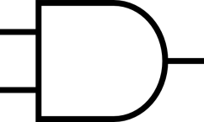
Fault Tree
RBD
AND
Parallel
(Redundant )
OR
+
Series
what is the frequency of the top event ?
Software packages are available to analyze fault trees .
Such as TTREE
A cutest is any combination of base events that can causes the top event

Slide 133
Chapter 9. Quantifying The Reliability Modes 9.3 Failure Mode And Effect Analysis (FMEA)
It’s the study of the system circuit to decide how its components contribute to the overall failure.
Failure modes and failure rate of each component software packages are available that perform this task.
Note: Some component failure mode do not cause either of overall failure modes.

Slide 134
Example 1-9 :
Software generated by FMEA (FARADIP THREE Package):
FARADIP 5.2 Data-output
Detector circuit
Mode 2 λ | MF 2 | FM 2 | Mode1 λ | Mode 1 factor (FM1) | Failure Mode1 (FM1) | Total λ | Component λ | Component Name | Component Reference
0.006 | 0.2 | 20% | 0.006 | 0.2 | 20% | 0.03 | 0.03 | CPU | IC1
0.005 | 0.5 | HIGH | 0.005 | 0.5 | LOW | 0.01 | 0.01 | CMOS | IC2
… | … | … | … | … | … | … | ... | … | …
… | … | … | … | … | … | … | … | … | …

Slide 135
Solution:
hrs. $\text{λ}=2.8 /{ 10 }^{6}$
MTBF=12.95 years
Failure to detect Mode 1 : $\text{λ}=3.76 /{ 10 }^{6}$
Mode 1 MTBF = 30.4 years
Spurious Output
Mode2 : $\text{λ}=4.9 /{ 10 }^{6}$ hrs
Mode2 : MTBF = 23.3 years

Slide 136
9.4 Human Factors
Human Error Assessment and Reduction Technique (HEART):
It identifies of nine basic errors task types.
For example:
Probability of error: Tasks:
1- Totally unfamiliar, perform at speed. (No idea of Output) 1- 0.55
2- Restore system to new state following procedure checks. 2- 0.003

Slide 137
9.4 Human Factors
Error-Producing Condition (EPC):
1- Newly qualified operator.
2- low morale
3- Unfamiliar with infrequent and important situation.
Maximum multiplies:
1- multiplied by 3
2- multiplied by 1.2
3- multiplied by 17

Slide 138
9.4 Human Factors
To calculate the total error rate, a proportion effect (0-1)
Is used for each EPC, and the following equation is used:
[(EPC-1)*(proportion)]+1
For each EPC, then the sum is multiplied by the task error rate.
Other methods include :
1-Technique for Human Error Rate Prediction.(THERP)
2-Empirical Technique to Estimate Operator Error.(TESOE)
Also: Appendix 6 contains human error rate.

Slide 139
9.5 Simulation The Techniques:
Reliability
Deterministic
Stochastic
RBD
FTA
Montecarlo
Simulation
Genetic Algorithms
Variable $\text{λ}$
Variable "λ"

Slide 140
Some reliability software packages:
A) UK:
1-OPTAGON
2-MAROS
3-TAROO
4-ACE
B) US:
1-minitab
2-Reliasoft

Slide 141
Chapter 10. Quantified Risk Assessment (QRA) 10.1 Frequency and consequence:
Risk = frequency * Consequence
Frequency probability of the event.
Consequence potential loss (measurable) such as: Fatalities, damage..

Slide 142
10.2 Perception of Risk and ALARP
ALARP: As Low AS Reasonably Practicable.
HSE: Health and Safety Executive.
Risk
Acceptable
No need to reduce risk
(no additional cost)
Unacceptable
Activity is not allowed
Tolerable
Need to reduce risk at a cost/benefit basis

Slide 143
ALARP Triangle:
Intolerable
ALARP
Negligible
Increasing
risk
Max tolerable
Broadly Acceptable
risk
More cost

Slide 144
Cost per life 1-4 million
Individual risk is more tolerable than societal risk
Individual: car accident voluntary more control.
Societal: train crash involuntary no control.

Slide 145
10.3 Hazard Identification (HAZID)
Identification of hazard comes before quantification of hazard.
HAZOP: Hazard and Operability studies
By how the hazard may arise in a process.
HAZAN: Hazard Analysis: Analysis the outcome of a hazard (Consequence Analysis)
Preliminary HAZAN: Identify safety critical areal
and sets safety targets, It include:

Slide 146
Preliminary HAZAN: Identify safety critical areal
and sets safety targets, It include:
1- Pervious experience
2-Hazardous materials.
3-Interfaces with operators or public.
4-legislation, Standards, regulations
5-Environmental hazard.
6-Impact on environment.
7-Safety-related equipment

Slide 147
10.3.1 HAZOP
It identify hazards in the process it is usually performed by a multidisciplinary team
And leads to recommendations for risk reduction.
It involves the study of the design details and requires working knowledge of the system operation.
A typical team may include:
1-Chem engineer 4-Safety/Reliability engineer
2-Mech engineer 5-Production engineer
3-Instrument engineer 6-Project Manager

Slide 148
10.3.1 HAZOP
Meeting minutes should be taken by a secretary Recording
HAZOP Procedure:
1-Define scope and objectives
2-Select documentation
3-Carry out the HAZOP
4-Implement the following-up action
5-recoed results

Slide 149
Severity of hazard can be ranged as follow:
1-No impact on plant or personnel
2-Damage to equipment only
3-Injuries to unit personnel
4-Major damage Formal Reliability Methods are used
HAZOP can be applied to:
1-Conceptual design.
2-Detailed design.
3-Proposed Modifications.
4-Regulatory requirements.
Phases of life-cycle

Slide 150
10.3.1 HAZOP
HAZOP can be applied to the following types of equipment:
1- process plant
2-transpont systems
3- data systems
4- buildings and structure
5-power generation and distribution
6-mechanical equipment
7-military equipment

Slide 151
10.3.1 HAZOP
HAZID ( Hazard Identification ) : It is a checklist technique such as a questionnaire used at early stage to identify the major hazards.
HAZAN ( Hazard / Consequences Analysis ) : It follows the HAZID and HAZOP ( Hazard and Operability ) activity.
It selects the high – consequence activities such as major spillage of flammable or toxic materials or explosion. It calculates the effects of such activity on human beings and objects.
Ex. : Toxic Release –> Food/Water pollution.

Slide 152
10.4 Factors to Quantify :
10.4.1 : Reliability : already covered
10.4.2 Lightening and Thunderstorms :
Thunderstorm – Related damages affects electrical equipment by induction. About 10 days in the UK lighting strikes one less frequent ( 1/10 ) than thunder.
About 0.5 the damage is calculated using the effective area of the structure.

Slide 153
10.4.3 Aircraft Impact ( A/C impact )
Aircraft crash is high-consequences low probability event.

Slide 154
10.4.3.2 Airfield Proximity
The Probability of an A/C impact increases when the distance from the runway decreases. Usually there are more light aircrafts crashes than larger aircrafts.

Slide 155
10.4.4 Earthquake :
The intensity-effect relationship are defined in the book , for EX :
Four types of masonry are defined A,B,C,D depending on workmanship and reinforcement.
As the serenity increases , the probability decreases.
Intensity | Effect
I | Not felt
VI | Felt By All
XII | Total Damage

Slide 156
10.4.5 : Meteorological Factors :
Data Include :
Extreme wind speeds and directions.
Barometric pressure Twister
Snow Depth Typhoon
Temperature Storm
Precipitation Tornado
Flooding areas ( rain and tsunami ) Cyclone
The Probability of each event can be extracted from the data for the region of concern.

Slide 157
10.4.6: Other Consequences :
- Chemical Release Vapor Cloud Dispersion
- Gas Explosion Volcano Eruption
- Fire and Blast Bush Fire
- Ship Collision
- Pipeline Corrosion
- Pipeline Rapture
- Thermal Radiation
- Pipeline Impact

Slide 158
Chapter 11: Design And Assurance Techniques :
To optimize reliability several techniques can be used.
11.1 Specifying and allocating the requirement :
- The Objective of a reliability and maintainability program is to assure adequate performance consistent with minimal maintenance costs.
- Design requirements must be described by suitable parameters.
- System reliability and maintainability can be specified by MTBF and MTTR.
- No Over-Specifying ( Over-Design) of some components. While under-Specifying ( Under-Design) of their components .

Slide 159
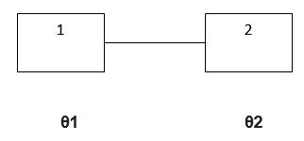
Example :
A System with two components :

Slide 160
Example :
Generally , the reliability of all components of the system should be equal , however , in some cases , one component is far more complex than the other components.
Therefore , less R or θ is assigned for that component.
If unit 1 is twice as complex as unit 2 , then θ1 < θ2.
The Same Principle Applies to the allocation of repair times.

Slide 161
11.2 : Stress Analysis :
Fail rates are sensitive to the applied stresses.
Types Of Stresses :
Environmental :
Temperature
Shock
Vibration
Humidity
Ingress of foreign bodies
Self-Generated / Operational :
Power Dissipation
Applied Voltage and Current
Wear

Slide 163
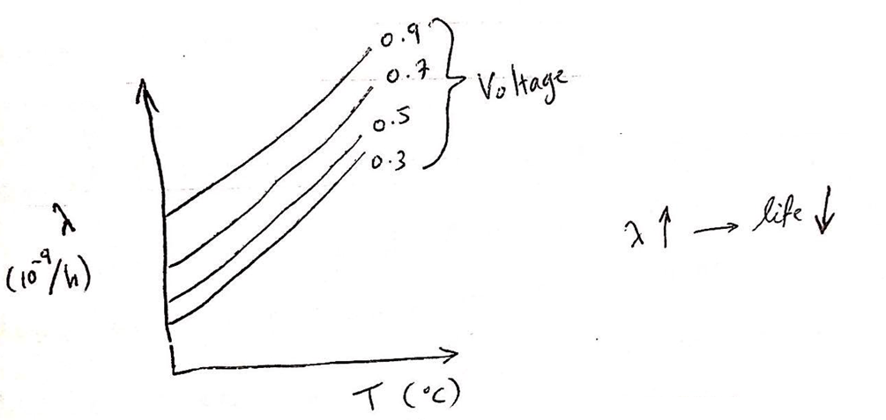
11.2 : Stress Analysis :
The Strength distribution is obtained by testing.
In Electronic components , the relationship of α to stress is normally expressed as an Eqn.
Care should be taken not to use these two Eqns. Outside of their ranges.

Slide 164
11.3 Environmental Stress Protection :
Environmental stress has taken the onset if wear out by contributing to physical deterioration.
Examples of environmental stress includes high temperatures, low temperatures, dust, shocks, humidity, salt, electromagnetic radiation, biological effects, noise and reactive years, sun radiation.
These kinds of stress can cause distraction of materials affected.
Actions taken to lessen these effects includes : Heat dissipation , Use of fins , applying heat , insulation , sealing , etc …

Slide 165
11.4 Failure Mechanisms 11.4.1 Types of failure mechanisms :
The majority of failures are due to the following phenomena :
Alloy formation between gold , aluminum , and Silicon causes “ Pimple Plague “ or black plague in silicon devices.
Biological effects like molds and insects may cause failure , especially in tropical regions .It affects electronic devices and wiring.
Chemical and electrolytic changes , Cause corrosion.
Contamination : Carbon , dirt , when deposited on insulations between conductors leads to breakdown and short circuit.
DE-polymerization : Degrading of insulation caused by liquefaction in synthetic materials.
Evaporation of filament molecules in filament devices causes aging.
Fatigues : Crystalline changes in metals leads to fractures.
Film Deposition : Oxide film formation on conductors leads to high resistance failure.
Electrical Failure due to weak springs.

Slide 166
11.4.1 Types of failure mechanisms :
10-Friction causes failure in motors , switches, gears,…etc
11- lonization of gases at voltage of 200-300 v(depending on pressure) ,cause noise and break down
12- Lon migration between silver surfaces and a wet salty insulation.
13- Magnetic degradation due to vibration or electric fields.
14- Mechanical stresses: affect components such as switches, insulators, printed-board tracks , etc.
15- Moisune gain or loss : can reduce capacitance.
16- Molecular migration :liquids diffuse through plastics.
17- Stress relaxation : creep (stress with time).
18-Thermal cycling: thermal stress (fatigue) .
19- Impact ,buckling , fracture (cracking) of composite materials.

Slide 167
11.5 Complexity and parts
11.5.1 Reduction of complexity
Complexity of electronic components have increased dramatically, reducing the number of required components. This leads to higher reliability.
Also , the use of standard (modular) components reduces the number of required components.

Slide 168
11.5.2 Part selection
Standard parts have proven performance while special parts may not.
The choice depends on the function, the environment ,life ,procurement ,λ , and availability of that part.

Slide 169
11.5.3 Redundancy
Active , stand by units, or load sharing
Active:
1- full
2- partial: example: 2 out of 4 engines on an aircraft.
Load sharing :active redundancy where failure of one unit places a greater stress on the remaining units.
Redundancy increases weight, space , and cost .and should be used only when no better choice is available.

Slide 170
11.6 Burn-in and screening
Early failures are due to manufacturing defects
Burn –in is operating at elevated stress (temperature , voltage) to accelerate failure and reduce defective items
Screening : tests (electrical , mechanical , visual) to reveal defective features in items.

Slide 171
Chapter 12. Design Review and Test
Design review is to compare the design with the requirement e.g functional specification (specs) vs requirements specs.
to verify the design
Feed back loop to provide confidence to proceed to the next step.
It is a formal meeting (minute taken , chock list).
What is reviewed ?
1.Requirements specs : completeness, un ambignity , consistency
2.Functional specs: accuracy, amission .
3.Detailed design: documents compliance
4.Software: code review.
5.Test result: test specs.

Slide 172
12.2 Categories of Testing
1.Design Testing: prototype, simulation.
2.Qualification Testing: testing of a model , function, performance, margins, limits , operating temperature, humidity, life, MTBF, MTTR, MDT, packaging, Transport, size, weight, power consumption , Ergonomics , interface with people , testability , safety/approval body.
3.Production testing and commissioning: verify performance and reliability.
4.Demonstration testing : Acceptance test according to criteria.

Slide 173
Type of tests
12.2.1 Environmental testing
System is sustainable under extreme environment within its envelope.
Environmental factors include: electrical fields, temperatures, humidity, wind, sun light, pressure , vibration, shock, acceleration, corrosive,……
12.2.2 Marginal testing
Proving functions at extreme limits, such as voltage, frequency, dimensions, pressure, force.

Slide 174
Type of tests
12.2.3 High-reliability testing
Using accelerated life testing to predict MTBF under normal conditions.
12.2.4 Testing for packaging and transport
Packaging material should be adequate e.g . Vibration during transporation , water proofing, seals, marking, coating, storage, handling instructions.

Slide 175
12.2.5 Multi parameter testing
Classical method is to hold all parameters constant except one parameter, where it is varied and its effect is recorded. Then another parameter is done and so forth. This method is not practical when you have many parameter. Therefore some techniques like DOE(design of experiments) or MCS (monte carlo simulation) are used.

Slide 176
12.2.6 Step-stress testing
Assessment based on extrapolation
If required reliability =0.995
Time period=10 minutes (test at 15.1 mins
Load=2*10^8 pa
T=450 c
Test at 3.1*10^8 pa
3.6*10^8 pa
Test at 520 c
570 c

Slide 178
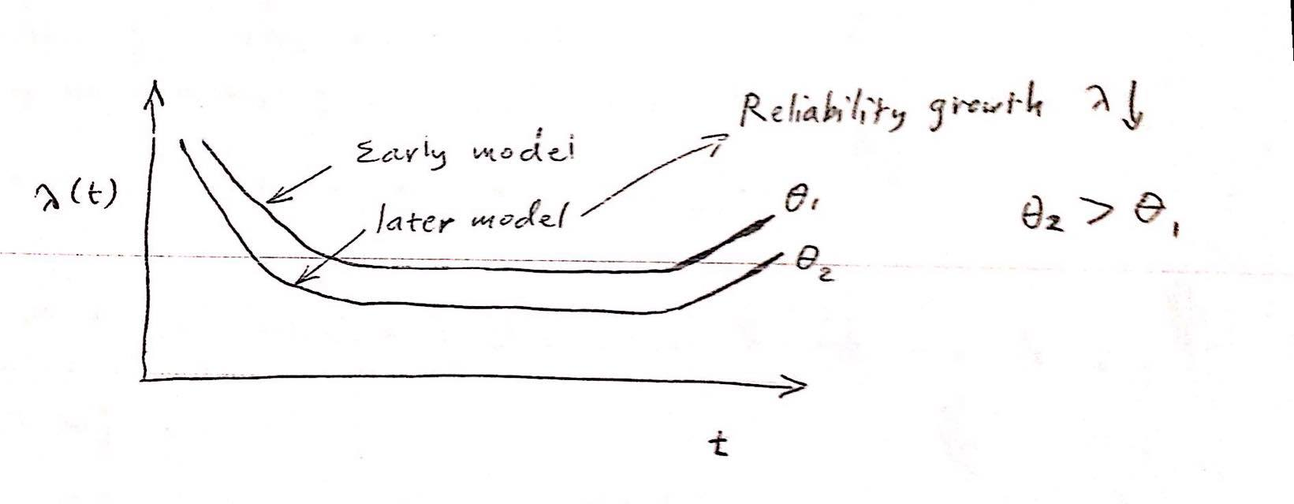
12.3 Reliability Growth Modelling
Reliability growth is improvement in reliability due to feed back from field . these improvements are a result of design modifications.
Two bath tub curves for the same equipment:

Slide 179
CUSUM (Cumulative sum chart)(for past event)

Slide 180
Duane model:
${θ =KT}^{α }$
MTBF
Proportionality constant
Total equipment time
Growth factor

Slide 181
Example
50 items are used for 3 months, 20 failures occurred, another 30 items are added after another 3 months, total failures became 35. a) When MTBF will reach 12000 hr. ? b) Find $α .$
c) If α = 0.6 , when will θ = 12000 hr. be reached ?

Slide 182
Solution :
a)${ T}_{1}=50×3 ×\frac{365 }{12}×24 =109,500 hrs.$
${ θ }_{1} =\frac{109,500}{20} =5475 hrs.$
$T_{2}$ $=109,500+\left(50+50\right)×\frac{365}{12} ×3×24 =328,500 hrs.$
${ θ }_{2} =\frac{328,500}{35} =9386 hrs.$
b) $\frac{θ_{2}}{θ_{1}}$ $={\left(\frac{T_{2}}{T_{1}}\right)}^{α}$ $= \frac{9386}{5475}$ $= {\left(\frac{328,500}{109,500}\right)}^{α}$
1.71 = $3^{α}$ α = 0.5
Dr. Osama Habahbeh

Slide 183
Solution :
$$θ={Ƙ T}^{α}$$
5475 = $Ƙ×{(109,500 \text{)}}^{0.5} Ƙ$ = 16.5
For $θ$ to be 12,000 hr.
12,000 = 16.5 $×$ ${T }^{0.5 }$ T = 528,900 hrs.
c) $θ={Ƙ T}^{α}$
9386 = $Ƙ$ ${×\left(328,500\right)}^{0.6}$ $Ƙ$ = 4.6
12,000 = 4.6$×$ ${T }^{0.6 }$ ${ T=491,800 hrs. }^{ }$

Slide 184
Chapter 13. Field Data Collection and Feedback 13.1 : Reasons for data collection
To find manufacture deficiencies and support reliability growth.
Provide quality trends.
Provide subcontractor ratings.
To predict repair time and spares requirements

Slide 185
13.2 Information and difficulties
Failure report from must collect the following :
Repair time active and passive.
Type of fault, primary or secondary, random or induced, etc.
Nature of fault, open or short circuit, drift condition, wear out, design deficiency.
Fault location LRA (Least Replaceable Assembly).
Environmental conditions.
Action taken (Replacement/Repair).
Personal involved.
Equipment used.
Spares used.
Unit running time.
Dr. Osama Habahbeh

Slide 186
Problems associated with failure recording:
Inventories: Lack of data on the total numbers of the item in question and their installation dates and running times.
Motivation: Lack of motivation to record feedback by engineer.
Verification: It is hard to verify the supplied feedback data.
Cost: Failure reporting is costly. However, the cost can be offset by the saving resulting from removing failure sourced.
Recording non-failures: replacing “suspect” components and mixing between primary (cause) and secondary (effect) failures.
Dr. Osama Habahbeh

Slide 187
13.3 Times to failure:
To establish the inventories, we need the number of failures, detects of equipment, and the installation times.
Items should be identified by “tag numbers” in order to track their histories and cumulative times.
Dates of installing items and tag numbers should be recorded.
Dates of failures items and tag numbers should be recorded.
Failure modes items and tag numbers should be recorded.
Running times items and tag numbers should be recorded.
Dr. Osama Habahbeh

Slide 188
13.4 Spreadsheets and databases
Maintenance data are best kept either in spreadsheet such as Excel or Lotus or in a database such as Access.
Data should be classified according to the following headings:
Equipment code e.g. C1: Compression system.
How found: e.g. 01: Plant shutdown.
Type of fault (Failure mode): e.g. 01: Leak.
Action taken: e.g. 01: Electrical.
Free text: e.g. Notes.
Dr. Osama Habahbeh

Slide 189
13.6 Analysis and presentation of results
Once collected, data should be analyzed and used.
A pareto analysis of defects can be used to find the major problems, another approach is to use the cost if the information is available to rank the failures accordingly.

Slide 190
Chapter 14. Factors Influencing Down Time
The main factors are :
Equipment design.
Maintenance philosophy.

Slide 191
14.1 Key design areas :
14.1.1 Access
Low reliability parts should be the most access able, Online diagnosis can reduce MDT, However, it sometimes induces faults, Every LRA (Least Replaceable Assembly) should be removable independently from other parts.

Slide 192
14.1 Key design areas :
14.1.2 Adjustment
It could be minimized by generous tolerance in the design,
aimed at low sensitivity to drift.

Slide 193
14.1 Key design areas :
14.1.3 Built-in test equipment (BITE)
It should be more reliable than the system of which it is part, in order to minimize false alarms, It carries a weight, volume, and power penalty, but reduces the diagnosis and checkout time.
Dr. Osama Habahbeh

Slide 194
14.1 Key design areas :
14.1.4 Interchangeability
Where LRA are interchangeable this simplified diagnosis and replacement, Interchange of non-identical boards should be made mechanically impossible.

Slide 195
14.1.10 Least Replaceable Assembly (LRA)
LRA is that replaceable module at which local fault diagnosis ceases and direct replacement occurs, the larger LRA, the faster the diagnosis and the higher the cost, However, LRA reliability, cost of testing, and spares inventory decrease.
Dr. Osama Habahbeh

Slide 196
14.1.11 Mounting
Self locating components are easy to replace mounting pins and brackets can be made to prevent transposition which is undesirable as in the case of a transformer.
Dr. Osama Habahbeh

Slide 197
14.1.12 Component part selection
Factors affecting MDT:
Spares availability/delivery.
Reliability under storage conditions.
Ease of recognition.
Ease of handling.
Cost of parts.
Physical strength and ease of adjustment.
Dr. Osama Habahbeh

Slide 198
14.1.12 Component part selection
14.1.13 Redundancy
Redundancy increases reliability, where redundant LRA can be removed if found inoperative.
Dr. Osama Habahbeh

Slide 199
14.1.12 Component part selection
14.1.14 Safety
Hazard increases MDT because it requires more attention, Accidents increases downtime substantially.
Hazard such as high voltage is isolated before carrying out maintenance if applicable.

Slide 200
14.1.12 Component part selection
14.1.15 Software
Because of the complexity of programmable LSI (Large Scale Integration) devices, testing is done using ATE (Automatic Test Equipment).
Dr. Osama Habahbeh

Slide 201
Factors Influencing Downtime
14.1.16 Standardization:
it leads to familiarization and hence shorter repair times, it leads to less verity of a test equipment and spares.

Slide 202
Factors Influencing Downtime
14.1.17 Test points:
They are the interface between test equipment and the system, they should protect the system from misuse of test equipment.

Slide 203
14.2 Maintenance strategies and handbooks:
factors influencing active and passive repair times are:
14.2.2. Organization of maintenance resources:
Maintenance tests are divided into three groups:
1) First line maintenance –corrective maintenance-call maintenance- field maintenance-line maintenance, it entails diagnosis only to the LRA lend and repair by LA replacement. On[ad-hoc] basis. 2) Preventive maintenance- Routine maintenance: entails scheduled replacement/ discard. 3) Second line maintenance-Workshop-Overhaul shop-Repair depot: Eutails scheduled overhaul and refurbishing of units in addotion to unscheduled repair of failed modules.

Slide 204
14.2.2 Maintenance Procedures
It consists of the following :
1) Making and interpreting test readings.
2) Isolating the cause of a fault.
3) Paint LRA replacement.
4) Adjusting for optimum performance.

Slide 205
Diagnosis procedures
1) Stimuli-response: response to parameter change is compound with expected response.
2) Parametric checks: parameters are observed and compared with expected values.
3) Signal injection: a pulse is applied at a particular point and observed at various points.
4) Functional isolation: parameters are checked at various points to narrow down the location of the fault.
5) Robot test method: ATE (Automatic Test Equipment) is used to flood the unit with a simulated load so as to observe the fault.

Slide 206
After isolating the fault, one of the following repair methods is used:
1) Direct replacement of the LRA (most common).
2) Component rebuilding.
3) cannibalization from non essential parts.

Slide 207
Tools and test equipment:
when specifying test equipment, the following is considered:
1) Simplicity: for ease of use.
2) standardization: to reduce training requirements and minimize spaces holdings.
3) reliability: test gear should be more reliable that the system tested.
4) Maintainability: ease of repair increase the availability of the test gear.
5) Replacement: suppliers delivery time and length of suggested period.
There is a trade off between the complexity of test equipment and the skill of maintenance personnel. This extends to BITE ( Build-in Test Equipment).

Slide 208
14.2.4 Personnel Considerations:
1) Training given: depends on complexity of system.
2) Skill level employed.
3) Motivation.
4) Number and distribution of personnel.

Slide 209
14.2.5 Maintenance Manuals:
They provide required information to perform maintenance tasks, they include any of the following:
1) Specifications of system performance.
2) Theory of operation and limitations
3) corrective and primitive maintenance procedures.
4) Permitted modifications.
5) Spare description.
6) Test equipment and procedure.
7) Disposal instructions.

Slide 210
14.2.6 Spares Provisioning:
If a system has {n} of a particular item and a nominal spares stock of {v}, then unavailability (U) is :
U = 1 – P(Failure < r)
Repair is assumed instantaneous.
The main consideration of spares provisioning are:
1) Failure rate: determine quality of spares.
2) Fixed spares level: acceptable probability of stock out.
3) Cost of each spare: affects spears level.
4) standardization and LRA: affects number of spares types.
5)lead time on ordering.

Slide 211
14.2.7 Logistics:
It is the time and resources involved in transporting personnel spares and equipment into the field.
These considerations are divided according to their location:
- Centralize:
Specialized test equipment, Low utilization of skills and test gear, Second line repair, Infrequent[1] spares.
- Decentralize:
Small tools and standard items where small MTTR is vital, Fragile test gear, Frequent[2] Spares.
[1] : High- Reliability , [2]: Low-reliability.

Slide 212
14.2.8 The user and the designer:
The following shows the relationship between maintenance(user) and design(designer):
Skill level of technician: Build in test equipment, Level of IRA replacement.
Tools and test equipment: IRA fixing and access, Test points, Equipment standardization.
Maintenance procedure: Ergonomics and environment, Build in test equipment diagnostics, Displays and finally; Interchangeability.
There is a link between repair time and cast.

Slide 213
14.2.9 Computer aids to maintenance:
Software packages are available that helps to setup a complete maintenance and spares management system.
Parts and their failure rates must be fed into the package.
In addition the routine maintenance schedules the package provides daily schedule of maintenance tasks and required spares, in addition to pares stock monitoring.

Slide 214
Chapter 15. Predicting and demonstrating repair times
Why to predict MDTR: to determine compliances with spares and to provide feedback.
15.1 prediction methods: Best known methods are described in US military handbook 472, a large amount of data is required in order to predict maintainability using statistical techniques.

Slide 215
Requirements to maintain prediction procedures
1- Must be fully documented and subject to modification.
That’s it we’ll continue them next class.
M.O.
2- assumption must be recorded.
3-prediction must not be done by the design group so as not be biased.
The relationship between maintainability and reliability is that the frequency of each repair is determined by failure rate.

Slide 216
Requirements to maintain prediction procedures
There are three approaches to the prediction task :
1)work study method analyses each task in a sample by breaking it into definable work elements .
2)empirical :
rating a number of maintainability factors against a checklist.
3)vs military handbook 472

Slide 217
15.1.1 vs military handbook 472 procedure 3 :
It is an empirical method , it utilizes a checklist according to the design ,maintenance support and personal requirements , the regression equation for MTTR is :
Log10 MTTR=3.544 - .0123c - 0.023(1.0638A+1.29B)
Where A,B and C are the checklist scores

Slide 218
15.1.2 checklist -Mil 472 procedure 3 :
Each checklist contains headings referring to elements to be scored, for example:
Checklist A contains: Access(external), Latches and fasteners (external), Etc..
Checklist B contains: External test equipment, visual contact, connectors, Etc…
Checklist C contains: Arm, leg and back strength, visual, Etc…
As design improved → DT(down time) decreases (A factors)
As skills improved →DT decreases (C factors)
As maintenance support improves →DT decrease (B factors)
Each factor is given a score of 0-4 .
The previous regression equation is used to find MTTR

Slide 219
15.2 Demonstration plans of MTTR
15.2.1 Demonstration risks
The following must be fixed :
1- method of task selection .
2- tools and test equipment.
3-maintenance documentation.
4-skill level of test subject.
5- test environment .

Slide 220
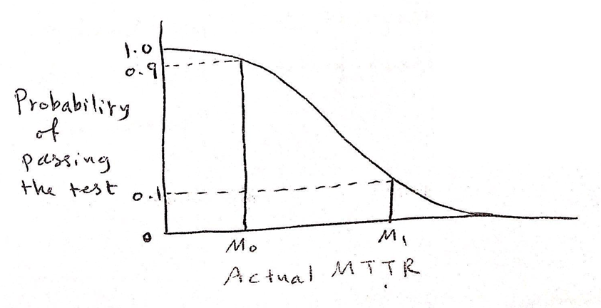

Slide 221
15.2.2 vs mil standard 471A (1973)
They are seven test methods ,they describe sampling plans for demonstrating MTTR , for various assumptions of statistical distributions

Slide 222
Chapter 16. quantified reliability-centered maintenance (QRCM)
16.1
What is QRCM:
It involves calculations to balance the cost of excessive maintenance against that of the unavailability a rising from insufficient maintenance.

Slide 223
QRCM uses reliability techniques to optimize:
1- replacement (discard )intervals.
2-spares holdings.
3-proof-test intervals.
4-condition monitoring .

Slide 224
16.2 The QRCM decision process:
Based on an algorithm which depends on several factors such as : failure distribution ,Degree of redundancy and the justification of maintenance cost .
Dose it save operating costs ??
Does it impact safety or environment ?

Slide 225
16.3 optimum replacement (discard)
Times to failure are obtained and waybill techniques are applied ,if β is far more than 1 ,discard is considered :
If β>>1 →discard
If β<<1→no need for maintenance
if β>1→consider a preventive replacement →if replacement due to failure costs more than planned there are two maintenance schools when it comes to replacement :

Slide 226
16.3 optimum replacement (discard)
A)age replacement : if a failure occurs , replace it and then wait the full interval before replacing again.
B) block replacement : if a failure occurs ,replace it and then replace it again at the expiration of the existing interval .
Age is good for expensive items

Slide 227
16.4 optimum spares:
The cost of carrying spares include : capital depreciation ,spare , etc…
The balance between spares level kept and unavailability depends on several factors :
1-number of spares held .
2-items failure rate.
3-number of identical items in service .
4-degree of redundancy .
5-lead time of spares procurement.
6-replacement down time .
A minimum stock of spares should be carried that achieves the required availability .

Slide 228
16.5 optimum proof test :
Proof test is especially important when there is redundancy and there for failures are not related .
Optimizing proof tests seeks to trade off the cost of the test (preventive maintenance) against reduction in unavailability (reducing outage cost ).

Slide 229
16.6 condition monitoring
It is carried out to identify degradation in the system FMEA is used to determine the indicatory that lead to failure.
It is important to determine appropriate inspection intervals ,so that failure can be prevented methods to find inspection interval include testing ,experience , data , etc..
For example →exhaust gas temperature is monitored in aircraft engines.

Slide 230
Chapter 17. Systematic failures
(especially software)
17.1 programmable devices :
A firmware is a program at the circuit level that is applied to microprocessors .

Slide 231
Categories of software :
1- mainframe computing : involves a large number of terminals.
2-minicomputing : a compact variation of main frames.
3-microprocessing: it refers to desktops which as a result of their speed and memory supericvity , have replaced many main frames and minicomputing systems.
4-programmable logic controllers (PLCs) :they provide input and output ports (data in X command out), they use simplified programming languages .
5-embedded microcomputing : they provide total flexibility of design , but on the expense of increasing the possibility of circuit and code errors.
From a reliability and safety integrity perspective

Slide 232
Advantages of programmable devices:
Fewer types of hardware.
Consistent architecture (CPU / BUS / I-O).
Easier to support several versions in the field .
Simpler to implement modifications.

Slide 233
Disadvantages of programmable devices:
Difficult to inspect software for errors.
Test involves a limited sample of execution possibilities.
Control of changes is more complicated and more critical.
Difficult to impose programming standard approaches.
Difficult to predict failure rates of software.

Slide 234
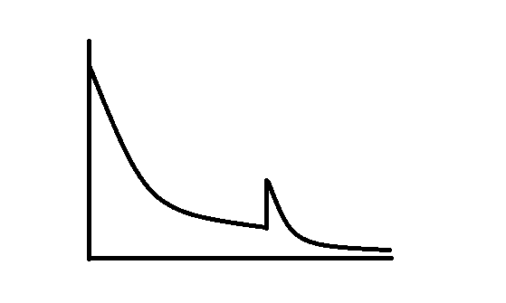
17.2 Software – Related Failures:
Software failure is an error that becomes evident only under a combination of condition.
Error rate
Software
change
Time
Software Error Curve

Slide 235
17.2 Software – Related Failures:
Errors can be reduced by reducing the complexity of the software or by standardization.
Software system failures can result from hardware of software faults.
A fault may not cause a failure for some software errors (bugs) until the conditions leading to failure come to play.
If the system contains an error, recovery software may help to stop a bug from leading to failure.
Most error result from software design and coding

Slide 236
17.3 Software – Failure Modelling:
Several Methods exist that attempt to quantity software failure rates. These includes Jelinski Moranda, Musa… etc. However, accurate prediction is too difficult and therefore qualitative methods remain more effective.

Slide 237
17.4 Software Quality Assurance (SQA):
It aims at preventing failures. It comprises the following elements:
17.4.1 Organization of Software QA:
Using a Quality Manual, Quality Plans and specific Test Documents controlled by QA independently of the project management.
Main activities includes: Configuration Control Library and Documentation, Design Review, Auditing and Test Planning. The previous tasks are done by specified individuals.

Slide 238
17.4 Software Quality Assurance (SQA):
17.4.2 Documentation Controls:
They include: A Functional Description, A Flowchart, and a program listing. The documentation hierarchy starts with user requirements in a Top-Down approach, then goes to Functional specifications, which addresses how the user requirements will be achieved.
Subsequent steps include: Software design specification, subsystem specification, module specification, module definition, chart and diagrams, utilities / hardware specifications, and development notebook.

Slide 239
17.4 Software Quality Assurance (SQA):
17.4.3 Programming Standards:
The use of structured programming to reduce complexity. Libraries are used where possible. No need to reinvent the wheel !

Slide 240
17.4.4 Fault – Tolerant Design Features:
Redundancy using Dual Processing and Alternative Path.
Use of Error – Checking software.
Timely display of error codes.
Generous tolerancing of timing requirements.
Error Confinement.
Watchdog timer taking a feedback from the processor and examining outputs to verify they are not stuck in one state.
Buffer protection at inputs and outputs to prevent the spread of failures from one processor the another.
The use of separate power supplies for replicated parts of the system.

Slide 241
17.4.5 Reviews:
Using two approaches:
Code inspection (by the team).
Structured Walkthrough (by the designer).

Slide 242
17.4.6 Integration and Test:
Dynamic testing: executing the code with real date.
Path testing: testing each path of the software.
Software Proving by Emulation: testing the system before completion using parts from another system.
Functional testing: testing every possible function.
Load testing: simulating all peripheral devices controlled by the software using another computer.

Slide 243
17.5 Modern / Formal Methods:
User Requirements Verification
Design
Validation Functions User
Test
The Quality Problem

Slide 244
17.5 Modern / Formal Methods:
They apply through the life cycle
Requirements specification and design: such as OBJ (Object Oriented Code). They require formal language statements.
Static Analysis: it examines the algebra of source code, not the execution.
Test Beds: It acts like animators during dynamic testing (actual execution of the code). They display the variables alongside the portions of code under test.

Slide 245
17.6 Software Checklists:
They involve items to be checked on order to ensure Organization of software QA, Documentation Controls, Programming Standards, Design Features, Code Inspection and Walkthroughs, and Integration and Tests.

Slide 246
Chapter 18. Project Management
18.1 Setting Objectives and Specifications:
A common mistake is to state a confidence level when specifying on MTBF. In fact, the MTBF requirement stands alone.
Vague statements such as “high reliability” should be avoided.
All engineering design specifications should be stated.

Slide 247
18.2 Planning, Feasibility, and Allocation:
A Reliability program manager should be appointed without conflicting authorities. Milestones, with dates are used to un-ensure progress.
A feasibility study is conducted so as to establish if the performance specification can be met within the constraints of cost, technology, time… etc.
There are three levels of RAM measurement:
Prediction using modelling.
Statistical Demonstration test (in a test environment).
Field Date: Reliability can be grown using failure date.

Slide 248
18.2 Program Activities:
Feasibility Study.
Setting Objectives.
Contract Requirements (RAM targets, warranty… )
Design Reviews: Discussed earlier
RAMs are predicted using FMEA to measure conformance to RAMs targets.
Design trade-offs.
Prototype tests
Parts Selection and approval.
Demonstration (using sampling).
Spares provisioning calculations.
Data collection and failure analysis.
Reliability growth.
Training for design engineers and customers.

Slide 249
18.4 Responsibilities
The design team is responsible for RAM parameters. RAM is conducted at different level from quality Assurance.
Parts:
RAMs specialist/QA or Engineering: support role, satisfies, part selection, contract advice.
Designer/ Engineering: primary responsibility for R and M.
Quality engineer/ QA: failure analysis, render appraisal, testing.

Slide 250
18.5 Functional Safety Capability
It can largely be achieved by working to an ISO 9000 management system, in addition to the following:
Contract / project review: to see safety – related items.
Control of modification: (impact safety or not?).
Project management: safety authority independent of design tasks.
Competence: people responsible, training, consultation.
Remedial action: documenting safety –related defects and defining responsibilities for remedial action.
Functional safety validation.

Slide 251
18.6 Standard and Guidance Documents
* B S 5760: reliability of system, equipment and components.
*U K MOD standard 00-40 reliability and Maintainability.
* U S Mil. Standard 785A reliability program for systems and equipment development and production.
* U S Mil. Standard 470 maintainability programmer requirements.

Slide 252
Chapter 19. Contract Clauses and their Pitfalls.
19.1 Essential Areas:
RAMs are included in invitation to tender and in contracts.
Pitfalls arise from contractual condition due to the omission or essential conditions or definitions, or due to inadequately worded condition.
In order to specify RAMs, the following headings are essential:
19.1.1 Definitions
All terms must be defined clearly. For example “repair time” should be defined as MTTR or MDT.

Slide 253
Chapter 19. Contract Clauses and their Pitfalls.
19.1.2 Environment:
To specify the environmental condition under which the product is to work ( such as T. P. vibration, humidity etc..).
19.1.3 Maintenance support:
Specify which party is visible provision of spares, test equipment, personnel, transport and training.
19.1.4 Demonstration and prediction:
If this required, the proses should be defined in details. This includes tools, equipment, technician level, test environment, etc…
19.1.5 Liability:
The exact nature of supplier’s liability must be defined.

Slide 254
Chapter 19. Contract Clauses and their Pitfalls.
19.2 Other Areas:
19.2.1 Reliability and Maintainability program
19.2.2 Reliability and Maintainability Analysis.
19.2.3 Storage.
19.2.4 Design standards.
19.2.5 Safety – related Equipment.

Slide 255
19.3 Pitfalls
19.3.1 Definition
What constitutes a failure?
Level of failure (system, unit).
Types of failure.
Causes of failure.
Effect of failure.

Slide 256
19.3 Pitfalls
19.3.2 Repair Time: Actives and passive elements, may be influenced by user.
19.3.3 Statistical Risks:
Such that MTTR not exceeded on a given number of attempts.
19.3.4 Quoted specification
Using a published standard may not be suitable.
19.3.5 Environment:
Should be specified, but not to lead to over-design.

Slide 257
19.3 Pitfalls
19.3.6 Liability: In terms of cost and time.
19.3.7 in summary:
Ambiguity is not good for either party. A contract should be as clear and simple as possible.

Slide 258
19.4 Penalties
19.4.1 Apportionment of cost during guarantee: Method of how the supplier contributes to the cost of maintenance during the guarantee period. It could be total or partial pay. 19.4.2 Payment According to Down Time: Paying a percentage of contract price during DT. Up to an upper limit.
19.5 Subcontracted Reliability Assessment:
It is common in large systems, it is usually convert by a contract that includes topics such as: Data bank sources to be used reliability assessment method/ software, schedules, cost, etc...

Slide 259
Chapter 20. Product Liability and Safety Legislation
Product liability is the liability of a supplier to the customer for injury or loss resulting from a defect in the product. It can result in spectacular awards for claims involving death or injury. 20.1 The General Situation 20.1.1 Contract Law The seller is always liable as the sale implies the existence of a contract.
20.1.2 Common Law
A claim for damage can be made due to negligence, however, the plaintiff has to prove it.

Slide 260
Chapter 20. Product Liability and Safety Legislation
20.2 Strict Liability
20.2.1 Concept
A liability exists for no other reason than the existence of a defect and the supplier will be liable for compensation if products causes injury.

Slide 261
20.2.2 Defects:
For the purpose of product liability, three types of defects exist:
Manufacturing defect: impurities present.
Design defect: design safety hazard.
Documentation defect: no warning.
Some European laws pertaining to product liability are: 20.3 The consumer protection Act 1987. 20.4 Health and Safety at work Act 1974.

Slide 262
20.5 Insurance and Product Recall
20.5.1 The effect of product liability trends
1- Increase the number of claims
2-Higher premiums
3-Creation of separate liability policies
4- Insurance companies interface in quality and reliability standards and procedures
5-Contracts that deal with claims

Slide 263
20.5.4 Product Recall:
It is done for replacement or modification. It should be urgent the defect is life threatening.
Normally, a major investigation follows the recall.
Possible causes could be insufficient testing , insufficient training , Poor engineering ,etc..

Slide 264
Chapter 22. Integrity Of Safety-Related Systems
Such systems include Fire Detection Systems , Emergency Shutdown Systems ,Rail Signaling , Aircraft Flight Controls ,And Nuclear Control Systems.

Slide 265
22.1 Safety-Related or Safety-Critical ?
They are used synonymously. However, Safety-Critical is used where the hazard leads to fatality.
Definitions:
Safety-Related Systems are those which, singly or together with other Safety-Related Systems, achieve or maintain a safe state for equipment under their control.
Safety-Critical Systems are those which on their own achieve or maintain a safe state for equipment under their control .
Protection Systems can override control systems in case of a fault condition.

Slide 266
22.2 Safety-Integrity Levels (SILs)
22.2.1 Targets
Safety-Integrity is the probability of a safety-related systems performing the required functions under stated conditions within a stated period of time.

Slide 267
Safety-Integrity Leads Targets
An alternative approach to establishing safety-integrity levels known as the Risk Graph approach is shown below.

Slide 268
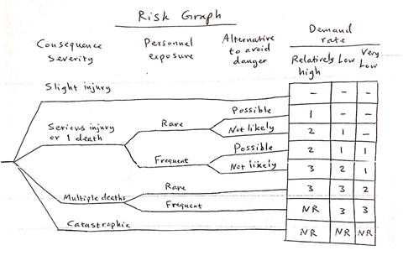
ـــ No special safety feature required
NR Not recommended, Consider alternatives

Slide 269
22.2.2 Assessing Equipment Against the Targets
Quantitative versus qualitative features:
Failure rates do not apply to systematic failures as in the software case.
Assessment methods include:
1-Random hardware failures (the traditional reliability prediction against a quantified target).
2-Establishing ALARP.
3-Meeting life-cycle activities requirement .
4-Demonstarting adequate functional safety competence as an organization .
5-Meeting the safe failure fraction requirement .

Slide 270
SFF describes the proportion of failures which are either “not hazardous” or “hazardous but revealed by some auto-test” . It equals (1-Undervealed hazardous failures) .
22.3 Programmable Electronic Systems (PESs)
PESs are the most common form of control or safety systems, Beside the hardwired systems.

Slide 271
There are three configurations of PESs as follows :
22.3.1 Simplex PES (Acting alone):
They should be designed to fail a safe state .
22.3.2 One or more PESs acting in combination with one or more non-programmable systems :
Offers a high level of protection .

Slide 272
22.3.3 A number of PESs acting in combination:
Reliability is increased by redundancy. Diversity of the PESs reduces the possibility of total failure of identical PESs. Diversity involves:
1- Separate module specifications.
2- Separate source codes.
3- Different types of CPU.
4- Separate power sources.
5- Different languages.
6- Different memory types.
7- Different supply voltages.

Slide 273
End of the course

