Slide 1
Chapter 7
The University of Jordan
Mechatronics Engineering Department
Numerical Control (NC)
Dr. Osama Al-Habahbeh

Slide 2
Example CNC Products
Car engine
Gears
Woodworking, furniture
Metal parts such as fittings, brackets, screws, flanges
Artifacts
Plastic parts
And many more

Slide 3
Numerical Control (NC)
It is a form of programmable automation in which the machine tool is controlled by a program ( program of instructions).
The program represents relative positions between a work head (e.g., cutting tool) and a work part (the object being processed).
NC is good for low and medium production because of the capability to change the program (between batches), usually no change in equipment is needed.

Slide 4
Numerical Control (NC)
NC is used for machine tool applications, such as drilling, milling, turning,….. In addition to assembly drafting & inspection.
Work head movement is controlled relative to the work part.
The first NC machine was developed in 1952 by a group of American inventors.

Slide 5
7.1 Fundamentals of NC Technology
7.1.1 Basic Components of an NC System
The Basic Components of an NC System :
  Program of instructions
  Machine control unit
  Processing equipment

Slide 6
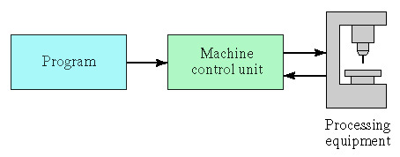
Numerical Control (NC)
Program
Machine Control Unit
MCU
Computer
Processing Equipment
(cutting tool)

Slide 7
Part Program of Instructions:
  It is the set of details step-by-step commands that direct the actions of the processing equipment.
  “Part Programmer” is the name of the person who prepares the program.
  The commands refer to positions of a cutting tool relative to the work part.
  Other program instructions include spindle speed, feed rate, etc.
  The program is coded electronically, or using diskettes.
  Older technologies include magnetic tape and punched tape.

Slide 8
Machine Control Unit (MCU) :
It is a microcomputer and control hardware. The hardware includes interface components with the processing equipment and feedback control elements.
The MCU also includes reading devices to enter the program into memory.
MCU installed software include:
    Control system software
    Calculations algorithms
    Translations software, to convert the NC part program into a usable format for the MCU.
NC includes hard-wired electronics and CNC.
CNC: Computer Numerical Control.

Slide 9
Processing Equipment :
It performs the actual productive work (e.g. , machining )
Its operation is directed by program of instructions through the MCU .
In machining , the processing equipment consists of the worktable and spindle , as well as the motors and controls to drive them .

Slide 10
7.1.2 NC Coordinate Systems :
A part programmer must define a standard axis system to specify the position of the work head .
There are two axis systems used in NC :
  1. Flat & prismatic workparts system.
  2. Rotational parts system .
Both are based on Cartesian coordinate system.

Slide 11
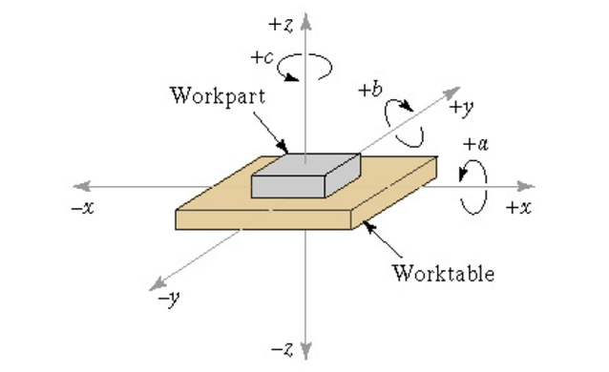
1- System for flat & prismatic workparts :
It consists of (x,y,z) plus three rotational axes (a,b,c) as shown below :

Slide 12
System for flat & prismatic workparts :
Generally , if the machine has four or five axes , three of them will be linear (x,y,z) and one or two will be rotational axes .
Most NC machine systems have less than six axes .

Slide 13
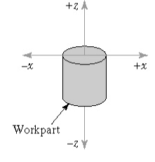
2. Rotational NC System :
Y-axis is not used!
Radial location of the tool
Longitudinal axis ( parallel to the rotation axis )

Slide 14
Rotational NC System :
The origin of the coordinate axis system is located based on convenience , e.g., the corner of the part .
The tool must be positioned at the target point ( Location on the worktable ) , where the axis system origin ( location in the workpart ) is known relative to the target point .

Slide 15
7.1.3 Motion Control Systems :
Some NC processes are performed at discrete locations on the workpart (e.g., drilling , spot wedding )
Other NC process are performed while the workhead is moving ( e.g. turning , milling , …)
Types of movement :
Straight line , circular , curvilinear path ,…

Slide 16
Features of motion Control systems
Point-to-Point Versus Continuous Path Control :
1-Point-to-Point Systems ( positioning Systems ) :
No regard to the path→ Just a series of point locations at which operations are performed .

Slide 17
Continuous Path Systems :
The tool trajectory relative to the workpart is controlled → Perform the process while moving .

Slide 18
Fundamentals of NC technology
Motion Control Systems
Continuous path systems :
(continuous path systems )
(Straight – cut NC )
(Contouring)
Tool moves parallel to one axis “only“
Tool moves relative to two or more axes (simultaneous control)

Slide 19
Interpolation Methods
The smaller the line segments the better the accuracy
→ small tolerance .
It is an important aspect of contouring .
Tolerance :
Inside , Outside , Inside & Outside .

Slide 20
Inside Tolerance

Slide 21
Outside Tolerance

Slide 22
Inside & Outside

Slide 23
NC Interpolation methods for continuous path Control :
1. Linear Interpolation :
Used when a straight line path is to be generated .
2- axis & 3-axis linear interpolations are used .
The programmer specifies the beginning and end points of the straight line , and feed rate along the straight line .

Slide 24

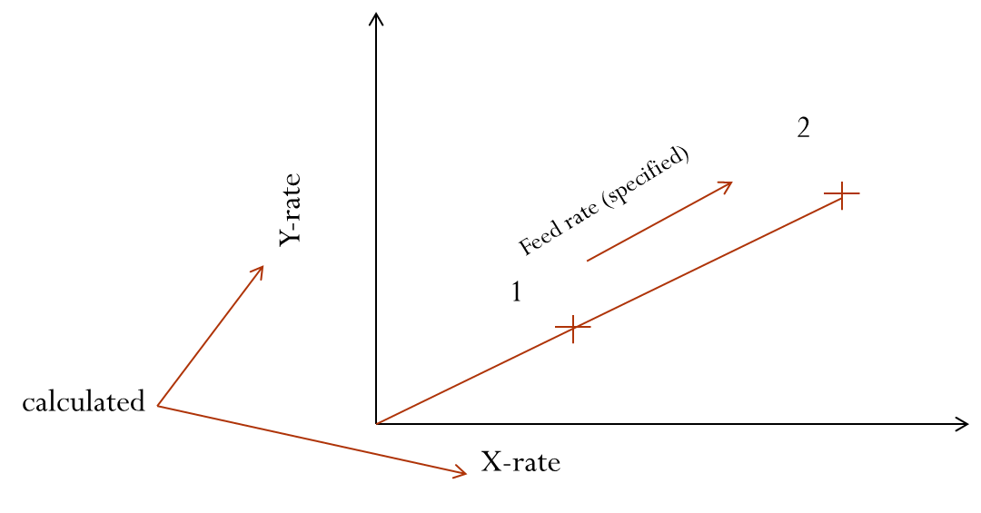

Slide 25
2. Circular Interpolation:
It permits programming of a circular arc .
The following parameters are needed :
  Starting & End points .
  Center or radius of the arc .
  Cutter direction ( along the arc )

Slide 26
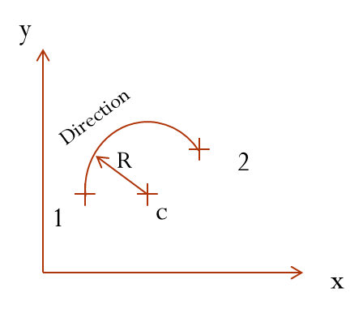
2. Circular Interpolation:

Slide 27
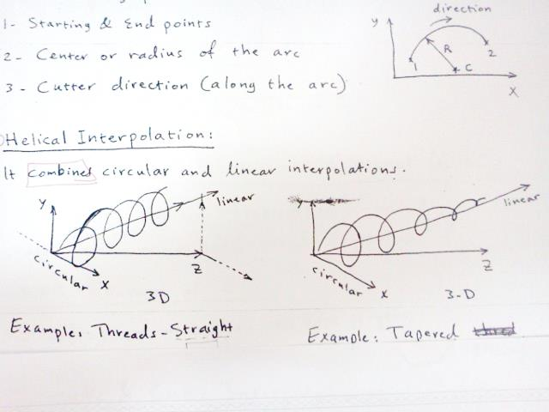
3. Helical Interpolation :
It combines circular & linear interpolation .

Slide 28
3. Helical Interpolation :

Slide 29
4. Parabolic & Cubic Interpolation :
Most applications in aerospace & automotive industries .
They use higher–order eqns. & require higher computational power .
They are less common→ complex.

Slide 30
Absolute versus incremental positioning (of work head):
Absolute | Incremental
Positions are defined Relative to the origin of the coordinate System (axis system) [x=40, y=50] | Positions are defined relative to the previous location of the tool (or next position relative to the present) [X=20, y=30]

Slide 31
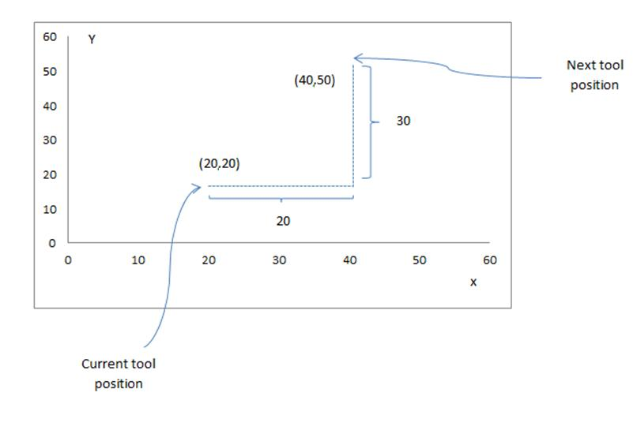
Absolute versus incremental positioning

Slide 32
7.2 Computer Numerical Control (CNC):
It is an NC system whose MCU is based on a PC rather than on a hard – wired controller.
7.2.1 Features of CNC:
  Storage of more than one part program.
  Various forms of program inputs; such as floppy disks and manual data entry.
  Program editing at the machine tool; the program can be connected and optimized Locally.

Slide 33
7.2.1 Features of CNC (CONT.)
  Fixed cycles and programming subroutines : such as macros that can be called within the program.
  Interpolation: usually executed by a stored program algorithm.
  Positioning features for setup : such as “ position set” (software option) that helps in setting up the machine tool for a given work part.

Slide 34
7.2.1 Features of CNC (CONT.)
  Cutter length and size compensation: such as using a tool length sensor built into the machine. The tool path is then corrected accordingly →(tool profile) (tool path page 48 )
  Acceleration and deceleration calculations: to prevent tool marks on the work surface during fast turns (slow down at turns).

Slide 35
7.2.1 Features of CNC (CONT.)
  Communications interface: linking with other devices is useful for downloading programs, collecting operational data, and interfacing with robots to load and unload parts.
  Diagnostics: of malfunctions and breakdowns .

Slide 36
7.2.2 The Machine Control Unit for CNC
The MCU consists of :
  Central processing unit (CPU)
  Memory
  I/O interface
  Controls for machine tool axes and spindle speed
  Sequence controls for other functions
These subsystems are interconnected by a system bus.

Slide 37
7.2.2 The machine control unit for CNC (CONT.)
1- Central Processing Unit (CPU):
It is the brain of the MCU it is divided into three sections:
Control section: It retrieves commands from memory and generates signals to activate other components.
Arithmetic –logic unit (ALU): It consists of the circuitry to perform calculations.
Immediate access memory:
It provides a temporary storage for data

Slide 38
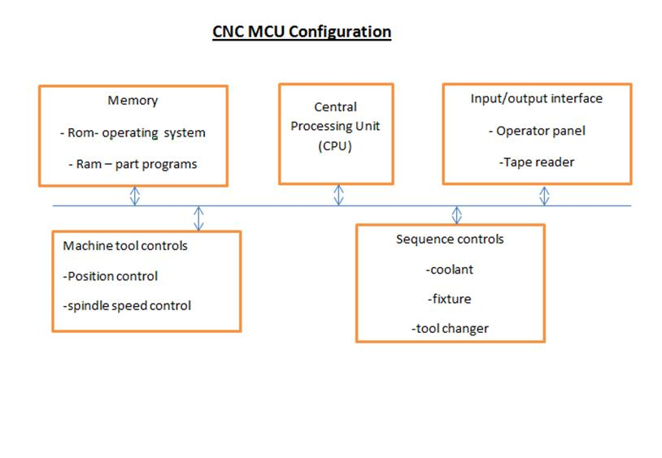
2-Memory:
It is used to store the software and data needed to operate the CNC system.

Slide 39
Memory
CNC memory is divided into two categories:
a) Main memory (primary storage) :
Consists of ROM (read only memory) and RAM (random access memory).
  ROM is used to store operating system and interface programs.
  RAM is used to store NC part programs (change with jobs).

Slide 40
CNC memory
b) Secondary memory (high – capacity secondary memory, auxiliary storage, or secondary storage):
Used to store large programs and data files, which are transferred to main memory as needed.
Example: Hard disks

Slide 41
3-Input/Output interface:
It provides communication between the components of the CNC system, other systems, and the operator (through the operator control panel) Used to control speeds, feed, …..
It also includes a display (CRT or LED) to indicate current status of the program.
I/O interface also include manual program entry capability in addition to program transmission via LAN.

Slide 42
4- Controls for machine tool axes and spindle speed:
These are hardware components that control the position and velocity (feed rate) of each axis, as well as the spindle speed.
The spindle is used to drive either:
  (a) The work piece -> like turning
  (b) A rotating cutter -> like milling & drilling

Slide 43
5- Sequence controls for other machine tool functions:
Other control functions include ON/OFF (binary) actuations, interlocks [coolant control, tool changer, wearing, part loading]
To manage these auxiliary functions (instead of the CPU).

Slide 44
Personal computers (PC’s) and the MCU:
PC’s are used for CNC in two configurations:
  a) The PC is used for CNC as a front-end interface for the MCU
  b) The PC contains the motion control board required to operate the
  machine tool

Slide 45
7.2.3 CNC Software
There are three types of software used in CNC systems:
Operating system
Machine interface
Application

Slide 46
7.2.3 CNC Software (CONT.)
1- Operating system:
It consists of:
1- An editor: which permits the operator to input and edit NC part
programs.
2- A control program: decodes the part program instructions performs
calculations.
3- An executive program: manage the execution of the CNC software.

Slide 47
7.2.3 CNC Software
(CONT.)
2- Machine Interface:
Used to operate the communication link between the CPU and the machine tool
3- Application software:
Consists of the NC part programs that are written for machining.
Some CNC auxiliary functions such as coolant control, fixture clamping and counters are often implemented by a PLC in the MCU.

Slide 48
7.3 Distributed Numerical Controls (DNC):
A central computer is connected to multiple MCU’s. complete part programs are sent from the central computer to the machine tools (via
MCUs ).
Data can be downloaded from the central computer to machine tools such as part programs, list of tools needed for job, and setup instructions.
Data can be uploaded from the machine tools to the central computer such as piece counts, actual machining times, and tool life statistics.

Slide 49
Distributed Numerical Controls (DNC)
Two ways of DNC:
Switching network.
Local area network (LAN).

Slide 50
Switching network
(Using RS-232-c connection)
Cons = limited number of
machines can be
connected.

Slide 51
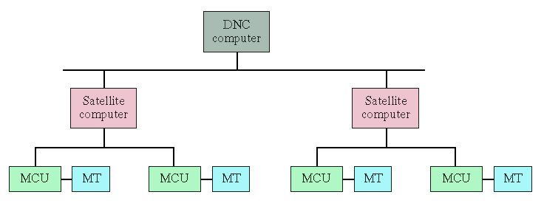
Local Area Network (LAN)
Hierarchy
Central (host) computer

Slide 52
7.4 Applications of NC
Two categories:
  Machine tool applications: Usually associated with the metalworking industry.
  Non- Machine tool applications: Other industries.

Slide 53
7.4.1 Machine Tool Applications
Machining operations and NC machine tools:
Four types of machining operations:
  Turning.
  Drilling.
  Milling.
  Grinding.
Speed, feed, depth of cut are called “cutting conditions”.

Slide 54
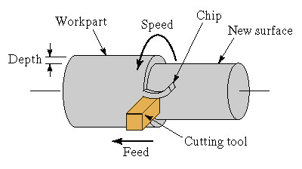
Turning (on a Lathe)

Slide 55
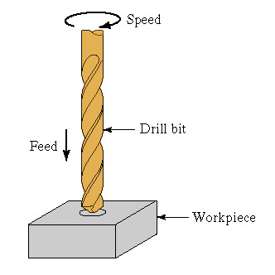
Drilling

Slide 56
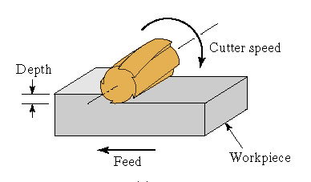
Peripheral Milling

Slide 57
Surface grinding

Slide 58
Controller parameters
Where:
N: Spindle rotation speed (RPM).
V: Cutting speed (m/min) or ft/min.
D: Milling cutter diameter (m, ft).

Slide 59
Controller parameters
In milling, “chip load or feed” means the size of the chip formed by each tooth in the cutter.
Where:
: Feed rate (mm/min, in/min).
: Rotational speed (RPM).
: Number of teeth on the milling cutter.
: Feed (mm/tooth, in/tooth).

Slide 60
For Tuning Operation
(mm/revolution)
Depth of cut: The distance the tool penetrates below the original surface of the workpart (mm, in).

Slide 61
Common NC machine tools
NC lathe:
Either horizontal or vertical axis.
Requires two-axis.
Continuous path control.
Straight turning → produces a straight cylindrical geometry.
Contour turning → creates a profile.

Slide 62
Common NC machine tools
NC boring mill:
Horizontal and vertical spindle.
Boring is similar to turning, except that an internal cylinder is created instead of an external cylinder.
Continuous path.
Two-axis control.

Slide 63
Common NC machine tools
NC drill press:
Point-to-point control of the workhead (spindle containing the drill bit).
Two-axis (x - y) control of the worktable.
NC milling machine:
Continuous path control.
Straight cut and contouring operations.
NC cylindrical grinder:
It is similar to a turning machine, except that the tool is a grinding wheel.
Continuous path two... Axis control

Slide 64
Common NC machine tools
Machining center :
A machine tool capable of performing multiple machining operations on a single work piece in one setup.

Slide 65
NC application characteristics .
Part characteristics most suited to NC :
  Batch production.
  Repeat orders.
  Complex part geometry.
  Much metal needs to be removed from the work part.
  Many separate machining operations on the part.
  The part is expensive.
NC for other metalworking processes :
  Punch press for sheet metal hole punching .
  Press for sheet metal bending .
  Welding machines : spot welding and continuous arc welding .
  Thermal cutting a machines such as laser cutting and plasma arc cutting .
  Tube bending machines .

Slide 66
7. 4. 2 Other NC Applications:
1- Electrical wire wrap machines :
  Used to establish connections between components on wiring boards in electronics.
2- Components insertion machines:
  Used in mechanical assembly and for inserting electronic components into printed circuit boards.
3- Drafting machines:
  Used in CAD systems, such as high–speed X-Y plotter

Slide 67
Other NC Applications
4- Coordinate measuring machines (CMM):
  Used to inspect dimensions of a part (automatically).
5- Tape-laying machines for polymer composites :
  The workhead is a dispenser of a matrix composites tape.
  The machine is programmed to lay the tape onto a mold.
6- Filament winding machines for polymer composites :
  Similar to the preceding machine except that a filament is dipped in uncured polymer and wrapped around a rotating Pattern of cylindrical shape.

Slide 68
7. 4. 3 Advantages & disadvantage of NC
Advantages of NC: (over manual)
  1- Nonproductive time is reduced: fewer setups, Less setup time …
  2- Greater accuracy and repeatability: reduces variations due to operator skill differences, fatigue...
  3- Lower scrap rates: due to higher accuracy .
  4- Inspection requirements are reduced: parts are virtually identical .
  5- More complex part geometrics are possible .

Slide 69
Advantages of NC
  6- Engineering changes can be accommodated more gracefully (using part program).
  7- Simple fixtures (supporting devices) are needed → NC takes care of positioning.
  8- Shorter manufacturing lead times.
  Lead time: elapsed time between order and completion.
  9- Reduced parts inventory: due to fewer setups and easier changeovers .
  10- Less floor space required: NC is more efficient → less NC machines are needed.
  11- Operator skill-level requirements are reduced:
  tending an NC machine involves loading, unloading & changing tools (only).

Slide 70
Disadvantages of NC :
  1- Higher investment cost.
  2- Higher maintenance effort.
  3- Part programming.
  4- Higher utilization of NC equipment:
  It is done to justify the cost, however, it takes more shifts and personnel → cost.

Slide 71
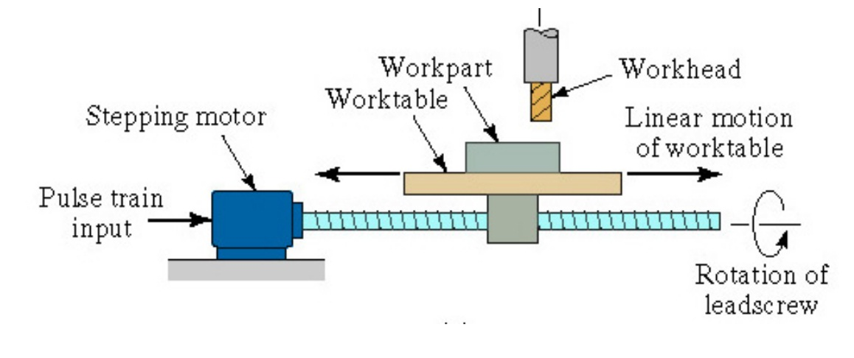
7.5 Engineering Analysis of NC Positioning Systems
An NC positioning system converts the coordinates in the part program into positions of the tool.
Simple positioning system

Slide 72
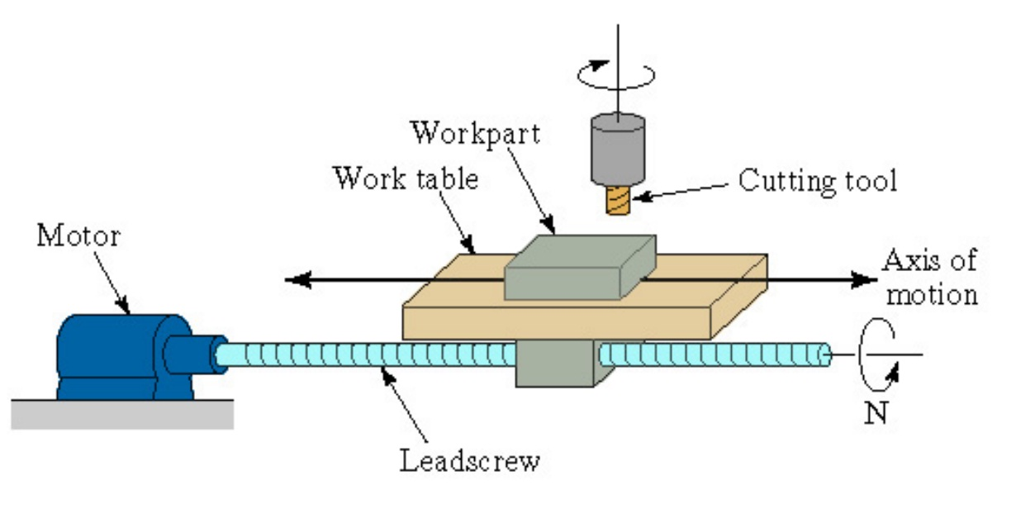
Simple position system
Screw pitch p(mm/thread, in/thread)
The table moves a distance equal to the pitch for each revolution.

Slide 73
Types of position control system:
  Open loop (as shown above ):no verification of actual position.
  Closed loop: confirms that the actual position is the desired one (in the program).

Slide 74
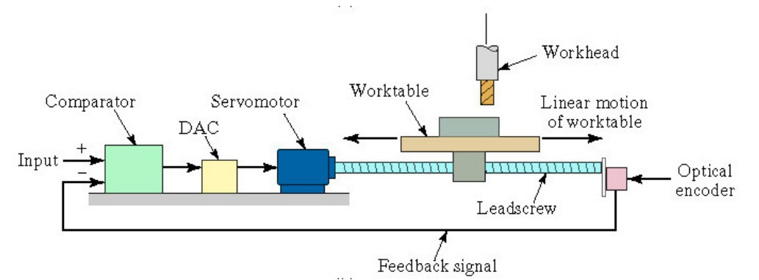
Closed loop:
- Closed-loop is used when high resisting forces (of machining) are involved (such as in milling or turning).

Slide 75
7.5.1 open-loop positioning systems
Typically uses a stepper motor, driven by pulses, generated by MCU. Each pulse rotates the motor through a "step angle” (in degree)
α : Step angle in degree.
: Number of step angles for the motor.
: Angle through which the motor rotates (degrees).
: Number of pulses received by the motor.
: Step angle (degree/pulse).

Slide 76
7.5.1 Open-loop positioning systems
The motor shaft is generally connected to the lead screw through a gearbox, so:
: angle of lead screw rotation (degrees).
: Gear ratio.
: Rotational speed of motor (rpm).
N : Rotational speed of lead screw (rpm).
Where

Slide 77
7.5.1 Open-loop positioning systems
Linear movement of work table is given by:
: X-axis position relative to the starting position (mm, in).
: Pitch of lead screw (mm/rev, in/rev).
: Number of lead screw revolutions.
The number of pulses required to achieve a specified x-position increment is given by (using the preceding relationships):

Slide 78
7.5.1 Open-loop positioning systems
Control pulses are generated at a certain frequency, which drives the worktable, where:
: Rotational speed of lead screw (rpm).
: Pulses train frequency ( Hz, pulses/s).
: Steps per revolution or pulses per revolution.
: Gear ratio .

Slide 79
7.5.1 Open-loop positioning systems
The work table travel speed in the direction of lead screw axis is:
: (mm/min, in /min)
: Table feed rate (mm/min, in /min).
: lead screw pitch (mm/rev, in/rev).

Slide 80
7.5.1 open-loop positioning systems
The required pulse train frequency to drive the table at a given rate is :

Slide 81
Ex.7.1 : NC Open-Loop Positioning
The work table of a positioning system is driven by a lead screw whose pitch = 6mm .
The lead screw is connected to the output shaft of a stepper motor though a gearbox whose ratio is 5 : 1
The stepper motor has 48 step angles . The table must move a distance of 250 mm at a linear velocity = 500 mm/min .
Motor
lead screw

Slide 82
7.5.1 Open-loop positioning systems
Determine :
How many pulses required to move the table the specified distance ?
The required motor speed and pulse rate to achieve the desired table velocity ?

Slide 83
Solution:
7.5.1 Open-loop positioning systems
a)
A : angle of lead screw rotations.

Slide 84
7.5.1 Open-loop positioning systems
b)

Slide 85
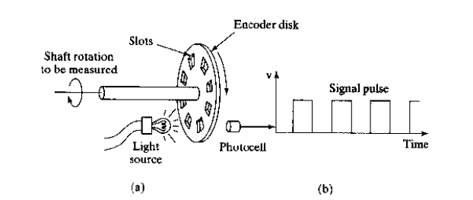
7.5.2 Closed-Loop Positioning Systems
They use servomotors and feedback measurements to ensure that the worktable is moved to the desired position.
A common feedback sensor is the optical encoder :

Slide 86
7.5.2 Closed-Loop Positioning Systems
An optical encoder is a device for measuring rotational speed .
The equations that define the operation of a closed-loop NC positioning system one similar to those for an open-loop system . In the optical encoder , the angle between slots in the disk is:
α : (deg/slot) ns : number of slots in disk
np : # of pulses sensed by the encoder &emitted
A : angle of rotation of the encoder shaft

Slide 87
7.5.2 Closed-Loop Positioning Systems
x : worktable pos.
p : lead screw pitch(mm/rev)
vt : worktable velocity (mm/min)
fr : feederate (mm/min)
fp : frequency of the pulse train
(Hz,pulse / sec )
The pulse train generated by the encoder is compared with position and feed rate specified in the part program , and the difference is used by the MCU to drive a servomotor , which drives the worktable .
Closed-loop NC is good for milling and turning because of the reactionary force that resists the movement of the table .

Slide 88
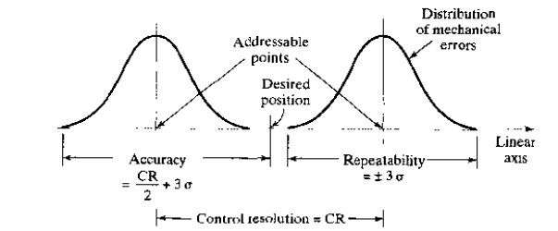
7.5.3 Precision in NC Positioning
NC positioning system has three measures of precision :
Control resolution
Accuracy
Repeatability
Worst-case scenario
Gear back lash, deflection,etc..
(distinguishable points)
By the MCU
(smaller is better)

Slide 89
Precision in NC Positioning
CR1 : Electromechanical (mm)
CR2 : Computer control system (mm)
L : Axis range (mm)
B : Number of bits in the devoted bit storage register
Both equations can be used for open or closed loop.
* Typical value of CR is 0.0025 mm
Standard-deviation

Slide 90
7.6 NC Part Programming
Consists of planning and documenting the sequence of processing steps to be performed on an NC machine .
Methods of part programming :
Manual part programming.
Computer-assisted part programming.
Part programming using CAD/CAM.
Manual data input.

Slide 91
7.6.1 Manual Part Programming
The programmer prepares the NC code using a low-level machine language, which is based on binary numbers. This language is understood by the MCU.
NC uses a combination of binary and decimal number systems . Called the “binary-coded decimal (BCD) system” , for example , the decimal value 1250 is coded in BCD as in the following table .

Slide 92
Manual Part Programming
Decimal value | Binary number | Number sequence
1000 | 0001 | 1st
200 | 0010 | 2nd
50 | 0101 | 3rd
0 | 0000 | 4th
1250 |  | Sum

Slide 93
Binary & decimal number conversion
Decimal | Binary | Decimal | Binary
5 | 0101 | 0 | 0000
6 | 0110 | 1 | 0001
7 | 0111 | 2 | 0010
8 | 1000 | 3 | 0011
9 | 1001 | 4 | 0100

Slide 94
Manual Part Programming
In addition to numerical values, the NC coding system provides for alphabetical characteristics and other symbols . A “word” specifies a detail about the operation , such as x-position , y-position , feed rate and spindle speed .
A “block” is one complete NC instruction , it specifies the destination for the move , speed and feed .
“Block format” or (tape format) is the organization of “words” within a block .
Modern Controllers use the word address format which uses a letter prefix and spaces to separate words , order of words is important .

Slide 95
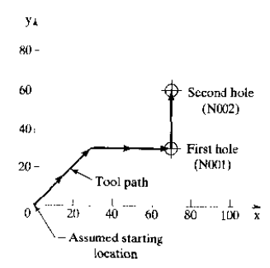
Drilling Example :
The two commands to perform the two drilling operations are :
N001 G00 X07000 Y03000 M03
N002 Y06000
Where :
N : sequence # prefix
X : x-axis prefix
Y : y-axis prefix
G-words are preparatory
words

Slide 96
Manual Part Programming
G-words (or G-codes) consists of two numerical digits (following “G” prefix ) .
For example , G00 prepares the controller for a point-to-point rapid traverse move between the previous point and the endpoint defined in the current command .
M-words are used to specify miscellaneous auxiliary functions available on the machine tool .
The M03 in the example is used to start the spindle rotation .

Slide 97
Manual Part Programming
The words in a block are usually given in the following order:
  Sequence number (N-Word)
  Preparatory word (G-word)
  Coordinates (x- , y- , z- words for linear axis A- , B- , C- words for rotational axes)
  Feed rate (F-word)
  Spindle speed (S-word)
  Tool Selection (T-word)
  Miscellaneous command (M-word)

Slide 98
Manual Part Programming
See Appendix A7 for the details of the coding system in manual part Program .
Manual part programming is used for point-to-point as well as contouring jobs such as milling and turning . However , for computer 3-D machining operations, computer-assisted part programming is used .

Slide 99
7.6.2 Computer-Assisted Part Programming
Manual part programming can be tedious. However, in computer-assisted programming, the tasks are divided between the programmer and the computer :
1) The Part Programmers Job (Done 1st)
The machining instructions are written in English-like statements that are subsequently translated by the computer into low-level machine code.
The two main tasks for the programmer are :
  Define the geometry of the part .
  Specify the tool path and operation sequence .

Slide 100
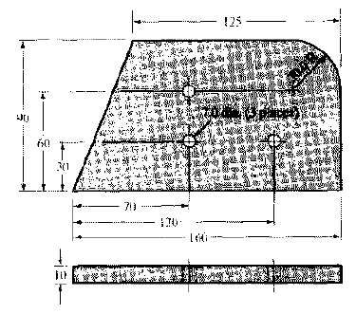
Computer-Assisted Part Programming
Example :
Geometry Elements :
  Points
  Lines
  Circles

Slide 101
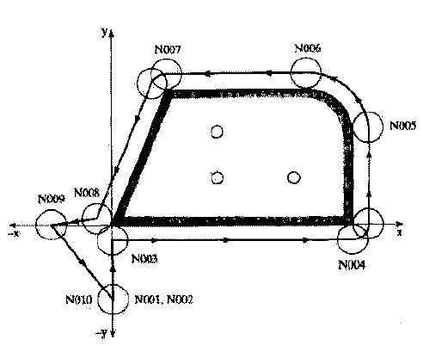
Computer-Assisted Part Programming
Ex. Cont. :
(High level language /general purpose)
APT : Automatically programmed tooling

Slide 102
Computer-Assisted Part Programming
Ex. Cont. :
1- Define the geometry :
P4=point/35,90,0
points x , y , z coordinates
L1=Line/P1 , P2
C1 = Circle/Center , P8 , Radius , 30 .
Circle center of circle location circle radius

Slide 103
Computer-Assisted Part Programming
2- Total path & sequence :
Outline contouring : if cutting tool at P2 (along L1), to cut along L2 :
GOLFT/L2 , TANTO , C1
Continuous path motion command
EX :
GOTO/PS (move the tool to point 5 )
Cutting Speed & feed rates must be also specified .
Turn left onto L2
Tangent to
Circle

Slide 104
(2) Computer Tasks (Done next) : (after programmer’s job)
Input translation : result in an output file called PROFIL.
Arithmetic & Cutter offset computations : result in an output file called CLFILE (Cutter location file)
Editing : output file called CLDATA (Machine Commands), it depends on the type of the machine tool (low-level code) for the controller of the machine tool.
Post-processing : a separate computer program . (specific to the concerned tool)
O/P of post processing is a G-codes program in addition to x , y , z coordinates , S , F , M word address format .
Post processing is an interface between APT & the machine tool .

Slide 105
7.6.3 NC Part Programming Using CAD/CAM
A CAD/CAM System is a computer graphics system that integrates design and manufacturing functions . It can perform NC part programming .
In this method , the computer does most of the part programmer’s Job.

Slide 106
Advantages:
Part program can be simulated off-line on the CAD/CAM system to verify its accuracy.
Time & cost of the operation can be determined by the CAD/CAM system .
Automatic tool selection .
Automatic optimization of speeds & feeds for work material & operations .
Immediate visual verification of geometric elements .

Slide 107
Geometry definition using CAD/CAM :
A computer graphics model of each part is developed by the designer . The model contains geometric , dimensional and material specifications for the part .
The model is stored in a database, in order to perform NC operations, the programmer retrieves the part geometry model from storage , and uses that model to construct the cutter (Tool) path . Where the geometry is already defined .

Slide 108
Geometry definition using CAD/CAM :
Geometric elements are then labeled (with symbols) , e.g.: lines(L1,L2) , circles(CI,C2) , etc ….
Sometimes , they are already labeled .
Points are defined in a coordinate system using the computer graphics system .
Lines & circles are defined from the points .

Slide 109
7.6.3 Tool path generation using CAD/CAM
Most CAD/CAM systems have tool libraries that can be called by the programmer.
The programmer decides which tool is appropriate for the operation at hand. Then he/she specifies it for the tool path , this permits the tool diameter to be entered automatically for tool offset calculations.
New tools can be added to the library as needed.

Slide 110
Tool path generation using CAD/CAM
Tool path can be defined using the interactive graphics system by entering the motion commands one-by-one.
Individual statements in APT are entered , and the CAD/CAM system provides immediate graphics display of the action resulting from the command.
A more advanced approach for generating tool path commands is to use an automatic software module, which is a subroutine that executes the machines cycle provided that it is given the required parameters .
An animated simulation can be provided for validation purposes .

Slide 111
Computer – Automated part programming :
It is a futuristic fully automated NC part programming procedure.
Given the geometric model of the part, the system could accomplish NC part programming without human assistance .
Example of machining cycles available in automatic programming modules include facing , shoulder facing , lettering , and threading.

Slide 112
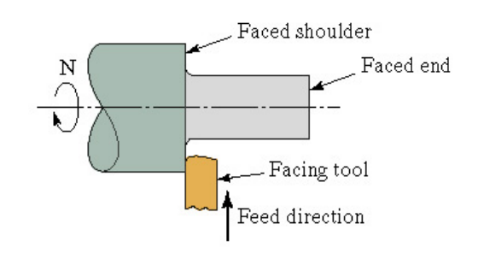
Facing and shoulder facing :

Slide 113
Mastercam :
It is the leading commercial CAD/CAM software package for CNC part Programming.
Files from other CAD packages can be translated for use within Master cam as well.
The input includes the part geometry , work piece orientation & material , type of operation (e.g. milling ) , cutting tool, cutting parameters (e.g. hole depth ) , & matching post process for the machine tool.
The output would be a word address format program.

Slide 114
7.6.4 Manual Data Input (MDI)
The machine operator performs the part programming task at the machine tool . The programmer manually enters the part geometry data and motion commands directly into the MCU.
MDI is AKA conversational programming. It requires minimal initial investment , but it is more prone to errors . It typically includes a monitor & keyboard.
Entering commands can be done using a menu – driven procedure→ that is responding to a series of questions.

Slide 115
Manual Data Input (MDI)
Simultaneous machining while the next program is being written is a desired feature of MDI systems.
See Appendix A7 & B7 for more details & examples on coding for manual part programming & part programming with APT .

