Slide 1
The Urinary System
Anatomy ,physiology and embryology

Slide 2
The Functions of Kidneys
A)
Excretion & Elimination:
removal of organic wastes products from body fluids (urea, creatinine, uric acid)
Homeostatic regulation:
Water -Salt Balance
Acid - base Balance
Endocrine function:
Productions of some hormones
B)
C)

Slide 3
B) Homeostatic Functions
1) Water –electrolytes balance
Regulate blood volume and blood pressure:
by adjusting volume of water lost in urine
releasing renin from the juxtraglomerular apparatus
Regulate plasma ion concentrations:
sodium, potassium, and chloride ions (by controlling quantities lost in urine)
calcium ion levels
2) Acid-Base Balance
(Help stabilize blood pH)
The kidneys control this by excreting H+ ions and reabsorbing HCO3 (bicarbonate).

Slide 4
C) The endocrine function
Kidneys have primary endocrine function since they produce hormones (erythropoietin, renin and prostaglandin).
Erythropoietin is secreted in response to a lowered oxygen content in the blood. It acts on bone marrow, stimulating the production of red blood cells.
Renin the primary stimuli for renin release include reduction of renal perfusion pressure and hyponatremia. Renin release is also influenced by angiotension II and ADH.
The kidneys are primarily responsible for producing vitamin D3

Slide 5
Organs of the Urinary System
Kidneys
Ureters
Urinary bladder
Urethra
Copyright © 2008 Pearson Education, Inc., publishing as Benjamin Cummings
Figure 23.1a

Slide 6
Location and External Anatomy of Kidneys
Located retroperitoneally
Lateral to T₁₂–L₃ vertebrae
Average kidney
12 cm tall, 6 cm wide, 3 cm thick
Hilus
On concave surface
Vessels and nerves enter and exit
Renal capsule surrounds the kidney

Slide 7
Relationship of the Kidneys to Vertebra and Ribs
Figure 23.1b

Slide 8
Position of the Kidneys with in the Posterior Abdominal Wall
Figure 23.2a

Slide 9
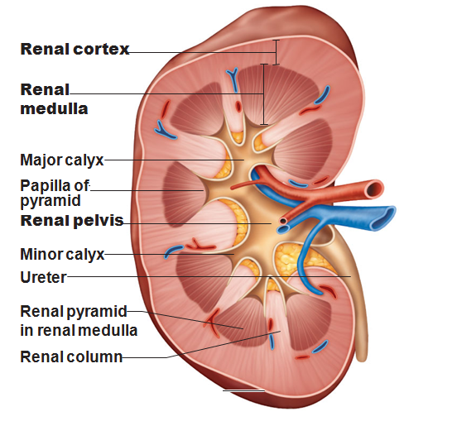
Internal Gross Anatomy of the Kidneys
Renal cortex
Renal pyramids
Renal pelvis
Major calicies
Minor calicies
Gross vasculature
Renal arteries
Branch into segmental arteries

Slide 10
Internal Anatomy of the Kidneys
Figure 23.3b

Slide 11
Summary of Blood Vessels Supplying the Kidney
Figure 23.3c

Slide 12
Mechanisms of Urine Production
Filtration
Filtrate of blood leaves kidney capillaries
Reabsorption
Most nutrients, water, and essential ions reclaimed
Secretion
Active process of removing undesirable molecules

Slide 13
Basic Kidney Functions
Figure 23.4

Slide 14
The Nephron
Renal corpuscle
Glomerulus and glomerular capsule
Glomerulus – tuft of capillaries
Capillaries of glomerulus are fenestrated
Glomerular (Bowman’s) capsule
Parietal layer – simple squamous epithelium
Visceral layer – consists of podocytes

Slide 15
Tubular Section of Nephron
Filtrate proceeds to renal tubules from glomerulus
Proximal convoluted tubule
Loop of Henle
Descending limb
Thin segment
Thick segment
Distal convoluted tubule
Collecting tubules

Slide 16
Ureters
Carry urine from the kidneys to the urinary bladder
Oblique entry into bladder prevents backflow of urine
Histology of ureter
Mucosa – transitional epithelium
Muscularis – two layers
Inner longitudinal layer
Outer circular layer
Adventitia – typical connective tissue

Slide 17
Microscopic Structure of the Ureter
Figure 23.12

Slide 18
Urinary Bladder
A collapsible muscular sac
Stores and expels urine
Full bladder – spherical
Expands into the abdominal cavity
Empty bladder – lies entirely within the pelvis
Figure 23.13

Slide 19
Urinary Bladder
Urachus – closed remnant of the allantois
Prostate gland
Lies directly inferior to the bladder
Surrounds the urethra
Figure 23.14

Slide 20
Urinary Bladder
Wall of bladder
Mucosa
Transitional epithelium
Muscular layer
Detrus or muscle
Adventitia

Slide 21
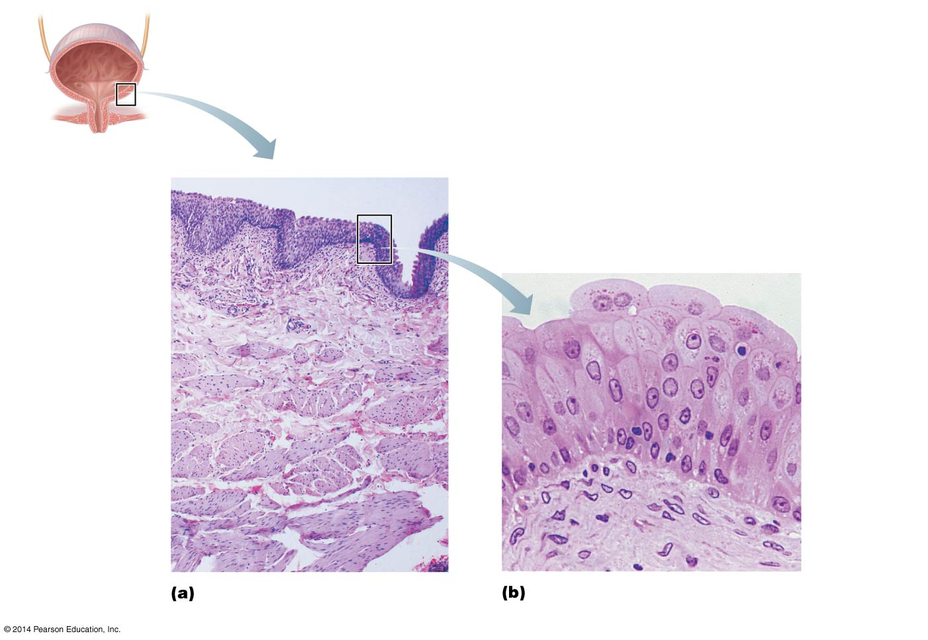
Histology of the Urinary Bladder
Figure 24.13 Histology of the bladder.
Lumen of the bladder
Transitional epithelium
Lamina propria
Muscular layer (detrusor)
Transitional epithelium
Basement membrane
Micrograph of the bladder wall (25× )
Epithelium lining the lumen of the bladder (285× )
Lamina propria
Figure 23.15a, b

Slide 22
Structure of the Urinary Bladder and Urethra
Peritoneum
Ureter
Rugae
Detrusor muscle
Ureteric orifices
Bladder neck
Internal urethral
sphincter
Trigone
External urethral
sphincter
Urogenital diaphragm
Urethra
External urethral
orifice
(b) Female
Figure 23.16b

Slide 23
Urethra
Internal urethral sphincter
Involuntary smooth muscle
External urethral sphincter
Voluntarily inhibits urination
Relaxes when one urinates

Slide 24
Urethra
In females
Length of 3–4 cm
In males – 16-20 cm in length – three named regions
Prostatic urethra
Passes through the prostate gland
Membranous urethra
Through the urogenital diaphragm
Spongy (penile) urethra
Passes through the length of the penis

Slide 25
Embryology of The Urinary System
Embryo develops three pairs of kidneys
Pronephros
Mesonephros
Metanephros
Only metanephros persists to become the adult kidneys
Metanephric kidney produces urine by fetal third month
Contributes to the volume of amniotic fluid

Slide 26
The urinary tract develops from the 3rd week of the embryonic period from the intermediate mesoderm as well as from the urogenital sinus. The kidneys develop from the 4th week in three steps:
As a first one, the pronephros, forms that then later atrophies in the 8th week and is never active functionally.
It is followed by the mesonephros, that is formed between the 6th and 10th weeks, but is only transitory.
The definitive kidneys develop from a metanephrones (mesodermal origin) and the ureter bud (that has its origin in the caudal part of the wolffian duct)

Slide 27
The urine-excreting part of the kidneys, the nephron, mainly arises from the metanephrones (glomerulus, proximal, intermediate and distal tubules), while the rest of the upper urinary tract (collecting ducts, calices, renal pelvis and ureter) develop from the ureteric bud.

Slide 28
The numerous induction mechanisms between ureter bud and metanephric mesenchyma during the development of the renal system, as well as the ascent of the kidneys, originating at the level of the sacrum and moving up to the diaphragm at the end of the development, make it possible for a large number of abnormalities to arise.
Many remain asymptomatic whereas others are not compatible with survival.

Slide 29
In males the internal sex organs come from the mesonephric duct (Wolff) that differentiates itself into the epididymis, deferent duct, seminal vesicle and the ejaculatory duct.
The paramesonephric duct (Müller) atrophies. It leaves behind embryonic remnants such as the testicular appendage and parts of the prostatic utricule.

Slide 30
In females the paramesonephric duct (Müller) remains in existence and differentiates itself into the fallopian tube with its ampullae and, following its fusion at the caudal end, into the uterus and the upper part of the vagina.
The mesonephric duct (Wolff) with its tubules atrophies and leaves embryonic remnants such as the ductus longitudinalis epoöphori (Gartner), epoöphoron and paroöphoron.

Slide 31
Development of the Urinary Organs
Figure 23.18a,b

Slide 32
Development of the Urinary Organs
Figure 23.18c, d

Slide 33
Good Luck

