Slide 1
Ureteral Injuries

Slide 2
Ureteral Injuries
An unrecognized or mismanaged ureteral injury can lead to significant complications, including:
  urinoma
  Abscess
  ureteral stricture
  urinary fistula
  potential loss of an ipsilateral renal unit

Slide 3
Causes
External trauma
Open surgery
Laparoscopy
Endoscopic procedures

Slide 4
External Trauma
Damage to the ureter after external violence is quite rare, occurring in less than 4% of all penetrating and less than 1% of all cases of blunt trauma
These patients often have significant concomitant injuries and a devastating degree of mortality that approaches one third

Slide 5
Associated visceral injury is common—predominantly small (39% to 65%) and large (28% to 33%) bowel perforation
A significant percentage (10% to 28%) of patients with ureteral injuries also has associated renal injuries
A smaller percentage (5%) has associated bladder injuries

Slide 6
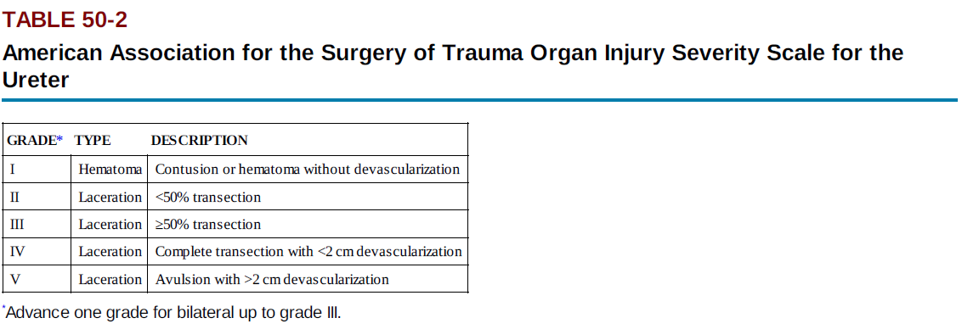

Slide 7
penetrating trauma imparts a large degree of energy over a small area (as in the course of a bullet)
The mechanism by which bullets injure the ureter is:
  direct transection
  disruption of the delicate intramural blood supply

Slide 8
patients with blunt trauma with ureteral injuries are subject to extreme force applied over the entire body, like a fall from heights or a high-speed motor vehicle accident
The presence of massive force injuries in the patient with blunt trauma should always increase the level of suspicion for ureteral injury

Slide 9
Patients with penetrating trauma with any degree of hematuria or a wound pattern that suggests the possibility of genitourinary injury should be imaged.
Patients with blunt trauma with gross hematuria or microhematuria plus hypotension, a history of significant deceleration, or significant associated injuries also should be imaged

Slide 10
Surgical Injury
Analysis of 13 published studies concluded that the following procedures contribute to iatrogenic ureteral injuries:
  hysterectomy (54%),
  colorectal surgery (14%)
  pelvic procedures such as ovarian tumor removal (8%)
  transabdominal urethropexy (8%)
  abdominal vascular surgery (6%)

Slide 11
Vascular Surgery.
Intraoperative ureteral manipulation resulting in subsequent hydronephrosis is common after aortoiliac and aortofemoral bypass surgery (12% to 20%), but the course is benign in most
Surgical devascularization or inflammation can result in symptomatic ureteral stenosis, often delayed in manifestation by months, occurring in only 1% to 2% of these patients

Slide 12
The majority (up to 85%) of surgical injuries to the ureter after vascular procedures are not recognized immediately
Postoperative symptoms of missed ureteral injury include
  flank pain (36% to 90%)
  fever
  Ileus
  abdominal distention
  urinary fistula

Slide 13
Ureteroarterial fistulas deserve special mention. This rare and potentially catastrophic condition should be diagnosed and treated immediately because it can cause life-threatening hematuria
The fistula, mostly between the ureter and ipsilateral iliac artery.

Slide 14
Robotic and Laparoscopic Surgery
the reported rate of ureteral injury varies between 0.5% (experienced surgeons) and 14% (inexperienced surgeons) after laparoscopic hysterectomy
Of ureteral injuries during hysterectomy, 50% have no identifiable risk factors. The other 50% are associated with malignancy, endometriosis, prior surgery, and surgery for prolapse

Slide 15
In contradistinction to open operation, in which at least one third of ureteral injuries are recognized immediately, fewer injuries to the ureter are immediately identified after laparoscopy. Therefore, during laparoscopy and robotic surgery, a high index of suspicion for ureteral injury is required.

Slide 16
Avoiding and Detecting Ureteral Injury.
Avoidance of ureteral injury is predicated on intimate knowledge of its location, especially its relation to the uterine and ovarian arteries, if those structures are going to be ligated, as in a hysterectomy
Visualization of the ureter in the area of the ureterosacral ligaments is thought to be especially difficult, and special care must be taken in this area

Slide 17
Intraoperative hydration or diuretic administration has been suggested to enhance ureteral visualization and potentially decrease the risk for injury
Preoperative ureteral stenting can be used to ease identification of the ureter in highrisk cases, although it may increase intraoperative recognition of ureteral injury, it may not actually decrease ureteral injuries

Slide 18
injection of 5 to 10 mL of IV indigo carmine dye followed by cystoscopy to ensure patency of the ureters after laparoscopic hysterectomy. When this technique was used in 118 patients undergoing laparoscopic hysterectomy, 4 of 4 cases of ureteral occlusion were identified immediately (mostly caused by suture ligation) and repaired immediately without complications

Slide 19
The Tenuous Ureteral Blood Supply.
The distal ureteral blood supply is variable. It is estimated by cadaver studies that 10% of females carry a disproportionate amount of their distal ureteral blood supply via uterine artery branches
It has been experimentally proved on cadavers that 40% of females have decreased ureteral perfusion after ligating the uterine artery

Slide 20
Distal ureteral devascularization may be an unavoidable consequence in a small percentage of women after hysterectomy
Ureteral devascularization tends to manifest differently from other ureteral injuries
Patients tend to present late (more than a week after surgery, but as late as 1 to 2 months), usually with ureteral stenosis, urinoma, or even ureterovaginal fistula

Slide 21
Ureteroscopic Injury
In fact, ureteroscopic injury was the most common cause of iatrogenic ureteral trauma in some modern series
Improvements in equipment and operator experience subsequently decreased the rate of ureteral perforation, to a stable average of 7% in the 1990s

Slide 22
One factor cited as a cause of ureteral injury during ureteroscopy was the persistence of stone basket attempts after recognition of a ureteral tear.
Current recommendations are to stop the procedure and place a ureteral stent when ureteral perforations are identified

Slide 23
It is also recommended to perform ureteroscopy alongside or over a wire placed up into the renal pelvis.
Factors associated with higher complication rates during ureteroscopy were
  longer surgery times
  reatment of renal calculi
  surgeon inexperience
  previous irradiation

Slide 24
Factors that are thought to protect against ureteral injury are smaller and flexible ureteroscopes

Slide 25
Diagnosis
Gunshot and Stab Wounds
  Hematuria is a nonspecific indicator of urologic injury
  Significant ureteral injury can occur in the absence of hematuria
  a high index of suspicion is required in cases of potential ureteral injury after penetrating trauma.

Slide 26
Intraoperative Recognition
Intraoperative detection requires a high degree of suspicion, but there is evidence that specific vigilance for ureteral injuries may decrease the incidence of missed injuries
With a 75% sensitivity for traumatic ureteral injury, wound location may be the only indicator for identifying ureteral injury in the acute setting

Slide 27
Intraoperative recognition of ureteral or renal pelvis injury may be aided by using a small needle to inject 1 to 2 mL of methylene blue (10 mg/mL) directly into the renal pelvis. Care must be taken not to inject excessive dye, because it can spill and stain local tissues, making dye determination of the source of leak impossible.

Slide 28
Inadequate exploration or a low index of suspicion in the presence of multiple injuries is often responsible for missed ureteral injury.
An unrecognized or undertreated ureteral injury can lead to other significant complications, including urinoma, abscess, ureteral stricture, and urinary fistula

Slide 29
Fever, leukocytosis, and local peritoneal irritation are the most common signs and symptoms of missed ureteral injury and always should prompt CT examination.
In contrast to acute injuries, “missed” injuries that are discovered more than 48 hours after injury may be best diagnosed with retrograde ureterography if possible

Slide 30
Imaging Studies
Excretory Urography
Ureteral injuries after external violence, unlike renal injuries, are difficult to detect with the usual array of diagnostic tools: preoperative urinalysis, CT scan, and intraoperative one-shot IVP.

Slide 31
However, in the absence of a better test, we still recommend intraoperative one-shot pyelography together with intraoperative inspection to detect ureteral injuries and assess the functional status of the contralateral system

Slide 32
Computed Tomography.
Ureteral injuries can be difficult to diagnose on CT
Because modern helical CT scanners can obtain images rapidly, before IV contrast dye is excreted in the urine, delayed images must be obtained (5 to 2 minutes after contrast injection) to allow contrast material to extravasate from the injured collecting system, renal pelvis, or ureter

Slide 33
Because ureteral injuries are often detected late, periureteral urinoma seen on delayed CT scans

Slide 34
Retrograde Ureterography.
The most sensitive radiographic test for ureteral injury
Delineate the extent of ureteral injury seen on CT scan or IVP if further clinical information is needed.
Most commonly used to diagnose initially missed ureteral injuries, because it allows the simultaneous placement of a ureteral stent if possible

Slide 35
Antegrade Ureterography
Anterograde ureterography is seldom used in our practice

Slide 36
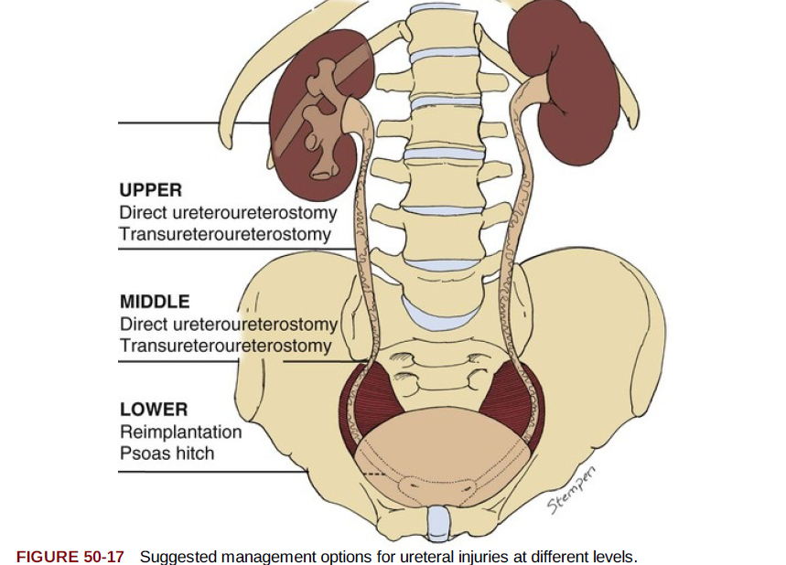
Management

Slide 37
General Principles
1. Mobilize the injured ureter carefully, sparing the adventitia widely, so as not to devascularize the ureter further.
2. Debride the ureter minimally but judiciously until edges bleed, especially in high-velocity gunshot wounds.
3. Repair ureters with spatulated, tension-free, stented, watertight anastomosis, using fine absorbable monofilament such as 5-0 polydioxanone and retroperitoneal drainage afterward. Use optical magnification if necessary.

Slide 38
4. Retroperitonealize the ureteral repair by closing peritoneum over it if possible
5. Do not tunnel ureteroneocystostomies but rather create a widely spatulated nontunneled anastomosis.
6. With severely injured ureters, blast effect, concomitant vascular surgery, and other complex cases, consider omental interposition to isolate the repair when possible.
7. If immediate repair is not possible, tie off the ureter with long silk sutures and plan to repair it later (damage control). Ipsilateral drainage can be achieved by placing a single J stent brought out cutaneously or a percutaneous nephrostomy tube placed later

Slide 39
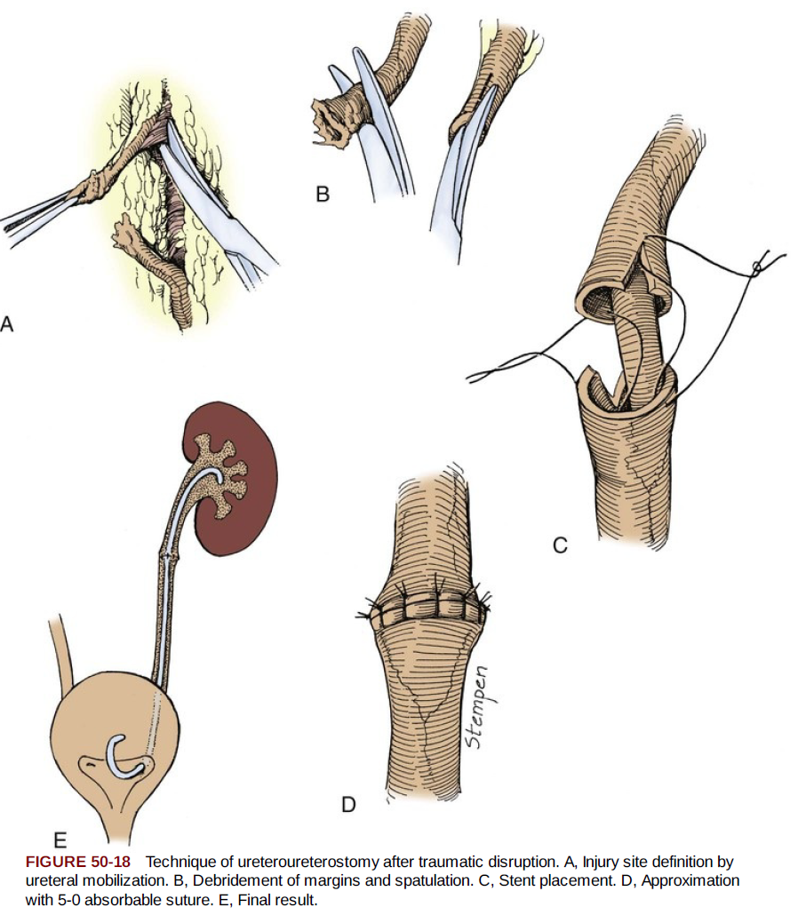

Slide 40
External Trauma
Contusion.
  Ureteral contusions, although the most minor of ureteral injuries, can heal with stricture
  Severe or large areas of contusion should be treated with excision of the damaged area an ureteroureterostomy/ureteroneocystostomy
  The safest approach in ureteral contusions that do not appear to require excision/anastomosis is to place a ureteral stent

Slide 41
  Management of ureteral leak is by percutaneous nephrostomy placement and ureteral catheter placement for at least 6 weeks,

Slide 42
Upper Ureteral Injuries
Ureteroureterostomy.
  Ureteral avulsion from the renal pelvis, or even very proximal ureteral injury, can be managed by reimplantation of the ureter directly into the renal pelvis
  Ureteroureterostomy, or so-called end-to-end repair, is used in injuries to the upper two thirds of the ureter

Slide 43
  Complications after ureteroureterostomy, usually urine leakage, occur 10% to 24% of the time.
  Other acute complications include abscess and fistula
  Chronic complications, usually ureteral stenosis, are less common, involving approximately 5% to 12% of patients

Slide 44
Autotransplantation.
  Autotransplantation of the kidney has been used after profound ureteral loss or after multiple attempts at ureteral repair have failed
  This maneuver remains the final option before nephrectomy

Slide 45
Bowel Interposition.
  Delayed ureteral repairs, especially when a very long segment of ureter is destroyed, also can be performed by creation of a ureteral conduit out of ileum in much the same way that an ileal conduit is constructed to drain the urine after cystectomy
  Success rates for ileal replacement of the ureter have been reported to be 81% to 100%

Slide 46
Ileal interposition is not suggested for acute repair of ureteral injury but rather would be used in delayed or staged repairs

Slide 47
Monitoring after Ureteral Repair.
  leave the stent in for 6 weeks
  At the time of stent removal, usually perform a retrograde ureterogram to document healing without leakage or stenosis
  One month postoperatively, perform a furosemide (Lasix) renogram to document that the system continues to be unobstructed
  Four months postoperatively, perform a renal ultrasound to document lack of hydronephrosis

Slide 48
Nephrectomy.
  Rarely, acute nephrectomy is required to treat ureteral injury after external violence
  Reasons for nephrectomy include associated severe visceral injuries (although damage control without nephrectomy is nearly always preferable) or severe associated injury to the ipsilateral kidney when renal repair is not possible

Slide 49
Delayed nephrectomy may be required because of:
  poor renal function (which can sometimes be seen after delayed recognition of an obstructing ureteral injury)
  severe panureteral injury when ileal ureter or other reconstruction is impossible
  persistent ureteral fistula (especially vascular fistula) despite previous intervention

Slide 50
Midureteral Injuries
Transureteroureterostomy.
  This form of repair involves bringing the injured ureter across the midline and anastomosing it end-to-side into the uninjured ureter
  most often performed as a secondary or delayed procedure.
  Caution is required while performing this procedure because it involves surgery on the uninjured, contralateral ureter with the theoretical risk for converting unilateral ureteral injury into (iatrogenic) bilateral ureteral injury

Slide 51
Lower Ureteral Injuries
Ureteroneocystostomy.
  Used to repair distal ureteral injuries that occur so close to the bladder that the bladder does not need to be brought up to the ureteral stump with a psoas hitch or Boari procedure
  Standard principles of ureteroneocystostomy include a long, nontunneled, spatulated, stented anastomosis

Slide 52
Psoas Bladder Hitch.
  The mainstay in the treatment of injuries to the lower third of the ureter and has a high success rate, from 95% to 100%

Slide 53
Boari Flap.
  Injuries to the lower two thirds of the ureter with long ureteral defects (too long to be bridged by bringing the bladder up in the psoas hitch procedure) can be managed with a Boari flap
  In this case, a pedicle of bladder is swung cephalad and tubularized to bridge the gap to the injured ureter
  The procedure is time-consuming, however, and is not appropriate for most acute injuries

Slide 54
Minimally Invasive.
  More recently, laparoscopic and robotic repair of distal ureteral injuries has emerged as a viable alternative to open surgery
  Laparoscopic direct ureteroneocystostomy, psoas bladder hitch, and Boari flap reconstructions have been described

Slide 55
Partial Transection
  Primary repair of a partial transection is used in the majority of ureteral injuries
  Principles of primary repair involve spatulated, watertight closure, with interrupted or running 5-0 or 6-0 absorbable monofilament

Slide 56
Surgical Ligation
Ligation of the ureter should be treated by removal of the ligature and observation of the ureter for viability.
If viability is in question, ureteroureterostomy or ureteral reimplantation should be performed
Placement of a ureteral stent, by opening the bladder or by immediate cystoscopic placement, is highly advised

Slide 57
Surgical Transection
Immediate Recognition.
  Injuries discovered immediately after nonaortic surgery are largely treated in the same way as ureteral injury after external violence.
  Most lacerations can be treated with ureteroureterostomy
  additional maneuvers such as omental wrapping of the repair or placement of an ipsilateral nephrostomy tube have been advocated to decrease the potential for urine leakage or breakdown of the repair

Slide 58
Ureteral injuries that occur during vascular graft surgery are a special case. Intraoperative management of these should be primary ureteroureterostomy with isolation of the repair with omentum

Slide 59
Delayed Recognition
Delayed diagnosis of ureteral injury is most often (66% to 76% of cases) achieved by CT pyelography, IVP, or retrograde ureterography
Repair of these delayed-recognition injuries is controversial. Some advocate immediate attempt at placement of a double-J ureteral stent but this is not always possible.

Slide 60
Usually, failure to place a stent is due to complete obstruction of the ureter or to too long a gap
If stent placement is achieved, open repair is planned only in patients with persistent leakage or significant ureteral stricture
If the ureter ultimately cannot be stented, a percutaneous nephrostomy is placed

Slide 61
Ureteroscopy Injury
Avulsion
  Ureteral avulsion during ureteroscopy is treated in the same manner as ureteral injuries after open or laparoscopic surgery
Perforation
  Ureteral perforation during ureteroscopy can be treated by ureteral stenting, usually with no subsequent complications

