Slide 1
Diseases of Nervous System
Fatima Obeidat, MD

Slide 2
I.Edema, Hydrocephalus and Herniation

Slide 3
A. Brain Edema

Slide 4
- Means accumulation of excess fluid within the brain parenchyma
-There are two main types that may occur together:

Slide 5
I. Vasogenic edema
- Is the most common type.
- Affects mainly the white matter
- Occurs when the integrity of the blood brain barrier is disrupted , allowing fluid to shift from the vascular compartment into the extracellular spaces of the brain and can be:

Slide 6
A. Localized in
Brain tumors either primary or metastatic:
- In brain tumors, the blood vessels are abnormal with fenestrations in the capillary wall
b. Cerebral abscess :
- Due to neoangiogenesis

Slide 7
Vasogenic edema surrounding glioblastoma (primary malignant brain tumor)

Slide 8
B. Generalized
- In late stages of ischemic encephalopathy due to damage of endothelial cells by ischemia:
II. Cytotoxic edema :
- An increase in intracellular fluid secondary to neuronal or glial membrane injury.
- The extracellular space is reduced.

Slide 9
- The blood brain barrier is intact
- Caused by ischemia to the brain
- It occurs because energy failure disables the Na/K pump system allowing large amounts of sodium accompanied by water to enter the cells
- Mainly affects the gray matter.

Slide 10
B. Brain Herniation
- Means accumulation of excessive CSF within the ventricular system as a result of a disturbance in its secretion, circulation or its absorption.

Slide 11
a. Most commonly due to impaired flow due to obstruction or impaired resorption of CSF
b. Overproduction of CSF, seen in choroid plexus papilloma is a rare cause of hydrocephalus.

Slide 12
Types of hydrocephalus
1. Non-communicating hydrocephalus (obstructive):
- It occurs when a lesion obstructing the free passage of the CSF from the ventricles to the subarachnoid space;

Slide 13
Tumors
Congenital Acqueduct stenosis

Slide 14
2. Communicating hydrocephalus, :
Refers to the abnormality in which there is a free passage of CSF from within the ventricular system into the subarachnoid space.
-Causes
a. Defects in the subarachnoid space such as fibrosis in leptomeningeal infection and hemorrhage from saccular aneurysms.

Slide 15
b. Defects in absorption of CSF at the arachnoid granulations such as
- Congenital deficiency of arachnoids' granulation
c. Overproduction of CSF by choroid plexus papilloma
d. Idiopathic

Slide 16
C. Brain Herniation

Slide 17
- Intracranial pressure may increase by focal expanding lesion or generalized edema.
- Because the cranial vault is subdivided by rigid dural folds (falx and tentorium), a focal expansion of the brain causes it to be displaced in relation to these partitions causing brain herniation.

Slide 18
- Herniations are named by .
a. Either the part of the brain that is displaced or
The structure across which it moves.
- Types of herniations:

Slide 19
1. Subfalcine (cingulate) herniation
- Expansion of a mass in the frontal or parietal lobe will result in herniation of ipsilateral cingulate gyrus under the free edge of the falx.

Slide 20
- to produce selective displacement of the pericallosal arteries away from the lesion and from the midline

Slide 21
Consequences
- This may compromise circulation through the pericallosal arteries ( branches of anterior cerebral artery) and result in infarction of the parietal parasaggital cortex , manifesting clinically as a weakness or sensory loss in one or both legs.

Slide 22
2. Tentorial (uncal) or uncinate gyrus herniation-
- Caused by any supratentorial expanding mass which may produce herniation of the ipsilateral uncus (tip and medial part of parahippocampal gyrus) downwards through the tentorial incisura.

Slide 23
- This occurs most frequently when the mass is located in the temporal lobe

Slide 24
Uncal herniation

Slide 25
- Consequences of temporal lobe displacement:
The ipsilateral oculomotor nerve compressed between the free edge of the tentorium and the posterior cerebral artery will result in paralysis of the nerve produces ptosis and dilation of the pupil ipsilateral to the lesion

Slide 26
Note - Dilation of the pupil is the earliest consistent sign of tentorial herniation and may occur before there is any loss of consciousness
Compression of the cerebral peduncle(crus cerbri) on the side of the mass lesion will result in contralateral limb weakness

Slide 27
C. Compression of the posterior cerebral artery resulting in ischemic injury to the territory supplied by that vessel, including the primary visual cortex

Slide 28
.
3.Tonsillar herniation (foramen impaction, cerebellar cone)
- Refers to displacement of the cerebellar tonsils through the foramen magnum.

Slide 29
- This pattern of herniation is life-threatening

Slide 30
II. Cerebrovascular diseases

Slide 31
A. Ischemia and infarction

Slide 32
Clinical terms
1. Stroke :
Is the clinical designation applied to
Abrupt onset of focal or global neurological symptoms
Caused by ischemia or hemorrhage
Symptoms must continue for more than 24 hours.
Should be permanent damage to the brain.

Slide 33
2. Transient ischemic attack(TIA):
a- The neurological symptoms resolve within 24 hours
b. No irreversible tissue damage

Slide 34
- It is convenient to consider cerebrovascular disease as two processes
a. Hypoxia, ischemia and infarction
b. Hemorrhage

Slide 35
A. Hypoxia, ischemia and infarction
- The brain may be deprived of oxygen by several mechanisms
a. Functional hypoxia in a setting of a low partial pressure of oxygen or impaired oxygen-carrying capacity
Global Ischemia; either transient or permanent due to tissue hypoperfusion, as in hypotension or shock
Focal ischemia: vascular obstruction.

Slide 36
Clinically
- Severe global ischemia.(pan necrosis)
Consequences
a. Persistent(more than 1 month)vegetative state ( awake but not aware)
Brain death
Evidence of diffuse cortical injury (isoelectric, or "flat," electroencephalogram
And brain stem damage, including absent reflexes and respiratory drive

Slide 37
II.Focal Cerebral Ischemia
- Cerebral arterial occlusion leads to infarction of CNS tissue in the distribution of the compromised vessel.
- The extent of tissue damage is determined by modifying variables, mainly the adequacy of collateral flow
- The major source of collateral flow is the circle of Willis.

Slide 38
- Occlusive vascular disease may be due to
In situ thrombosis
- The most common sites of primary thrombosis are
a. The carotid bifurcation..
b. The origin of the middle cerebral artery,
c. And at either end of the basilar artery

Slide 39
2. Embolization from a distant source.
- Overall, embolic infarctions are more common than thrombosis.
- Sources of emboli:
a. Cardiac mural thrombi are a frequent source
b. Thromboemboli also arise in arteries, most often from atheromatous plaques within the carotid arteries.

Slide 40
NOTE:
- The territory of distribution of the middle cerebral artery-the direct extension of the internal carotid artery-is most frequently affected by embolic infarction

Slide 41
B. Intracranial Hemorrhage
- Hemorrhage within the skull can occur in a variety of locations, and each location is associated with a set of underlying causes.
1. Hemorrhages within the brain itself can occur:
Secondary to hypertension (most common)
Cerebral amyloid angiopathy

Slide 42
c. Arterio-venous malformation.
d. A cavernous malformation.

Slide 43
2. Subarachnoid hemorrhages:
- Are most commonly seen with aneurysms but occur also with other vascular malformations.
3. Hemorrhages associated with the dura (in either subdural or epidural spaces) usually due to trauma.

Slide 44
1. Primary Brain Parenchymal Hemorrhage
- Spontaneous (non-traumatic) intra-parenchymal hemorrhages occur most commonly in mid to late adult life, with a peak incidence at about 60 years of age
- Most are caused by rupture of a small intraparenchymal vessel

Slide 45
A. Hypertension :
Is the leading underlying cause of intraparenchymal hemorrhage accounts for roughly 15% of deaths among persons with chronic benign hypertension
- It has a peak incidence at about 60 years

Slide 46
- Massive Hypertensive intraparenchymal hemorrhages occur in:
a. Basal ganglia,--most common location
b. Thalamus
c. Pons
d. Cerebellum

Slide 47
B.. Cerebral Amyloid Angiopathy (CAA) :
- Is the second most common cause of spontaneous intraparenchymal brain hemorrhage.
- Is a disease in which amyloidogenic peptides, deposit in the walls of meningeal and cortical vessels.

Slide 48
CAA-associated hemorrhages often occur in the lobes of the cerebral cortex (lobar hemorrhages).

Slide 49
2. Subarachnoid Hemorrhage
Causes:
A. Saccular (berry) aneurysm rupture
- Is the most frequent cause of clinically significant subarachnoid hemorrhage..
B. Vascular malformation

Slide 50
Saccular (Berry ) aneurysm:
- Rupture of saccular aneurysm can occur at any time
- In about one-third of cases it is associated with acute increase in intracranial pressure, such as with straining at stool or sexual orgasm.
- Blood under arterial pressure is forced into the subarachnoid space,

Slide 51
- Between 25% and 50% of individuals die with the first rupture, although those who survive typically improve and recover consciousness in minutes.
- Recurring bleeding is common in survivors

Slide 52
Although they are sometimes referred to as congenital, they are not present at birth but develop over time because of underlying defects in the vessel media especially in patients with hypertension

Slide 53
Complications
1- In the early period after a subarachnoid hemorrhage, there is a risk of additional ischemic injury from vasospasm involving other vessels.
2- In the healing phase of subarachnoid hemorrhage, meningeal fibrosis and scarring occur, sometimes leading to obstruction of CSF flow as well as interruption of the normal pathways of CSF resorption.

Slide 54
Note:
-90% of cases arise in the anterior circulation

Slide 55
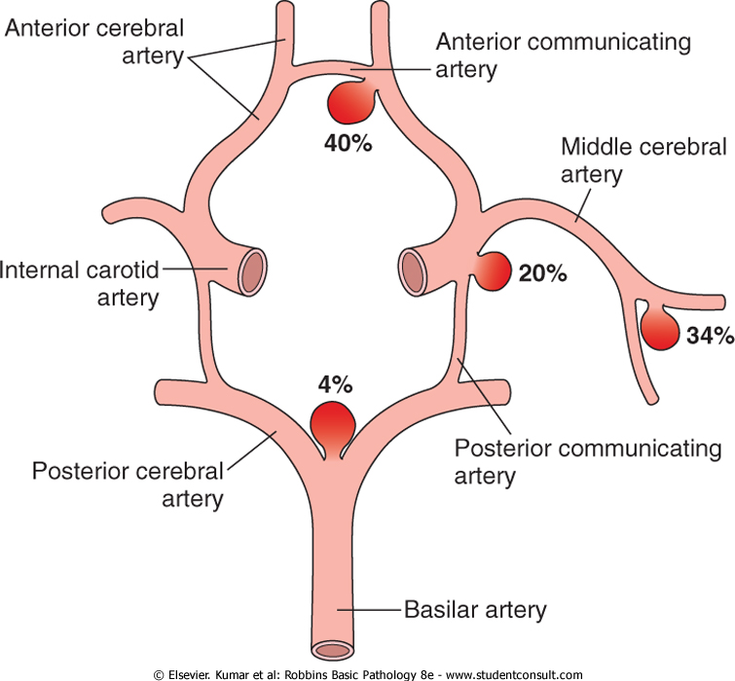

Slide 56
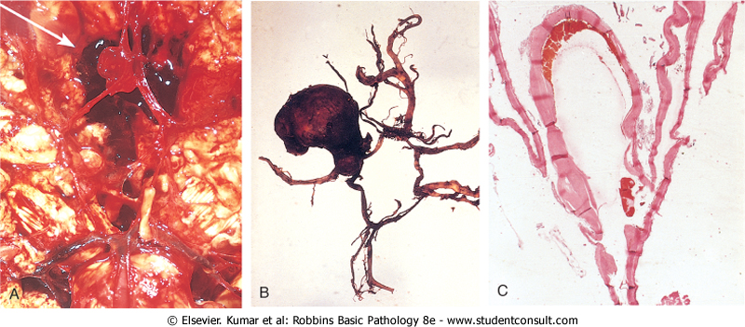
Berry aneurysm

Slide 58
NOTE
- While saccular aneurysms are the most common type of intracranial aneurysm, other types include atherosclerotic (fusiform, mostly of the basilar artery), mycotic, traumatic, and dissecting aneurysms.
- These latter three (mycotic, traumatic, dissecting), as with saccular aneurysms, are most often found in the anterior circulation.
- They usually present with cerebral infarction from vascular occlusion instead of subarachnoid hemorrhage

Slide 59
B. Vascular Malformations
- Vascular malformations of the brain are classified into four principal types based on the nature of the abnormal vessels:
1. Arteriovenous malformations (AVM), the most common
2. Cavernous angiomas,
3. Capillary telangiectasias, and
4. Venous angiomas.

Slide 60
1. Arteriovenous malformations (AVMs)
- Affect males twice as frequently as females;
- The lesion is most often recognized clinically between the ages of 10 and 30 years,
- The lesions presenting as :

Slide 61
a. A seizure disorder
b. An intra-cerebral hemorrhage
c. A subarachnoid hemorrhage
d. Large AVMs occurring in the newborn period can lead to high-output congestive heart failure because of blood shunting directly from arteries to veins.

Slide 62
- The risk of bleeding makes AVM the most dangerous type of vascular malformation
Morphology
- Involve vessels in the subarachnoid space extending into brain parenchyma or they may occur exclusively within the brain.
Macroscopic appearance
- They resemble a tangled network of wormlike vascular channels

Slide 63
Microscopically
- They are enlarged blood vessels separated by gliotic tissue, often with evidence of prior hemorrhage

Slide 64
- Some vessels can be recognized as arteries with duplicated and fragmented internal elastic lamina, while others show marked thickening or partial replacement of the media by hyalinized connective tissue.

Slide 65
.
2. Cavernous hemangiomas
- Consist of distended, loosely organized vascular channels with thin collagenized walls.
- They are devoid of intervening nervous tissue (thus distinguishing them from capillary telangiectasias).

Slide 66
- They occur most often in the cerebellum, pons, and subcortical regions,
- Have a low flow without arterio-venous shunting.
- Foci of old hemorrhage, infarction, and calcification frequently surround the abnormal vessels

Slide 67
3. Capillary telangiectasias
- Are microscopic foci of dilated, thin-walled vascular channels separated by relatively normal brain parenchyma
- Occurring most frequently in the pons.

Slide 68
4. Venous angiomas (varices)
- Consist of aggregates of ectatic venous channels.
Note:
- These latter two types of vascular malformation are unlikely to bleed or cause symptoms, and are most commonly discovered as incidental lesions

Slide 69
V. CENTRAL NERVOUS SYSTEM TRAUMA

Slide 70
- Repetitive episodes of trauma can lead to later development of neurodegenerative processes
Note: Association of trauma with the risk of Alzheimer disease

Slide 71
I. Traumatic Parenchymal Injuries
Contusions :
Results from blunt brain trauma
- The pia-arachnoid is not breached
When an object impacts the head, brain injury may occur at the site of impact called -a coup injury

Slide 72
-or opposite the site of impact on the other side of the brain-a contrecoup injury.
- Both coup and contrecoup lesions are contusions

Slide 73
1. Coup contusions
- Occur at the site of impact and tend to be more severe in relation to a blow to the stationary head
2. Contrecoup contusions
- Occur in the brain away from the point of impact and they occur due to sudden deceleration of the head and the classic example is a fall on the occiput resulting in severe contusions to the frontal and temporal poles

Slide 74
Contusions are caused by rapid tissue displacement, disruption of vascular channels,
Trauma affects the superficial- layer of cortex in contrast to ischemia
The crests of the gyri are the most susceptible to traumatic injury than depth of sulci.

Slide 75
Are common in regions of the brain overlying rough and irregular inner skull surfaces, such as:
a. The frontal poles
b. The orbital surfaces of the frontal lobes
c. And the temporal lobe tips

Slide 76
Contusions: Recent and old

Slide 77
II. Diffuse axonal injury
- Trauma can also cause more subtle but widespread injury to axons within the brain Mechanism:
- The movement of one region of brain relative to another is thought to disrupt axonal integrity and function such as in angular acceleration of brain in car accidents.

Slide 78
- As many as 50% of patients who develop coma shortly after trauma are believed to have white matter damage and diffuse axonal injury.
- Although these injuries may be widespread, the lesions usually are asymmetric and are most commonly found

Slide 79
a. Regions near the angles of the lateral ventricles
b. Corpus callosum
c. Various tracts in the brain stem.

Slide 80
IV. Concussion
- Describes reversible altered consciousness from head injury in the absence of contusion.
-The characteristic transient neurologic dysfunction includes;
1. Loss of consciousness,
2. Temporary respiratory arrest

Slide 81
3. Loss of reflexes.
- Although neurologic recovery is complete, amnesia for the event persists.
- The pathogenesis of the sudden disruption of nervous activity is unknown

Slide 82
PRIMARY DISEASES OF MYELIN

Slide 83
I. Demyelinating diseases of the CNS
- Are acquired conditions characterized by preferential damage to previously normal myelin and include:
1. Immune-mediated injury, such as multiple sclerosis (MS)
2. Progressive multifocal leukoencephalopathy
3. And injury caused by drugs and other toxic agents

Slide 84
1. Multliple sclerosis: Is an autoimmune demyelinating disorder characterized by distinct episodes of neurologic deficits, separated in time, attributable to white matter lesions that are separated in space.
- It is the most common of the demyelinating disorders,.

Slide 85
- The disease may become apparent at any age, although onset in childhood or after age 50 is relatively rare.
- Women are affected twice as often as men
.

Slide 86
PATHOGENESIS :
- A combination of environmental and genetic factors result in a loss of tolerance to self proteins (myelin antigens).
- The nature of the initiating agent, often suggested to be an- infectious agent, remains uncertain.
A- There is a significant contribution of genetic factors to the risk of developing MS

Slide 87
..
1.The disease risk is 15-fold higher when the disease is present in a first-degree relative
2. The concordance rate for monozygotic twins is about 25%, with a much lower rate for dizygotic twins
.

Slide 88
3. A significant fraction of the genetic risk for MS is attributable to HLA-DR variants and DR2 allele is the one that most significantly increases the risk for developing MS
4. Polymorphisms in the genes encoding receptors for the cytokines IL-2 and IL-7 , which control the activation and regulation of T cell-mediated immune responses

Slide 89
.
- Immune-mediated myelin destruction is thought to have a central role in MS exemplified by the central role for CD4+ T cells with an increase in T_{H}17 and T_{H}1 CD4+ cells thought to be a critical component of the injury to myelin.
.

Slide 90
- There is also contributions from CD8+ T cells and B cells.
- MS is characterized by the presence of de-myelination out of proportion to axonal loss,

Slide 91
Chronic multiple sclerosis
Clinical course patterns;
1.Relapsing remitting pattern
Most common pattern
Characterized by relapses with full recovery or with residual deficit upon recovery , periods between

Slide 92
relapses characterized by lack of disease progression
Usually symptoms have acute or subacute onset, with symptoms increasing over days to weeks followed by a

Slide 93
- period of a f a few weeks with little change and the a period of recovery over 1-2 months
Remission occurs due to redistribution of sodium channels throughout the axolemma of demylinated segment.

Slide 94
2. Secondary progressive MS
Second most common
Begins similar to the first pattern but evolves wit an unremitting progressive course
3. Primary progressive MS
- Have steadily progressive course from the onset

Slide 95
Acute MS(Marburg diseaase)
Characterized by rapidly progressive course , with neurological symptoms similar to Chronic MS such as hemiplegia,
MRI shows one or 2 lesions
Death occurs 1-6 months after clinical onset

Slide 96
Acute MS(Marburg diseaase)
Characterized by rapidly progressive course , with neurological symptoms similar to Chronic MS such as hemiplegia,
MRI shows one or 2 lesions
Death occurs 1-6 months after clinical onset

Slide 97
Clinically isolated patterns
optic neuritis
Is the initial clinical event in20% of cases of MS
But may be clinically isolated
Symptoms include loss of visual activity, loss of peripheral vision or loss of colour vision
May be followed by optic atrophy

Slide 98
2. Neuromyelitis optica (NMO)(Devic disease) :
- Is an inflammatory demyelinating disease of the optic nerves and spinal cord and previously thought to be a form of MS with stereotypic anatomic regions of susceptibility
-

Slide 99
- This is now recognized to be an antibody-mediated autoimmune disorder with antibodies to the water channel aquaporin-4 are both diagnostic and pathogenic.

Slide 100
. MORPHOLOGY :
- MS is primarily a white matter disease and the affected areas show multiple, well-circumscribed, slightly depressed, gray irregularly shaped lesions termed plaques commonly arise near the ventricles
-

Slide 101
They are also frequent in
a. Optic nerves and chiasm,
Brain stem ascending and descending fiber tracts,
c. Cerebellum, and spinal cord.
- The lesions have sharply defined borders at the microscopic level

Slide 102
Multiple sclerosis

