Slide 2
Diseases of the Respiratory system
Fatima Obeidat, MD
Assistant Professor
Consultant: Histopathologist /Neuropathologist

Slide 3
Lecture 1

Slide 4
I. ATELECTASIS (COLLAPSE)

Slide 5
- Is loss of lung volume caused by inadequate expansion of air spaces.
- It results in shunting of inadequately oxygenated blood from pulmonary arteries into veins, thus giving rise to hypoxia.

Slide 6
- On the basis of the underlying mechanism , atelectasis is classified into three forms:
1. Resorption atelectasis
2. Compression atelectasis
3. Contraction atelectasis

Slide 7
1. Resorption atelectasis. :
- Occurs when an obstruction prevents air from reaching distal airways.
- The air already present gradually becomes absorbed, and alveolar collapse follows.
- Depending on the level of airway obstruction, an entire lung, a complete lobe, or one or more segments may be involved.

Slide 8
1. The most common cause of resorption collapse is obstruction of a bronchus by mucus or mucopurulent plug
a. Postoperatively
b. Complicate bronchial asthma, bronchiectasis, chronic bronchitis,

Slide 9
2. Obstruction by:
a. Tumor, or
b. Foreign body aspiration, particularly in children.

Slide 10
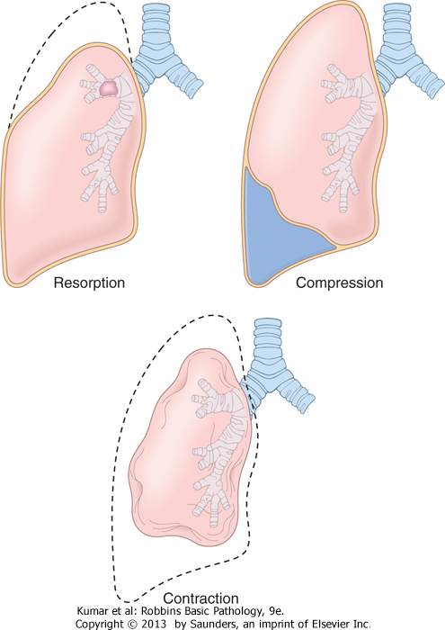
Types of atelectasis

Slide 11
2. Compression atelectasis.
- Sometimes called passive or relaxation atelectasis)
- Is usually associated with accumulation of fluid, blood, or air within the pleural cavity, which mechanically collapses the adjacent lung.

Slide 12
- Causes:
a. Pleural effusion, caused most commonly by congestive heart failure (CHF).
b. Leakage of air into the pleural cavity (pneumothorax)
c. Hemothorax
d. Basal atelectasis resulting from the elevated position of the diaphragm commonly occurs in

Slide 13
a. Bedridden patients,
b. In patients with ascites, and
.

Slide 14
Types of atelectasis

Slide 15
C.- Contraction atelectasis.
- Called cicatrization atelectasis
- Occurs when either local or generalized fibrotic changes in the lung or pleura or prevents expansion of air spaces

Slide 16
Note
- Atelectasis (except when caused by contraction) is potentially reversible and should be treated promptly to prevent hypoxemia and superimposed infection of the collapsed lung.

Slide 17
II. ACUTE LUNG INJURY

Slide 18
- The term includes a spectrum of bilateral pulmonary damage (endothelial and epithelial), which can be initiated by numerous conditions.
- Clinically, acute lung injury manifests as:

Slide 19
,
1. Acute onset of dyspnea,
2. Decreased arterial oxygen pressure (hypoxemia),
3. Development of bilateral pulmonary infiltrates on the chest radiograph,
4. Absence of clinical evidence of primary left-sided heart failure

Slide 20
- The pulmonary infiltrates in acute lung injury are caused by damage to the alveolar capillary membrane, rather than by left-sided heart failure , such accumulations constitute an example of noncardiogenic pulmonary edema.

Slide 21
Note-
- Acute lung injury can progress to the more severe acute respiratory distress syndrome

Slide 22
Acute Respiratory Distress Syndrome ARDS
- Is a clinical syndrome caused by diffuse alveolar capillary and epithelial damage.
- The usual course is characterized by:
A. Rapid onset of life-threatening respiratory insufficiency,

Slide 23
b. And severe arterial hypoxemia that is refractory to oxygen therapy and may progress to multisystem organ failure.
Note: The histologic manifestation of ARDS in the lungs is known as diffuse alveolar damage (DAD).

Slide 24
ARDS
- Occurs in a multitude of clinical settings
- And is associated with either
a. Direct injury to the lung or
b. Indirect injury in the setting of a systemic process

Slide 25
Direct Lung Injury
I. Common Causes
1.Pneumonia
2. Aspiration of gastric contents
II. Uncommon Causes
1. Pulmonary contusion

Slide 26
- Indirect causes
I. common causes
1. Sepsis
2. Severe trauma with shock
II. Uncommon causes
Acute pancreatitis

Slide 27
Note:
- Respiratory distress syndrome of the newborn is pathogenetically distinct; it is caused by a primary deficiency of surfactant

Slide 28
PATHOGENESIS
- The alveolar-capillary membrane is formed by two separate barriers: the microvascular endothelium and the alveolar epithelium.
- In ARDS, the integrity of this barrier is compromised by either endothelial or epithelial injury, or, more commonly, both.

Slide 29
The acute consequences of damage to the alveolar capillary membrane include:
1. Increased vascular permeability and alveolar flooding
2. Loss of diffusion capacity,
3. Widespread surfactant abnormalities caused by damage to type II pneumocytes

Slide 30
Suggested mechanism:
- In ARDS, lung injury is caused by an imbalance of pro-inflammatory and anti-inflammatory mediators.

Slide 31
As early as 30 minutes after an acute insult,
a. Increased synthesis of interleukin 8 (IL-8), a potent neutrophil chemotactic and activating agent, by pulmonary macrophages.
b. Release of this and IL-1 and tumor necrosis factor (TNF), leads to endothelial activation

Slide 32
C. Activated neutrophils release a variety of oxidants, proteases, leukotrienes that cause damage to the alveolar epithelium and endothelium.

Slide 33
d- Combined assault on the endothelium and epithelium increases vascular leakiness and loss of surfactant that render the alveolar unit unable to expand.
- The destructive forces by neutrophils can be counteracted by endogenous antiproteases, antioxidants, and anti-inflammatory cytokines (e.g., IL-10)

Slide 34
- In the end, it is the balance between the destructive and protective factors that determines the degree of tissue injury and clinical severity of ARDS

Slide 35
Note:
- Neutrophils are thought to have an important role in the pathogenesis of ARDS

Slide 36
MORPHOLOGY
In the acute phase of ARDS
Gross,
1. The lungs are red, firm
2. Airless, and heavy.

Slide 37
Microscopic examination reveals:
1. Capillary congestion,
2. Necrosis of alveolar epithelial cells,
3. Interstitial and intra-alveolar edema and hemorrhage,
4. Increased numbers of neutrophils within the vascular space, the interstitium, and the alveoli.
.

Slide 38
5. The most characteristic finding is the presence of hyaline membranes, alveolar ducts
- Such membranes consist of
a. fibrin-rich edema fluid
b.Remnants of necrotic epithelial cells.
- Overall, the picture is similar to that seen in respiratory distress syndrome in the newborn .

Slide 39
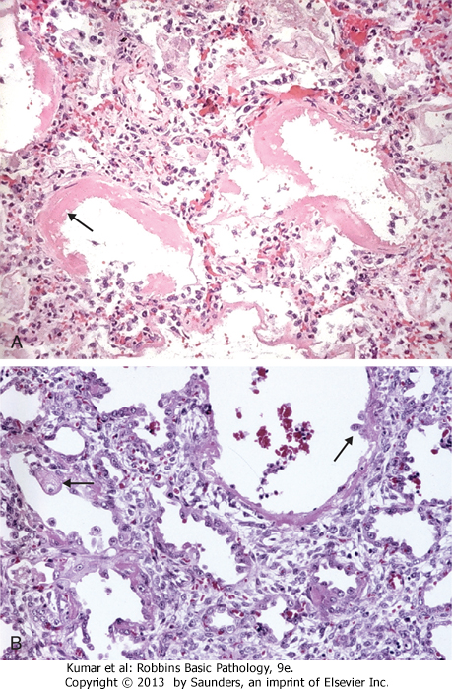
ARDS

Slide 40
In the organizing stage,
- Vigorous proliferation of type II pneumocytes occurs in an attempt to regenerate the alveolar lining.

Slide 41
Resolution is unusual-
a. More commonly, there is organization of the fibrin exudates, with resultant intra-alveolar fibrosis.
b. Marked thickening of the alveolar septa ensues, caused by proliferation of interstitial cells and deposition of collagen..

Slide 42
Clinical Features
- Approximately 85% of patients develop the clinical syndrome of acute lung injury or ARDS within 72 hours of the initiating insult.
- With improvements in supportive therapy, the mortality rate ARDS cases occurring yearly has decreased from 60% to 40% in the last decade.

Slide 43
Predictors of poor prognosis include
- Advanced age
- Underlying bacteremia (sepsis
- The development of multisystem (especially cardiac, renal, or hepatic) failure.

Slide 44
- If the patient survives the acute stage, diffuse interstitial fibrosis may occur, with continued compromise of respiratory function.
- However, in most patients who survive the acute insult and are spared the chronic sequelae, normal respiratory function returns within 6 to 12 months

