Slide 1
LECTURE 2 , SALIVARY GLANDS
Fatima Obeidat, MD

Slide 2
SALIVARY GLANDS
- Three major salivary glands
Parotid.
Submandibular.
Sublingual.
- Minor salivary glands are present throughout oral mucosa

Slide 3
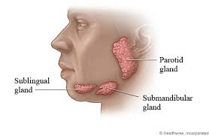

Slide 4
Diseases of salivary glands
1- Inflammatory
2- Neoplastic.

Slide 5
1. Inflammatory lesions

Slide 6
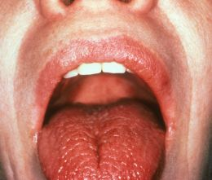
A. XEROSTOMIA
Is defined as a dry mouth resulting from a decrease in the production of saliva.

Slide 7
- It affects 20% of population over 70 years
- Causes:
Drugs: Antidepressant/antipsychotic, diuretic, antihypertensive, sedative
Is major feature of the autoimmune disorder Sjögren syndrome, in which it usually is accompanied by dry eyes.
Radiotherapy

Slide 8
Clinical features
- Dry mucosa
- Atrophy of tongue papillae.
- Fissuring.
-Ulceration.

Slide 9
Complications
- Dental caries.
- Candida infection.
- Difficulty in swallowing and speaking.

Slide 10
B. SIALADENITIS
Or inflammation of the salivary glands
Causes
Trauma
Viral or bacterial infection
Autoimmune disease.

Slide 11
NOTE
- The most common form of viral sialadenitis is mumps, which is a paramyxovirus that h may produce enlargement of all salivary glands but predominantly involves the parotids.

Slide 12
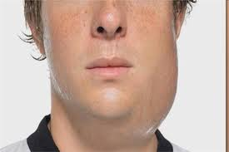
VIRAL SIALADENITIS

Slide 13
Bacterial Sialadentis
Is a common infection that most often involves the major salivary glands, particularly the submandibular glands.
The most frequent pathogens are Staphylococcus aureus and Streptococcus viridans. .

Slide 14
Predisposing factors include
A. Duct obstruction by stones (sialolithiasis)
B. Impacted food debris .
C. Dehydration and decreased secretory function

Slide 15
AUTOIMMUNE SIALADENITIS
SJOGREN SYNDROME.
- Characterized by dry eyes and dry mouth due to immune mediated lacrimal or salivary gland destruction.
- 40% occur in isolation
- 60% are associated with other autoimmune diseases such as rheumatoid arthritis, or SLE

Slide 16
C. MUCOCELE
- Is the most common inflammatory lesion of the salivary glands, and results from rupture of a salivary gland duct, with consequent leakage of saliva into the surrounding connective tissue stroma.

Slide 17
- It occurs most often in toddlers, young adults, and the aged, and typically manifests as a fluctuant swelling of the lower lip that may change in size, mainly in association with meals

Slide 18
Histologic examination
Shows a cyst-like space lined by inflammatory granulation tissue or fibrous connective tissue that is filled with mucin and inflammatory cells, particularly macrophages
Complete excision of the cyst and the minor
salivary gland lobule constitutes definitive treatment.

Slide 19
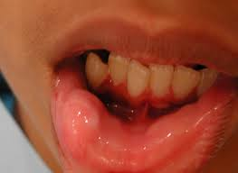
Mucocele gross
Fluctuant swelling of lower lip.

Slide 20
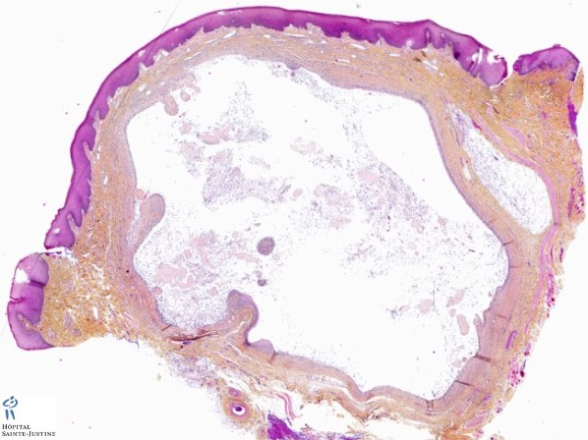
Mucocele Histopathology

Slide 21
Ranula:
- Is a term reserved for epithelial-lined cysts that arise when the duct of the sublingual gland has been obstructed

Slide 22
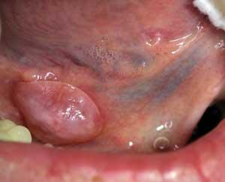
Ranula-Gross

Slide 23
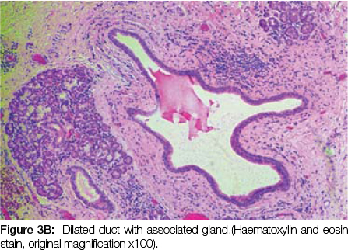
Ranula-Histopathology

Slide 24
2. Neoplasms of salivary glands

Slide 25
The salivary glands give rise to at least 30 histologically distinct tumors.
Approximately 65% to 80% arise within the parotid,
10% arise in the submandibular gland
The remainder in the minor salivary glands including the sublingual glands

Slide 26
Approximately 15% to 30% of tumors in the parotid glands are malignant.
By contrast, approximately 40% of submandibular, 50% of minor salivary gland, and 70% to 90% of sublingual tumors are malignant.

Slide 27
Note
- Whatever the histologic pattern, parotid gland neoplasms produce swelling in front of and below the ear.

Slide 28
A.PLEOMORPHIC ADENOMAS
- Pleomorphic adenomas are benign and the most most common salivary gland tumors
- Present as painless, slow-growing, mobile discrete masses.
They represent about 60% of tumors in the parotid

Slide 29
- Are less common in the submandibular glands, and are relatively rare in the minor salivary glands in the buccal cavity

Slide 30
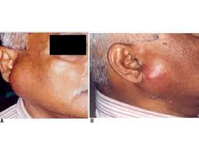
Pleomorphic Adenoma-Clinically

Slide 31
Gross
- Are rounded, well demarcated masses rarely exceeding 6 cm in the greatest dimension.
Although they are encapsulated, in some locations (particularly the palate), the capsule is not fully developed
- The cut surface is gray-white and typically contains myxoid and blue translucent chondroid (cartilage-like) areas

Slide 32
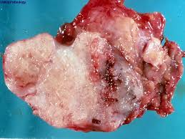
Pleomorphic adenoma

Slide 33
Histologic Features
- Mixture of epithelial and myoepithelial cells in a myxoid ,hyaline and chondroid matrix

Slide 34
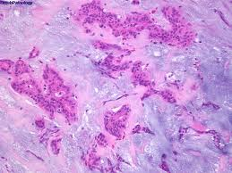
Histopathology

Slide 35
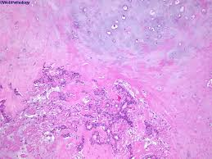
Histopathology

Slide 36
PLEOMORPHIC ADENOMA
- Treatment: Complete excision.
Can recur if not well excised
- 25% recurrence if enucleated and , 4% recurrence with wide excision

Slide 37
Carcinoma arising in a pleomorphic adenoma is referred to as a carcinoma ex pleomorphic adenoma or malignant mixed tumor.
The incidence of malignant transformation increases with time from 2% of tumors present for less than 5 years to almost 10% for those present for more than 15 years

Slide 38
B.Mucoepidermoid carcinomas
Represent about 15% of all salivary gland tumors,
And while they occur mainly (60% to 70%) in the parotids, they account for a large fraction of salivary gland neoplasms in the minor salivary glands
- Is the most common form of primary malignant tumor of the salivary glands.

Slide 39
Gross
Can grow as large as 8 cm in diameter
Although they are apparently circumscribed, they lack well-defined capsules and often are infiltrative.
The cut surface is pale gray to white and demonstrates small, mucinous cysts

Slide 40
Histopathology
- Grows in cords or sheets of squamous , mucous or indeterminate cells .
- Can be low, intermediate or high grade.
a. Low grade:
Invades locally and recurs in 15% of cases.
b. High grade:
- Recurs in 25% of cases and has 50% chance of 5 year survival

Slide 41
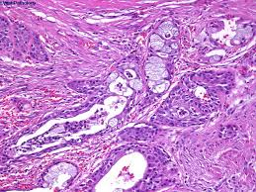
Mucoepidermoid carcinoma

Slide 42
C.Adenoid cystic carcinoma
Is rare
50% of cases are located in the minor salivary gland(in particular the palatine glands

