Slide 1
Introduction to pathology lecture 1
Fatima Obeidat,MD

Slide 2
Mechanisms of cell Injury

Slide 3
Depletion of ATP
Consequences

Slide 5
Cells normally maintain a steady state called Homeostasis.
This means the intracellular environment is kept within a narrow range of physiologic state
Examples: temperature, pH, chemical reactions, electrolyte concentration, water content… All are regulated and kept constant.

Slide 6
Cells and stress!
If cells are subjected to stresses ( like changes in electrolyte balance) then cells adapt and reach a new homeostatic state that will preserve cell function.
However if the stress is more severe and is beyond capability of adaptation then this will result in cell injury.

Slide 7
Cell injury: at the beginning it is reversible within certain limits
Then it becomes irreversible.
Irreversible injury ends in cell death.
Two types of cell death: necrosis and apoptosis ( more details later)

Slide 8
Note
Not all injuries start as reversible then become irreversible
If the injury is severe enough it will be irreversible even in the early stages.

Slide 9
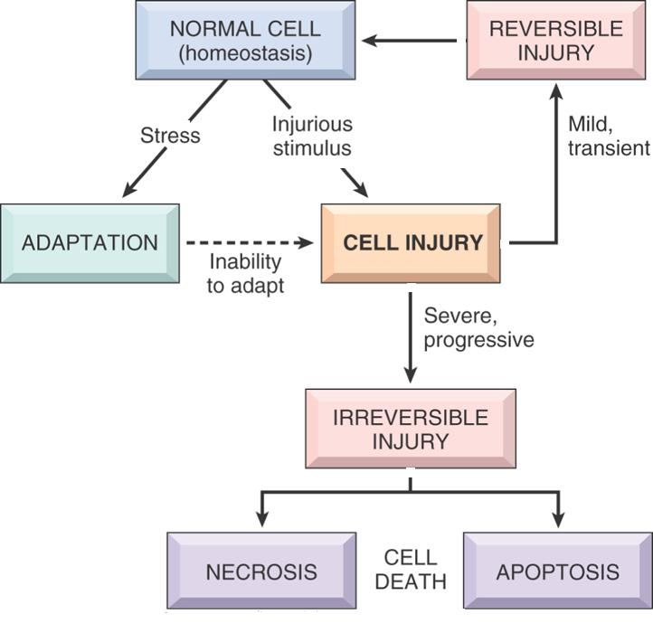

Slide 10
Adaptation in cells
Adaptation means: reversible changes in the
a. number
b. size
c. phenotype,
d. metabolic activity or
e. function of cells
in response to changes in their environment.

Slide 11
Adaptation
Adaptive changes are reversible.: if the insult is removed, things can go back to normal.
Can be physiologic or pathologic; depending on the cause

Slide 12
Cells and tissues adapt by four main mechanisms
Hyertrophy
Hyperplasia
Atrophy
Metaplasia

Slide 13
Hypertrophy: Increased cell size.
Hyperplasia: increased number of cells occurs in labile cells, the cells that undergo.. Cell division.
Metaplasia: change from one adult cell type to another
Atrophy: decreased size.

Slide 14
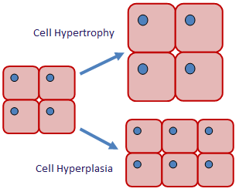
Hypertrophy versus hyperplasia

Slide 15
Hypertrophy
Increased cell size.
Due to increased organelles and proteins.
Increased intracellular synthesis of the proteins and organelles.
Caused by: increased demands, hormones or growth factors.

Slide 16
Examples of Physiologic hypertrophy
a. Uterus during pregnancy… due to oestrogen effect on smooth muscles of the uterine wall.
b. Skeletal muscle in body builders… due to increased demand.
Note: smooth muscles can divide.. So in the pregnant uterus there is hypertrophy and hyperplasia… whereas skeletal muscle is permanent tissue that can not divide, so there is pure hypertrophy without hyperplasia.

Slide 17
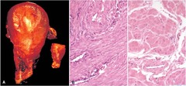
Physiologic hypertrophy Uterine wall

Slide 18
Pathologic hypertrophy
Cardiac enlargement due to hypertension = Hypertensive heart disease
Pathogenesis.. Two types of signals: mechanical: stretch and trophic: growth factors and androgenic hormones cause the hypertrophy in the cardiac muscle
Note: the cardiac muscle can not undergo hyperplasia because it is a permanent cell.

Slide 19
Cardiac hypertrophy during hypertension results in more contractile force that is needed to meet the demands of the increased pressure
This works to a certain extent.. But with time hypertrophy can not compensate for for the increased burden and degenerate changes occur in the muscle.

Slide 20
The myofibrllar contractile elements will be fragmented
Why hypertrophy can not compensate forever???
Maybe because there is limited blood supply and limited mitochondria to provide ATP .. So if there is more tissue than that can be supported by this blood supply and energy then degeneration occurs.

Slide 21
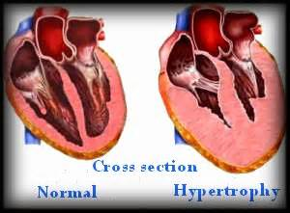
Pathologic hypertrophy

Slide 22
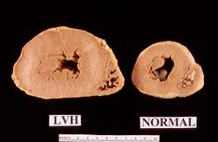
Pathologic hypertrophy

Slide 23
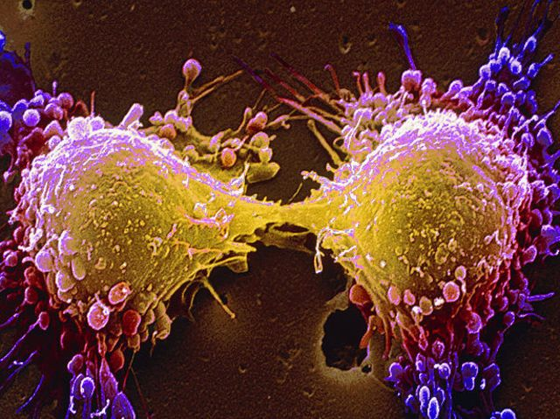
Hyperplasia: increased cell proliferation and division
Only in tissues that can replicate.
Can be physiologic or pathologic.
Occurs due to proliferation of both differentiated cells and stem cells.

Slide 24
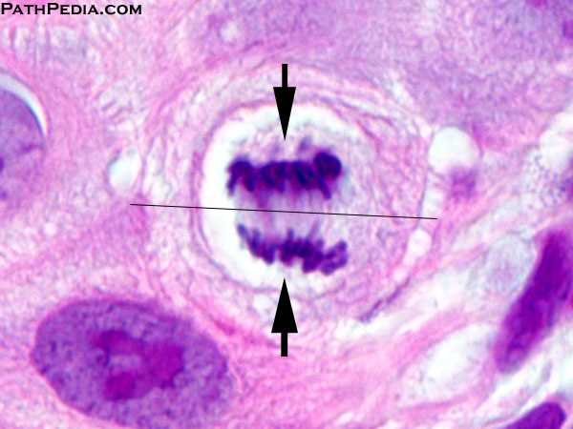
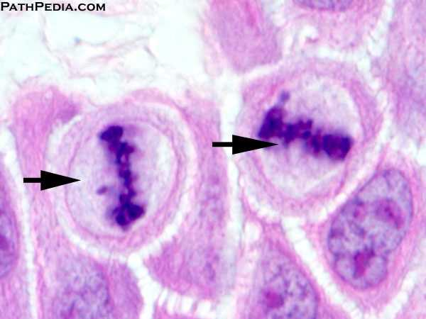
Cell division
Morphologically: we see mitosis

Slide 25
Physiologic hyperplasia
Hormonal: uterus, breast.
Compensatory: after removal or loss of part of tissue such as liver in transplantation.
- In liver transplantation, after part of the liver is excised , the mitotic activity will start after 12 hours eventually restoring the normal size of the liver

Slide 26
Pathologic hyperplasia
Due to excess in hormones or growth factors.
E:g endometrial hyperplasia due to oestrogen- progesterone imbalance.
Hyperplasia is controlled.. it responds to normal growth stimuli and inhibitors .This differentiates it from cancer because cancer keeps growing regardless of normal growth mechanisms.

Slide 27
Note: However.. Because hyperplastic tissue divides there is more chance that it will acquire mutations that can lead to cancer.
-This occurs more in pathologic hyperplasia, because the stimuli are long lived

Slide 28
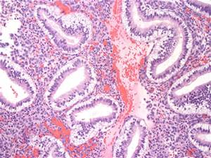
Normal endometrium

Slide 29
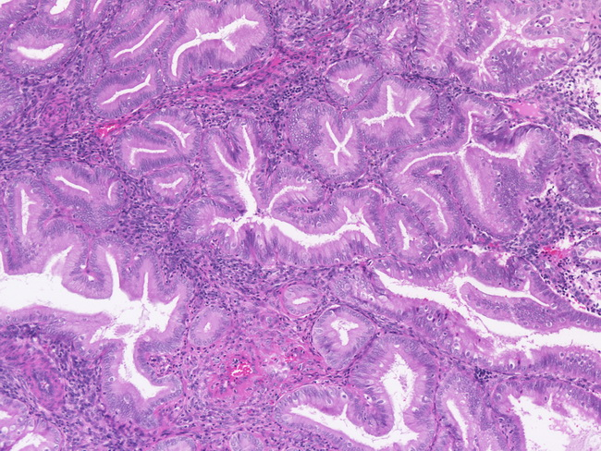
Endometrial hyperplasia

Slide 30
atrophy
Shrinkage in cell size due to loss of cell substance.
Causes
Decreased work load.
Loss of innervation
Loss of endocrine stimulation.
Decrease blood supply
Aging

Slide 31
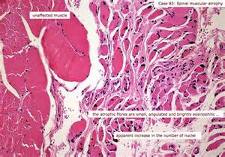
Muscle atrophy

Slide 32
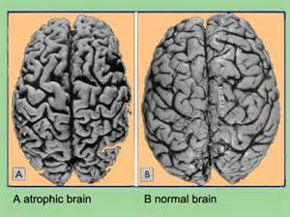
Brain atrophy

Slide 33
Atrophy
Physiologic: endometrial atrophy during menopause
Pathologic: loss of innervation such as in poliomyelitis.

Slide 34
atrophy
Mechanisms:
Decreased protein synthesis.
Degradation of cellular proteins, mainly by ubiquitin- proteasome pathway.. Proteins are attached to ubiquitin which targets them to be degraded by proteasome.
Autophagy…. Literally means self eating.

Slide 35
metaplasia
Adult cell type replaced by another adult cell type.
The cell type sensitive to a certain stress changes to another type which can better tolerate this particular stress.
Arise due to reprogramming of stem cells to differentiate along a new pathway.

Slide 36
Epithelial metaplasia/ example
Respiratory epithelium which is normally glandular, if exposed to smoking it changes to squamous epithelium, which can cope better with the smoke
However, this change means loss of the goblet cells that are present in the columnar glandular epithelium.. So no mucus secretion
Also there will be loss of the cilia.. So there is loss of important protective in metaplastic tissue.

Slide 37
Respiratory epithelium

Slide 39
Barrett mucosa
This is another example of metaplasia
Normal esophageal mucosa is stratified squamous
If there is reflux of gastric content into the stomach, the esophageal epithelium changes to glandular.. So it can withstand the acidity.

Slide 40
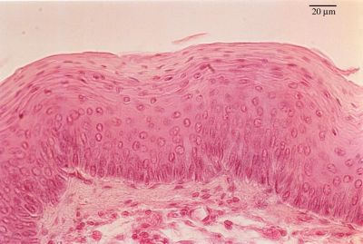
Normal oesophageal mucosa

Slide 41
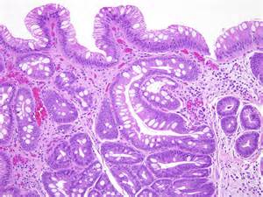
Metaplastic, Barrett’s mucosa

Slide 42
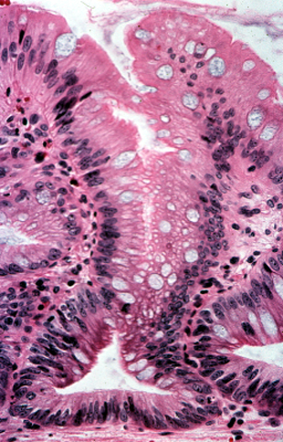
Metaplastic Barrett’s mucosa

Slide 43
Metaplasia in mesenchymal tissue
Usually pathologic
Ossification of soft tissue due to injury.

Slide 44
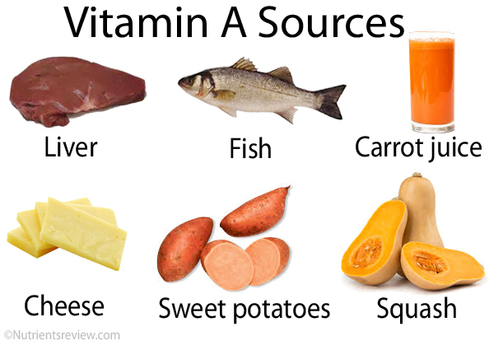
Vitamin A and metaplasia
Vitamin A is important for epithelial differentiation
If there is Vitamin A deficiency… metaplasia can happen.. Especially in the respiratory epithelium.

Slide 45
Metaplasia and cancer
The stimuli that cause metaplasia if persist for a long time can cause cancer
So metaplasia is considered premalignant.

Slide 46
Thank You

