Slide 1
Inflammation
Fatima obeidat , MD,

Slide 2
- Is a protective response involving host cells, blood vessels, and proteins and other mediators that is intended to eliminate the initial cause of cell injury, as well as the necrotic cells and tissues resulting from the original insult, and to initiate the process of repair.

Slide 3
- Without inflammation, infections would go unchecked and wounds would never heal.
- However, can cause considerable harm (if strong, prolonged or inappropriate)

Slide 4
Components of inflammation
1. Leukocytes
2. Plasma proteins and mediators
3. Blood vessels
4. Extracellular matrix

Slide 6
- Inflammation is normally controlled and self-limited.
The outcomes of acute inflammation
1. Elimination of the noxious stimulus.
2. Decline of the reaction and repair of the damaged tissue,
3.Persistent injury resulting in chronic inflammation.

Slide 7
Acute inflammation

Slide 9
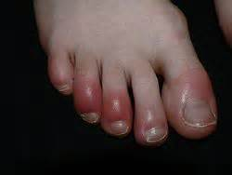
Signs of inflammation

Slide 10
Hotness versus fever
- Hotness : localized, due to vasodilation.
- Fever : systemic, caused by mediators mainly prostaglandins.
- Hotness is a cardinal sign of inflammation, fever is not!

Slide 11
Stimuli for Acute Inflammation
1. Infections
2.Trauma
3.Physical and chemical agents
4. Tissue necrosis
5.Foreign bodies
6. Immune reactions

Slide 12
Inflammation.. ITIS
- Tonsillitis
- Apendicitis
- Pancreatitis
- Liver…?

Slide 13
Acute Vs chronic Inflammation
Acute inflammation
- Rapid onset
- Short duration
- Lasting few minutes to few days
- Exudate
- Predominantly neutrophilic.
- Prominent signs

Slide 14
Chronic inflammation
- More insidious.
- longer duration (days to years)
- lymphocytes and macrophages
- Vascular proliferation and fibrosis (scarring).
- Mild signs

Slide 15
Gout

Slide 16
1. Vascular Changes
A. Changes in Vascular Caliber and Flow:
- Transient vasoconstriction (lasting only for seconds)
- Arteriolar vasodilation.
- Capillary and venular vasodilatation.
.

Slide 17
- Slowing of the circulation and stasis.
- Leukocyte margination.
NET RESULT HOTTNESS AND REDNESS

Slide 18
Normal

Slide 20
Vasodilatation
- Begins first in arterioles then affects capillaries and venules.
- It leads to
i. increasing blood flow., therfore hotness and redness.
ii. Increased local hydrostatic pressure
iii.Transudation of protein poor fluid into the extravascular space

Slide 21
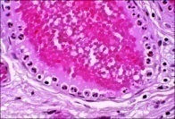
Persistence of stasis
- Leads to peripheral orientation of leukocytes (mainly neutrophils) along the vascular endothelium [leukocytic margination].

Slide 22
Vascular changes
B. Increased Vascular Permeability:
- Increasing vascular permeability that allows the movement of protein-rich fluid and even cells (exudate)=====EDEMA.

Slide 23
Components of exudate
a. Fluid
b. Fibrin
c.Cells:
- Neutrophils predominate (6-72 hours), also macrophages (involved slightly later: 48+ hours)

Slide 24
Mechanisms of increased vascular permeability
1. The most common is endothelial cell contraction
- It involves in post capillary venules
Others:
2. Endothelial cell retraction.
3. Direct endothelial injury.
4.Leukocyte-mediated endothelial injury

Slide 25
2.Leukocyte Cellular Events
A. Margination, rolling and adhesion.
B. Transmigration between endothelial cells.
C. Migration in the interstitium toward the site of stimulus (chemotaxis and activation)
D.Phagocytosis and degranulation (Release of leukocyte products.)

Slide 26
Mediators :
1. Selectins in rolling.
2. Integrins in firm adhesion.
3. CD31 (PECAM-1) in transmigration

Slide 27
Morphologic Appearance of Acute Inflammation
1. Serous inflammation
- Abundant protein-poor fluid with low cellular content
- e.g. skin blisters in burns or viral infections and fluid in body cavities (effusions)

Slide 28
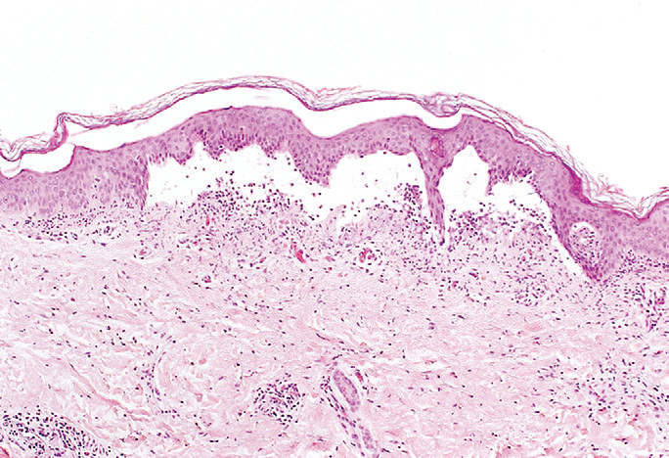
Serous inflammation skin blister

Slide 29
2. Fibrinous inflammation:
- Accumulation of thick exudate rich in fibrin.
-May
a. Resolve by fibrinolysis or
b. Organize into thick fibrous tissue.
e.g. acute pericarditis

Slide 30
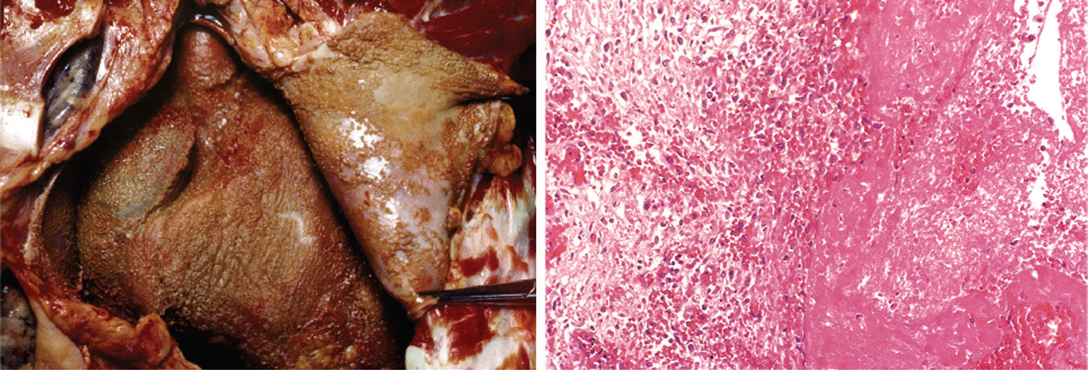
Fibrinous Pericarditis

Slide 31
3. Suppurative (purulent):
- Pus: Creamy yellow or blood stained fluid consisting of neutrophils, microorganisms & tissue debris
- Staphylococcal infections.
- Abscess: Focal localized collection of pus
- Empyema: Collection of pus within a hollow organ

Slide 32
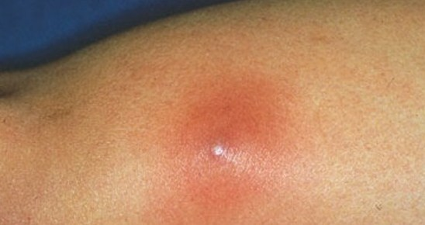
Subcutaneous Abscess

Slide 33
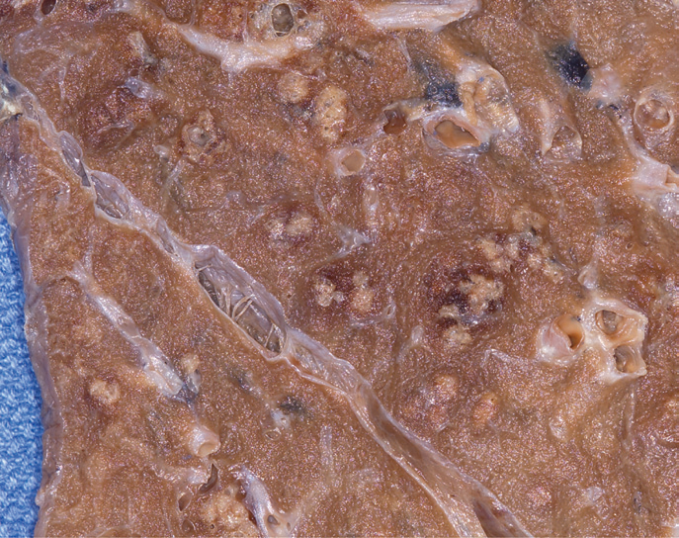
Lung Abscess

Slide 34
Outcomes of Acute Inflammation
1. Complete resolution (back to normal)
- Clearance of injurious stimuli
- Removal of the exudate, fibrin & debris
- Reversal of the changes in the microvasculature
- Replacement of lost cells (regeneration)

Slide 35
2. Healing
- Organization by fibrosis through formation of Granulation tissue. Why?
- Substantial tissue destruction or
- Tissue cannot regenerate or
- Extensive fibrinous exudates
3. Abscess formation
4. Progression to chronic inflammation

