Slide 1
Diseases of Nervous System
Fatima Obeidat, MD

Slide 2
I.Edema, Hydrocephalus and Herniation

Slide 3
A. Brain Edema

Slide 4
- Means accumulation of excess fluid within the brain parenchyma
-There are two main types that may occur together:

Slide 5
I. Vasogenic edema
- Is the most common type.
- Affects mainly the white matter
- Occurs when the integrity of the blood brain barrier is disrupted , allowing fluid to shift from the vascular compartment into the extracellular spaces of the brain and can be:

Slide 6
A. Localized in
Brain tumors either primary or metastatic:
- In brain tumors, the blood vessels are abnormal with fenestrations in the capillary wall
b. Cerebral abscess :
- Due to neoangiogenesis

Slide 7
B. Generalized
- In late stages of ischemic encephalopathy due to damage of endothelial cells by ischemia:
II. Cytotoxic edema :
- An increase in intracellular fluid secondary to neuronal or glial membrane injury.
- The extracellular space is reduced.

Slide 8
- The blood brain barrier is intact
- Caused by ischemia to the brain
- It occurs because energy failure disables the Na/K pump system allowing large amounts of sodium accompanied by water to enter the cells
- Mainly affects the gray matter.

Slide 9
B. Brain Herniation
- Means accumulation of excessive CSF within the ventricular system as a result of a disturbance in its secretion, circulation or its absorption.

Slide 10
a. Most commonly due to impaired flow due to obstruction or impaired resorption of CSF
b. Overproduction of CSF, seen in choroid plexus papilloma is a rare cause of hydrocephalus.

Slide 11
Types of hydrocephalus
1. Non-communicating hydrocephalus (obstructive):
- It occurs when a lesion obstructing the free passage of the CSF from the ventricles to the subarachnoid space;

Slide 12
Tumors
Congenital Acqueduct stenosis

Slide 13
2. Communicating hydrocephalus, :
Refers to the abnormality in which there is a free passage of CSF from within the ventricular system into the subarachnoid space.
-Causes
a. Defects in the subarachnoid space such as fibrosis in leptomeningeal infection and hemorrhage from saccular aneurysms.

Slide 14
b. Defects in absorption of CSF at the arachnoid granulations such as
- Congenital deficiency of arachnoids' granulation
c. Overproduction of CSF by choroid plexus papilloma
d. Idiopathic

Slide 15
C. Brain Herniation

Slide 16
- Intracranial pressure may increase by focal expanding lesion or generalized edema.
- Because the cranial vault is subdivided by rigid dural folds (falx and tentorium), a focal expansion of the brain causes it to be displaced in relation to these partitions causing brain herniation.

Slide 17
- Herniations are named by .
a. Either the part of the brain that is displaced or
The structure across which it moves.
- Types of herniations:

Slide 18
1. Subfalcine (cingulate) herniation
- Expansion of a mass in the frontal or parietal lobe will result in herniation of ipsilateral cingulate gyrus under the free edge of the falx.

Slide 19
- to produce selective displacement of the pericallosal arteries away from the lesion and from the midline

Slide 20
Consequences
- This may compromise circulation through the pericallosal arteries ( branches of anterior cerebral artery) and result in infarction of the parietal parasaggital cortex , manifesting clinically as a weakness or sensory loss in one or both legs.

Slide 21
2. Tentorial (uncal) or uncinate gyrus herniation-
- Caused by any supratentorial expanding mass which may produce herniation of the ipsilateral uncus (tip and medial part of parahippocampal gyrus) downwards through the tentorial incisura.

Slide 22
- This occurs most frequently when the mass is located in the temporal lobe

Slide 23
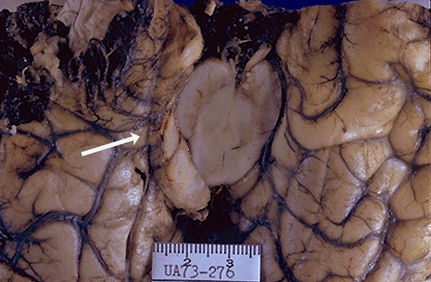
Uncal herniation

Slide 24
- Consequences of temporal lobe displacement:
The ipsilateral oculomotor nerve compressed between the free edge of the tentorium and the posterior cerebral artery will result in paralysis of the nerve produces ptosis and dilation of the pupil ipsilateral to the lesion

Slide 25
Note - Dilation of the pupil is the earliest consistent sign of tentorial herniation and may occur before there is any loss of consciousness
Compression of the cerebral peduncle(crus cerbri) on the side of the mass lesion will result in contralateral limb weakness

Slide 26
C. Compression of the posterior cerebral artery resulting in ischemic injury to the territory supplied by that vessel, including the primary visual cortex

Slide 27
.
3.Tonsillar herniation (foramen impaction, cerebellar cone)
- Refers to displacement of the cerebellar tonsils through the foramen magnum.

Slide 28
- This pattern of herniation is life-threatening

Slide 29
II. Cerebrovascular diseases

Slide 30
A. Ischemia and infarction

Slide 31
Clinical terms
1. Stroke :
Is the clinical designation applied to
Abrupt onset of focal or global neurological symptoms
Caused by ischemia or hemorrhage
Symptoms must continue for more than 24 hours.
Should be permanent damage to the brain.

Slide 32
2. Transient ischemic attack(TIA):
a- The neurological symptoms resolve within 24 hours
b. No irreversible tissue damage

Slide 33
- It is convenient to consider cerebrovascular disease as two processes
a. Hypoxia, ischemia and infarction
b. Hemorrhage

Slide 34
A. Hypoxia, ischemia and infarction
- The brain may be deprived of oxygen by several mechanisms
a. Functional hypoxia in a setting of a low partial pressure of oxygen or impaired oxygen-carrying capacity
Global Ischemia; either transient or permanent due to tissue hypoperfusion, as in hypotension or shock
Focal ischemia: vascular obstruction.

Slide 35
Clinically
- Severe global ischemia.(pan necrosis)
Consequences
a. Persistent(more than 1 month)vegetative state ( awake but not aware)
Brain death
Evidence of diffuse cortical injury (isoelectric, or "flat," electroencephalogram
And brain stem damage, including absent reflexes and respiratory drive

Slide 36
II.Focal Cerebral Ischemia
- Cerebral arterial occlusion leads to infarction of CNS tissue in the distribution of the compromised vessel.
- The extent of tissue damage is determined by modifying variables, mainly the adequacy of collateral flow
- The major source of collateral flow is the circle of Willis.

Slide 37
- Occlusive vascular disease may be due to
In situ thrombosis
- The most common sites of primary thrombosis are
a. The carotid bifurcation..
b. The origin of the middle cerebral artery,
c. And at either end of the basilar artery

Slide 38
2. Embolization from a distant source.
- Overall, embolic infarctions are more common than thrombosis.
- Sources of emboli:
a. Cardiac mural thrombi are a frequent source
b. Thromboemboli also arise in arteries, most often from atheromatous plaques within the carotid arteries.

Slide 39
NOTE:
- The territory of distribution of the middle cerebral artery-the direct extension of the internal carotid artery-is most frequently affected by embolic infarction

Slide 40
B. Intracranial Hemorrhage
- Hemorrhage within the skull can occur in a variety of locations, and each location is associated with a set of underlying causes.
1. Hemorrhages within the brain itself can occur:
Secondary to hypertension (most common)
Cerebral amyloid angiopathy

Slide 41
c. Arterio-venous malformation.
d. A cavernous malformation.

Slide 42
2. Subarachnoid hemorrhages:
- Are most commonly seen with aneurysms but occur also with other vascular malformations.
3. Hemorrhages associated with the dura (in either subdural or epidural spaces) usually due to trauma.

Slide 43
1. Primary Brain Parenchymal Hemorrhage
- Spontaneous (non-traumatic) intra-parenchymal hemorrhages occur most commonly in mid to late adult life, with a peak incidence at about 60 years of age
- Most are caused by rupture of a small intraparenchymal vessel

Slide 44
A. Hypertension :
Is the leading underlying cause, and brain
hemorrhage accounts for roughly 15% of
deaths among persons with chronic
hypertension
- It has a peak incidence at about 60 years

Slide 45
- Massive Hypertensive intraparenchymal hemorrhages occur in:
a. Basal ganglia,--most common location
b. Thalamus
c. Pons
d. and Cerebellum

Slide 46
B.. Cerebral Amyloid Angiopathy (CAA) :
- Is the second most common cause of spontaneous parenchymal hemorrhage
- Is a disease in which amyloidogenic peptides, deposit in the walls of meningeal and cortical vessels

Slide 47
CAA-associated hemorrhages often occur in
the lobes of the cerebral cortex (lobar
hemorrhages)

Slide 48
Subarachnoid Hemorrhage
Causes:
A. Saccular (berry) aneurysm rupture
- Is the most frequent cause of clinically significant subarachnoid.
B. Vascular malformation

Slide 49
Saccular (Berry ) aneurysm:
- Rupture of saccular aneurysm can occur at any time
- In about one-third of cases it is associated with acute increase in intracranial pressure, such as with straining at stool or sexual orgasm.
- Blood under arterial pressure is forced into the subarachnoid space,

Slide 50
- Between 25% and 50% of individuals die with the first rupture, although those who survive typically improve and recover consciousness in minutes
- Recurring bleeding is common in survivors

Slide 51
Although they are sometimes referred to as congenital, they are not present at birth but develop over time because of underlying defects in the vessel media in hypertension

Slide 52
- It might be associated with:
a. Disorders of extracellular matrix proteins,
b. There is an increased risk of aneurysms in individuals with autosomal dominant polycystic kidney disease

Slide 53
Complications
1- In the early period after a subarachnoid hemorrhage, there is a risk of additional ischemic injury from vasospasm involving other vessels.
2- In the healing phase of subarachnoid hemorrhage, meningeal fibrosis and scarring occur, sometimes leading to obstruction of CSF flow as well as interruption of the normal pathways of CSF resorption.

Slide 54
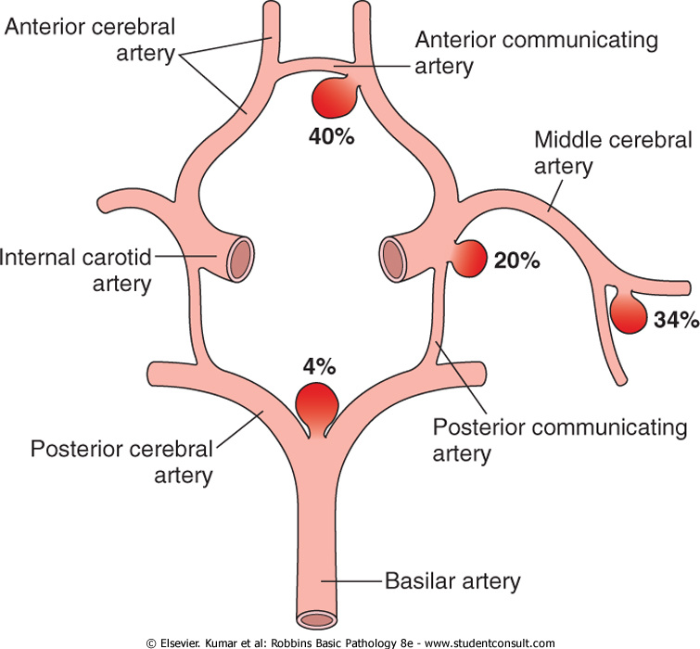

Slide 55
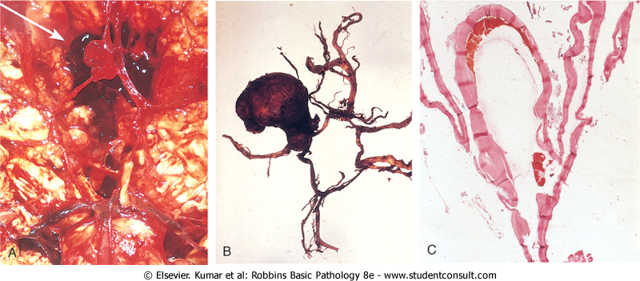
Berry aneurysm

