Slide 2
B. Primary adrenal hyperplasia and neoplasms
- Are responsible for about 10% to 20% of cases of endogenous Cushing syndrome and this form is called ACTH-independent Cushing syndrome, or

Slide 3
adrenal Cushing syndrome and its biochemical hallmark is elevated levels of cortisol with low serum levels of ACTH

Slide 4
Note
- In most cases, adrenal Cushing syndrome is caused by a unilateral adrenocortical neoplasm, which may be either benign (adenoma) or malignant (carcinoma).

Slide 5
C. Secretion of ectopic ACTH by nonpituitary tumors
- Accounts for about 10% of cases of Cushing syndrome mostly caused by small cell carcinoma of the lung.

Slide 6
2. Hyperaldosteronism
A. In secondary hyperaldosteronism:
- Aldosterone release occurs in response to activation of renin-angiotensin system and characterized by increased levels of plasma renin and is encountered in conditions associated with:

Slide 7
a. Decreased renal perfusion
b. Arterial hypovolemia such as in heart in heart failure
c. Pregnancy (caused by estrogen-induced increases in plasma renin substrate)
:

Slide 8
Primary hyperaldosteronism:
- Indicates primary , autonomous overproduction of aldosterone with secondary suppression of renin- angiotensin system and decreased plasma renin activity and the causes are

Slide 9
a. Bilateral idiopathic hyperaldosteronism,
- Characterized by bilateral nodular hyperplasia of adrenals
- Is the most common underlying cause of primary hyperaldosteronism, accounting for about 60% of cases.
.

Slide 10
b. Adrenocortical neoplasm, either an adenoma (the most common cause) or, rarely, an adrenocortical carcinoma.
-

Slide 11
- In approximately 35% of cases, the cause is a solitary aldosterone-secreting Aldosterone-producing adrenocortical adenoma referred to as Conn syndrome

Slide 12
Clinical Features :
- The clinical hallmark is hypertension
- Hyperaldosteronism may be the most common cause of secondary hypertension
-

Slide 13
- Hypokalemia results from renal potassium wasting and, can cause neuromuscular manifestations, including weakness, paresthesias.

Slide 14
II.ADRENAL INSUFFICIENCY
The patterns are:
1. Acute Adrenocortical Insufficiency : causes
a. Crisis in patients with chronic adrenocortical insufficiency precipitated by stress
b. In patients maintained on exogenous corticosteroids

Slide 15
- rapid withdrawal of steroids or failure to increase steroid doses in response to an acute stress, because of the inability of the atrophic adrenals to produce glucocorticoid
c. Massive adrenal hemorrhage

Slide 16
This condition may occur :
1. In patients maintained on anticoagulant therapy
2. Patients suffering from sepsis : a condition known as the Waterhouse-Friderichsen syndrome

Slide 17
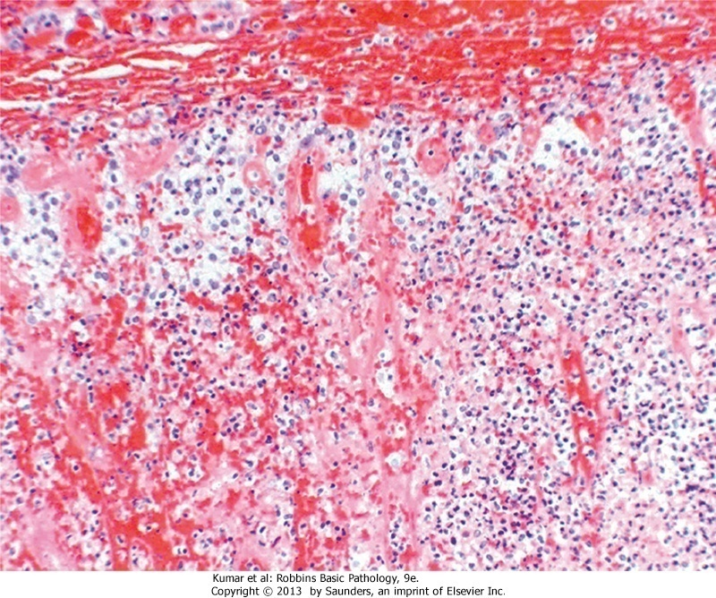
Adrenal hemorrhage

Slide 18
- This catastrophic syndrome is associated with Neisseria meningitidis septicemia

Slide 19
2. Primary Chronic Adrenocortical Insufficiency (Addison Disease):
- Resulting from progressive destruction of the adrenal cortex.
- More than 90% of all cases are attributable to

Slide 20
a. Autoimmune adrenalitis
Accounts for 60% to 70% of cases and is the most common cause of primary adrenal insufficiency in developed countries

Slide 21
B. Infections,: Tuberculosis and Fungal infections
C- Metastatic neoplasms involving the adrenals
- Carcinomas of the lung and breast

Slide 22
Diseases of Nervous System
Fatima Obeidat, MD

Slide 23
I.Edema, Hydrocephalus and Herniation

Slide 24
A. Brain Edema

Slide 25
- Means accumulation of excess fluid within the brain parenchyma
-There are two main types that may occur together

Slide 26
I. Vasogenic edema
- Is the most common type
- Affects mainly the white matter
- Occurs when the integrity of the blood brain barrier is disrupted , allowing fluid to shift from the vascular compartment into the extracellular spaces of the brain and can be:

Slide 27
A. Localized in
Brain tumors either primary or metastatic
- In brain tumors, the blood vessels are abnormal with fenestrations in the capillary wall
b. Cerebral abscess : Due to neoangiogenesis

Slide 28
B. Generalized
- In late stages of ischemic encephalopathy due to damage of endothelial cells by ischemia
II. Cytotoxic edema :
- An increase in intracellular fluid secondary to neuronal or glial membrane injury
- The extracellular space is reduced

Slide 29
- The blood brain barrier is intact
- Caused by ischemia to the brain
- It occurs because energy failure disables the Na/K pump system allowing large amounts of sodium accompanied by water to enter the cells
- Mainly affects the gray matter

