Slide 1
PATHOLOGY FOR DENTISTRY HEAD AND NECK
Fatima Obeidat , MD

Slide 2
Lecture 1 Diseases of the oral mucosa

Slide 3
ORAL MUCOSA
1. Inflammatory Lesions: Aphthous ulcers, Herpes Simplex, candida.
2.Proliferative and neoplasticc lesions: Fibrous proliferative lesions, leukoplakia, Erythroplakia, Squamnous cell carcinoma.

Slide 4
1. Inflammatory lesions

Slide 5
A. APHTHOUS ULCERS
- Are superficial mucosal ulcerations.
- Affect 40% of the population.
- Are more common in the first 2 decades of life
Are painful and recurrent
More prevalent within some families

Slide 6
- Cause is unknown.
Can be associated with
Celiac disease ,
Inflammatory bowel diseases
Behcet disease.
Can be solitary or multiple

Slide 7
Are shallow, hyperemic ulcerations covered by a thin exudate and rimmed by a narrow zone of erythema
In most cases they resolve spontaneously in 7 to 10 days
Can recur.

Slide 9
B.HERPES SIMPLEX VIRAL INFECTION
- Most oro-facial herpetic infections are caused by herpes simplex virus type 1 (HSV-1), with the remainder being caused by HSV-2 (genital herpes).
With changing sexual practices, oral HSV-2 is increasingly common.
Primary infections typically occur in children between 2 and 4 years of age and are often asymptomatic

Slide 10
However, 10% to 20% of cases the primary infection manifests as acute herpetic gingivostomatitis, with abrupt onset of vesicles and ulcerations throughout the oral cavity.
Most adults harbor latent HSV-1, and the virus can be reactivated, resulting in a so-called “cold sore” or recurrent herpetic stomatitis.

Slide 11
Factors associated with HSV reactivation
Trauma
Allergies
Exposure to ultraviolet light
Upper respiratory tract infections,
Pregnancy, immunosuppression, and exposure to extremes of temperature.

Slide 12
The recurrent lesions, which occur at the site of primary inoculation or in adjacent mucosa innervated by the same ganglion
Typically appear as groups of small (1 to 3 mm) vesicles

Slide 13
CLINICAL FEATURES
Most common sites :Lips, nasal orifices , buccal mucosa , gingiva and hard palate.
Resolve within 7-10 days.
- Antiviral therapy may be needed in the immunocompromised patients

Slide 14
Cold sors

Slide 15
HISTOPATHOLOGY
- Infected cells are ballooned with large eosinophilic intranuclear inclusions

Slide 16
Herpes virus inclusion

Slide 17
C.ORAL CANDIDIASIS (THRUSH)
Is the most common fungal infection of the oral cavity.
- Candida albicans is a normal component of the oral flora and only produces disease under unusual circumstances.

Slide 18
Modifying factors that cause infection by Candida Albicans nclude:
a. Immunosuppression
b. Only certain strains of C. Albicans cause disease
c. Broad-spectrum antibiotics that alter the normal microflora.

Slide 19
CLINICAL FORMS
A. Pseudomembranous
B. Erythematous
C. Hyperplastic
The Pseudomembranous form is most common and is known as thrush

Slide 20
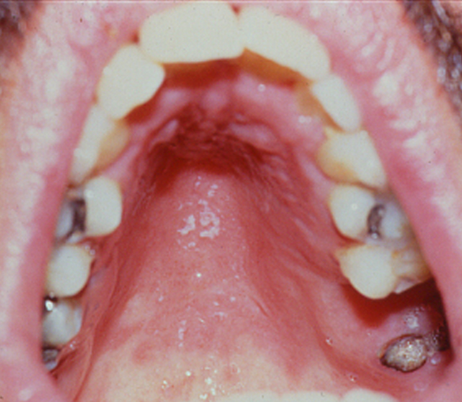
Erythematous candidal infection in palate

Slide 21
PSEUDOMEMBRANOUS
Characterized by a superficial, gray to white inflammatory membrane which is composed of matted organisms surrounded by a fibrinosuppurative exudate ,which can scraped off to reveal an underlying erythematous base.

Slide 22
Microscopy of candida

Slide 23
1. In mildly immunosuppressed or debilitated individuals, such as diabetics, the infection usually remains superficial,
2. In more severe immunosuppression, can spread to deep sites

Slide 24
Organ or hematopoietic stem cell transplant recipients,
Patients with neutropenia, chemotherapy-induced immunosuppression, or AIDS.

Slide 25
2.PROLIFERATIVE AND NEOPLASTIC LESIONS

Slide 26
A.FIBROMA
Is sub-mucosal nodular fibrous tissue masses
Is formed when chronic irritation results in reactive connective tissue hyperplasia
- Occurs most often on the buccal mucosa along the bite line
Treatment is complete surgical excision and removal of the source of irritation.

Slide 27
Fibroma:Gross

Slide 28
Fibroma:Histopathology

Slide 29
B. PYOGENIC GRANULOMAS
Are pedunculated masses usually found on the gingiva
Affects children, young adults, and pregnant women.
These lesions are richly vascular and typically are ulcerated, which gives them a red to purple color.

Slide 30
In some cases, growth can be rapid and misdiagnosed as malignant neoplasm.
- Complete surgical excision is definitive treatment

Slide 31
HISTOPATHOLOGY
- Dense proliferation of fibroblasts and immature vessels.

Slide 32
Pyogenic granuloma Gross

Slide 33
Pyogenic granuloma:histopathology

Slide 34
C. LEUKOPLAKIA WHO DEFINITION
A white patch or plaque that cannot be scraped off and cannot be characterized clinically or pathologically as any other disease.
This clinical term is reserved for lesions that
arise in the oral cavity in the absence of any known etiologic factor

Slide 35
NOTE:
- White patches caused by lichen planus and candidiasis are NOT considered leukoplakia.
Approximately 3% of the world’s population has leukoplakic lesions,
5% to 25% of which are premalignant and may progress to squamous cell carcinoma

Slide 36
Thus, all leukoplakias must be considered precancerous until proved otherwise by means of histologic evaluation.
Spectrum of histological features
1.Hyperkeratosis.
2.Dysplasia.
3.Carcinoma in situ

Slide 37
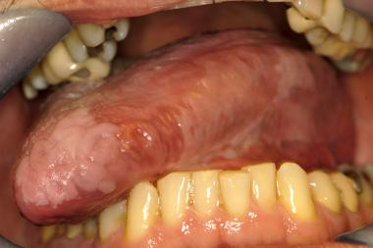
Leukoplakia gross

Slide 38
D.ERYTHROPLAKIA
- Is a red, possibly eroded area that is flat or slightly depressed relative to the surrounding mucosa.
- Is less common than leukoplakia but has a greater risk of malignant transformation( 50%)

Slide 39
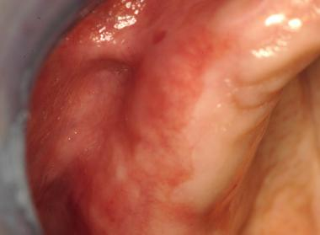
Erythroplakia Gross

Slide 40
LEUKOPLALIA AND ERYTHROPLAKIA ETIOLOGY
Multifactorial etiology
Tobacco use (cigarettes, pipes, cigars, and chewing tobacco) is the most common risk factor for leukoplakia

Slide 41
E.SQUAMOUS CELL CARCINOMA
It accounts for approximately 95% of cancers of the oral cavity.
- This aggressive epithelial malignancy is the sixth most common neoplasm in the world
- Long term survival is less than 50%.
- Diagnosed at late stage.

Slide 42
Multiple primary tumors may be present at initial diagnosis
Patients who survive 5 years after diagnosis of the initial tumor have up to a 35% chance of developing at least one new primary tumor within that interval.
- Patients with small tumors have > 50% chance of 5 year survival but many die from second primary tumors

Slide 43
PATHOGENESIS
TWO PATHWAYS:
SCC arising in oral cavity are mostly due to chronic alcohol and tobacco users
These have mutations related to carcinogens in tobacco
2. SCC arising in tonsillar crypts or bases of the tongue are related to HPV infection mainly HPV 16

Slide 44
- Prognosis for HPV positive tumors is better than HPV negative ones
- HPV vaccine can limit the HPV associated tumors.

Slide 45
The most common locations of oral cavity type are
The ventral surface of the tongue
Floor of the mouth
c. Lower lip
d. Soft palate
e. Gingiva

Slide 46
MORPHOLOGY--Gross
a. Raised firm plaques
b. Irregular rough mucosal thickening
c. Verrucous mucosal thickening
d. As they enlarge : Form ulcerated masses with irregular borders

Slide 47
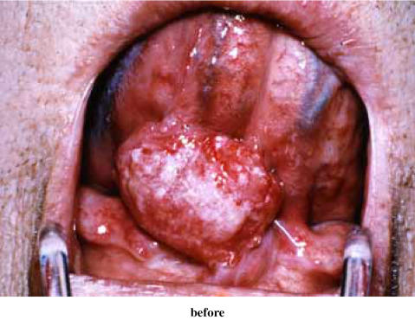
SCC arising in ventral surface of tongue

Slide 48
Histopathology
- Squamous cell carcinoma develops from dysplastic precursor lesions.
Histologic patterns range from well-differentiated keratinizing neoplasms to anaplastic, sometimes sarcomatoid tumors.
Differentiation does not affect the behavior.

Slide 49
Histopathology of squamous cell carcinoma

Slide 50
Clinical Course
Oral squamous cell carcinoma infiltrates locally before it metastasizes.
The cervical lymph nodes are the most common sites of regional metastasis
Frequent sites of distant metastases include the mediastinal lymph nodes, lungs, and liver

