Slide 1
Lecture 4

Slide 2
3. Asthma
- Asthma is a chronic inflammatory disorder of the airways that causes recurrent episodes of wheezing, breathlessness, chest tightness, and cough, particularly at night and/or early in the morning.

Slide 3
The hallmarks of the disease are
1. Intermittent and reversible airway obstruction,
2. Chronic bronchial inflammation with eosinophils,
3. Bronchial smooth muscle cell hypertrophy and hyperreactivity,
4. Increased mucus secretion.

Slide 4
1. Atopic Asthma
- This is the most common type of asthma,
- Usually beginning in childhood,
- Is a classic example of type I IgE-mediated hypersensitivity reaction

Slide 5
- A positive family history of atopy and/or asthma is common,
- Asthmatic attacks are often preceded by allergic rhinitis, urticaria, or eczema.
- The disease is triggered by environmental antigens, such as dusts, pollen, and foods

Slide 6
.
- A skin test with the offending antigen results in an immediate wheal-and-flare reaction.
- Atopic asthma also can be diagnosed based on serum radioallergosorbent tests (RASTs) that identify the presence of IgE specific for a panel of allergens.

Slide 7
2. Non-Atopic Asthma
- No evidence of allergen sensitization,
- Skin test results usually are negative.
- A positive family history of asthma is less common.

Slide 8
d. Respiratory infections due to viruses (e.g., rhinovirus, parainfluenza virus) and inhaled air pollutants (e.g., sulfur dioxide, ) are common triggers.
- It is thought that virus-induced inflammation of the respiratory mucosa lowers the threshold of the subepithelial vagal receptors to irritants.

Slide 9
Note:
-Although the connections are not well understood, the ultimate humoral and cellular mediators of airway obstruction (e.g., eosinophils) are common to both atopic and nonatopic variants of asthma, so they are treated in a similar way.

Slide 10
3. Drug-Induced Asthma
- Several pharmacologic agents provoke asthma--aspirin being the most striking example
- Patients with aspirin sensitivity present with recurrent rhinitis and nasal polyps, urticaria, and bronchospasm.

Slide 11
- The precise mechanism remains unknown, but it is presumed that aspirin inhibits the cyclooxygenase pathway of arachidonic acid metabolism without affecting the lipoxygenase route, thereby shifting the balance of production toward leukotrienes that cause bronchial spasm.

Slide 12
PATHOGENESIS
- The major etiologic factors of asthma are:
1. Genetic predisposition to type I hypersensitivity (atopy)
2. Acute and chronic airway inflammation,
3. and bronchial hyperresponsiveness to a variety of stimuli.

Slide 13
- Role of type 2 helper T (T_{H}2) cells may be critical to the pathogenesis of asthma.
- The classic atopic form of asthma is associated with an excessive T_{H}2 reaction against environmental antigens.

Slide 14
- Cytokines produced by T_{H}2 cells account for most of the features of asthma
a.IL-4 stimulates IgE production,
b. IL-5 activates eosinophils,
c. IL-13 stimulates mucus production and also promotes IgE production by B cells
4. IgE coats submucosal mast cells, which, on exposure to allergen, release granule contents.

Slide 15
- This induces two waves of reaction: an early (immediate) phase and a late phase
- Early reaction is dominated by
a. Bronchoconstriction, triggered by direct stimulation of subepithelial vagal receptors
b. Increased mucus production and
c. Vasodilation.

Slide 16
The late-phase reaction consists of inflammation, with
a. Activation of eosinophils, neutrophils, and T cells.
b. Epithelial cells are activated to produce chemokines that promote recruitment of more T_{H}2 cells and eosinophils (including eotaxin, a potent chemoattractant and activator of eosinophils),

Slide 17
- Repeated bouts of inflammation lead to structural changes in the bronchial wall, referred to as airway remodeling.
These changes include
1. Hypertrophy of bronchial smooth muscle and mucus glands,
2. Deposition of subepithelial collagen, which may occur as early as several years before initiation of symptoms.

Slide 18
- Repeated bouts of inflammation lead to structural changes in the bronchial wall, referred to as airway remodeling.
These changes include
1. Hypertrophy of bronchial smooth muscle and mucus glands,
2. Deposition of subepithelial collagen, which may occur as early as several years before initiation of symptoms.

Slide 19
MORPHOLOGY
- The morphologic changes in asthma have been described in persons who die of prolonged severe attacks (status asthmaticus) and in mucosal biopsies of persons challenged with allergens

Slide 20
Gross:
- The most striking macroscopic finding is occlusion of bronchi and bronchioles by thick, mucous plugs.

Slide 21
Histologically,
a. The mucous plugs contain whorls of shed epithelium (Curschmann spirals).
b. Numerous eosinophils
c. Charcot-Leyden crystals (collections of crystalloids made up of eosinophil proteins) in the mucus.

Slide 22
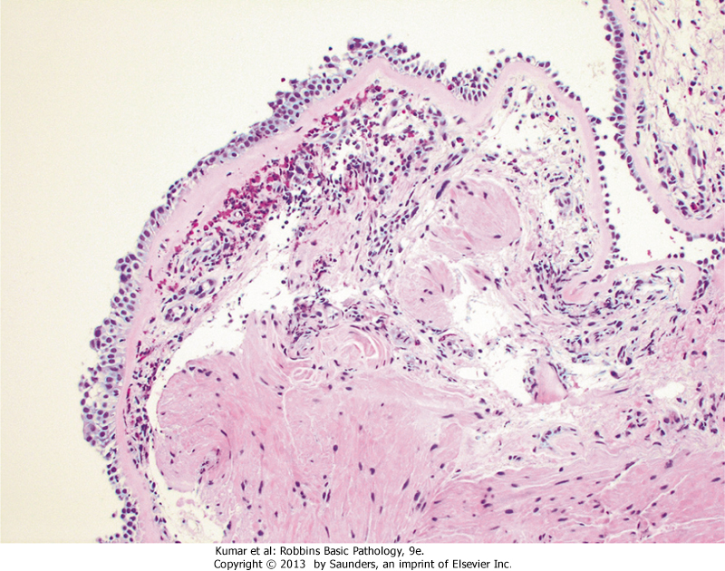
Asthma

Slide 23
Airway remodeling," include
a. Thickening of airway wall Sub-basement membrane fibrosis
b. Increased vascularity in submucosa
c. An increase in size of the submucosal glands and goblet cell metaplasia of the airway epithelium

Slide 24
d- Hypertrophy and/or hyperplasia of the bronchial muscle- this is the basis for the novel therapy of bronchial thermoplasty, which involves controlled delivery of thermal energy during bronchoscopy; this reduces the mass of smooth muscles which in turn reduces airway hyperresponsiveness)

Slide 25
Asthma is a complex genetic disorder in which multiple susceptibility genes interact with environmental factors to initiate the pathologic reaction.
There is significant variation in the expression of these genes and in the combinations of polymorphisms that effect the immune response or tissue remodeling.

Slide 26
A..One of the susceptibility loci is on the long arm of chromosome 5 (5q), where several genes involved in regulation of IgE synthesis and mast cell and eosinophil growth and differentiation map.
The genes at this locus include:
IL13 (genetic polymorphisms linked with susceptibility to the development of atopic asthma)
, CD14

Slide 27
2. and IL-4 receptor gene (atopy, total serum IgE level, and asthma).
B. Another important locus is on 20q where ADAM-33 that regulates proliferation of bronchial smooth muscle and fibroblasts is located; this controls airway remodeling.

Slide 28
Clinical Features
- An attack of asthma is characterized by severe dyspnea with wheezing; the chief difficulty lies in expiration.
- The victim labors to get air into the lungs and then cannot get it out, so that there is progressive hyperinflation

Slide 29
- Intervals between attacks are characteristically free from overt respiratory difficulties, but persistent, subtle deficits can be detected by spirometry.
- Occasionally a severe paroxysm occurs that does not respond to therapy and persists for days and even weeks (status asthmaticus).
- The associated hypercapnia, acidosis, and severe hypoxia may be fatal, although in most cases the condition is more disabling than lethal

