Slide 1
c. Some of the inhaled particles may reach the lymphatics either by direct drainage or within migrating macrophages and thereby initiate an immune response to components of the particulates and/or to self-proteins that are modified by the particles and this then leads to an amplification and extension of the local reaction.

Slide 2
Note:
- Tobacco smoking worsens the effects of all inhaled mineral dusts, more with asbestos than other particles.

Slide 3
A. Coal Worker's Pneumoconiosis
-The spectrum of lung findings in coal workers :
1. Pulmonary anthracosis
- Is the most innocuous coal-induced pulmonary lesion in coal miners and also is commonly seen in all urban dwellers and tobacco smokers.

Slide 4
- Inhaled carbon pigment is engulfed by alveolar or interstitial macrophages, which then accumulate in the connective tissue along the lymphatics, including the pleural lymphatics, or in lymph nodes
- The pigment accumulates without cellular reaction

Slide 5
2. Simple coal worker's pneumoconiosis (CWP),
- In which accumulations of macrophages occur with little to no pulmonary dysfunction,
a. Coal macules :- Consists of dust-laden macrophages;
b. Coal Nodules:- In addition, it contains small amounts of collagen fibers arrayed in a delicate network

Slide 6
Note: Although these lesions are scattered throughout the lung, the upper lobes and upper zones of the lower lobes are more heavily involved.

Slide 7
3. Complicated CWP or (PMF) :
- Progressive massive fibrosis (PMF), in which fibrosis is extensive and lung function is compromised and occurs on a background of simple CWP by coalescence of coal nodules and generally requires many years to develop.

Slide 8
- Characterized by usually multiple, blackened scars larger than 2 cm, sometimes up to 10 cm in diameter.
- On microscopic examination the lesions are seen to consist of dense collagen and pigment
- Less than 10% of cases of simple CWP progress to PMF.

Slide 9
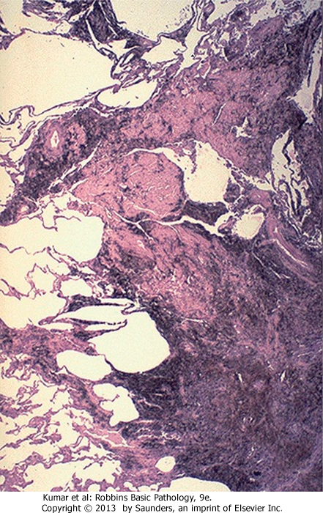
CWP

Slide 10
Note:
- PMF is a generic term that applies to a confluent fibrosing reaction in the lung; this can be a complication of any one of the pneumoconioses

Slide 11
Clinical Features
- CWP is usually a benign disease that produces little decrement in lung function.
- In those in whom PMF develops, there is increasing pulmonary dysfunction, pulmonary hypertension, and cor pulmonale.

Slide 12
- Progression from CWP to PMF has been linked to a variety of conditions including coal dust exposure level and total dust burden.
- Unfortunately, PMF has a tendency to progress even in the absence of further exposure.

Slide 13
Note:
- Once smoking-related risk has been taken into account, there is no increased frequency of lung carcinoma in coal miners, a feature that distinguishes CWP from both silica and asbestos exposures .

Slide 14
B. Silicosis
- Silicosis is the most prevalent chronic occupational disease in the world and caused by inhalation of crystalline silica, mostly in occupational settings.
Workers in sandblasting are at particular risk
Silica Forms
a. Crystalline (such as quartz) are by far the most toxic and fibrogenic and quartz is most

Slide 15
commonly implicated in silicosis and when mixed with other minerals, it has been observed to have a reduced fibrogenic effect and quartz in the workplace is rarely pure
b. Amorphous forms
MORPHOLOGY
Silicotic nodules :- Characterized grossly in early stages by barely palpable ,

Slide 16
pale-to-blackened (if coal dust is present) nodules in the upper zones of the lungs.
Microscopically,
- It shows concentrically arranged hyalinized collagen fibers surrounding amorphous center and this whorled" appearance of the collagen fibers is distinctive for silicosis

Slide 17
- Polarized microscopy reveals weakly birefringent silica particles, primarily in the center of the nodules
- As the disease progresses, the individual nodules may coalesce into hard, collagenous scars, with eventual progression to PMF
- Fibrotic lesions may also occur in the hilar lymph nodes and pleura.

Slide 18
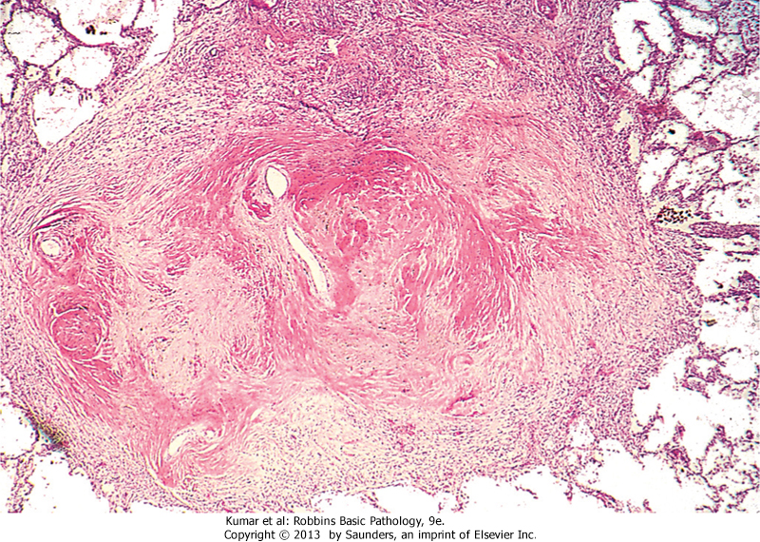
silicosis

Slide 19
- Sometimes, thin sheets of calcification occur in the lymph nodes and are appreciated radiographically as "eggshell" calcification (e.g., calcium surrounding a zone lacking calcification).

Slide 20
Clinical Features:
- Silicosis usually is detected on routine chest radiographs obtained in asymptomatic workers.
- The radiographs shows a fine nodularity in the upper zones of the lung, but pulmonary function is either normal or only moderately affected.
- Most patients do not develop shortness of breath until late in the course, after PMF is present.

Slide 21
- At this time, the disease may be progressive, even if the person is no longer exposed.
- Many patients with PMF develop pulmonary hypertension and cor pulmonale.
- The disease is slow to kill, but impaired pulmonary function may severely limit activity

Slide 22
NOTE: Silicosis is associated with an increased susceptibility to tuberculosis.
- It is postulated that crystaline silica may inhibit the ability of pulmonary macrophages to kill phagocytosed mycobacteria.
- Nodules of silicotuberculosis often contain a central zone of caseation

Slide 23
.
The relationship between silica and lung cancer has been a contentious issue.
- In 1997, based on evidence from several epidemiologic studies, the International Agency for Research on Cancer concluded that crystalline silica is carcinogenic in humans.
- However, this subject continues to be controversial

Slide 24
C. Asbestosis and Asbestos-Related Diseases
- Occupational exposure to asbestos is linked to
1. Parenchymal interstitial fibrosis (asbestosis);
2. Localized fibrous plaques and rarely, diffuse fibrosis in the pleura;
3. Pleural effusions;

Slide 25
4. Lung carcinomas;
5. Malignant pleural and peritoneal mesotheliomas;
6. Laryngeal carcinoma.
- An increased incidence of asbestos-related cancers in family members of asbestos workers

Slide 26
PATHOGENESIS: Forms of asbestos:
A. Serpentine :
- In which the fiber is curly and flexible and chrysotile accounts for most of the asbestos used in industry and because of their structure are likely to become impacted in the upper respiratory passages and removed by the mucociliary elevator.

Slide 27
Note:
- Those that are trapped in the lungs are gradually leached from the tissues, because they are more soluble than amphiboles.
b. Amphibole, in which the fiber is straight, stiff
- Amphiboles, are less prevalent but more pathogenic than the serpentine and align themselves in the airstream and are delivered deeper into the lungs

Slide 28
- Where they may penetrate epithelial cells to reach the interstitium
- Asbestos probably also functions as both a tumor initiator and a promoter
- Some of the oncogenic effects of asbestos on the mesothelium are mediated by reactive free radicals generated by asbestos fibers

Slide 29
.
MORPHOLOGY
1- Asbestosis is marked by diffuse pulmonary interstitial fibrosis which is indistinguishable from UIP, except for the presence of asbestos bodies,
a. Which are golden brown, fusiform or beaded rods with a translucent center and consists of asbestos fibers coated with an iron-containing material are formed when macrophages attempt to phagocytose asbestos fibers; the iron is derived from phagocyte ferritin.

Slide 30
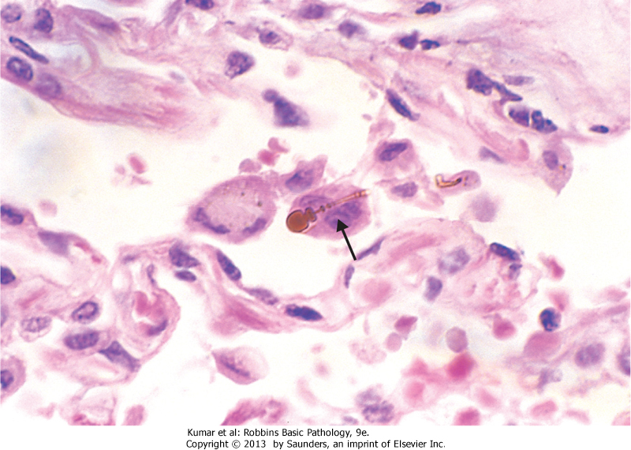
Asbestos body

Slide 31
- Asbestos bodies sometimes can be found in the lungs of normal persons, but usually in much lower concentrations and without an accompanying interstitial fibrosis.:
Note
- In contrast with CWP and silicosis, asbestosis begins in the lower lobes and subpleurally
- Contraction of the fibrous tissue distorts the normal architecture,

Slide 32
- Simultaneously, fibrosis develops in the visceral pleura, causing adhesions between the lungs and the chest wall.
- The scarring may narrow pulmonary arterie causing pulmonary hypertension and cor pulmonale
2. Pleural plaques :
- Are the most common manifestation of asbestos exposure
- Are well-circumscribed plaques of dense collagen , often containing calcium.

Slide 33
- They develop most frequently on the anterior and posterolateral aspects of the parietal pleura and do not contain asbestos bodies, and rarely do they occur in persons with no history or evidence of asbestos exposure.
3. Uncommonly, asbestos exposure induces pleural effusion or diffuse pleural fibrosis

Slide 34
Clinical Manifestations
- Progressively worsening dyspnea appears 10 to 20 years after exposure which is usually accompanied by a cough associated with production of sputum.
- The disease may remain static or progress to congestive heart failure, and death.
- Pleural plaques are usually asymptomatic and are detected on radiographs as circumscribed densities.

Slide 35
Note
- Both lung carcinoma and malignant mesothelioma develop in workers exposed to asbestos.
- The risk of lung carcinoma is increased about five-fold for asbestos workers; and the relative risk for mesothelioma, normally a very rare tumor (2 to 17 cases per 1 million persons), is more than 1000 times greater.

Slide 36
- Concomitant cigarette smoking greatly increases the risk of lung carcinoma but not that of mesothelioma and .

