Slide 1
Eating disorders
DSM 5

Slide 2
What are eating disorders?
People with eating disorders often use food and the control of food in an attempt to compensate for feelings and emotions that may otherwise seem over-whelming.
It is an unhealthy way to cope with painful emotions and to feel in control of one’s life
Affect 10% of young women & 1% of the affected are male
Most vulnerable age 12 -30

Slide 3
Eating Disorders
Disorders are characterized by a persistent disturbance of eating or eating-related behavior that results in the altered consumption or absorption of food and that significantly impairs physical health or psychosocial functioning

Slide 4
Eating Disorders
Pica
Rumination disorder
Avoidant/Restrictive food intake disorder
Anorexia nervosa
Bulimia nervosa
Binge-eating disorder

Slide 5
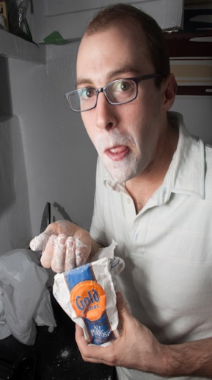
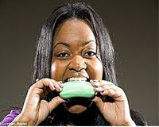
Pica
A. Persistent eating of nonnutritive, nonfood substances over a period of at least 1 month.
  Typical substances ingested vary with age and availability
  Includes paper, soap, cloth, hair, string, wool, soil, chalk, talcum powder, paint, gum, metal, ash, clay, or ice.
B. The eating of nonnutritive, nonfood substances is inappropriate to the developmental level of the individual.

Slide 6
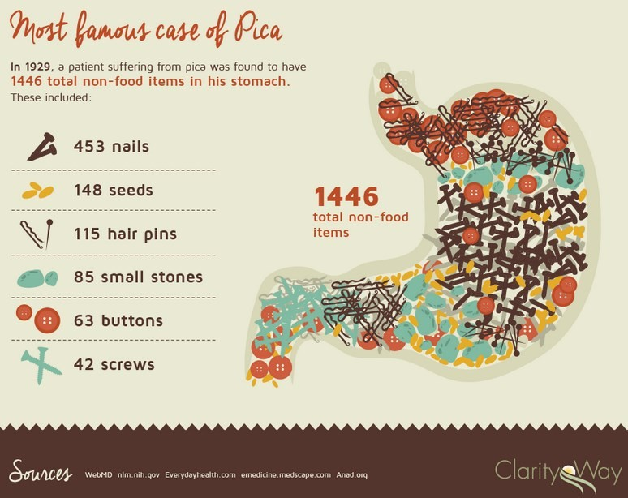

Slide 7
Pica
C. The eating behavior is not part of a culturally supported or socially normative practice.
D. If the eating behavior occurs in the context of another mental disorder (e.g., intellectual disability [intellectual developmental disorder], autism spectrum disorder, schizophrenia) or medical condition (including pregnancy), it is sufficiently severe to warrant additional clinical attention.

Slide 8
Pica: Associated features
Pica comes to clinical attention only following general medical complications example:
Mechanical bowel problems
Intestinal obstruction
Intestinal perforation
Infections such as toxoplasmosis (protozoan) and toxocariasis (worm) as a result of ingesting feces or dirt
Poisoning, such as by ingestion of lead-based paint

Slide 10
Rumination
A. Repeated regurgitation of food over a period of at least 1 month. Regurgitated food may be re-chewed, re-swallowed, or spit out.
B. The repeated regurgitation is not attributable to an associated gastrointestinal or other medical condition (e.g., gastro-esophageal reflux, pyloric stenoses).

Slide 11
C. The eating disturbance does not occur exclusively during the course of other eating disorders
D. If the symptoms occur in the context of another mental disorder (e.g., intellectual disability [Intellectual developmental disorder] or another neuro-developmental disorder), they are sufficiently severe to warrant additional clinical attention.

Slide 12

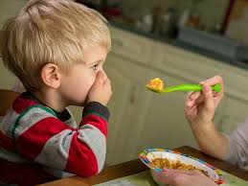
Avoidant / Restrictive food intake disorder

Slide 13
Avoidant / Restrictive food intake disorder
A. An eating or feeding disturbance e.g.,
  Apparent lack of interest in eating or food
  Avoidance based on the sensory characteristics of food
  Concern about aversive consequences of eating
  These behaviors lead persistent failure to meet appropriate nutritional and/or energy needs associated with one (or more) of the following:
Significant weight loss (or failure to achieve expected weight gain or faltering growth in children).
Significant nutritional deficiency.
Dependence on internal feeding or oral nutritional supplements.
Marked interference with psychosocial functioning.

Slide 14
Avoidant / Restrictive food intake disorder
B. The disturbance is explained by lack of available food or by an associated culturally sanctioned practice.
C. The eating disturbance does not occur exclusively during the course of any other eating disorder
D. Exclude any concurrent medical condition or another mental disorder.

Slide 15
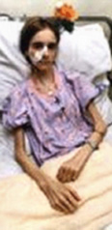
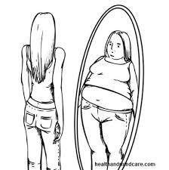
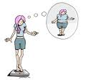
Anorexia Nervosa

Slide 16
Anorexia Nervosa
A. Restriction of energy intake relative to requirements, leading to a significantly low body Weight in the context of age, sex, developmental trajectory, and physical health.
B. Intense fear of gaining weight or of becoming fat, or persistent behavior that interferes with weight gain, even though at a significantly low weight.
C. Disturbance in the way in which one’s body weight or shape is experienced, undue influence of body weight or shape on self-evaluation, or persistent lack of recognition of the seriousness of the current low body weight.

Slide 17
Anorexia Nervosa
Restricting type: During the last 3 months, the individual has not engaged in recurrent episodes of binge eating or purging behavior (i.e., self-induced vomiting or the misuse of laxatives, diuretics, or enemas). Weight loss is done through dieting, fasting, and/or excessive exercise.
Binge-eating/purging type: During the last 3 months, the individual has engaged in recurrent episodes of binge eating or purging behavior (i.e., self-induced vomiting or the misuse of laxatives, diuretics, or enemas).

Slide 18
Anorexia Nervosa
Specify current severity: (according to WHO measurement)
  Mild: BMI>17kg/m2
  Moderate: BM116-16.99 kg/m^
  Severe: BM115-15.99 kg/m^
  Extreme: BMI < 15 kg/m^

Slide 19
Subtypes Anorexia Nervosa
Most individuals with the binge-eating/purging type of anorexia nervosa who binge eat also purge through self-induced vomiting or the misuse of laxatives, diuretics, or enemas.
Some individuals with this subtype of anorexia nervosa do not binge eat but do regularly purge after the consumption of small amounts of food.
Crossover between the subtypes over the course of the disorder is not uncommon; therefore, subtype description should be used to describe current symptoms rather than longitudinal course.

Slide 20
Anorexia Nervosa
Physiological disturbances, including amenorrhea and vital sign abnormalities, are common.
Physiological disturbances associated with malnutrition are reversible with nutritional rehabilitation, some, loss of bone mineral density, are often not completely reversible.
Some clients might show lab result changes others might not show any change

Slide 21
Anorexia: Associated features
Depressive features increase risk for suicide
OCD features
Other features sometimes associated with anorexia nervosa include concerns about:
Feelings of ineffectiveness,
Strong desire to control one's environment,
Limited social spontaneity,
overly restrained emotional expression.

Slide 22
Other features of the disorder
Thinks continuously about food.
Refusal to eat with family or in public places.
Exhibit peculiar behaviours around food such as:
  Collect food not eaten.
  Carry food in pocket.
  Dispose food in different places.
  When eating cuts food into small pieces.
  If confronted with their behaviours they will deny it.

Slide 23
Other features of the disorder
Exhibit peculiar behaviours around food such as:
  Drinks full glass of ice water (with lemon, optional) and consume it before meals.
  Develops a specific pattern of eating such as eats a bit puts the spoon down and then drinks water wait for a while then eats a bite and carry the same pattern tell finishing the meal
  Avoid all breaded or battered items, fried items, sauted items, breads, pasta, rice, sweet drinks, and of course, desserts.
  Decrease carbohydrate and decrease fat in food

Slide 24
Excuses for not participating in eating in social gatherings?
"Oh, thank you, but I already ate at work (school, friend's house, on your way home, etc. wherever you just came from)."
"Well, I haven't really been feeling well today. My stomach is kind of queasy; maybe I'll just have some hot tea and see if it settles for now."
“Oh, I've got a massive headache -- I'll just take a big glass of water and an aspirin if you don't mind ..."
"Well, I had a really HUGE breakfast (lunch, snack, whatever) and I'm still full from that ... maybe later."

Slide 25
Other features of the disorder
Difficulty in developing trust relationships
Rigid and inflexible thinking
Dichotomous thinking.
Body image disturbances.
Low self esteem that is raised by controlling weight.
High achievement in academic Jobs during periods of anorexia.
Concerned about achieving perfection and avoiding self indulgence.
Equate weight gain with being bad or out of control.
Some report childhood sexual abuse.

Slide 26
Other features of the disorder
Hospitalized when body weight becomes less than 70% of normal body weight.
Excessive exercise and increase movement.
Denial of seriousness of low body weight.
Excessive fear ( phobia ) from gaining weight

Slide 27
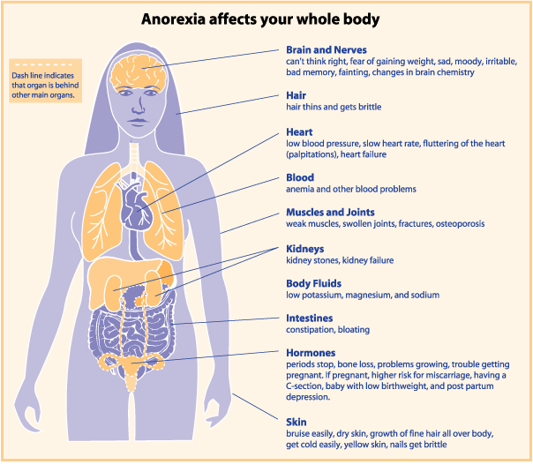

Slide 28
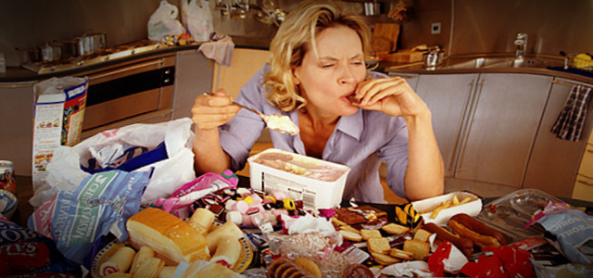
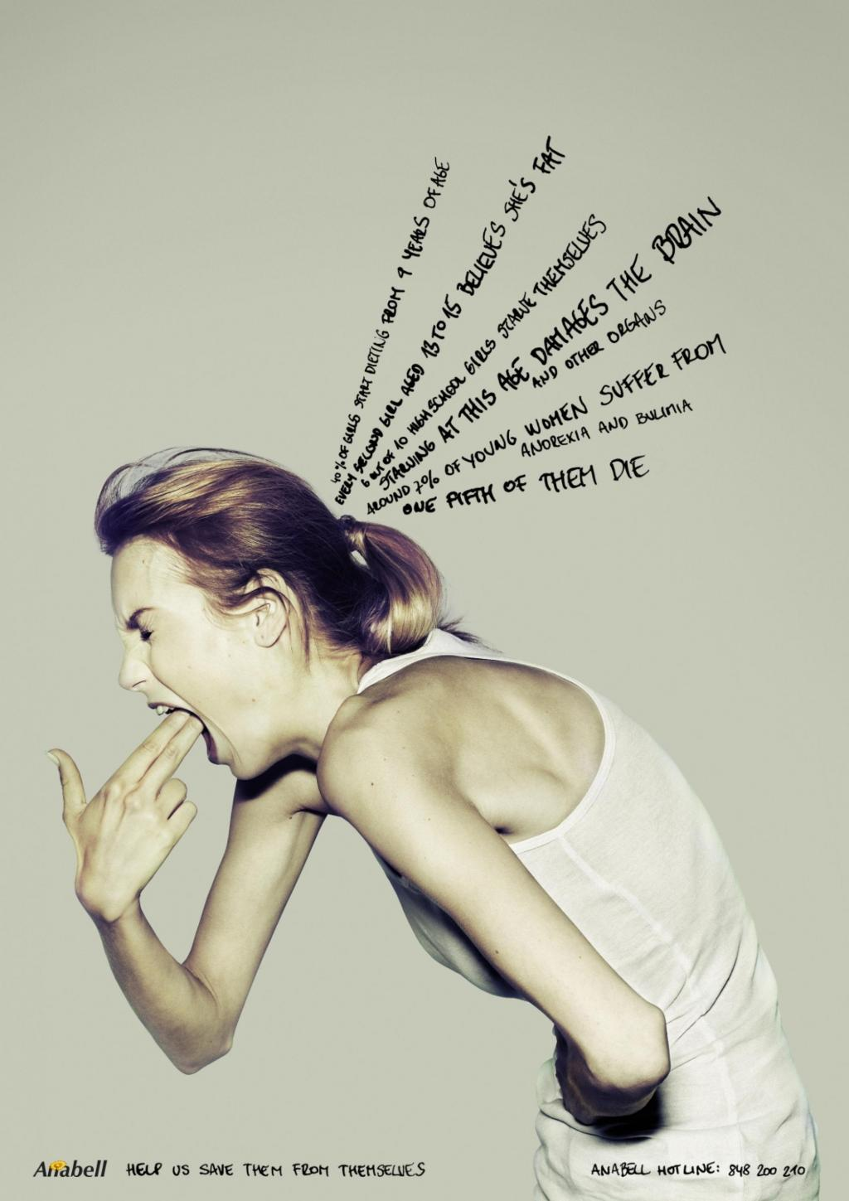
Bulimia Nervosa

Slide 29
Bulimia Nervosa
A. Recurrent episode of binge eating.
  Eating a very large amount of food that can not be eaten by most people and during a certain time (2 hour period)
  A sense of lack of control over eating during the episode
B. Recurrent inappropriate compensatory behaviors in order to prevent weight gain, such as self-induced vomiting; misuse of laxatives, diuretics, or other medications; fasting; or excessive exercise.

Slide 30
Bulimia Nervosa
C. The binge eating and inappropriate compensatory behaviors both occur, on average, at least once a week for 3 months.
D. Self-evaluation is unduly influenced by body shape and weight.
E. The disturbance does not occur exclusively during episodes of anorexia nervosa.

Slide 31
Bulimia: Level of severity
The minimum level of severity is based on the frequency of inappropriate compensatory behaviors
Mild: An average of 1-3 episodes of inappropriate compensatory behaviors per week.
Moderate: An average of 4-7 episodes of inappropriate compensatory behaviors per week.
Severe: An average of 8-13 episodes of inappropriate compensatory behaviors per week.
Extreme: An average of 14 or more episodes of inappropriate compensatory behaviors per week.

Slide 32
Bulimia: Level of severity
Individuals with bulimia nervosa typically are within the normal weight or overweight range (body mass index [BMI] > 18.5 and < 30 in adults).
The disorder occurs but is uncommon among obese individuals.
Between eating binges, individuals with bulimia nervosa typically restrict their total caloric Consumption and preferentially select low-calorie ("diet") foods while avoiding foods that they perceive to be fattening or likely to trigger a binge

Slide 33
Associated physical changes
Menstrual irregularity
Electrolyte imbalance
Esophageal tears
Gastric rupture
Cardiac arrhythmias.
Individuals who chronically abuse laxatives may become dependent on their use to stimulate bowel movements.
Gastrointestinal symptoms are common
Rectal prolapse has also been reported among individuals with this
Suicidal

Slide 35
What factors contribute to the occurrence of eating disorders?
Disordered eating is NOT just about food and diets…
Can you list the other factors that play a role in the development or continuation of disordered eating behaviors?

Slide 36
Factors
Psychological factors:
  Low self-esteem
  Feelings of inadequacy or lack of control in life
  Depression, anxiety, anger, or loneliness
Interpersonal Factors
  Troubled family and personal relationships
  Difficulty expressing emotions and feelings
  History of being teased or ridiculed based on size or weight
  History of physical or sexual abuse

Slide 37
Factors
Social Factors:
  Cultural pressures that stress on being "thin" and place value on obtaining the "perfect body" (media affects)
  Cultural norms that value people on the basis of physical appearance and not inner qualities and strengths

Slide 38
Factors
Biological:
  Genetic 56% of the cases
  Chromosome 1, 2, & 13
Neuro-endocrine:
  Hypothalamus dysfunction associated with serotonin and nor-epinephrine
  Increased cerebrospinal fluid cortesol & possible impairment & dopaminergic regulation

Slide 39
Factors
Family:
  Conflict avoidance
    The child becomes the problem not the marital conflict
  Elements of control & power
    Passive father- dominant mother
    Value & push for perfectionism
    Parental criticism lead to the child feeling helpless (adolescent)

