Slide 1
Hydraulic Pumps

Slide 2
Midterm Exam
Wednesday 3 April, 2013

Slide 3
Introduction
A pump converts mechanical energy into hydraulic energy. The mechanical energy is delivered to the pump via a prime mover such as an electric motor. The energy is used to increase the pressure of the fluid passing through the pump, allowing it to overcome frictional losses and other loads in the circuit.
There are two broad classifications of pumps:
  Positive Displacement Pumps
  Dynamic Pumps
Hydraulic Cylinder
F x v
V x I
Electric Motor
T x ω
Hydraulic Pump
P x Q
Hydraulic Motor
T x ω

Slide 4
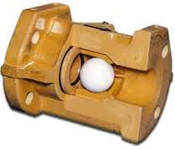
Positive Displacement Pumps
A positive displacement pump increases the pressure of the fluid by trapping a fixed amount of it into a cavity then reducing the volume of the cavity be mechanical means. As the volume of the fluid inside the cavity is reduced, its pressure is increased, allowing it to be forced against the higher pressure in the pipe

Slide 5
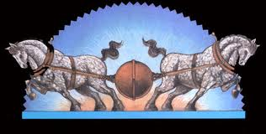

Slide 6
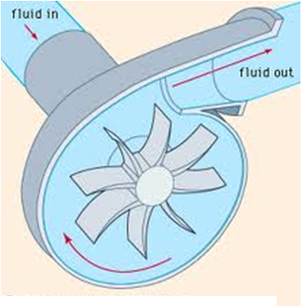
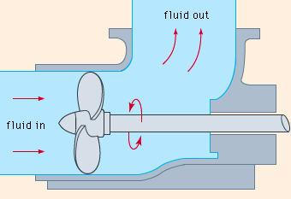
Dynamic Pumps
In dynamic pumps, kinetic energy is added to the fluid by increasing its velocity. This increase in energy is then converted to a gain in potential energy (pressure) when the velocity is reduced as the flow exits the pump into an expanding discharge pipe. According to Bernoulli principle, a reduction in flow velocity is accompanied by an increase in its pressure.
Dynamic pumps are generally used for low pressure, high volume applications. Because they are not capable of withstanding high pressure, they are of little use in the fluid power field. This type of pump is primarily used for transporting fluids in pipeline. The two most common types are centrifugal and axial flow propeller pumps.
Centrifugal pump
Axial Flow pump

Slide 7
Advantages of Positive Displacement Pumps for Fluid Power Applications
Positive displacement pumps eject a fixed amount of fluid into the hydraulic system per revolution of pump shaft rotation.
For fluid power applications, positive displacement pumps have the following advantages over dynamic pumps:
  High-pressure capability (up to 80,000 kPa) (800 kgf/square cm)
  Small, compact size
  High volumetric efficiency
  Small changes in efficiency throughout the design pressure range.
  Can operate over a wide range of pressure requirements and speed ranges
1 square cm
cylinder

Slide 8
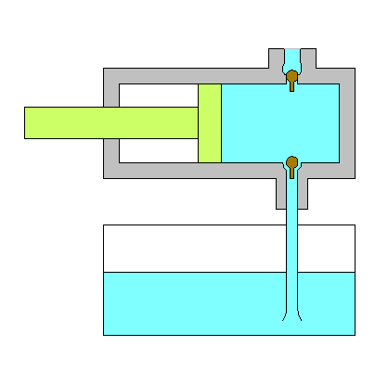
Piston Pump Operation
Each of the check valves opens when the pressure of the fluid below the ball is slightly higher than the pressure of the fluid above it. Otherwise, it remains closed. Check valves allow the flow to move in one direction only, upwards in this case.
Piston move in a reciprocating motion
Suction
Atmospheric Pressure
TANK

Slide 9
Piston Pump Operation
Piston movement to the left creates a partial vacuum in the pump cavity, causing check valve 2 to close and check valve 1 to open. This allows atmospheric pressure to push the fluid out of the oil tank and into the pump cavity through the inlet line. Flow continues as long as the piston is moving to the left
When the piston stops at the end of the stroke, pressure in the cavity increases, causing check valve 1 to close. This pressure may not be sufficient to open valve 2, though.
High Pressure Outlet
Suction
Atmospheric pressure
TANK

Slide 10
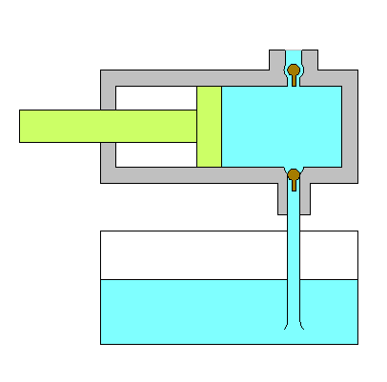
Piston Pump Operation
When the piston starts moving to the right, the pressure in the pump cavity rises sharply, opening valve 2 and tightly closing valve 1. The quantity of fluid displaced by the piston is forcibly ejected out of the discharge line leading to the hydraulic system.
The volume of fluid displaced by the piston during the discharge stroke is called the displacement volume of the pump
High Pressure Outlet
Compression
Atmospheric Pressure
TANK

Slide 11
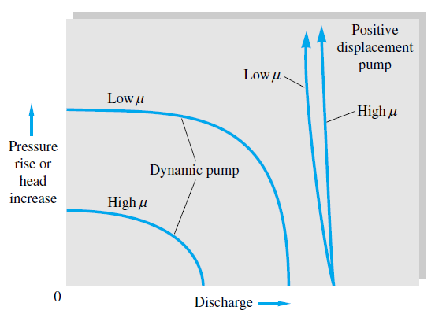
Dynamic Pumps
The two most common types of dynamic pumps are the centrifugal and the axial (propeller) pumps
These pump types provide continuous non-pulsating flow, but their flow output is reduced dramatically as circuit resistance is increased. The pump will produce no flow at high pressure head.
The pressure at which produces no flow is called the shutoff head or the shutoff pressure. It is the maximum pressure that can be delivered by the pump.
Centrifugal pump
Axial Flow pump

Slide 12
Dynamic Pumps
They are not suitable for handling viscous fluids, and thus are not suitable for use in hydraulic applications.
Dynamic pumps are typically used for low pressure, high volume flow applications.
Unlike positive displacement pumps, dynamic pumps are not self priming. This is because large clearance between the rotating part and the stationary housing does not allow a suction pressure to occur at the inlet port when the pump is turned on.
Centrifugal pump
Axial Flow pump

Slide 13
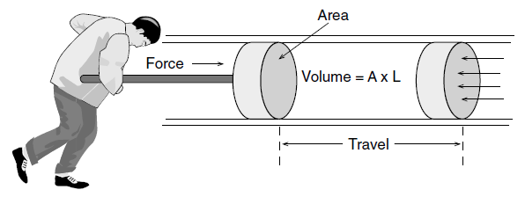
Positive Displacement Pumps
There are three main types of positive displacement pumps: gear, vane and piston. Because of tight sealing design, these pumps eject a fixed quantity of fluid per revolution of the pump shaft.
Pump flow is almost constant and not dependent on system pressure. Their ability to produce large amounts of pressure without loosing their efficiency makes them well suited for fluid power systems.

Slide 14
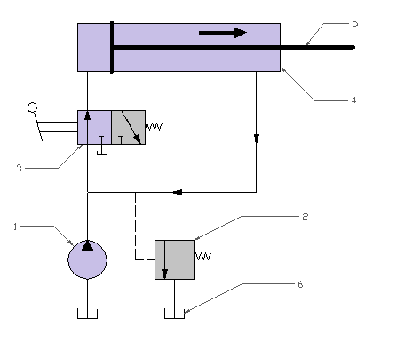
Positive Displacement Pumps
Positive displacement pumps must be protected against overpressure if the flow resistance becomes very large. A pressure relief valve is used to protect the pump against overpressure by diverting pump flow back into the hydraulic oil tank.

Slide 15
Positive Displacement Pumps
Positive displacement pumps can be classified by the type of mechanical motion of its internal elements that produces the volume change in the liquid. The motion may be reciprocating or rotary. There are essentially three basic types:
  1. Gear Pumps
    External gear pumps
    Internal gear pumps
    Lobe pumps
    Screw Pumps
  2. Vane Pumps
    Unbalanced Vane Pump (Fixed or variable displacement)
    Balanced Vane Pump (Fixed Displacement Only)
  3. Piston Pumps
    Axial Design
    Radial Design

Slide 16
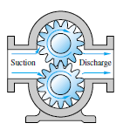
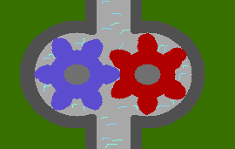
Gear Pump: External Gear Pumps
Develop flow by carrying fluid between the teeth of two meshing gears. One of the gears is connected to the drive shaft, the other is driven as its meshes with the driver gear.
Oil chambers are formed between the gear teeth, the pump housing and the side wear plates.
The suction side is where teeth come out of mesh, and this is where the volume expands, bringing about a reduction in pressure.
The discharge side is where teeth go into mesh, and this is where the volume decreases between mating teeth. Oil is positively ejected into the outlet port since the pump has an internal seal against leakage.

Slide 17
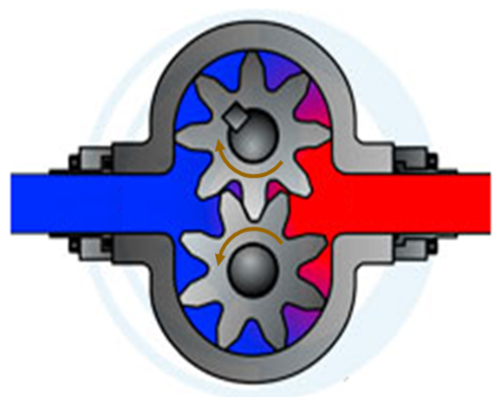
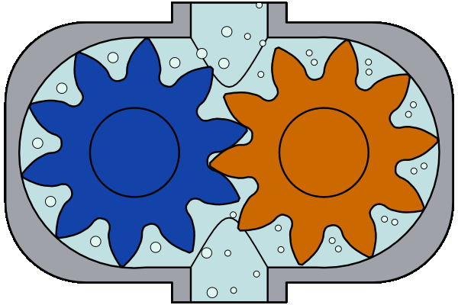
Gear Pump: Volumetric Displacement and Theoretical Flow Rate
The volumetric displacement, V_{D} of a gear pump may be defined as the theoretical volume of fluid displaced per one rotation of the gear.
If the theoretical displacement is known, the theoretical volume flow rate, Q_{T} , may be related to the pump speed, N, using the relation:

Slide 18
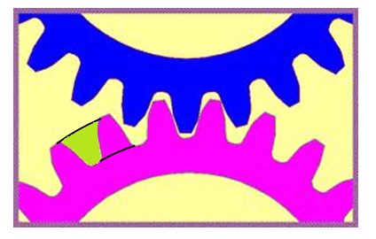
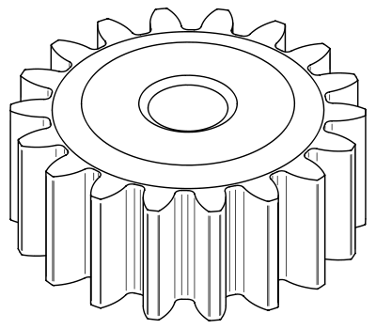
Gear Pump: Volumetric Displacement and Theoretical Flow Rate
The volumetric displacement, V_{D} is given by:

Slide 19
Gear Pump: Volumetric Displacement and Theoretical Flow Rate
Q
P
Internal Loss
Actual Flow Curve
Theoretical Flow Curve
N
Q

Slide 20
Gear Pump: Volumetric Efficiency
Because of the small clearance (about 20 µm) between the teeth tip and pump housing, some of the oil at the at the discharge port can leak directly back toward the suction port. This means that the actual flow rate is Q_{A} is less than the theoretical flow rate Q_{T}.
The internal leakage, also called pump slippage is quantified by the term volumetric efficiency, η_{v} .
P
Internal Loss
Actual Flow Curve
Theoretical Flow Curve
Q

Slide 21
Gear Pump: Volumetric Efficiency
The volumetric efficiency for positive displacement pumps operating at design pressure is usually about 90%. It drops rapidly if the pump is operated above its design pressure because pressure increases the clearances though which leakage takes place.
Pump manufacturers usually specify the volumetric efficiency at the pump rated pressure, which is the design pressure at which the pump may operate without causing mechanical damage to the pump, and does not produce excessive leakage.
P
Internal Loss
Theoretical Flow Curve
Actual Flow Curve
Q

Slide 22
Gear Pump: Volumetric Efficiency
Operating the pump above its rated pressure produces excessive leakage and can damage the pump by distorting the casing and overloading the shaft bearing.

Slide 23
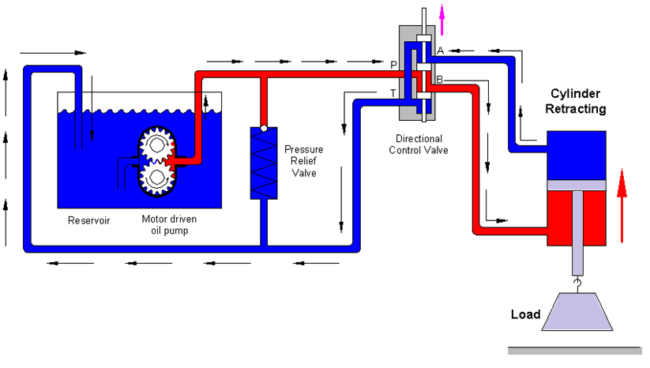
Gear Pump: Volumetric Efficiency
Pump operation above its rated pressure could occur when a high resistance to flow is encountered. This could result from a large actuator load or a closed (blocked) valve in the pump outlet line.

Slide 25
Gear Pump: Volumetric Efficiency
Positive displacement pumps are usually protected from high pressure by diverting pump flow to the oil tank through a pressure relief valve.

Slide 26
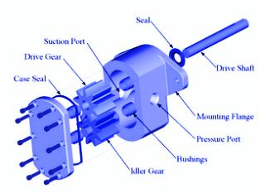
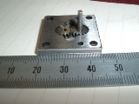
Example Gear Pump: Mizuhata Miniature Gear Pump
Dimensions: 25 x 25 x 10 mm
Used as a lubrication pump to drive oil for lubricating machine tools.
Flow rate of 3 ml/min with pump speed of 1750 to 3450 rpm
Can accommodate fluids of varying viscosity (32-1300mm2/s)
Low to medium pressure head (2500-4000 psi) ~ (15,000 – 25,000 kPa).

Slide 27
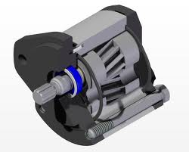
Gear Pump: Helical and Herringbone Gear
Gear pumps utilizing spur gear teeth design could develop severe vibrations and noise at high pump speeds due to sudden teeth contact in spur gears.
To reduce noise and produce smoother operation, helical gears are sometimes employed. Helical gears, however, are limited to low pressure applications (below 1500 kPa) because they produce excessive axial thrusts due to the action of the helical gear.

Slide 28
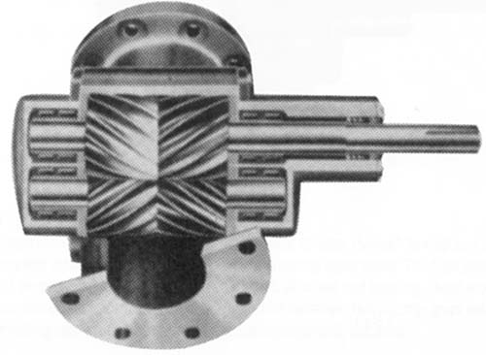
Gear Pump: Helical and Herringbone Gear
Herringbone gear pumps eliminate end thrust and can be used to develop a pressure up to 3000 psi ~(20,000 kPa).
Herringbone gears consist of two rows of helical teeth cut into one gear. One of the rows of each gear is right handed, while the other is left handed. This arrangement cancels out axial thrust force. Herringbone gear pumps operate as smoothly as helical gear pumps, and provide greater flow rates, because they could be run at higher speeds. They also produce less pulsating action because of the higher speeds.

Slide 29
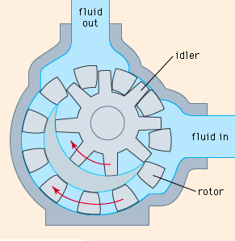
Internal Gear Pump
The internal spur gear drives the outside ring gear which is set off center. Between the two gears on one side is a crescent-shaped spacer around which oil is carried.
The inlet and outlet ports are located in the end plates between where the teeth mesh and the ends of the crescent-shaped spacer.

Slide 30
Internal Gear Pump
In operation, the internal gear drives the external ring gear and makes a fluid tight seal at the place where the teeth mesh.
Rotation causes the teeth to unmesh near the inlet port, the cavity volume to increase, and suction to occur. Oil is trapped between the internal and external gear teeth on both sides of the crescent-shaped spacer and is carried from the inlet to the outlet cavity of the pump. Meshing of the gear teeth reduces the volume in the high pressure cavity near the outlet port and fluid exits from the outlet port.
Wear on internal gear pumps has a tendency to reduce the volumetric efficiency more quickly than on external gear pumps. They are used mostly for lubrication and charge pumps at pressures under 1000 psi.

Slide 31
Internal Gear Pump
The internal gear drives the external ring gear and makes a fluid tight seal at the place where the teeth mesh.
Rotation causes the teeth to unmesh near the inlet port, the cavity volume to increase, and suction to occur. Oil is trapped between the internal and external gear teeth on both sides of the crescent-shaped spacer and is carried from the inlet to the outlet cavity of the pump. Meshing of the gear teeth reduces the volume in

Slide 32
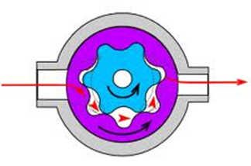
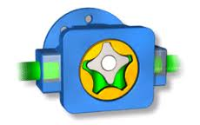
Gerotor Pump
This pump operates very much like the internal gear pump. The inner gear rotor (gerotor) is power driven and draws the outer gear rotor around as they mesh together.
The tips of the inner and outer rotors make contact to seal the pumping chambers from each other.
The inner gear has one tooth less than the outer gear, and the volumetric displacement is determined by the space formed by the extra tooth in the outer rotor.
The gerotor pump is a compact and simple pump with only two moving elements.

Slide 33
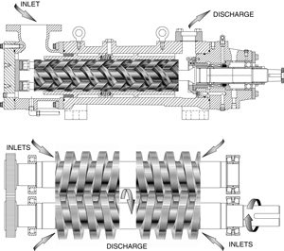
Screw Pump
In a screw pump, three precision ground screws meshing within a close fitting housing deliver non pulsating flow quietly and efficiently.
The screw pump is an axial flow positive displacement unit. The two symmetrically opposed idler rotors act as rotating seals, confining the fluid in a succession of closures or stages.

Slide 34
Screw Pump
The idler rotors are in a rolling contact with the central power rotor, and are free to float in their respective housing bores in a hydrodynamic oil film.
There are no radial bending loads on the rotor set, and axial hydraulic forces are balanced, which eliminates the need for a thrust bearing

Slide 35
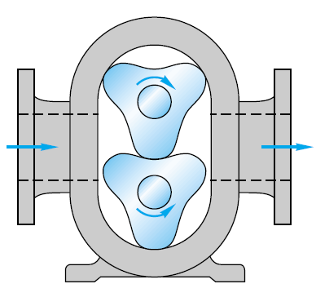
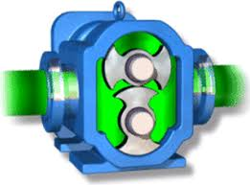
Lobe Pump
This pump operates in a fashion similar to the external gear pump. But unlike the external gear pump, both lobes are driven externally and they do not actually contact one another. They are therefore quieter in operation than other types of gear pumps.
Due to the smaller number of mating elements, lobe pumps have a higher volumetric displacement than other types of gear pumps of the same size and speed. They will, however, produce a higher amount of pulsation.

Slide 36
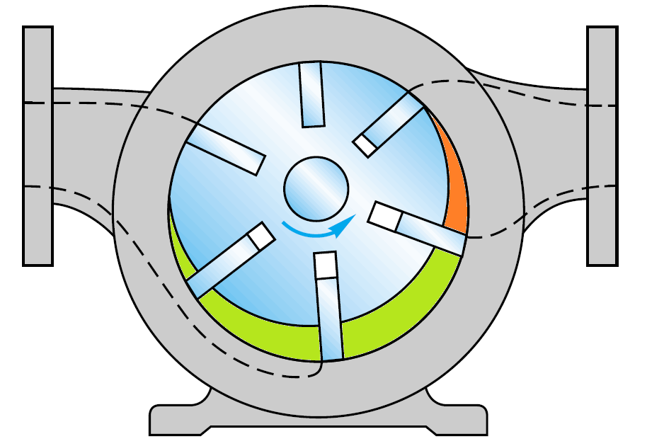
Vane Pump

Slide 37
Vane Pump
The rotor contains radial slots and is splined to the drive shaft. The rotor rotates inside a cam ring. Each slot contains a vane designed to mate with the surface of the cam ring as the rotor turns.
Centrifugal forces keep the vanes in contact with the cam ring. During rotation, the volume increases between the rotor and the cam ring near the inlet and decreases near the outlet. This causes a continuous suction and ejection of the fluid from the inlet port to the discharge port.

Slide 38
Vane Pump: Volumetric Displacement
The maximum volumetric displacement of the pump is the volume between the rotor and the cam ring when the eccentricity is maximum

Slide 39
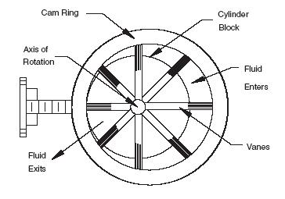
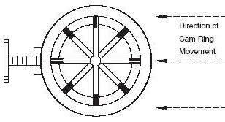
Vane Pump: Volumetric Displacement
If the eccentricity is less than the maximum, the theoretical volumetric displacement is
Some vane pumps have provision for mechanically varying the eccentricity. Those pumps are called variable displacement pumps. A handwheel, or a pressure compensator can be used to move the cam ring to change the eccentricity. The direction of flow through the pump can be reversed by movement of the cam ring on either side of center.

Slide 40
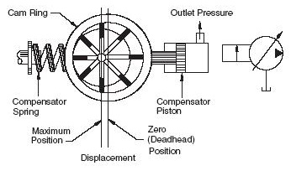
Pressure Compensated Vane Pump
In a pressure compensated vane pump, system pressure acts directly on the cam ring via a hydraulic piston on the right side as shown. This forces the cam ring against the compensator spring-loaded piston on the left side of the cam ring.

Slide 41
Pressure Compensated Vane Pump
If the discharge pressure is large enough, it overcomes the compensator spring force, and shifts the cam ring to the left, reducing the eccentricity. If the discharge pressure continues to increase, zero eccentricity is finally achieved, and the pump flow becomes zero. Such a pump has its built-in protection against pressure buildup.

Slide 42
Flow –Rate Pressure Curve of a Pressure Compensated Vane Pump
P
Slope determined by stiffness of compensator spring
P_{deadhead}
P_{cutoff}
Q
e = 0
e = e_{max}

Slide 43
Pressure Compensated Vane Pump
The pressure at which the hydraulic force piston force is equal to the compensator spring force is called the cutoff pressure, P_{cutoff}. The eccentricity is below its maximum value at a pressure above P_{cutoff}.
The pressure at which the eccentricity is zero is called the dead head pressure, P_{deadhead.} At dead head pressure, no pumping occurs, no power is wasted, and fluid heating is reduced.
P
Slope determined by stiffness of compensator spring
P_{deadhead}
P_{cutoff}
P-Q Curve of a pressure compensated vane pump
Q
e = 0
e = e_{max}

Slide 44

Balanced Vane Pump
A side load is exerted on the bearing of a vane pump because of pressure unbalance. This undesirable side load is also present in gear pumps. These pumps are hydraulically unbalanced.

Slide 45
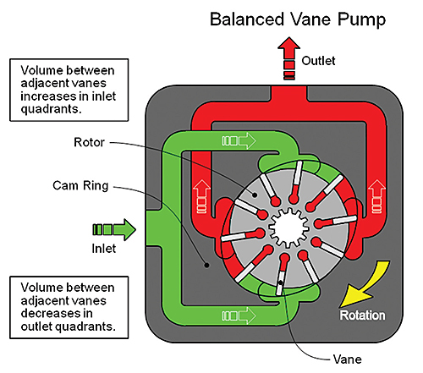
Balanced Vane Pump

Slide 46
Balanced Vane Pump
A balanced vane pump is one which has two intakes and two outlets diametrically opposite each other.
This produces complete hydraulic balance and minimum side load is exerted on the bearings. This permits the pump to operate at a higher pressure.

Slide 47
Balanced Vane Pump
Instead of the circular cam ring, a balanced design vane pump has an elliptic housing, which forms two separate pumping chambers on opposite sides of the rotor.
One disadvantage of a balanced vane pumps is that it can not be designed as a variable displacement unit.

Slide 48
Piston Pump Types
A piston pump works on the principle that a reciprocating piston can draw in fluid when it extends out of a cylinder bore, and discharges it when it retracts into the bore. This principle can be applied to pump fluid, but the resulting flow will suffer from large pulsations.
In order to reduce pulsations, a series of reciprocating piston pumps working with a time shift between them need to be utilized.
Suction
Compression

Slide 49
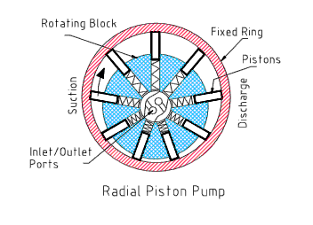
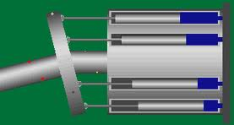
Piston Pump Types
There are two mechanical arrangements which allows a set of pump to work with a time shift between them. The axial piston pump, and the radial piston pump.

Slide 50
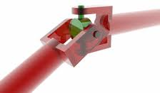

Axial Piston Pump (Bent Axis Pump)
In this pump, the pistons are at an angle to the drive shaft and Thrust Plate. The piston block shaft is connected to the drive shaft by a universal joint. The drive shaft, thrust plate, piston block shaft, and piston block all revolve.
The connecting rods are attached to the thrust plate and revolve with it. The outlet ports are semi-circular holes in the Valve Plate, shown on the far right of the animation on edge and in a head-on view below, right.
As the pump revolves, half the pistons suck in fluid as they pass over the intake port. The other pistons discharge their fluid through the outlet port.

Slide 51
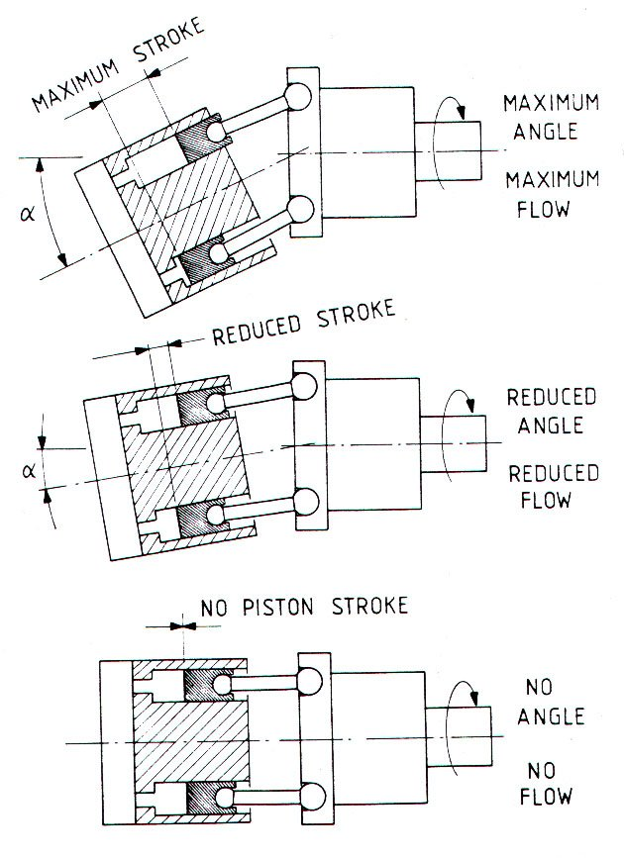
Axial Piston Pump (Bent Axis Pump)
The volumetric displacement of the pump varies with the offset angle, α.
No flow is produced when the cylinder block centerline is parallel to the drive shaft centerline, (α = 0)
The offset angle can vary between 0⁰ to a maximum of about 30⁰. Fixed displacement units are usually provided with 23⁰ or 30⁰ offset angle.

Slide 52
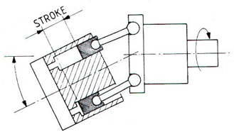
Volumetric Displacement and Theoretical Flow Rate
α
α

Slide 53
Radial Piston Types
The working pistons extend in a radial direction symmetrically around the drive shaft, in contrast to the axial piston pump.
The stroke of each piston is caused by a rotating block which houses the pistons. The pistons are held against a fixed ring which is placed eccentrically to the rotating block. The pistons are held against the ring by centrifugal force or by a set of springs.
The inlet and outlet ports are placed in the center cavity in the rotating block. The placement is dependent on the direction of eccentricity between the rotor and the ring. In the figure shown, the inlet port is placed in the upper part where suction takes place, and the outlet port in the lower part, where compression takes place.

Slide 54
Volumetric Displacement and Theoretical Flow Rate

Slide 55
Pump Performance

Slide 56
Pump Performance
Pump performance is primarily a function of the precision of its manufacture.
This influences both the mechanical efficiency and the volumetric efficiency of the pump.
Suction
Compression

Slide 57
Volumetric Efficiency
Pump Type | η_{v} (%)
Gear Pump | 80 – 90
Vane Pump | 82 – 92
Piston Pump | 90 – 98

Slide 58
Mechanical Efficiency

Slide 59
Overall Efficiency

Slide 60
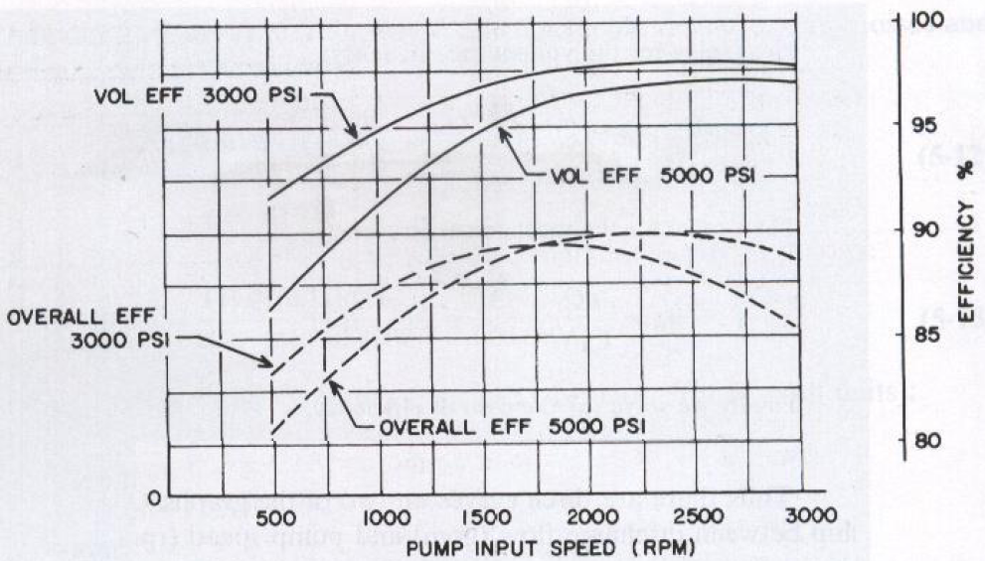
Pump Performance Curves
Pump manufacturers specify pump performance characteristics in the form of graphs. The figure shows typical performance curves for a variable displacement piston pump operating at full displacement.

Slide 61
Pump Performance Curves
The graph shown gives curves of overall and volumetric efficiencies as a function of pump speed (rpm) for pressure heads of 3000 and 5000 psi.

Slide 62
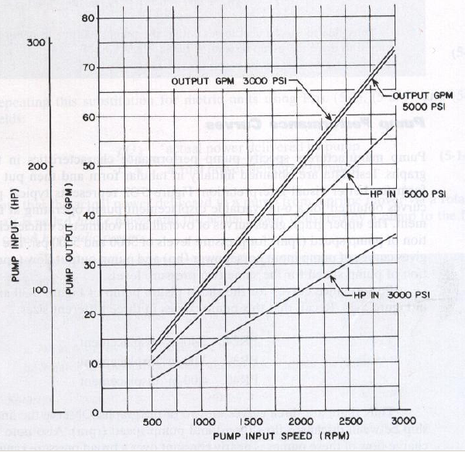
Pump Performance Curves
The graph gives curves of pump input horsepower (hp) and pump output flow (gpm) as a function of pump speed for the same two pressure levels

Slide 63
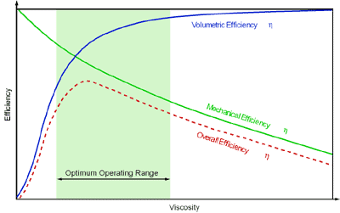
Overall Efficiency

Slide 64
Pump Performance Comparison Factors
Pump Type | Pressure Rating (PSI) | Speed Rating (RPM) | Overall Eff. (%) | HP / LB Ratio | Capacity (GPM) | Cost ($ per HP)
External Gear | 2000 – 3000 | 1200 – 2500 | 80 – 90 | 2 | 1 – 150 | 4 – 8
Internal Gear | 500 – 2000 | 1200 – 2500 | 70 – 85 | 2 | 1 – 200 | 4 – 8
Vane | 1000 – 2000 | 1200 – 1800 | 80 – 95 | 2 | 1 – 80 | 6 – 30
Axial Piston | 2000 – 12,000 | 1200 – 3000 | 90 – 98 | 4 | 1 – 200 | 6 – 50
Radial Piston | 3000 – 12,000 | 1200 – 1800 | 85 – 95 | 4 | 1 – 200 | 5 – 35

Slide 65
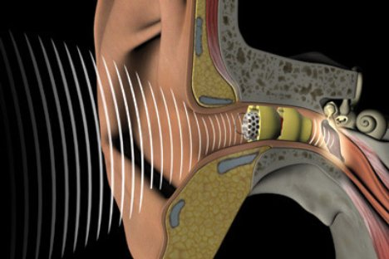
Pump Noise
Prolonged exposure to loud noise can result in loss in hearing. In addition, noise can mask sounds that people want to hear, such as voice communication between people and warning signals emanating from safety equipment.
The sound that people hear come as pressure waves through the surrounding air medium. The pressure waves, which possess an amplitude and frequency, are generated by a vibrating object such as a pump, hydraulic motor, or pipeline.
The human ear receives the sound waves and converts then into electrical signals that are transmitted to the brain. The brain translates these electrical signals into the sensation of sound.

Slide 66
Sound Intensity Levels (dB)
The strength of a sound wave, which depends on the pressure amplitude, is described by its intensity. Intensity is defined as the rate at which sound energy is transmitted through a unit area. As such, intensity is typically represented in units of W/m2. However, it is general practice to express this energy-transfer rate in units of decibels.
Decibels give the relative magnitudes of two intensities by comparing the one under consideration to the intensity of a sound at the threshold of hearing (the weakest intensity that the human can hear). This threshold is typically considered to be 10-12 W/m2

Slide 67
Sound Intensity Levels (dB)
Sound Intensity in decibels (dB) | Significance
0 | Weakest intensity that an average human ear can hear = 10⁻¹² W/m² (Reference sound intensity level)
1 | The smallest change in intensity that can be detected by most people
3 | A dB increase due to the doubling of sound (10 log 2 = 3)
10 | Whisper Also a 10 folds increase in intensity, (10 log 10 = 10)
50 | Moderate sound
90 | OSHA maximum sound level that a person may be exposed to during an 8-hr period in the workplace
100 | Noisy city traffic
>120 | Produces pain and may cause permanent loss of hearing

Slide 68
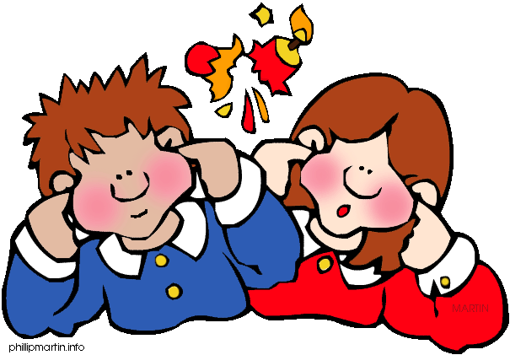
Control of Pump Noise
Noise reduction can be accomplished as follows:
  Source treatment: treat misaligned pump motor/coupling, improperly installed pump/mounting plate, cavitation,i excess pump speed or pressure
  Modify components connected to the primary source of noise, e.g., clamping hydraulic piping at specifically located supports.
  Use sound absorbing material in nearby screens or partitions.

Slide 69
Noise levels for Various Pumps
Pump Type | Noise Level (dB-A)
External Gear | 80 – 100
Internal Gear | 80 – 100
Vane | 65 – 85
Piston | 60 – 80
Screw | 50 – 70

Slide 70
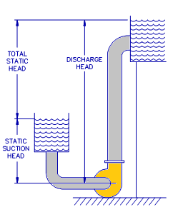
Pump Heads
Suction Head and Discharge Head
Pumps are used to increase the pressure of liquids. Liquid pressure at the inlet of the pump when the pump is not running is called the static suction pressure, and the pressure at the pump’s exit is called the static discharge pressure.
The difference between the static discharge pressure and the static suction pressure is called the total static pressure of the pump.
The term ‘head’ is frequently used as an alternative to pressure, particularly in US standards

Slide 71
Suction Head and Discharge Head
When a pump is used to elevates water from a lower level to a higher level, and installed such that its centerline is at a certain height below the free surface of the inlet tank, this height becomes becomes the static suction head for the pump.
Similarly, the static discharge head is the difference in level between the pump’s centerline and the liquid level at the free surface of the discharge tank .
The total static pressure is the difference in elevation between the free surface of the discharge tank and the inlet tank.

Slide 72
Suction and Discharge Head
During operation, the pressure of the liquid entering into the pump is reduced due to the losses in the piping connecting the supply tank to the pump’s inlet. The head loss is due to the resistance to flow presented by system piping, pipe fittings, and valves in the inlet piping.
For a specific piping section, head loss depends on pipe length pipe diameter and fluid’s velocity. In addition to these parameter, it depends on fluid viscosity for the case of laminar flow, and on fluid density and surface roughness for the turbulent flow.

Slide 73
Suction and Discharge Head
The pressure at the pump’s suction is the static suction head minus the head loss due to piping resistance. It is called the total suction head.
In centrifugal pumps, liquid pressure may be reduced even further as its speed is increased in the narrow passages leading to the impeller of the pump.
Due to the repeated drop in liquid pressure, its pressure inside the casing may become significantly lower than the atmospheric pressure.

Slide 74
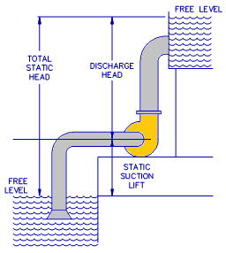
Suction and Discharge Head
A more serious situation occurs if the pump is placed at an elevation above the free surface of the supply tank. In this case, the pressure at the pump inlet is already below atmospheric pressure even when there is no drop due to flow. Suction head is already negative, and is called the static suction lift.
When flow takes place, the resistance of the piping increases the suction lift, and fluid gets into the pump at a an even further reduced pressure.

Slide 75
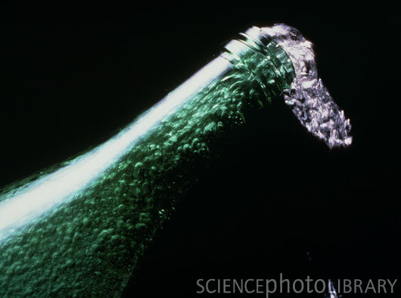
Suction and Discharge Head
In either case, the pressure of the liquid entering the pump may drop below the atmospheric pressure (Total suction head is negative).
When the liquid pressure drops below atmospheric pressure, two things can take place:
    The liquid may reach its boiling pressure at the given temperature, and start to boil.
    Air bubbles can form inside the liquid as the air dissolved in the liquid becomes oversaturated due to the drop in its solubility at the reduced pressure.

Slide 76
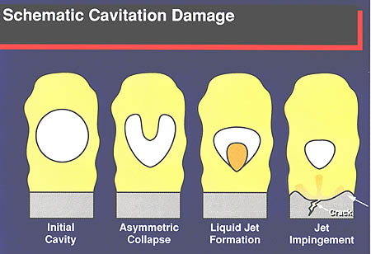
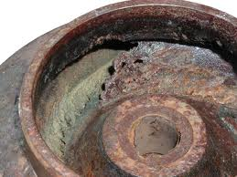
Cavitation
Cavitation is the formation of cavities in the liquid inside the pump. Cavities in the form of air bubbles and vapor bubbles can develop at reduced pressure zones, and they will collapse when they reach a high pressure region inside the casing. Bubble collapse is accompanied with high velocity jet which could hit a solid surface inside the casing with high noise and vibration.
The repeated formation and collapse of the bubbles produces severe impacts which can erode the metallic components of the pump and shorten its life.

Slide 77
Net Positive Suction Head
The difference between the pressure at the pump’s inlet during operation (total suction head) and the liquid’s vapor pressure is called the net positive suction head (NPSH).
To avoid cavitation, the NPSH must be kept above a certain value specified by the pump’s manufacturers. This value is called NPSH required, or (NPSHr)
The NPSH actually present at the suction line must be kept above NPSHr. The actual available NPSH is labeled NPSHa.

Slide 78
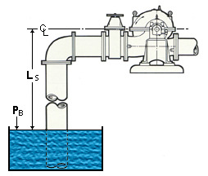
Pump Cavitation
Cavitation is the formation of cavities in the liquid inside the pump. Cavities in the form of air bubbles and vapor bubbles can develop at reduced pressure zones, and will implode when they reach a high pressure zone.
Vapor bubbles form when the liquid boils at a pressure below its vapor pressure at the respective temperature. Air bubbles form when the air dissolved in the liquid becomes oversaturated due to the drop in pressure.

Slide 79
Pump Cavitation
Cavitation occurs when the pump suction lift is excessive such that the inlet pressure falls below the vapor pressure of the fluid. As a result, air or vapor bubbles, which form in the low-pressure inlet region of the pump are collapsed when they reach the high pressure discharge region.
This produces high fluid velocity, noise, vibration and severe impacts which can erode the metallic components of the pump and shorten its life.

Slide 80
Controlling Pump Cavitation
Keep suction line velocities low (below 1.2 m/s)
Keep pump inlets lines as short as possible.
Minimize the number of fittings in the inlet line.
Mount the pump as close as possible to the reservoir.
Use low pressure drop inlet filters of strainers. Use indicating-type filters and strainers so that they can be replaced at proper intervals as they become dirty.

Slide 81
Controlling Pump Cavitation
Use the proper oil as recommended by the pump manufacturer.
Use proper control on oil temperature. Operating oil temperature should be kept in the range of 50°C to 65°C to provide an optimum viscosity range and maximum resistance to liberation of air and the formation of vapor bubbles

Slide 82
Pump Selection
Select the actuator (hydraulic cylinder or motor) that is appropriate to the load encountered.

Slide 83
Pump Selection
Determine the flow rate requirements. This involves calculating the flow rate necessary to drive the actuator to move the load through a specified distance within a given time limit.

Slide 84
Pump Selection
Select the system pressure. This ties in with the actuator size and the magnitude of resistive forces produced by external loads on the system. Also involved here the total amount of power to be delivered by the pump.

Slide 85
Pump Selection
Determine the pump speed and select the prime mover. This together with the flow rate calculation, determines the pump size (volumetric displacement)

Slide 86
Pump Selection
Select the pump type based on the application (gear, vane or piston pump, and fixed or variable displacement)

Slide 87
Pump Selection
Select the reservoir and the associated plumbing, including piping, valving, filters and strainers, and other miscellaneous components.

Slide 88
Pump Selection
Consider factors such as pump noise levels, power loss, need for a heat exchanger due to generated heat, pump wear and scheduled maintenance service to provide a desired life of the total system.

Slide 89
Pump Selection
Calculate the overall cost of the system.

