Slide 1
The University of Jordan
Mechatronics Engineering Department
PLC: Programmable Logical Controller

Slide 2
PLC: Programmable Logical Controller
CONTENTS
1. What is PLC
2. Electrical Ladder Logic Diagrams
3. Software Ladder Logic Diagrams
4. PLC Implementation
5. An example

Slide 3
1. PLC - Introduction
What does PLC stand for?
PLC - programmable logic controller
PLC implements logic control functions by means of a program

Slide 4
1. PLC - Introduction
PLC Features

Slide 5
1. PLC - Introduction
PLC Features

Slide 6
1. PLC - Introduction
PLC application example 1: Gate Control
PLC can sense a vehicle at the entrance or exit, and open and close the gate automatically
The current vehicle count is easily determined by programming a simple counter

Slide 7
1. PLC - Introduction
PLC application example 2: Conveyor System
PLC can be used to start/stop latching logic for motor control
Counters can be used for monitoring product amounts

Slide 8
Other Examples
First-in priority circuit
Entry/exit car park control
Product mass packaging
Daily production record
Water-level monitoring
Automatic liquid-mixing control
Automatic coffee maker
Automatic toilette flushing control system
Food and beverage industry
Textile industry, etc..

Slide 9
1. PLC - Introduction
Comparing traditional and programmable control systems - 1

Slide 10
1. PLC - Introduction
Comparing traditional and programmable control systems - 2
In traditional control, the switches S1, S2 and S3 must close for K1 to be turned on - the wiring makes the rule
In PLC systems, the program is written to perform the logic “when S1 is closed AND S2 is closed AND S3 is closed, THEN turn on K1” - the program makes the rule
It is much simpler to change program than wiring!

Slide 11
1. PLC - Introduction
How does a PLC differ from a computer?
A computer is optimized for calculation and display tasks
A computer is programmed by specialists
A PLC is designed for (logic) control and regulating tasks
A PLC is programmed by non-specialists
A PLC is well adapted to industrial environment

Slide 12
1. PLC - Introduction
Why are PLCs so common?
They are cost-effective
They are flexible, reliable and compact
They have significant advantages over traditional control systems based on relay or pneumatics

Slide 13
1. PLC - Introduction
Where are PLCs used?
In every industry where automation is involved, from individual machines to whole processes

Slide 14
1. PLC - Introduction
What tasks do PLCs perform?
The logic control tasks such as interlocking, sequencing, timing and counting (previously undertaken with relays or pneumatics)
In addition, PLCs can perform a variety of calculation, communication and monitoring tasks

Slide 15
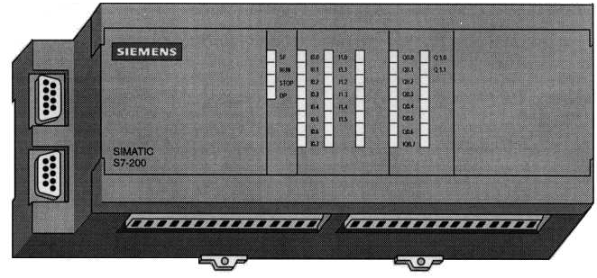
1. PLC - Introduction
PLC Example
Outputs & Power Supply
Communication
Ports (RS-485)
Inputs

Slide 16
1. PLC - Introduction
Structure of a PLC

Slide 17
1. PLC - Introduction
The PLC processor

Slide 18
1. PLC - Introduction
PLC Input/Output Devices

Slide 19
1. PLC - Introduction
PLC Input Devices
Push buttons
Switches (limit switches, level switches, etc.)
Sensors
...

Slide 20
1. PLC - Introduction
PLC Output Devices
Relay contacts
Solenoid valves
Signal devices (such as lamps, alarms, etc.)
Motors
...

Slide 21
1. PLC - Introduction
Programming terminal

Slide 22
1. PLC - Introduction
PLC Programming
Programming is done through programming terminal
Programming terminal translates engineering language (logic control) to machine language (binary code)

Slide 23
1. PLC - Introduction
Programming through standard computer
Most PLC manufacturers offer software packages that allow a standard computer to be used as a programming terminal

Slide 24
1. PLC - Introduction
Programming through standard computer

Slide 25
1. PLC - Introduction
Relating the program to inputs and outputs
The CPU reads the data from the inputs
The program in the CPU uses the inputs to evaluate the control logic. As the program runs, the CPU updates the data
The CPU writes the data to the output

Slide 26
1. PLC - Introduction
Relating the program to inputs and outputs

Slide 27
1. PLC - Introduction
Data Flow in the PLC

Slide 28
1. PLC - Introduction
PLC Programming
One of the advantages of PLC is that it can be programmed by non-specialists
Program can be written either in the form of a
statement list: a set of mnemonic instructions representing a function of the CPU
or a
ladder diagram: a graphical language resembling the electrical relay diagrams

Slide 29
1. PLC - Introduction
Statement List

Slide 30
1. PLC - Introduction
Ladder Diagram

