Slide 1
Chapter 9
The University of Jordan
Mechatronics Engineering Department
Discrete Control Using Programmable Logic Controllers (PLCs) & Personal Computers (PCs)
Dr. Osama Al-Habahbeh

Slide 2
Discrete Control using Programmable Logic Controllers (PLC) & Personal Computers (PCs)
NC & Industrial robotics are mostly concerned with motion control of cutting tool or end effecter .
A more general control category is discrete control.
The two principal industrial discrete controllers are : 1- PLCs 2- PCs

Slide 3
9.1 Discrete Process Control
It deals with discrete parameters & variables , which are typically binary (1 or 0)→ ON or OFF ,True or false , object present or not present , high voltage or low voltage ….etc .
Input signals to the controller are generated by binary sensors ,such as limit switches or photosensors.
Output signals are generated by the controller as a function of time to operate binary actuators (values, motors, switches, etc….

Slide 4
9.1 Discrete Process Control
Discrete process control is divided into two categories:
AKA switching systems
1- Logic control : concerned with event – driven changes
2- Sequencing : concerned with time – driven changes

Slide 5
9.1.1 Logic Control
Also referred to as “combinational logic control” Its output is determined by the current inputs. It has no memory !
It disregards any previous values of input signals .
It does not perform as a function of time .
The work cycle is initiated only after receiving the required input signals (regardless of the past history ).

Slide 6
Elements of Logic Control :
They are the Logic gates AND, OR, & NOT .
For both inputs & outputs , the values can be 0 (OFF) or 1 (ON ) .

Slide 7
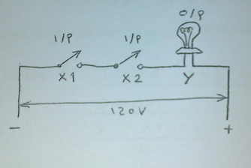
AND Gate:
if X1 = 1 , X2 = 1 then Y =1 if either X1 or X2 = 0 then Y = 0
Series circuit two or more inputs

Slide 8
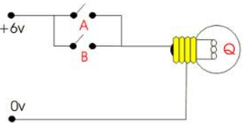
OR Gate:
if either A = 1 or B = 1 then Q =1 otherwise Q = 0
Parallel circuit two or more inputs

Slide 9
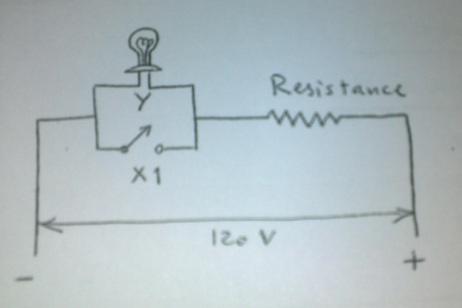
NOT Gate:
Reverse the input signal (single input) :
O/P | I/P
1 | 0
0 | 1
Currents goes through either Y or X1

Slide 10
Boolean Algebra (AKA logical algebra) & Truth Tables “AND”
AND function is expressed as Y=X1 . X2 → logical product of X1 & X2 → It means Y is true if both X1 & X2 are true.
Otherwise , Y is false .
A Truth table is a Tabulation of all combinations of input values to corresponding logical output values .

Slide 11
Truth Table for logical AND Gate
Output | Input
Y = X1 . X2 | X2 | X1
0 | 0 | 0
0 | 1 | 0
0 | 0 | 1
1 | 1 | 1

Slide 12
Boolean Algebra & Truth Tables “OR”
The OR function in logical algebra notation is :-
Y = X1 + X2
Y is true if either X1 or X2 is true. otherwise, Y is false.
Truth Table for logical OR Gate
Output | Input
Y = X1 + X2 | X2 | X1
0 | 0 | 0
1 | 1 | 0
1 | 0 | 1
1 | 1 | 1

Slide 13
Boolean Algebra & Truth Tables “NOT”
The NOT function is referred to as the negation or inversion of the variable. It is indicated by placing a bar above the variable (e.g. X1) . The Logical equ. is :-
Y = X1
Truth Table for logical NOT Gate
Output | Input
Y = X1 | X1
1 | 0
0 | 1

Slide 14
Boolean Algebra & Truth Tables “NAND”
NAND gate is a combination of AND & NOT. The equ. is :-
Y = X1 . X2
Truth Table for logical NAND Gate
Output | Input
Y = X1 . X2 | X2 | X1
1 | 0 | 0
1 | 1 | 0
1 | 0 | 1
0 | 1 | 1

Slide 15
Boolean Algebra & Truth Tables “NOR”
NOR is formed by combining an OR & NOT gate with the equ. :-
Y = X1 + X2
Truth Table for logical NOR Gate
Output | Input
Y = X1 + X2 | X2 | X1
1 | 0 | 0
0 | 1 | 0
0 | 0 | 1
0 | 1 | 1

Slide 16
Boolean Algebra & Truth Tables (Con.)
Symbols used for logical gates
ISO Symbol | U.S. Symbol
X1 X2 Y | X1 X2 Y | AND
X1 X2 Y | X1 X2 Y | OR
X1 Y | X1 Y | NOT
X1 X2 Y | X1 X2 Y | NAND
X1 X2 Y | X1 X2 Y | NOR
&
≥ 1
1
&
≤1

Slide 17
Laws & Theorems Of Boolean Algebra
Laws and theorems of Boolean (Logical) algebra are used to simplify logic circuits, resulting in software and/or hardware savings.
These Laws are:-
Commutative Law:-
X + Y = Y + X
X . Y = Y . X
Associative Law:-
X + Y + Z = X + (Y + Z)
X + Y + Z = (X + Y) + Z
X . Y . Z = X . (Y . Z)
X . Y . Z = (X .Y) . Z

Slide 18
Laws & Theorems Of Boolean Algebra (Con.)
Distributive Law:-
X . Y + X .Z = X . (Y + Z)
(X + Y) . (Z + W) = X . Z + X . W + Y . Z + Y . W
Law Of Absorption:-
X . (X + Y) = X + X . Y = X
De Morgan’s Laws:-
(X + Y) = X . Y
(X . Y) = X + Y

Slide 19
Laws & Theorems Of Boolean Algebra (Con.)
Consistency Theorem:-
X . Y + X . Y = X
(X + Y) . (X + Y) = X
Inclusion Theorem:-
X . X = 0
X + X = 1

Slide 20
Example 9.2
Logic Control
Example 9.2 :- Push-Button Switch for a motor.
Determine the logic network diagram ?
Solution:-
START:-
0 open circuit
1 pressed to contact
STOP:-
0 normally closed contact
1 pressed to break contact
START
STOP

Slide 21
Example 9.2 (Con.)
Logic Control
POWER TO MOTOR:-
0 contacts are open
1 contacts are closed
MOTOR:-
0 off
1 on

Slide 22
Example 9.2 (Con.)
Logic Control
Truth Table for Push-Button Switch
Motor | Power-to-Motor | STOP | START
0 | 0 | 0 | 0
0 | 0 | 1 | 0
0 | 1 | 0 | 1
0 | 0 | 1 | 1
1 | 1 | 0 | 0
1 | 0 | 1 | 0
1 | 1 | 0 | 1
1 | 0 | 1 | 1

Slide 23
Example 9.2 (Con.)
Logic Control
Corresponding Network Logic Diagram:-
STOP
Power-to-Motor
Motor
AND
START
OR
Motor ON or OFF (Feedback Signal)

Slide 24
9.1.2 Sequencing
It is the use of timing devices (timers) to initiate changes. These devices are internal to the system. The changes affect the output variable.
The outputs are often generated in an open-loop fashion. Also, the sequence of output signals is usually cyclical in repeated pattern.
A timer switches its output ON or OFF at preset time intervals.

Slide 25
9.1.2 Sequencing (Con.)
Two additional types of timers are:-
1 - Delay–off Timers
2 - Delay–on Timers
Delay–off Timers:-
Switches power on immediately, and then switches power off after a specified time delay. e.g. car cabin light.
Delay–on Timers:-
Waits a specified length of time before switching power on when it receives a start signal. e.g. TV recorder.

Slide 26
9.1.2 Sequencing (Con.)
A counter is used to count electrical pulses and store the results. It can display the results at any time.
Counters are three types:-
1 – Up-counters ( 0 - n )
2 – Down-counters ( n - 0 )
3 – Up/Down-counters ( 0 - n ) – adding entering items
( n - 0 ) – subtracting exiting items
Up/Down-counters may be used in a storage buffer to get the current count ( entering – exiting ) .

Slide 27
9.2- Ladder Logic Diagrams (LD)
Ladder Logic Diagram (LD):-
Is a graphical technique that exhibits the logic and to some extent the timing and sequencing of the system. It is analogous to the electrical circuits used to accomplish the logic and sequence control.
LDs are familiar to shop personnel who deal with the discrete control system.
LD is the main technique for setting up the control programs in PLCs.

Slide 28
9.2- Ladder Logic Diagrams (LD) (Con.)
As the name implies, it looks like a ladder!
Rail
Rung ( Step )

Slide 29
9.2- Ladder Logic Diagrams (LD) (Con.)
Elements and components represent :
Input → contacts
Output→ loads, coils.
Input include switches & relay
contacts
X1 = start button
C1,C2 = relay
S1,S2 = solenoid
T1,T2 = timer
FS = float switch
X1
FS
C1
C1
C1
S1
FS
T2
C2
C2
T1
C2
T M R
120 s
T1
S2
T M R
90 s
T2

Slide 30
9.2 Ladder Logic Diagrams (LD) (Con.)
Outputs include motors , lamps & alarms.
The two vertical rails provide the power (voltage) to the components.

Slide 31
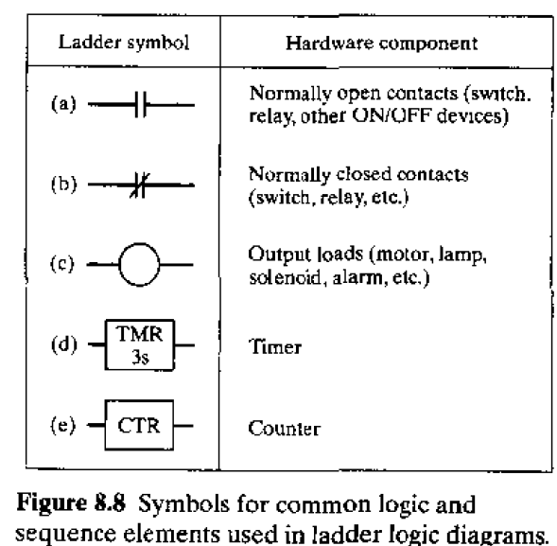
Symbols used in LD that represent Logic & sequence elements:
ON/OFF inputs to the logic circuit
(Binary contact devices
Node
Input signal
Pulse train
Reset signal

Slide 32
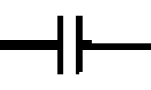
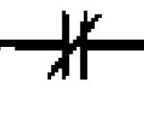
Symbols used in LD that represent Logic & sequence elements:
Normally open contact:
remains open until activated. When activated, it closes to allow current to flow.
Normally closed contact:
remains closed , allowing current to flow , until activated. When activated, it opens , thereby turning off the flow of current.

Slide 33
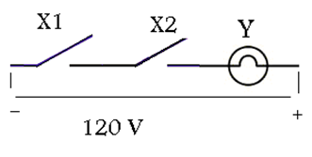
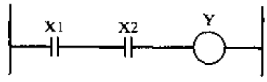
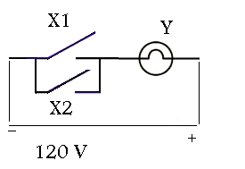
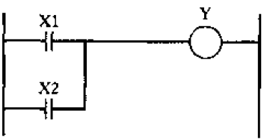
Ex:9.3 Create LDs for the following circuits :
(a) AND
(b) OR

Slide 34
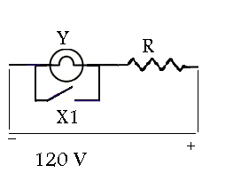
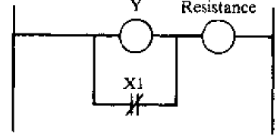
Ex:9.3 Create LDs for the following circuits (cont.) :
(C) Not

Slide 35
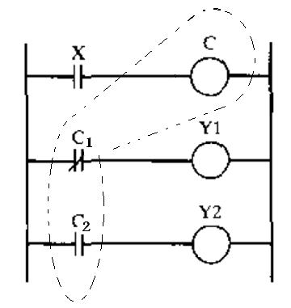
LD, Ex:9.5
Control Relay used for ON/OFF actuation of a powered device at a remote location, in addition to defining alternative decisions in logic control.
Relay(control relay)
ON/OFF operation
Control switch :
Open: relay is de-energized →load Y1 is connected.
Closed: relay is energized
→C1 opens & C2 closes
→Y1 shuts off & Y2 turns on
rung
Tow motor (loads)
C has two logic function:
Opens C1
Closed C2
C1: normally closed
C2: normally open
C is used as both input & output!

Slide 36
9.3 Programmable Logic Controllers(PLCs)
A PLC is a microcomputer-based controller that uses stored instructions to implement logic and sequencing functions.
It does so through digital or analog I/O modules.
Its purpose is to control machines & processes.
It is used both in process & discrete industries.
It was introduced around 1970. Before that, hard-wired controllers were used.
PLC is more productive & reliable than hard-wired controllers.

Slide 37
Advantages of PLCs (over hard-wired controllers):
1- Programming the PLC is easier than wiring the relay control panel.
2- PLC can be reprogrammed, whereas hard-wired controls must be rewired or scrapped.
3- PLCs take less floor space.
4- Greater reliability & easier maintenance.
5- Easier to connect to computers.
6- Can perform a greater variety of control functions.

Slide 38
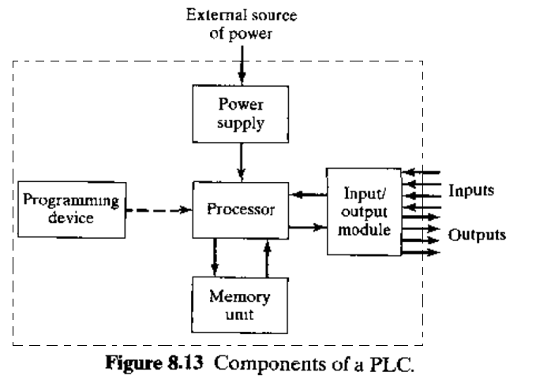
9.3.1 Components of the PLC
Housing cabinet design for industrial environment (electrical noise)

Slide 39
Components of the PLC
Processor:
It is the CPU of the PLC. It consists of one or more microprocessors.
Memory unit :
(AKA user or application memory) It contains the programs of logic , sequencing, & I/O operations . The operating system memory is stored in the processor. The operating system is entered by the PLC manufacturer and Cannot be altered by the user.
The Power Supply :
converts the AC voltage into smaller DC voltage . The power supply often includes battery backup that switches on automatically in case of power outage.

Slide 40
Components of the PLC
The input/output module :
Provides the connections to the industrial equipment or process that is to be controlled.
Inputs include signals from limit switches ,push-buttons , sensors ,etc…
Outputs are ON/OFF signals to operate motors, valves , actuators , etc…
Many PLCs are capable of accepting continuous signals from analog sensors and generating signals for analog actuators.

Slide 41
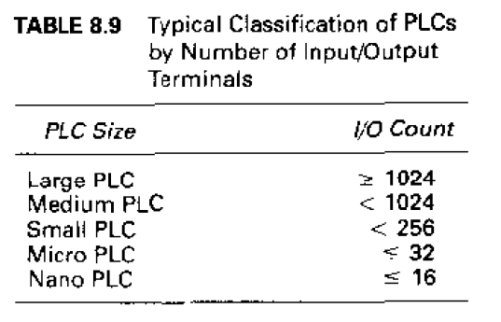
Typical classification of PLCs

Slide 42
Programmable Logic Controllers(PLCs)
The PLC is programmed by means of a programming device, which is usually detachable from the PLC cabinet, so that it can be shared among different controllers.
PCs can also be used to program PLCs.

Slide 43
9.3.2: Programmable Logic Controllers(PLCs)
The typical operating cycle of the PLC called a scan.
It consist of three parts:
Input scan: inputs are read by the processor and stored in memory.
Program scan : control program is executed.
Output scan: The outputs are updated to agree with the calculated values.

Slide 44
9.3 Programmable Logic Controllers(PLCs)
Scan time:
The time to perform the scan.
It depends on the number of inputs , complexity of control functions , and the number of outputs. It also depends on the speed of processor.
Typical scan times vary between (1 & 25 )ms → shorter is better.

Slide 45
9.3.3: Additional Capabilities of the PLC :
Analog Control:
Proportional-integral-derivative (PID) control is available on some PLCs.
Arithmetic Functions:
Such as addition , subtraction , multiplication, and division → more complex control algorithms can be developed.
Matrix Functions:
Used to compare actual I/O values with stored values to see if there is an error.
Data processing and reporting :
They make the PLC more like a PC .

Slide 46
9.3.4 . Programming the PLC:
The control instructions are entered through the programming device.
Basic control instructions include switching, logic, sequencing, counting and timing.
To address the need for more advanced functions, various PLC programming languages have been developed.
A standard for PLC programming was published in 1992, entitled ‘’ International Standard for Programmable Controllers (IEC 1131-3)’’.

Slide 47
9.3.4 . Programming the PLC:
This standard specifies the following graphical and text-based languages:
Graphical:
Ladder logic diagrams.
Function block diagrams.
Sequential functions charts.
Text-based:
Instruction list.
Structured text.

Slide 48
9.3.4 . Programming the PLC:
Features of the five PLC languages specified in the IEC 1131-3 standard:
Application best suited for | Type | Abbreviation | Language
Discrete control | Graphical | LD | Ladder logic diagram
Continuous control | Graphical | FBD | Function block diagram
Sequencing | Graphical | SFC | Sequential function chart
Discrete control | Textual | IL | Instruction list
Complex logic, computations, etc… | Textual | ST | Structured text

Slide 49
Ladder Logic diagrams (LDs)
The most widely used PLC programming language direct entry of LD into PLC memory requires a keyboard and monitor → for verification.
The components are of two types: contacts and coils.
The programmer inputs the ladder logic circuit diagram rung by rung into the PLC.

Slide 50
Function Block Diagram (FBD) :
Provides a means of inputting high-level instructions.
Instructions are composed of operational blocks.
Each block has one or more inputs and one or more outputs .
Within a block certain operations take place on the inputs to transform the signals into desired outputs .
The function blocks include operations such as timers and counters, control computations using equations (PID control) data manipulations, and data transfer to other computer systems.

Slide 51
Sequential function charts (SFC):
AKA “Grafcet” method , graphically displays the sequential functions of an automated system as a series of steps and transitions from one state of the system to the next. It is used in Europe more than in the US.

Slide 52
Instruction list (IL):
Provides a away of entering the ladder logic diagram into PLC memory. The programmer uses a low-level computer language to construct the LD by entering statements that specify the components and their relationships for each rung.

Slide 53
Typical low-level language instruction set for a PLC
Description | Instruction
Store a new input and start a new rung of the ladder | STR
logical AND interpreted as a series circuit relative to the previously entered element | AND
logical OR→ parallel circuit relative to the previously entered element | OR
logical NOT or inverse of entered element | NOT
Output element for the rung | OUT
Timer element requires one input signal to initiate timing sequence. Output is delayed as specified by the programmer . resetting is accomplished by interrupting (stopping) the input signal | TMR
counter element . Requires two inputs : incoming pulse train and rest signal | CTR

Slide 54
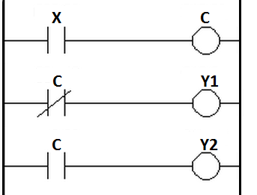
Ex 9.8 Language commands for control relay
Write the PLC program for the control relay depicted in the LD below: Using low-level language Instruction list (IL).

Slide 55
Ex 9.8 Language commands for control relay
Solution :
Commands | comment
STR X | Store input X
OUT C | Output contact relay C
STR NOT C | Store inverse of C output
OUT Y1 | Output load Y1
STR C | Store C output
OUT Y2 | Output load Y2

Slide 56
Structured Text (ST)
Is a high-level computer-type language.
It has a good prospect.
It is capable of performing data processing and calculations on values other than binary→ can do more complex control algorithms.
LD and low-level PLC language have limited ability to operate on signals that are other than ON/OFF types.
It also makes it easier to interpret complicated control programs.
Explanatory comments can be inserted into the program.

Slide 57
9.4 Personal Computers Using Soft Logic
PLCs were favored for use in factories because:
They were designed to operate in harsh environment.
PCs were designed for office environment.
PLC is ready to connect to external equipment for process control →PCs need I/O cards and programs to connect.
PCs sometimes lockup for no apparent reason.

Slide 58
9.4 Personal Computers Using Soft Logic
However, PCs have developed faster than PLCs.
PCs now have much greater frequency than PLCs.
There is much more proprietary software in PLCs than in PCs. Making it difficult to mix components from different vendors.
Therefore, PLCs performance lags its PC counterpart by two years and the gab is increasing.
PC speeds are doubling every 18 months improvements in PLC technology is slower.

Slide 59
9.4 Personal Computers Using Soft Logic
PCs are now available in more sturdy enclosures for industrial environment ,in addition to feature like dirt resistance ,noise resistance, moisture protection.
I/O cards are reliable together with related hardware to connect to equipment.
Operating systems for real-time control can be installed.

Slide 60
There are two basic approaches used in PC-based control systems
Soft-logic configuration :
The PC’s operating system is windows, and control algorithms are installed as high-priority programs.
However, it is possible to interrupt the control tasks by windows systems→ control function is delayed→ possible -ive consequences to the process→it is not considered a real-time controller→this leads to potential hazards in critical processes.

Slide 61
Hard Real-time control system :
The PC’s operating system is the real-time operating system and the control software takes priority over all other software → windows cannot interrupt the execution of the real-time controller. If windows lock up, it does not affect the controller operation.

