Slide 1
Anatomy of penis, pathophysiology of erection and impotence

Slide 2
Anatomy of the penis and male urethra

Slide 3
Gross Appearance
The penis is composed of 2 corpora cavernosa and the corpus spongiosum, which contains the urethra, whose diameter is 8-9 mm.
These corpora are capped distally by the glans.
Each corpus is encolsed in a fascial sheath (tunica albuginea) and all are surrounded by a thick fibrous envelope known as Buck’s fascia (deep fascia).
Beneath the skin of the penis (and scrotum) and extending from the base of the glans to the urogenital diaphragm is Colle’s fascia, which is continuous with Scarpa’s fascia of the lower abdominal wall.

Slide 4
The proximal ends of the corpora cavernosa are attached to the pelvic bones just anterior to the ischial tuberosities.
Occupying a depression of their ventral surface in the midline is corpus spongiosum, which is connected proximally to the undersurface of the urogenital diaphragm through which emerges the membranous urethra.
This portion of corpus spongiosum is surrounded by the bulbospongiosus muscle. Its distal end expands to form the glans penis.
The suspensory ligament of the penis arises from the linea alba and pubic symphysis and inserts into the fascial covering of the corpora cavernosa.

Slide 5
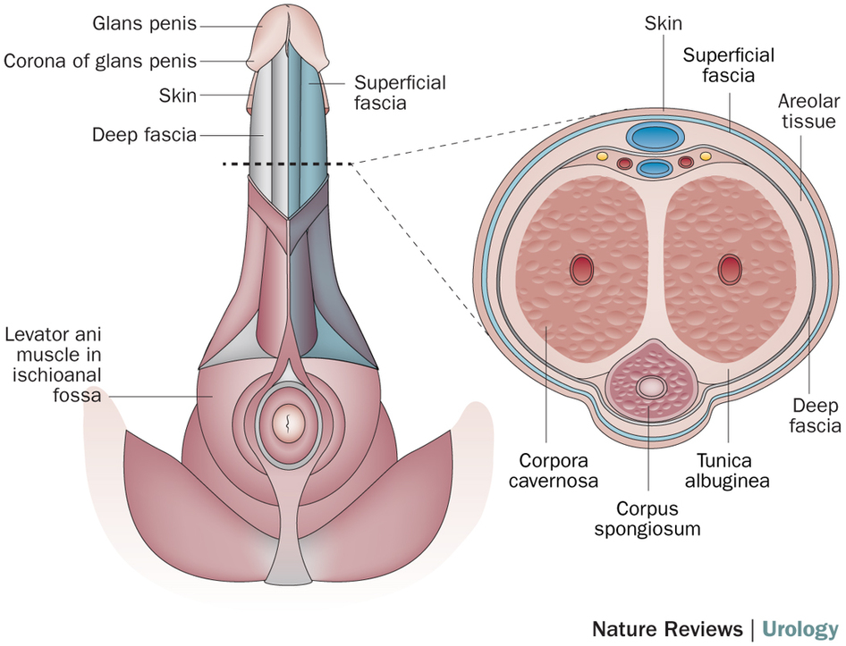

Slide 6
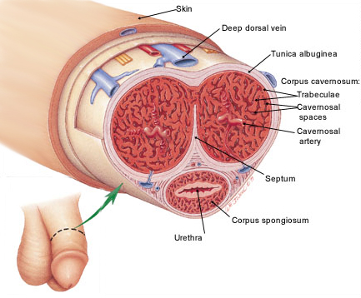

Slide 7
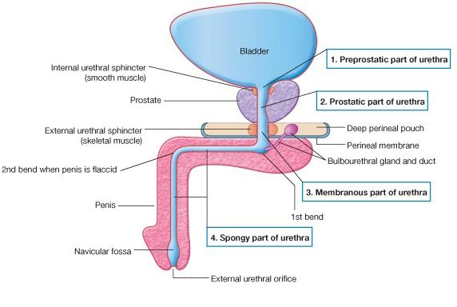

Slide 9
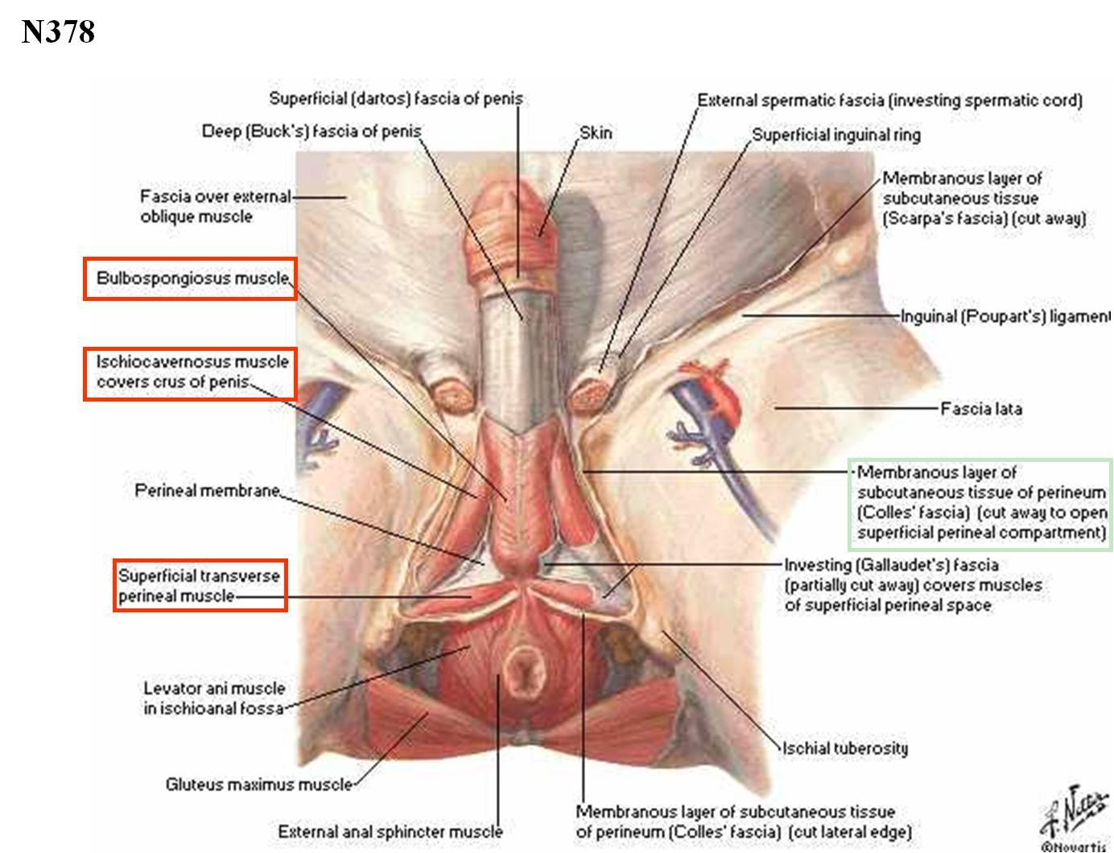

Slide 10
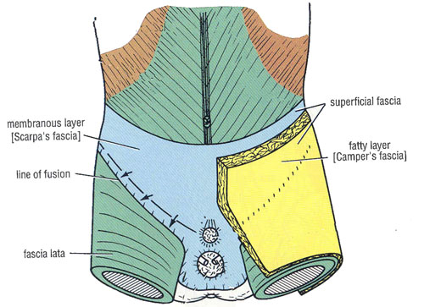

Slide 11
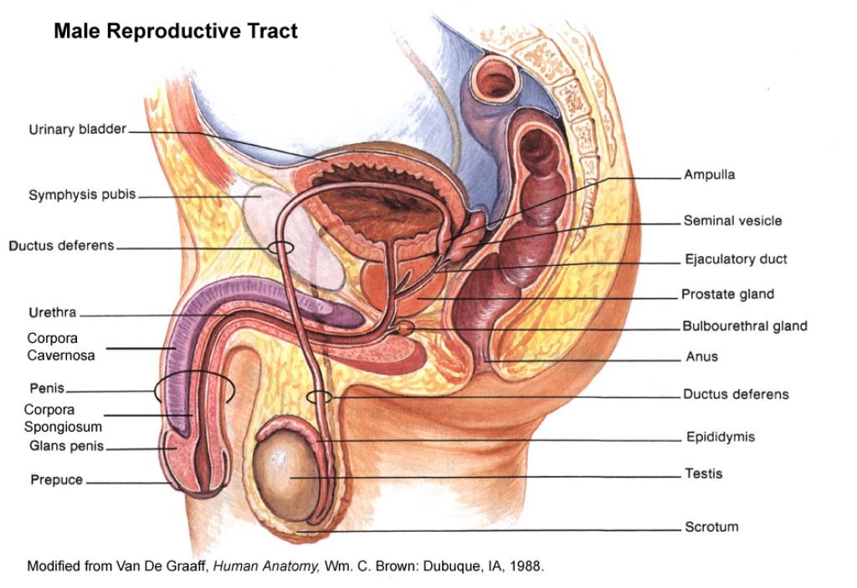

Slide 12
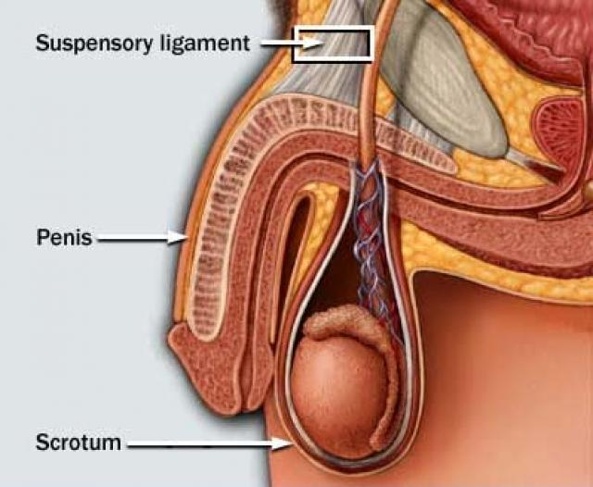

Slide 13
Histology
A. Corpora and glans penis -The corpora cavernosa, the corpus spongiosum, and the glans penis are composed of septa of smooth muscle and erectile tissue that enclose vascular cavities.
B. Urethra -The urethral mucosa that traverses the glans penis is formed of squamous epithelium. Proximal to this, the mucosa is transitional in type. Underneath the mucosa is submucosa which contains connective and elastic tissue and smooth muscle. -In the submucosa are the numerous glands of Littre, whose ducts connect with the urethral lumen. -The urethra is surrounded by the vascular corpus spongiosum and the glans penis.

Slide 14
Blood Supply
A. Arterial -The penis and urethra are supplied by the internal pudendal arteries (the terminal branch of the anterior trunk of the internal iliac artery). -Each artery divides into a deep artery of the penis (which supplies the corpora cavernosa), a dorsal artery of the penis, and the bulbourethral artery. -These branches supply the corpus spongiosum, the glans penis, and the urethra.
B. Venous -The superficial dorsal vein lies external to Buck’s fascia. -The deep dorsal vein is placed beneath Buck’s fascia and lies between the dorsal arteries. -These veins connect with the pudendal plexus which drains into the internal pudendal vein.

Slide 16
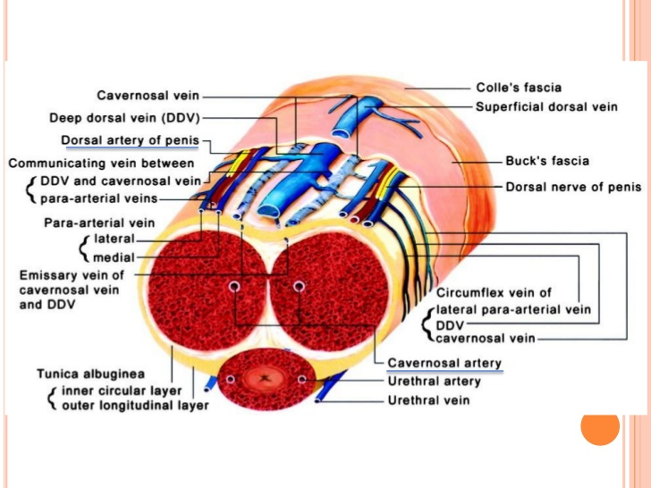

Slide 17
Lymphatics
Lymphatic drainage from the skin of the penis is to the superficial inguinal and subinguinal lymph nodes.
The lymphatics from the glans penis pass to the subinguinal and external iliac nodes.
The lymphatics from the deep urethra drain into the internal iliac (hypogastric) and common iliac lymph nodes.

Slide 18
Nerve Supply
The penis is innervated by somatic and autonomic nerves.
The somatic nerves supply the sensory fibers and the perineal motor fibers.
The penis is innervated by both the parasympathetic and sympathetic nervous system. The parasympathetic innervation results in the formation of the erection, while the sympathetic innervation is involved in ejaculation.
The maintenance of an erection and the tone of the cavernosal smooth muscle are determined by an integrated response to neural stimulation and paracrine or autocrine systems.
Sympathetic noradrenergic fibers and parasympathetic cholinergic fibers innervate the cavernosal tissue. Both sets have opposing effects. In addition to these there are the non-adrenergic-non-cholinergic fibers (NANC).

Slide 19
The Physiology of an Erection

Slide 20
There are 3 types of erection:
A. Psychogenic erections:
These occur as a result of visual or auditory stimuli.
B. Reflexogenic erections:
occur as a result of tactile stimulation of the penis, and are important in maintaining the erection during sexual activity.
C. Nocturnal erections:
occur during REM sleep. Although the exact mechanism is unknown, it is thought that low androgens levels is one of the components.

Slide 21
The physiological mechanism by which an erection occurs begins with an increase in blood flow to the penis, filling the sinusoids of the corpora cavernosum.
The cavernosal smooth muscle relaxes to allow the expansion to facilitate the extra volume of blood.
This expansion presses on the venous plexus, which creates an outflow obstruction, thereby increasing the pressure within the penis and aiding rigidity.
The relaxation of the smooth muscle of the penis relies on the parasympathetic nervous system.

Slide 22
The sympathetic nervous system controls ejaculation, and also causes contraction of smooth muscle. This constricts the blood-containing lacunar spaces of the penis and empties them of blood, therefore aiding detumescence.
The maintenance of an erection and the tone of the cavernosal smooth muscle is determined by an integrated response to neural stimulation and paracrine or autocrine systems.

Slide 23
The Neurophysiology of an Erection

Slide 24
When the NANC system is stimulated nitrogen oxide (NO) is released within the smooth muscle cells of the penis.
The NO is converted from L-Arginine by nitrogen oxide synthase, which in turn increases the production of cyclic guanosine monophosphate (cGMP).
cGMP decreases the intracellular concentration of the calcium ions (Ca2+) that are essential for muscle contraction. In this case, the Ca2+ is decreased and smooth muscle relaxes, allowing blood flow to the penis and expansion.
cGMP is broken down by phosphodiesterase type 5 (PDE5).

Slide 25
When this occurs the Ca2+ increases in concentration in the cell, resulting in contraction of the smooth muscle cells and detumescence.
Sildenafil ('Viagra') is a PDE5 inhibitor, and allows for erections to be maintained in response to stumuli. It will not initiate an erection.
When the sympathetic fibres are stimulated noradrenaline (NA) is released from the nerve terminal.
This activates (α1) adrenergic receptors to produce contraction of the smooth muscle of both the vasculature and the corpora cavernosum. This causes detumescence of the penis.

Slide 26
Erectile Dysfunction

Slide 27
Erectile dysfunction, often referred to as impotence, is the consistent inability to attain and/or maintain an erection enough for penetration.
While there may be no erection, the desire, sex drive, the ability to achieve orgasm and the capacity to ejaculate may still be present.
Erectile dysfunction can strongly affect the quality of life of those affected, and also that of their sexual partners
It often leads to depression and lack of self-esteem and self-confidence. These psychological affects may in turn perpetuate the disorder.

Slide 28
Erectile dysfunction is a common problem among men of all ages, ethnicities, and cultural backgrounds
In 1995, it was estimated that more than 152 million men worldwide experienced erectile dysfunction.
Roughly, 2.3 million men in the U.K suffer from this problem, with only about 10% actually receiving treatment.
The incidence of erectile dysfunction increases with age.

Slide 29
Causes of ED
Age It is estimated that between 30 and 40% of men of 40 years old have suffered from some degree of erectile dysfunction.
Vascular Disease An alteration in vascular haemodynamics is thought to be the leading cause of organic ED. It may affect those suffering from:
-Myocardial infarction
-Coronary artery disease
-Stroke
-Peripheral vascular disease
-Hypertension
-Atherosclerosis/dyslipidaemia

Slide 30
Diabetes The prevalence of ED in diabetics has shown to be consistently higher then the general population. It is also age related, with an incidence risk of 15% at 34 years increasing to a risk of 55% at 60 years.
High density lipoprotein The risk of suffering ED was inversely proportional to the level of HDL-C.
Smoking Smoking in itself does not cause ED, but it is a risk factor for those with heart disease and hypertension.
Surgery or trauma Surgery or trauma that affects the nerve supply or the blood supply to the penis increases the risk of ED. Other suggested causes include injuries from bicycles and fractures of the pelvis.

Slide 31
Drugs
It is thought that drug related ED is common, and may occur in up to 25% of patients in a medical outpatient clinic.
Such drugs include thiazide diuretics, the most common cause of drug induced ED because of their common usage.
Some antihypertensive agents may affect up to 40% of patients, both by blocking calcium channels and by reducing the systemic blood pressure necessary for penile rigidity.
Anti-androgens such as oestrogens, luteinizing hormone-releasing hormone agonists, H2 antagonists and spironolactone may also cause ED.
Antidepressants may also be a cause by affecting central nervous system mechanisms.
Digoxin inhibits the Na+-K+-ATPase pump, leading to an increase in intracellular calcium that causes an increase in tone of corporal smooth muscle.

Slide 32
Hypogonadism Men suffering from hypogonadism, whether it be primary or secondary, characteristically suffer from a lack of sexual desire and a decrease in both frequency and intensity in response to sexual stimuli

Slide 33
Psychological state Erectile dysfunction has a positive correlation with depression, anger, anxiety, stress, tiredness and familiarity or dissatisfaction with a relationship. Dominant personality traits have a negative correlation. Any condition that leads to a diminished sexual interest can cause erectile dysfunction.
Erectile dysfunction also affects those who have experienced any of the following:
- Prolactinoma
- Adult castration
- Alcoholism
- Acromegaly
- Chronic renal failure

Slide 34
Approach Considerations
The laboratory investigation for erectile dysfunction (ED) depends on information gathered during the interview.
Laboratory testing is necessary for most patients, though not for all. On the basis of these study results, the physician should be able to determine the medical status of the patient, to identify and characterize the type of dysfunction, and to determine the need for additional testing (e.g. penile or pelvic blood flow studies, nocturnal penile tumescence testing, or other blood tests).
Imaging studies are rarely performed, except in situations involving pelvic trauma or surgery.
In making any decisions about further management or referral, the patient’s needs, expectations, and priorities should be discussed and taken into account.

Slide 35
Laboratory Studies:
- Hormonal blood tests.
- Hemoglobin A_{1c.}
- Serum chemistry panel (lipid, sugar, LFT, KFT…etc)
Injection of Prostaglandin E1 - One of the most common tests used to evaluate penile function is the direct injection of prostaglandin E1 (PGE1; alprostadil) into one of the corpora cavernosa.
Biothesiometry - The sensitivity of the skin of the penis to detect vibrational stimuli (ie, biothesiometry) can be employed as a simple nerve function office screening test, but it is infrequently indicated.

Slide 36
Ultrasonography
Vascular function within the penis can be evaluated by means of duplex ultrasonography. In this procedure, blood flow in the cavernosal arteries within the corpora cavernosa is measured before and after the intracavernosal injection of a test dose of a standard vasodilator (e.g. 20 µg of PGE1).
Criteria for evaluating the study results vary to some degree. A peak systolic velocity lower than 25 cm/sec is generally agreed to indicate arterial insufficiency. The proposed value for the lower limit of normal ranges from 25-35 cm/sec, but a peak systolic velocity of 35 cm/sec or higher clearly rules out arterial insufficiency. End-diastolic velocity serves as a proxy for venous outflow; a velocity of 5 cm/sec or lower when the penis is at full rigidity indicates the absence of abnormal venous leakage.

Slide 37
Nocturnal Penile Tumescence Testing
Nocturnal penile tumescence testing involves placing several bands around the penis, connected to a device such as the Rigiscan monitor, and instructing the patient to wear the assembly for 2 or 3 successive nights. If an erection occurs, which is expected during rapid eye movement sleep, its force and duration are measured on a graph.
Inadequate or absent nocturnal erections suggest organic dysfunction, whereas a normal result indicates a high likelihood of a psychogenic etiology.

Slide 38
Other Studies
Angiography is useful if the patient is a potential candidate for some type of vascular surgery. Young men with traumatic vascular injuries resulting in ED are candidates for this angiography because they may qualify for a vascular reconstruction.
In the vast majority of patients with ED, formal neurologic testing is unnecessary. However, those with a history of central nervous system (CNS) problems, peripheral neuropathy, diabetes, or penile sensory deficit may benefit from some level of neurologic testing.

Slide 39
Treatment

Slide 40
Sexual Therapy
When there are psychological factors as a cause of erectile dysfunction, a course of sex therapy may be recommended. The therapy can be very useful in helping couples re-establish their sexual relationship. The therapy is often used in combination with other therapies.

Slide 41
Intracavernous injection therapy
Prostaglandin E1 is now commonly used; one of its benefits being a lower risk of experiencing priapism
Mainly deals with initiation of an erection
The dose required is dependant on the patient and this is determined by measuring the response of the patient to several dosages and then adjusting the amount required for the desired effect.
Many patients find this method for treating impotence uncomfortable or inconvenient, and as a result there is a high drop out rate of up to 50%

Slide 42
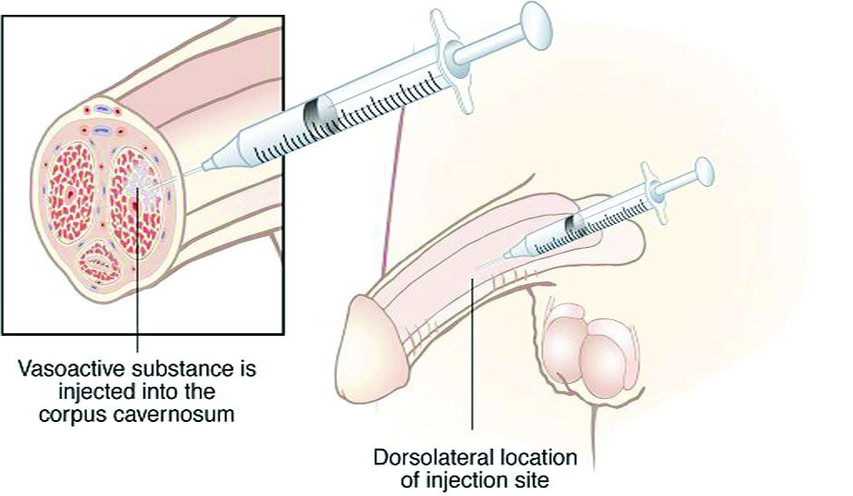

Slide 43
Transurethral Therapy
This form of therapy has the advantage of not using needles. A small pellet is introduced into the urethra via an applicator. The drug is absorbed and an erection forms in approximately five to ten minutes.
This form of therapy was developed in the United States and is called - MUSE (medicated urethral system for erection).
The active ingredient of the pellet is alprostadil. This drug relaxes the muscles in the erectile tissue of the penis allowing increased blood flow.
MUSE should not be used in the following conditions:
- Allergy to alprostadil
- Abnormal penis anatomy
- Any patient who is at risk of priapism (e.g. multiple myeloma, sickle cell disease)
- MUSE should not be used in pregnancy without a condom

Slide 44
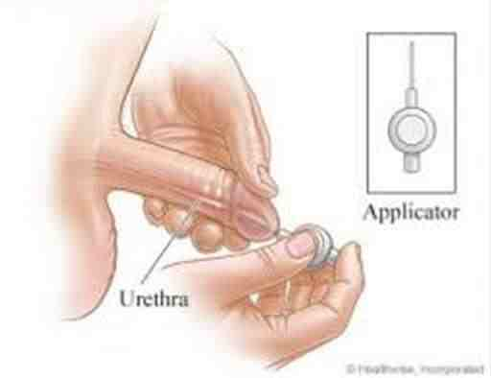

Slide 45
Vacuum devices
The patient inserts his penis into the device, a vacuum is created by withdrawing air and blood is sucked into the penis to give an erection. A band is placed around the base of the penis to decrease blood flow from the penis, hence maintaining the erection. There are no major complications of this method, however some patients have complained about bruising.

Slide 46
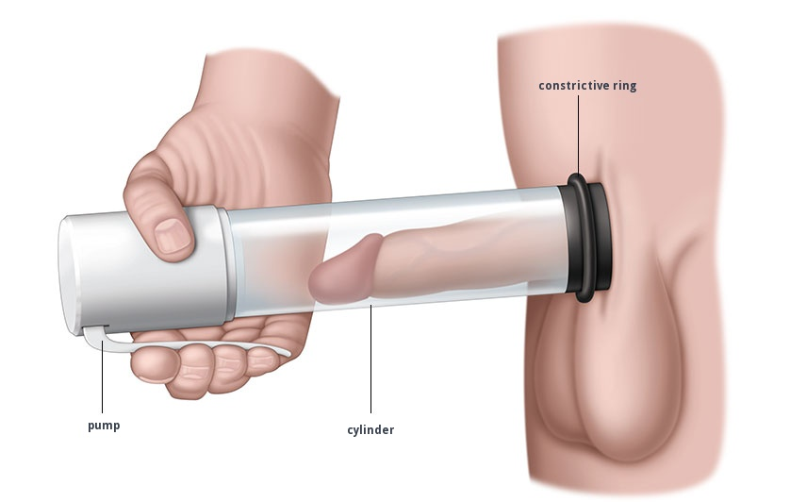

Slide 47
Oral Medications for erectile dysfunction
Sildenafil
- Sildenafil ('viagra') is a selective PDE5 inhibitor. During sexual stimulation, nerves in the penis release nitric oxide (NO). This molecule in turn causes an increase in the amounts of cGMP in the corpora cavernosa. It is this elevation of cGMP that is responsible for the vasodilation that produces erections. Sildenafil works by inhibiting the enzyme that breaks the cGMP down.
- Sildenafil is supplied in 25, 50 and 100mg doses of sildenafil citrate. The tablet is taken one hour before sexual activity. It does not cause an erection unless the man is sexually stimulated.

Slide 48
The most common adverse side effects of this treatment are:
- Headache
- Flushing
- Nasal stuffiness
- Visual disturbances
There are other oral medications available such as:
- Phentolamine
- Yohimbine
- Delaquamine
- Trazodone
- Apomorphine
- L-arginine

Slide 49
Hormone Replacement for erectile dysfunction
Only a small proportion of the cases of erectile dysfunction are caused by a hormone deficiency
In those cases, the most common cause is a testosterone deficiency. This can be replaced in hormone replacement therapy
The most commonly used form of this therapy is the depot formulation of the long-acting esters of testosterone. The esters are converted to free testosterone in the circulation
Oral preparations have the problem of unpredictable blood levels of testosterone, and the risk of liver damage.

Slide 50
Penile prosthesis
The prosthesis may be rigid or inflatable. It is inserted under general anesthetic and strict aseptic conditions must be observed, otherwise an infection may lead to the removal of the prosthesis.

Slide 51
Thank you

